Slide 1
Notes:
Good evening, commissioners. This item is for Project No. 2371-Certificate of Appropriateness, for 1020 Milan Avenue

Slide 2
PROJECT DESCRIPTION
COA for two-story 1,177-square-foot addition and alterations to an existing single-story, 1,660 square-foot single-family residence located at 1020 Milan Avenue (Assessor’s Parcel Number: 5318-010-027).
CEQA: Categorical Exemption – Section 15301, Class 1 Existing Facilities and Section 15331, and Class 31 Historical Resource Restoration/Rehabilitation.
Notes:
This project is for a two-story, 1,177-square foot addition and alterations to a single-story, 1,660 square-foot residence
Built in 1905, the residence is a designated contributor to the Southeast Mission Craftsman District

Slide 3
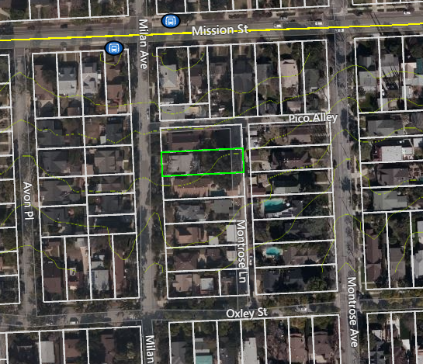
Figure 1: LOCATION
Notes:
Figure 1 shows the location of the subject property, on Milan Avenue, between Oxley and Mission Streets.

Slide 4
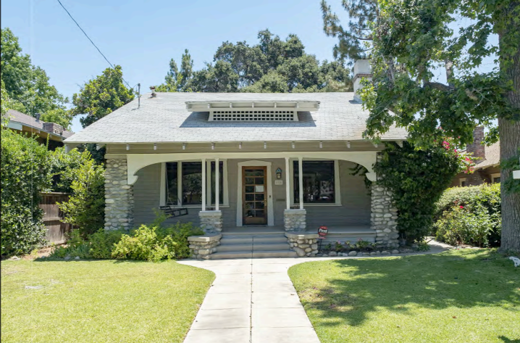
Figure 2: STREET VIEW
Notes:
Figure 2 provides an overview of the street-level view of the home.

Slide 5
PROPERTY INFORMATION
Notes:
Table 1 summarizes the historic property information for 1020 Milan.
The Sanborn Fire Insurance Map is shown on the right.

Slide 6
PROJECT OVERVIEW
Demolition of approximately 961 square feet of existing house and part of original gable roof, non-character-defining concrete rear addition and patio; and portions of the walls; and
Alteration to the north, east, and south elevations with a two-story addition including rear porch and balcony; and
Demolition of the 1939 garage (which will require an HRE report prior to CHC taking action).
Notes:
This one you can read from the slide.

Slide 7
PROJECT OVERVIEW (Continued)
New Addition:
Sheathed 8” wood siding with “belly band;” and
New wood windows and doors; and
Capped with a prominent, two-story cross-gable roof with rafter tails and eave supports; and
Second-story balcony with wood balustrade; and
Charcoal Presidential TL roofing on the roof.
Notes:
This one you can read from the slide.

Slide 8
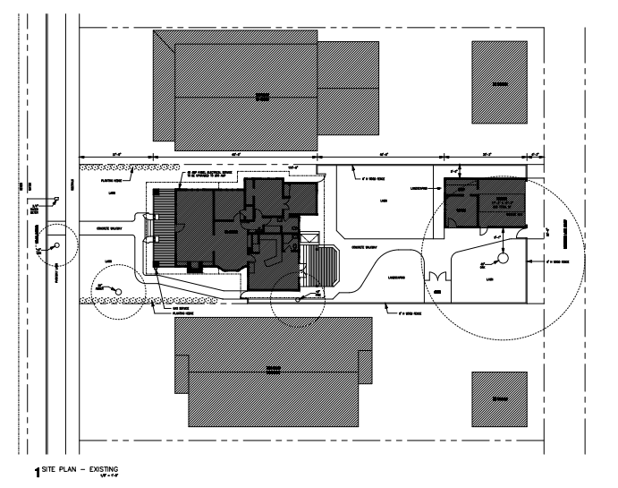
EXISTING SITE PLAN
Notes:
This slide shows an overview of the existing site plans.

Slide 9
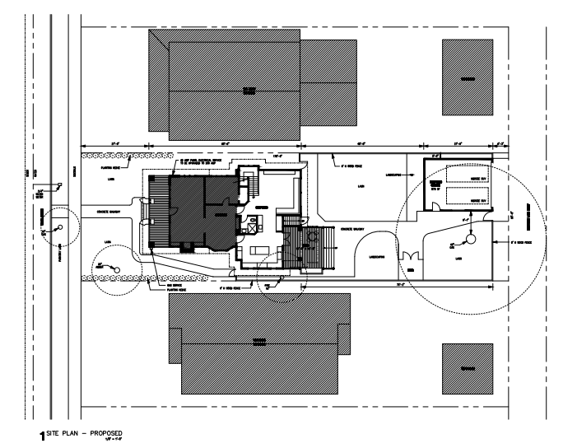
PROPOSED SITE PLAN

Slide 10
Zoning Development Standards
2nd Story setback – CHC determination
Detached Garage setback – allowed if it meets criteria
Notes:
In general, the project conforms to zoning district development standards,
For the proposed addition, the second story setback is required to be at least 3 feet on both sides unless the CHC determines that the architectural style requires a zero side second story setback.
With additional requirements needed to potentially allow for a new detached 2-car garage located in the side yard setback, a detached garage would be conditioned to:
1.) have no openings in the exterior walls abutting the property lines,
2.) The structure would be constructed of one-hour fire resistant materials, and
3.) A provision is made for all water runoff to drain onto the subject property.

Slide 11
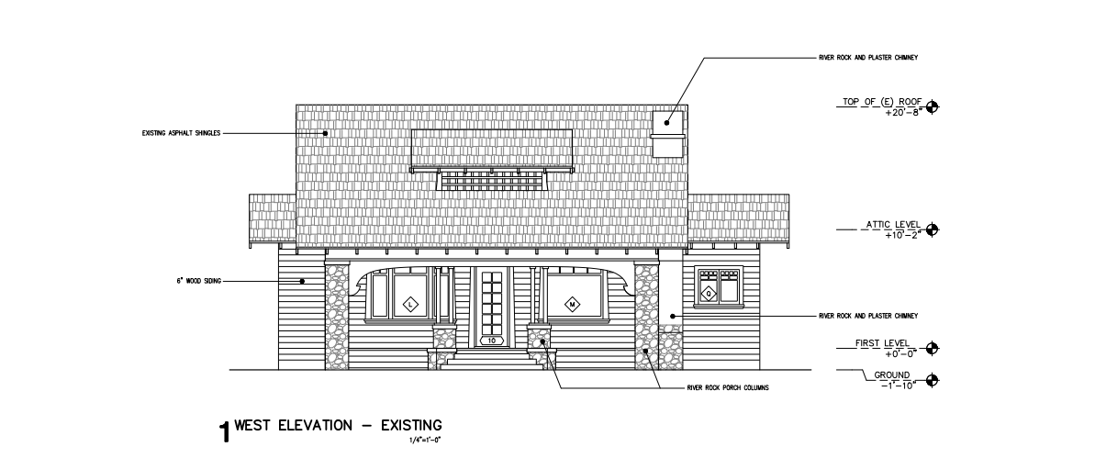
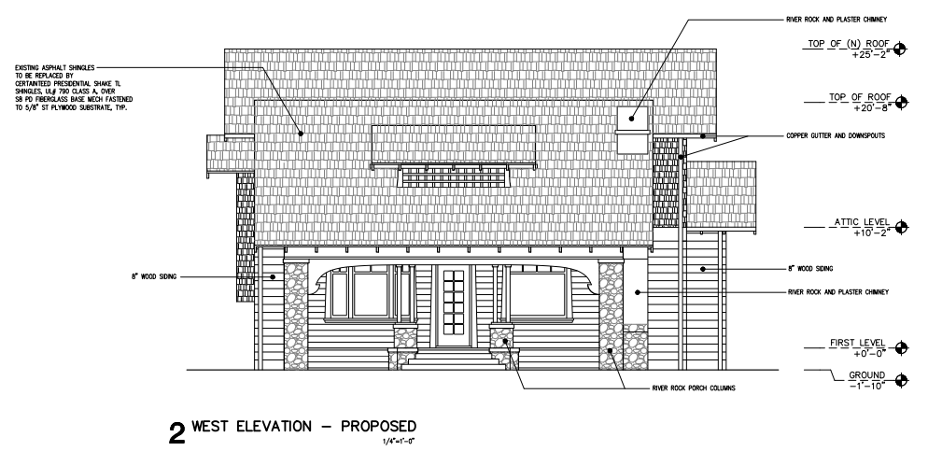
WEST ELEVATIONS
Notes:
Here we see the existing and proposed plans for the west elevation

Slide 12
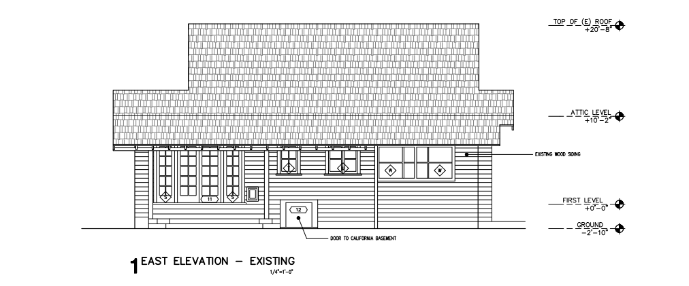
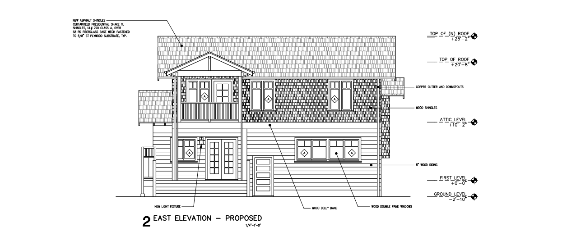
EAST ELEVATIONS
Notes:
Here we see the existing and proposed plans for the east elevation

Slide 13
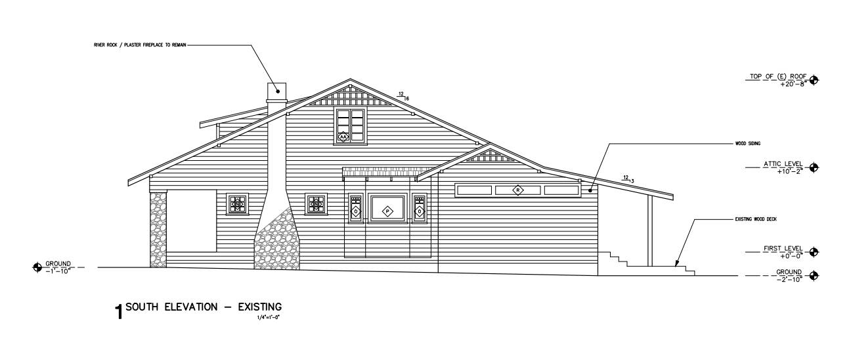
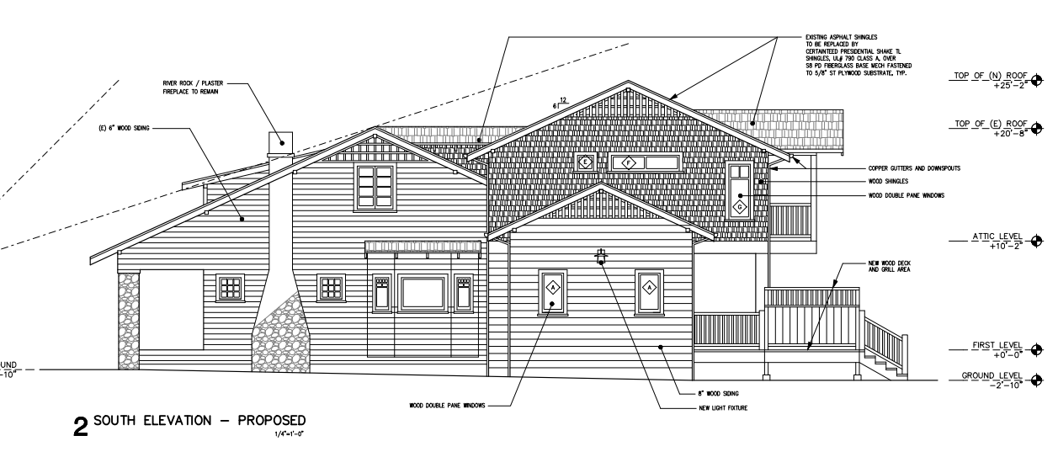
SOUTH ELEVATIONS
Notes:
Here we see the existing and proposed plans for the south elevation

Slide 14
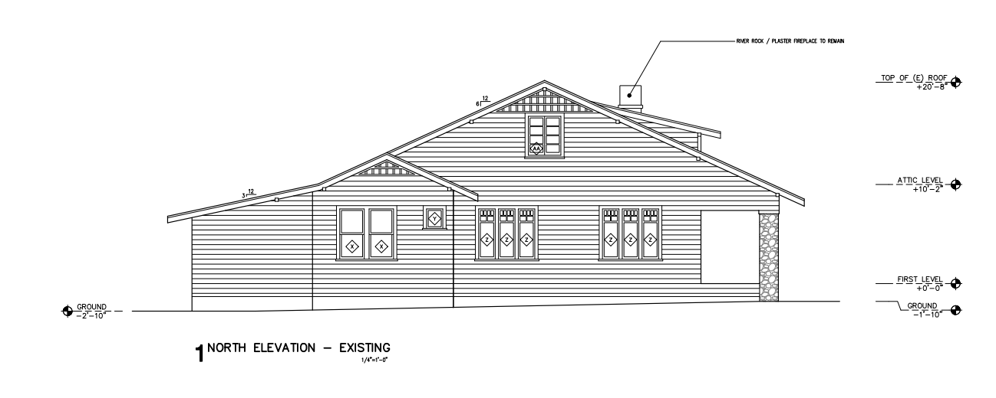
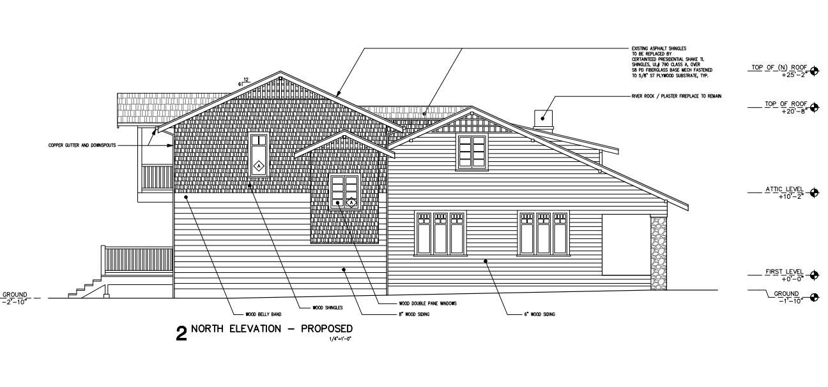
NORTH ELEVATIONS
Notes:
And finally, Here we see the existing and proposed plans for the north elevation

Slide 15
PROJECT ANALYSIS
Some elements of the project comply with the City of South Pasadena’s Design Guidelines and Secretary’s Standards.
The project components that do not completely comply are as follows:
The current addition; staff recommends working to refine the addition’s roof to be more appropriate in relation to the original, character-defining roof;
The incorporation of wood shingle cladding on the addition, because exterior cladding is encouraged to match but be distinguished from the additions’ original siding;
The demolition of the original garage, because it requires an HRE.

Slide 16
STAFF RECOMMENDATION:
Staff recommends that the Cultural Heritage Commission form a subcommittee to work with the applicant to refine the design of the proposed addition for 1020 Milan Avenue.

Slide 17
Cultural Heritage Commission Options:
If the Commission does not agree with staff’s recommendation, the following options are available:
The Cultural Heritage Commission can Approve the project as is or with additional condition(s) added; or
The Cultural Heritage Commission can continue the project, providing the applicant with clear recommendations to revise the proposal; or
The Cultural Heritage Commission can Deny the project.
Notes:
If the commission does not agree…”

Slide 18
Questions?

