Slide 1
Notes:
Good evening, commissioners. This item is for Project No. 2371-Certificate of Appropriateness, Administrative Use Permit and Notice of Intent to Demolish for 1020 Milan Avenue. It was continued from the March hearing, for the applicant to work with the Chair to revise the plans.

Slide 2
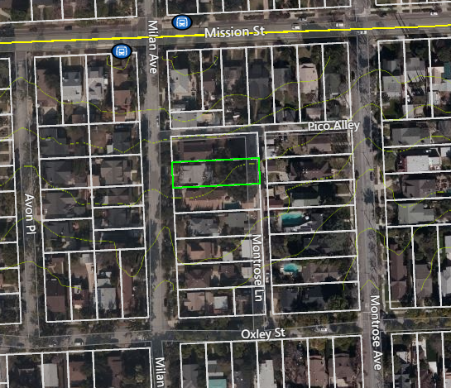
Figure 1: LOCATION
Notes:
For background, Figure 1 shows the location of the subject property, on Milan Avenue, between Oxley and Mission Streets.

Slide 3
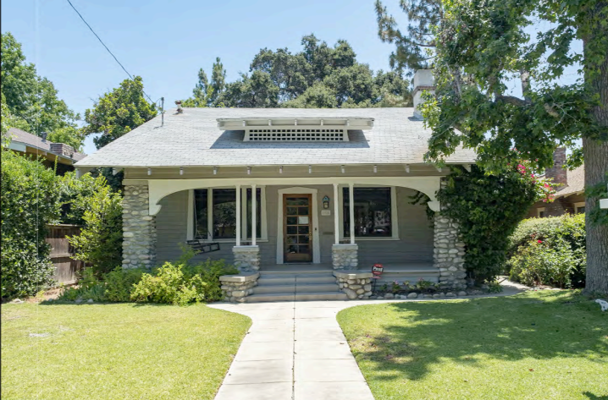
Figure 2: STREET VIEW
Notes:
Figure 2 provides an overview of the street-level view of the home.

Slide 4
PROPERTY INFORMATION
Notes:
Table 1 summarizes the historic property information for 1020 Milan.
The Sanborn Fire Insurance Map is shown on the right.

Slide 5
PROJECT DESCRIPTION
COA for two-story 1,184-square-foot addition and alterations to an existing single-story, 1,660 square-foot single-family residence located at 1020 Milan Avenue
Residence built in 1905 – single-story contributor to the Southeast Mission Craftsman District
Notes:
This project is for a two-story, 1,184-square foot addition and alterations to a single-story, 1,660 square-foot residence
Built in 1905, the residence is a contributor to the Southeast Mission Craftsman District

Slide 6
PROJECT OVERVIEW
Demolition of approximately 961 square feet of existing house and part of original gable roof, non-character-defining concrete rear addition and patio; and portions of the walls; and
Alteration to the north, east, and south elevations with a two-story addition including rear porch and balcony; and
Demolition of the 1939 garage (ESA Report).
Location of garage (2-foot side yard setback) requires AUP.

Slide 7
PROJECT OVERVIEW (continued)
Lower and bring in the south elevation’s 1st story pop out.
Bring east elevation/kitchen into house’s envelope.
Lower slope of the main 2nd story gable roof.
Use wood lap siding in lieu of wood shingle siding on the addition.
Complete an evaluation of the garage prior to demolition.
Notes:
Under Chair review, the following recommendations were made
Lower and bring in the south elevation’s 1st story pop out.
Bring east elevation/kitchen into house’s envelope.
Lower slope of the main 2nd story gable roof.
Use wood lap siding in lieu of wood shingle siding on the addition.
Complete an evaluation of the garage prior to demolition.

Slide 8
PROJECT OVERVIEW (continued)
CHANGES:
Exterior cladding changed from shingles to wood siding
Roof height lowered from 25’2” to 23’7” (original roof is 20’8’).
NO CHANGE:
The pop out was not brought into the envelope of the house.
Second-story addition increased in size from 1,177 to 1,184 square feet.
Notes:
The project has been redesigned to accommodate some of these recommendations. The exterior cladding was changed from shingles to wood siding and the height of the roof was lowered from 25’2” to 23’7” (original house’s roof is 20’8’). The pop out was not brought into the envelope of the house, and the second-story addition has increased in size by 7 square feet

Slide 9
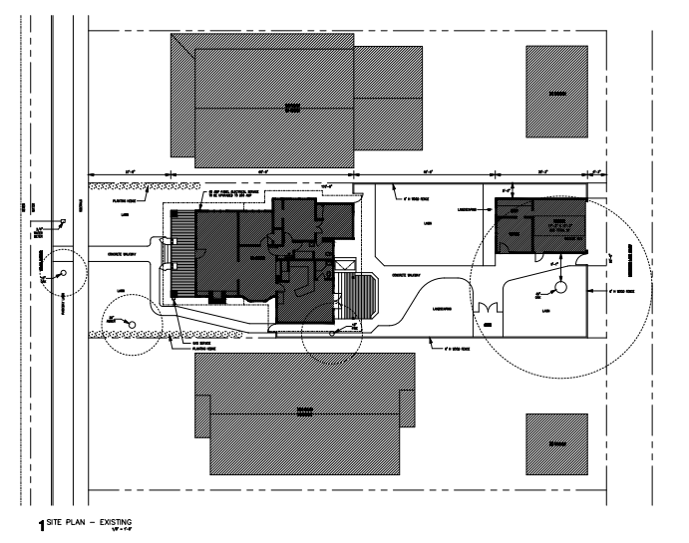
EXISTING SITE PLAN
Notes:
This slide shows an overview of the existing site plans.

Slide 10
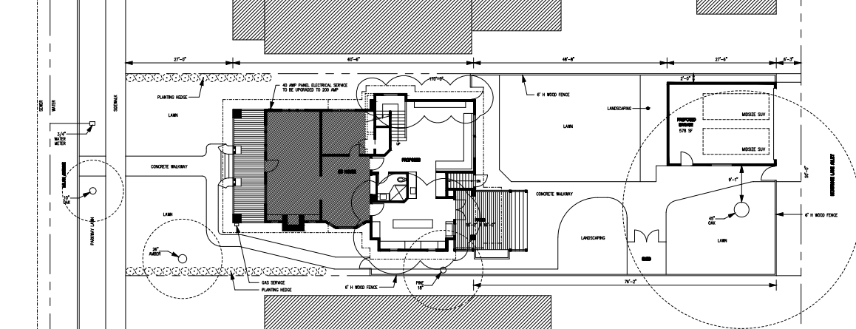
PROPOSED SITE PLAN

Slide 11
Zoning Development Standards
2nd Story setback – Doesn’t comply. CHC determination. Staff recommends further reducing scale of second story.
Detached Garage setback – allowed if it meets criteria/conditions
Notes:
The project conforms to most of the zoning district development standards,
However, for the proposed addition, the second story setback is required to be at least 3 feet in on both sides unless the CHC determines that the architectural style requires a zero side second story setback. Staff recommends reducing the scale of the second story.
The green circle shows the location of an existing oak tree that the applicant wishes not to encroach upon with the new garage. Conditions have been added to allow a new detached garage to be located within two feet from the north property line.

Slide 12
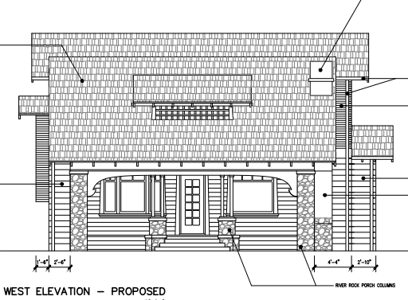
WEST ELEVATIONS
PREVIOUS PROPOSAL
NEW PROPOSAL
Notes:
Here we see the existing, previously proposed, and revised plans for the west elevation

Slide 13
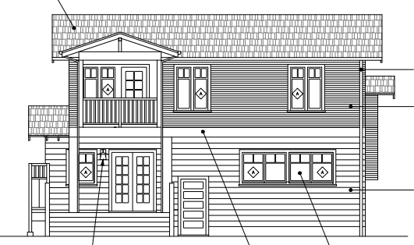
EAST ELEVATIONS
PREVIOUS PROPOSAL
NEW PROPOSAL
Notes:
Here we see the existing and new plans for the east elevation

Slide 14
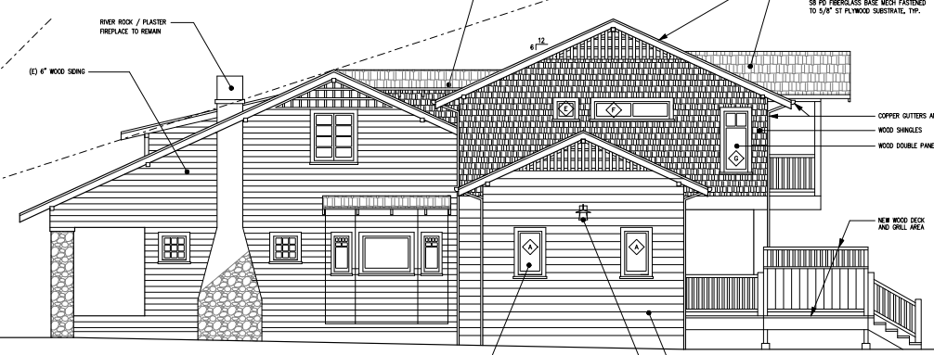
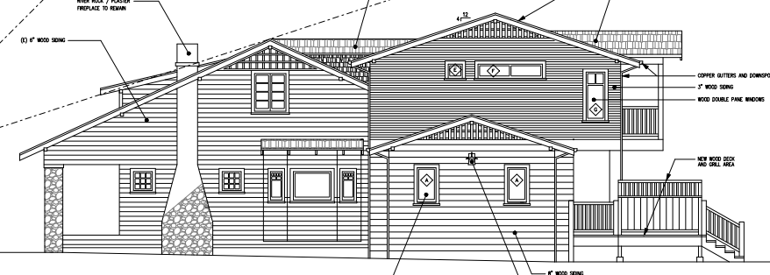
SOUTH ELEVATIONS
EXISTING
PREVIOUS PROPOSAL
NEW PROPOSAL
Notes:
Here we see the existing and new plans for the south elevation

Slide 15
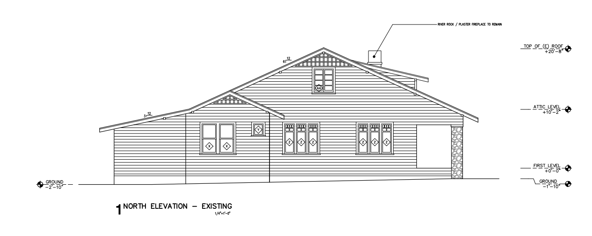
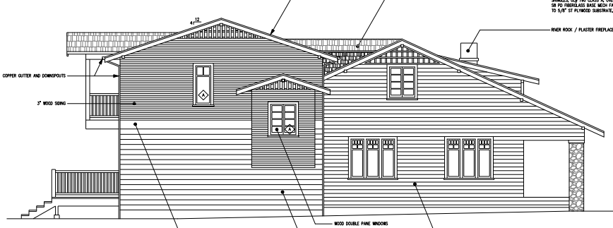
NORTH ELEVATIONS
PREVIOUS PROPOSAL
NEW PROPOSAL
Notes:
And finally, Here we see the existing and proposed plans for the north elevation

Slide 16
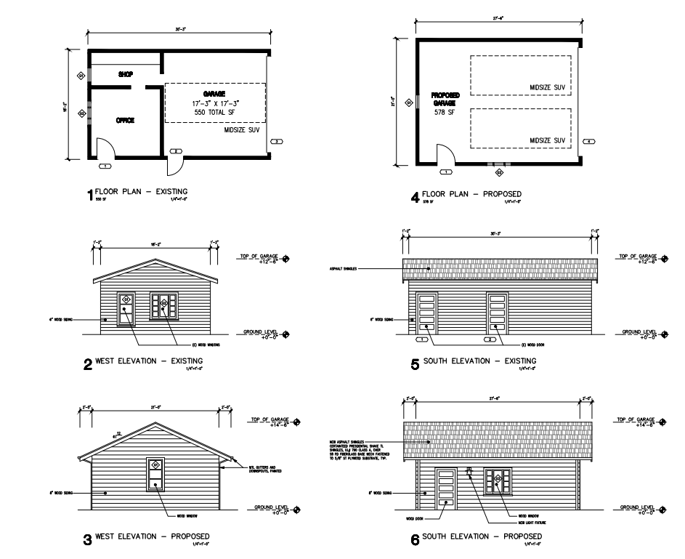
GARAGE (WEST & SOUTH ELEVATION)
EXISTING
PROPOSED

Slide 17
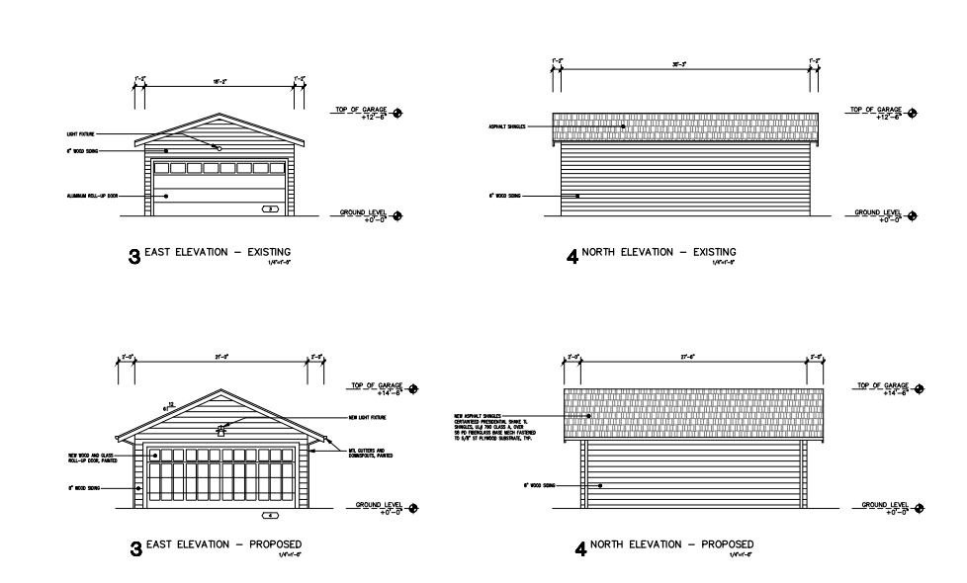
GARAGE (EAST & NORTH ELEVATION)
EXISTING
PROPOSED

Slide 18
PROJECT ANALYSIS
Some elements of the project comply with the City’s Design Guidelines and Secretary’s Standards.
The project components that do not completely comply are as follows:
The height of the roof.
The scale of the addition as seen from the side.
The walkway between roof gables

Slide 19
STAFF RECOMMENDATION:
Staff recommends that the Cultural Heritage Commission approve the project with the following conditions to be closer to compliance with the Standards:
Further reduce the height of the second story addition to be no more than 20’ high.
Remove the connecting walkway between the original and proposed gables.
Reduce the scale by trimming the first and second floor addition’s south elevation so that it follows the plane of the existing house.
Notes:
Based on project analysis, staff recommends the commission approve the project with the following special conditions...

Slide 20
Cultural Heritage Commission Options:
If the Commission does not agree with staff’s recommendation, the following options are available:
The Cultural Heritage Commission can Approve the project as is or with additional condition(s) added; or
The Cultural Heritage Commission can continue the project, providing the applicant with clear recommendations to revise the proposal; or
The Cultural Heritage Commission can Deny the project.
Notes:
If the commission does not agree…”

Slide 21
Questions?

