Slide 1
1123 Donaldo Ct Project No. 2423 Certificate of Appropriateness November 18, 2021
City of South Pasadena | Cultural Heritage Commission

Slide 2
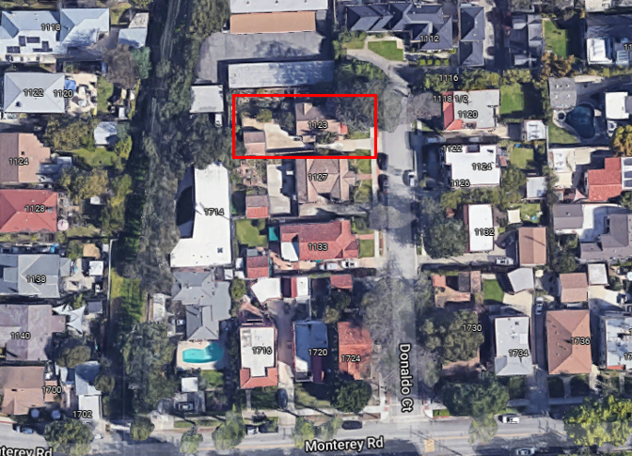
Location
Notes:
The property at 1123 Donaldo Court is a contributor to the Donaldo Court Cluster (eligible historic district).

Slide 3
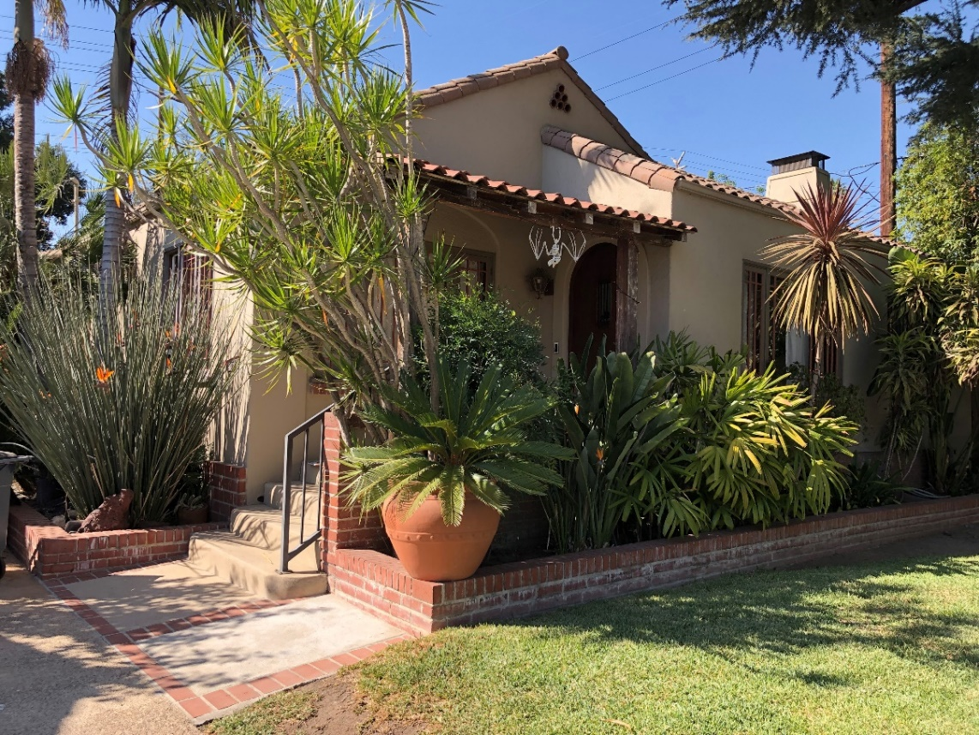
Street View
The 1,046 square-foot single-family residence with a 329 square-foot detached one-car garage was built in 1927 and is designed in the Spanish Colonial Revival style.
Notes:
The character-defining features of the historic house are:
Asymmetrical composition;
Smooth stucco siding;
Cross-gabled roof with red tile cladding;
Front entry porch with squared wood columns and shed roof;
Round terracotta vents at gable ends;
Tapered chimney;
Wood-framed windows in a variety of configurations;
Arched window openings/surrounds;
Original front wood door and surround with keystone;
Original side wood gate and wing wall; and
Northern courtyard with brick wall and flagstones.
The house is highly intact and has not undergone major alterations.

Slide 4
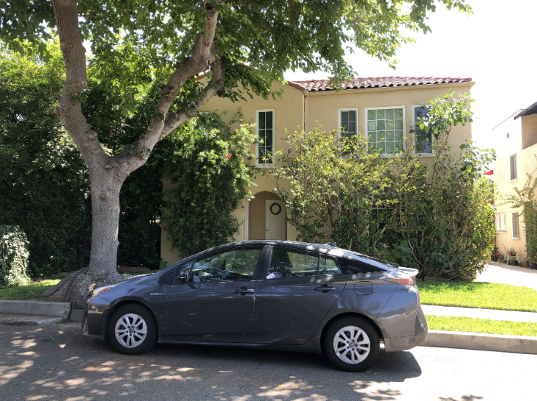
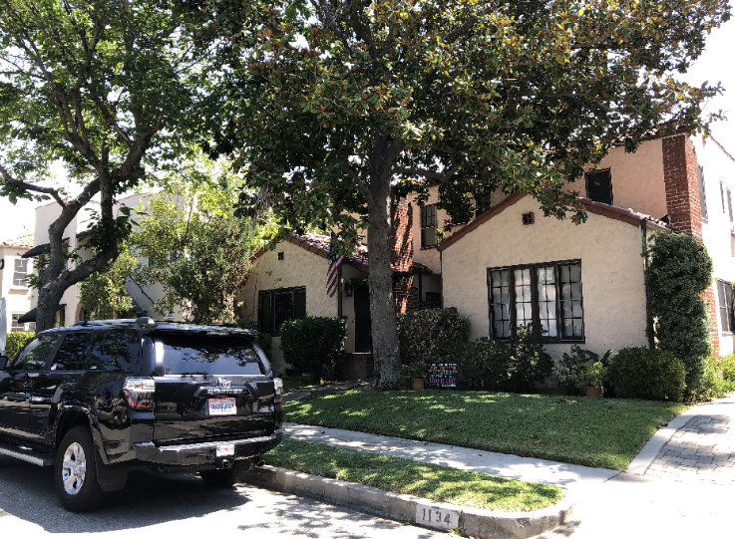
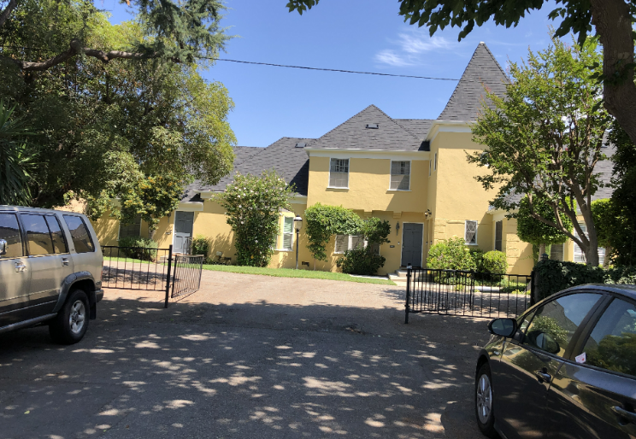
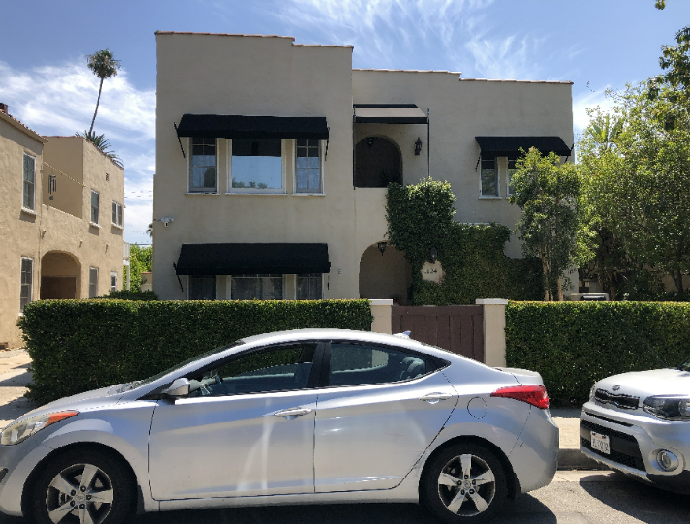
Nearby Properties
1118-1122 Donaldo Court
1132-1134 Donaldo Court
1112 Donaldo Court
1124-1126 Donaldo Court
Notes:
The Donaldo Court Cluster eligible historic district consists of predominantly one-story Spanish Colonial Revival and Colonial Revival style houses.

Slide 5
Project Description
The applicant is requesting an approval of a Certificate of Appropriateness to add 790 square feet of habitable space to the rear of the existing residence. The changes proposed to accommodate the addition include:
The one-story addition with a matching, slightly lower gable
Red clay barrel tiles roof to match existing
Smooth stucco finish to match existing
New wood windows on the rear addition to match proportions and type of the existing front windows
New wood French doors to match existing doors
Round terracotta vents beneath gable
Slight expansion of side porch along south elevation including new stairs and removal of wing wall
New wood gate at side porch to match gate at driveway

Slide 6
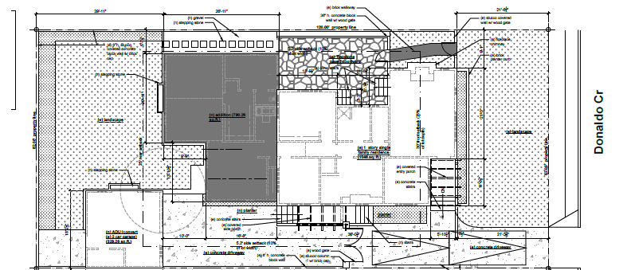
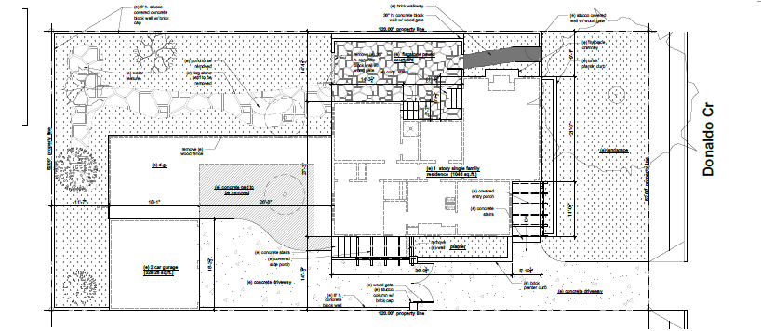
Plot Plan
Proposed
Existing

Slide 7
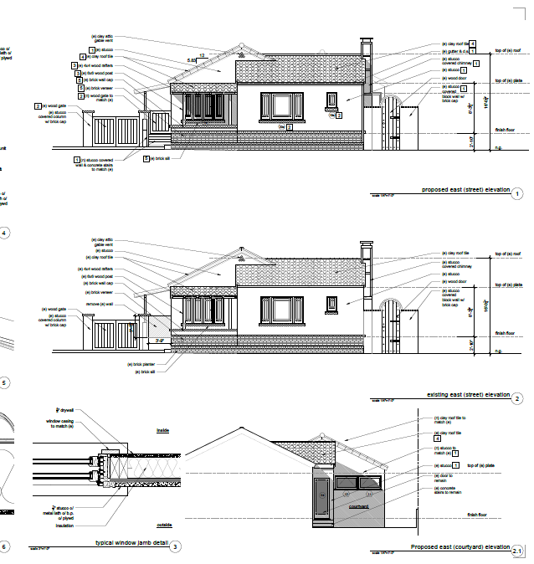
East Elevation
Proposed
Existing
Proposed
Notes:
The proposed project is one story, modest in scale, and located at the rear of the house. The addition has been designed to retain and compliment the character-defining features of the house. Smooth stucco will be used for the exterior cladding of the modest one-story addition and wood-frame windows will match existing in materials and overall design.
The addition’s gable is slightly lower than the original and will be minimally if at all visible from the public right-of-way.

Slide 8
South Elevation
Proposed
Existing
Notes:
On the south (side) elevation, the addition is stepped-in from the original volume so that is it not visible from the public-right-of-way and is discernible but compatible with the original house. The porch’s character-defining features, including shed roof upheld by wood columns, will be retained while the porch is slightly expanded to provide access to the front yard. This includes new steps leading eastward that match the original steps, removal of a low wing wall, and installation of a small wood gate. The wood gate has been designed to match an original gate to the south of the property, which provided access to the driveway. New windows will be of a complimentary wood double-hung variety.

Slide 9
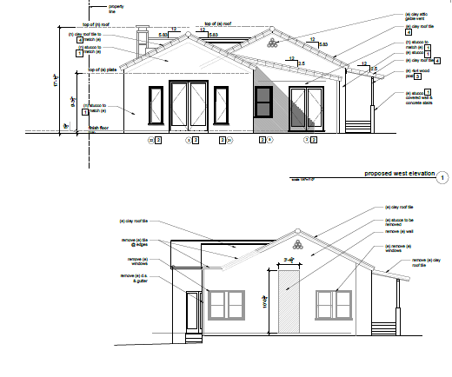
West Elevation
Proposed
Existing
Notes:
On the west (rear) elevation, the addition has a gable slightly lower than the original on the front of the house. This breaks the mass and distinguishes the volume from the original house. The addition’s roof therefore complements but does not compete with or overwhelm the original historic house. It is also discernible from the original house with its stepped in south elevation. The rear elevation incorporates design elements of the original house such as clay barrel tile roofing and terracotta vents. This elevation has wood French doors and wood casement and double-hung windows similar to the house’s original windows.

Slide 10
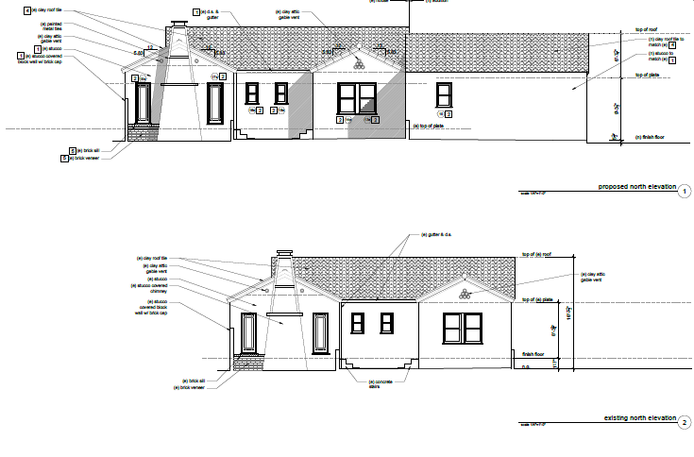
North Elevation
Proposed
Existing
Notes:
To the north, the addition slightly extends beyond the original building but is obscured from public view by its depth from the street, the original mass of the building, and the deep courtyard. A wood gate separates the north elevation from the street. Proposed new fenestration along this elevation includes a wood double-hung window.

Slide 11
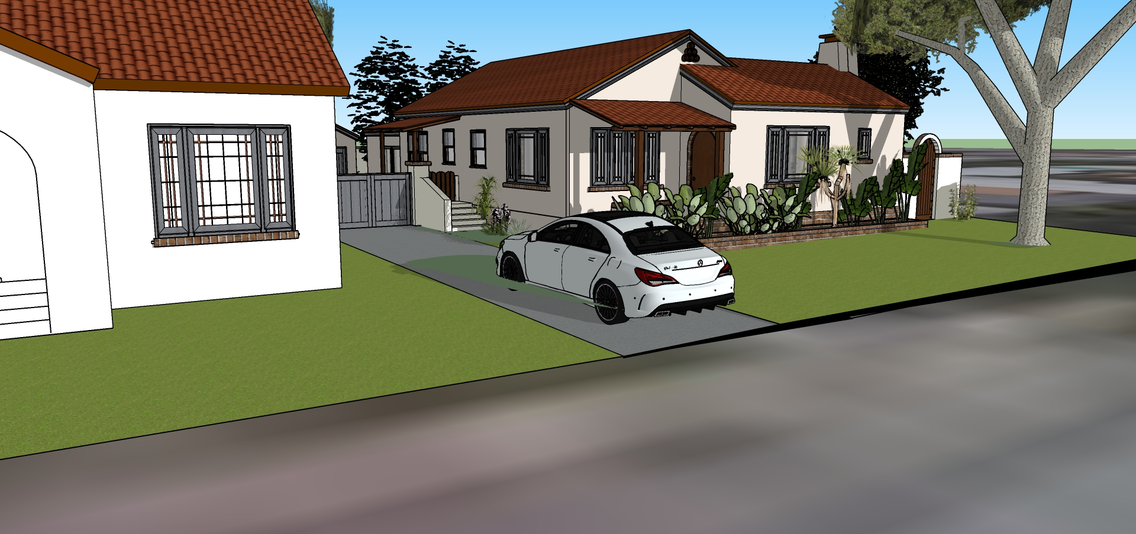
Proposed Elevations

Slide 12
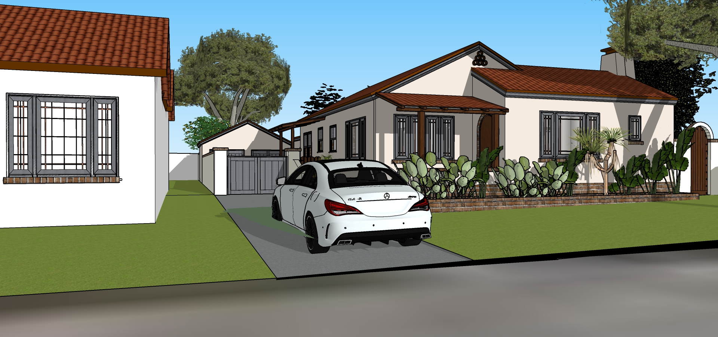
Proposed Elevations

Slide 13
Staff Recommendation
Staff recommends that the Cultural Heritage Commission approve the project.

Slide 14
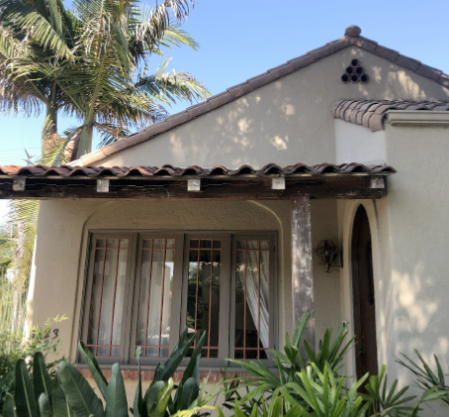
Thank you!

