Slide 2
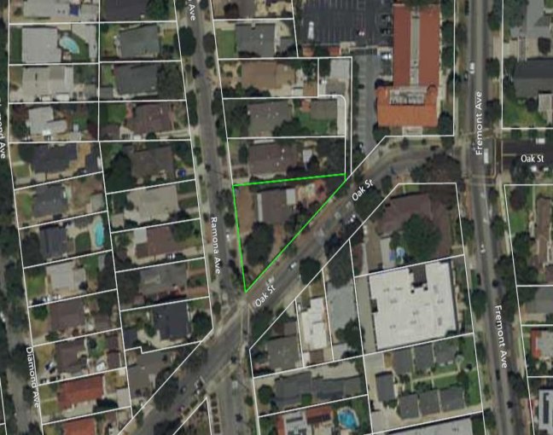
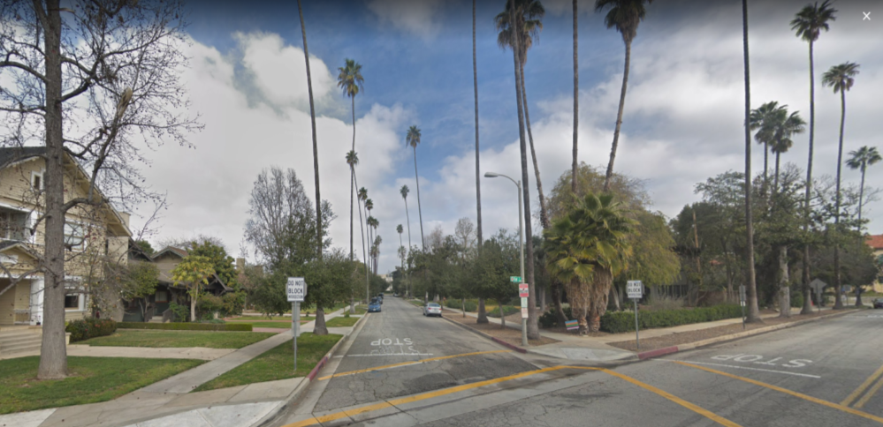
PROJECT LOCATION
Ramona Avenue Historic District
N

Slide 3
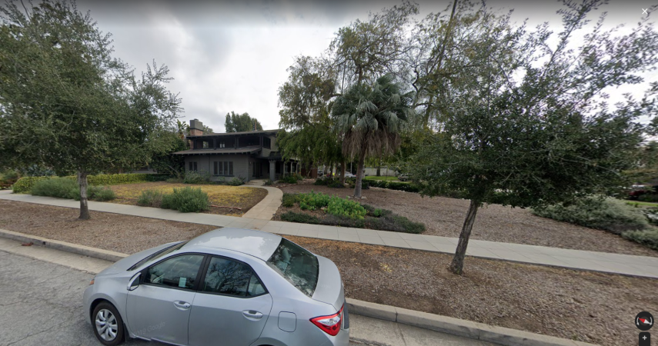
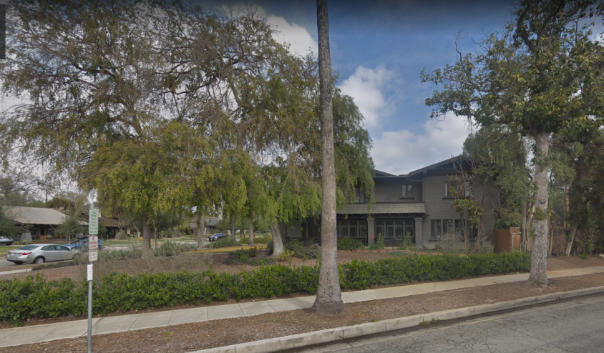
1534 Ramona

Slide 4
Recent Project Background
January 15, 2021 – Revised landscape plan submitted
February 7, 2021 – Comments received from the preservation planner
February 8, 2021 – Meeting with the applicant, neighborhood stakeholders, preservation planner, and CHC Subcommittee
February 12, 2021 – Revised landscape plan submitted
March 8, 2021 – Comments received from the preservation planner

Slide 5
Outreach Meeting Summary
February 8, 2021
CHC Subcommittee, several neighbors, Planning staff, and a preservation planner participated
Key requests from the neighbors and preservation planner:
Majority of yard shall be lawn
Ensure the main walkway is historically accurate
Identify plant species and heights
Redesign secondary path to be smaller and simpler
Relocate the gate closest to Oak Street so the entire length of the house is visible from the street
Replace the fence and add a Craftsman style pergola entrance off of Oak Street
Notify neighboring properties before noisy activities

Slide 6
1
2
3

Slide 7
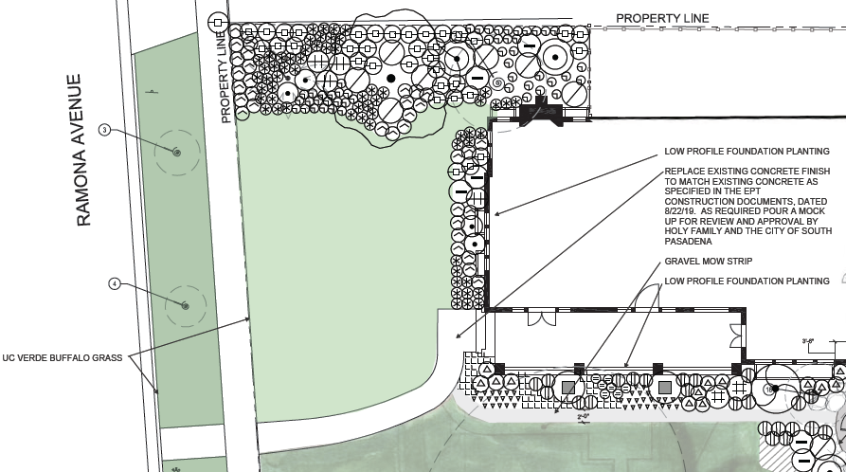
1

Slide 8
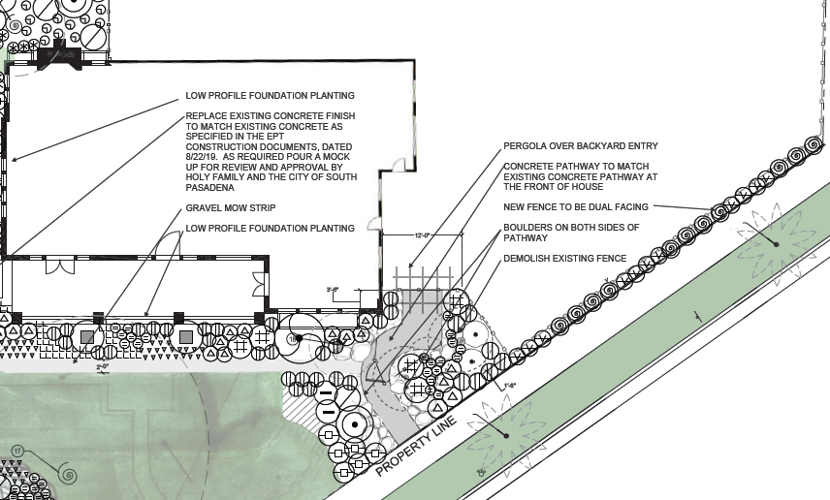
2

Slide 9
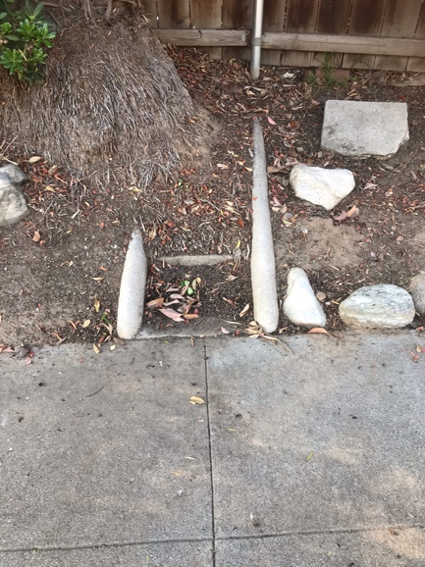
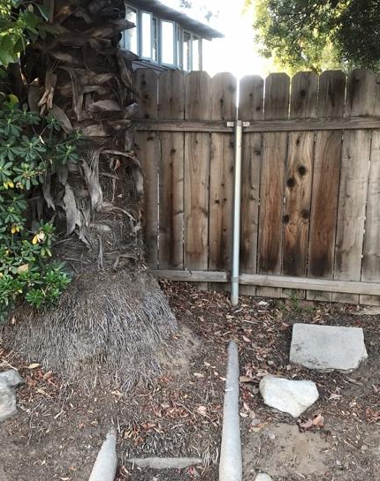
Historic Steps Along Oak Street
Would require the removal of a mature palm
Are these steps appropriate for the refined Craftsman style?

Slide 10
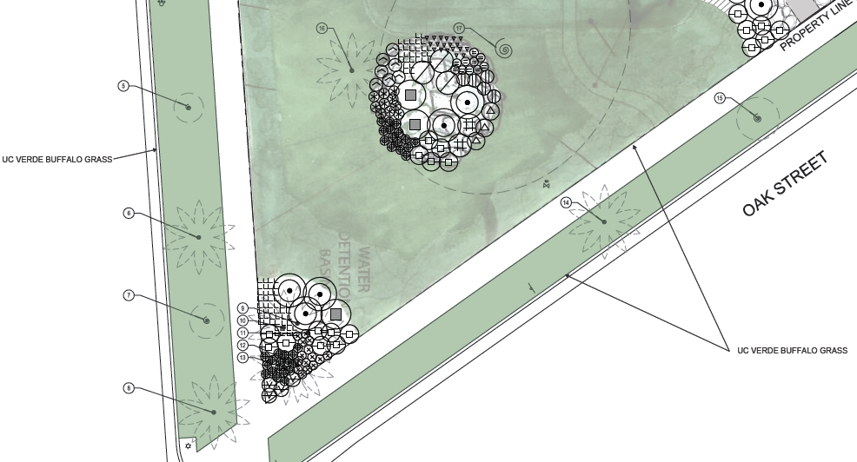
3

Slide 11
Applicant Response to Key Requests
Majority of yard shall be drought-tolerant lawn
Removed fountain and statue
Committed to provide samples of main walkway concrete finish prior to installation
Provided more detailed planting plan and tree measurements
Redesigned secondary path off Oak Street to be more narrow and less noticeable
Relocated the Oak Street gate
Replaced the Oak Street fence and shall add a Craftsman style pergola as recommended by the Subcommittee
Verbal commitment to provide more notice to neighbors before construction activities and gatherings

Slide 12
Additional Preservation Planner Comments
Prefer to see the details of the entire site on the plan
Simplify the plan to reduce busyness and be more refined
Explore the use of the historic steps from Oak Street
Soften the appearance of the new side yard fence with a Craftsman style hedge
Use irrigation instead of drought-tolerant plants

Slide 13
Summary of Draft Conditions of Approval
Maximum shrub species height of three to four feet
Sample of main walkway concrete finish to be approved by the Subcommittee
Add historic pedestals where the porch steps meet the walkway
Revise secondary path off Oak Street to be more refined
Explore historic steps as the secondary entrance
Revise plan to include a Chinese Elm per historic records

Slide 14
Certificate of Appropriateness
Criteria in Cultural Heritage Ordinance
Mandatory Findings
Project-Specific Findings
City’s Design Guidelines
Streetscape and Site Design
Secretary of the Interior’s Standards for the Treatment of Historic Properties
District/Neighborhood Setting
Building Site

Slide 15
Recommendation
Approve the Certificate of Appropriateness, subject to conditions of approval
Approval of a Certificate of Appropriateness with CEQA exemption, and adopt the conditions of approval and findings provided in the staff report.
Disagree, the Commission has the following options:
Provide design recommendations to support approval of the Certificate of Appropriateness; or
Direct staff to get a second opinion; or
Deny the Certificate of Appropriateness.

Slide 16
Questions?

