Slide 1
1716 Lyndon St, South Pasadena CA
Oct 12, 2020
Project No. 2296-COA
October 12th, 2020
City of South Pasadena | Cultural Heritage Commission

Slide 2
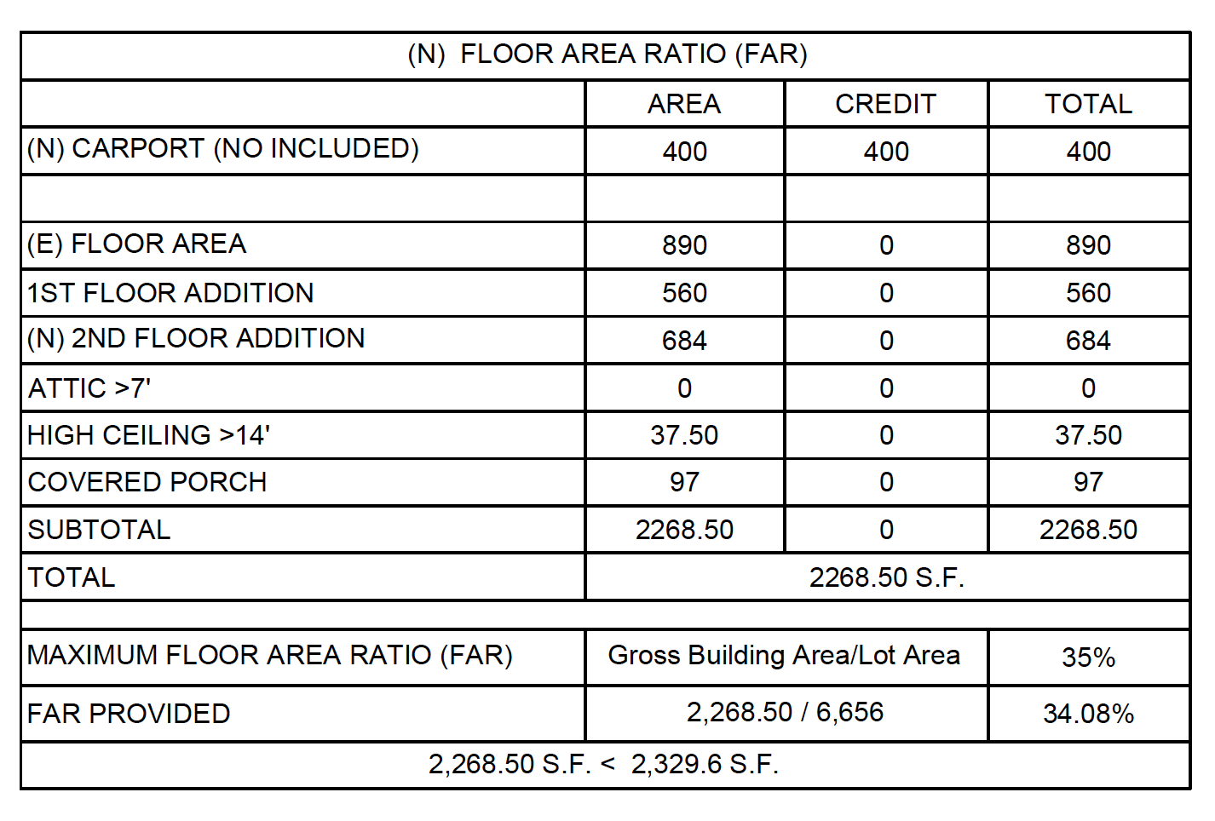
Project Summary
Item 1 – 1716 Lyndon St (2296-COA)
Oct 12, 2020
• 560 square foot first floor addition
• 684 square foot second story addition
• Demolition of structurally deficient 274 square foot one car garage
• Construction of new 400 square foot two car carport
• Lot size: 6,656 square feet

Slide 3
Item 1 – 1716 Lyndon St (2296-COA)
Oct 12, 2020
N

Slide 4
Item 1 – 1716 Lyndon St (2296-COA)
Oct 12, 2020

Slide 5
Item 1 – 1716 Lyndon St (2296-COA)
Oct 12, 2020
Existing Site Plan
Proposed Site Plan

Slide 6
Item 1 – 1716 Lyndon St (2296-COA)
Oct 12, 2020
Existing Floor Plan
Proposed Floor plan

Slide 7
Item 1 – 1716 Lyndon St (2296-COA)
Oct 12, 2020
Proposed 2nd Story Floor Plan
Roof Plan

Slide 8
Item 1 – 1716 Lyndon St (2296-COA)
Oct 12, 2020
Existing & Proposed East & South (Front) Elevation

Slide 9
Item 1 – 1716 Lyndon St (2296-COA)
Oct 12, 2020
Proposed Color Palette

Slide 10
Item 1 – 1716 Lyndon St (2296-COA)
Oct 12, 2020
Existing & Proposed North & West Elevations

Slide 11
Item 1 – 1716 Lyndon St (2296-COA)
Oct 12, 2020
Proposed Elevation Renderings

Slide 12
Item 1 – 1716 Lyndon St (2296-COA)
Oct 12, 2020

Slide 13
Item 1 – 1716 Lyndon St (2296-COA)
Oct 12, 2020
Proposed Milgard Ultra Series

Slide 14
Item 1 – 1716 Lyndon St (2296-COA)
Oct 12, 2020
Questions?

