Slide 1

Notes:
Good evening, Chair and Commissioners, my name is Candida Neal, I am a contract planner for the City of South Pasadena
Before you tonight is Project No. 2309-NID/DRX to adopt a finding that the property at 23 Short Way
Does not meet the national, state, or local criteria for historic designation AND
project may proceed through the city’s application process without any further restrictions under the Cultural Heritage Ordinance
The applicant is Vincent Chen, the architect for the project. Also, attending the meeting is the property owner Pokil Wong

Slide 2
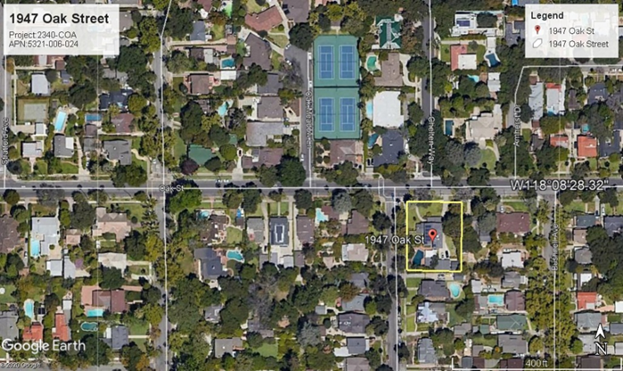
N
Notes:
The project is located on Short Way in the western portion of the City.
South of Monterey Road
West of Brunswick Avenue
The corporate boundary between the City South Pasadena and LA is runs through the middle of the block about 3 lots west of the project site.
The site is surrounded by sfd that were constructed in the 1920s. Most of the homes have been

Slide 3
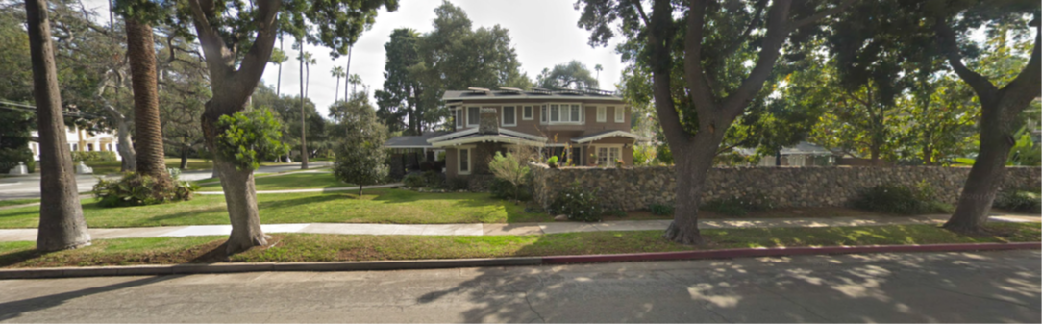
Notes:
Table 1: Historic Property Information
Year Built: 1916 (House and Garage)
National Register Status Code: 5B1 (5B)
Historic Name: N/A
Architectural Style: Craftsman
District Name: Not in a Historic District but within Wayne/Bushnell/Fletcher potential district

Slide 4
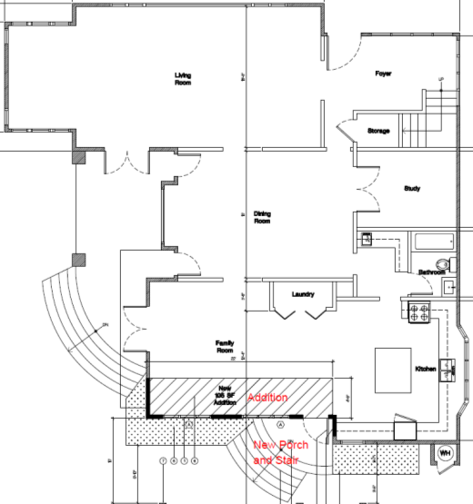
    Project Description
    Proposal: Construction of a 150 sf addition to a 3,455 sf home
Notes:
Demolition of the first story family room exterior wall, rear porch, and semi-circular stairs.
Construction of a 1-story addition of approximately 150 square feet to the family room.
Construction of a new rear porch entry. Similar to the existing porch, the new porch will include semi-circular steps clad in a river rock veneer. This design mimics the patio steps on the west elevation.
Construction of a new, single story, south-facing gable to cover the addition, new porch, and entry area.
Relocation of existing windows and door on the new wall.

Slide 5
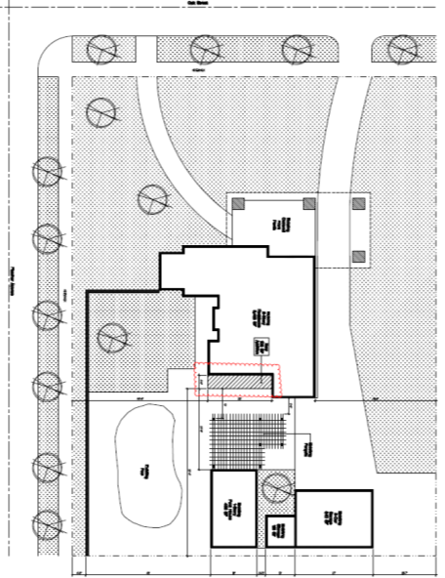

Slide 6
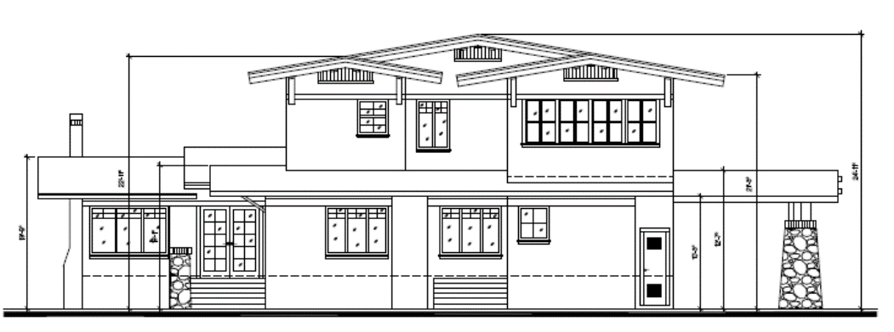

Slide 7
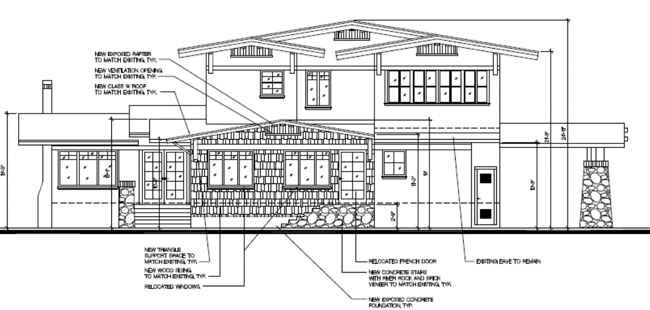

Slide 8
Design Review
Architectural Style
Scale and Massing
Setback/Orientation
Height and Roof Form
Fenestration
Exterior Cladding and Roofing
Façade Treatments
Secondary Structures
Notes:
Architectural Style
The home exhibits many of the character-defining elements of the Craftsman architectural style. The proposed addition incorporates these elements including a low slope gable, wide overhanging eaves with supporting structural braces, and open ventilation at the top of the gable. The proposed addition also includes elements that are unique to the home such as retaining the semi-circular stair and rear porch. The existing windows and doors will be reused.
Scale and Massing
The one story addition is visually subordinate to the original building and helps to breaks up the south elevation.
Setback / Building Placement / Orientation on Parcel
Located at the rear of the home, the proposed addition will not change existing setbacks or orientation, building placement of the single-family home.
Height and Roof Form
A new gable roof will cover the proposed addition. The roof slope of the new gable matches existing first and second story gables. The height of the gable, 13 feet is the same as the two single-story gables on the west elevation.
Fenestration – Windows and Doors
The proposed project will reuse the existing windows and door currently on the south elevation wall that will be demoed for the proposed addition.
Exterior Cladding and Roofing Materials
Specialty wood shingles that match the existing siding will be used. Although the original roofing material was wood shake, the composition shingles that cover the rest of the home will be used on the addition. Façade Treatments
The new gable and semi-circular porch and stair will provide visual interest and contribute to the overall quality of the residence.
Secondary Structures / Outbuildings
No secondary structures or outbuildings are proposed as part of the project

Slide 9
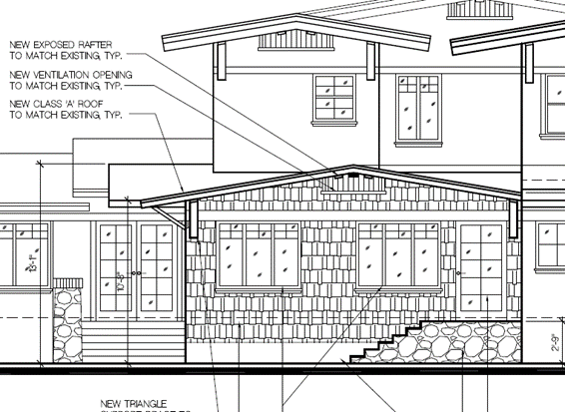
Project Specific Findings
Appropriate, Size and Massing
Distinction between historic and new
New living space.
Notes:
Architectural Style
The home exhibits many of the character-defining elements of the Craftsman architectural style. The proposed addition incorporates these elements including a low slope gable, wide overhanging eaves with supporting structural braces, and open ventilation at the top of the gable. The proposed addition also includes elements that are unique to the home such as retaining the semi-circular stair and rear porch. The existing windows and doors will be reused.
Scale and Massing
The one story addition is visually subordinate to the original building and helps to breaks up the south elevation.
Setback / Building Placement / Orientation on Parcel
Located at the rear of the home, the proposed addition will not change existing setbacks or orientation, building placement of the single-family home.
Height and Roof Form
A new gable roof will cover the proposed addition. The roof slope of the new gable matches existing first and second story gables. The height of the gable, 13 feet is the same as the two single-story gables on the west elevation.
Fenestration – Windows and Doors
The proposed project will reuse the existing windows and door currently on the south elevation wall that will be demoed for the proposed addition.
Exterior Cladding and Roofing Materials
Specialty wood shingles that match the existing siding will be used. Although the original roofing material was wood shake, the composition shingles that cover the rest of the home will be used on the addition. Façade Treatments
The new gable and semi-circular porch and stair will provide visual interest and contribute to the overall quality of the residence.
Secondary Structures / Outbuildings
No secondary structures or outbuildings are proposed as part of the project

Slide 10
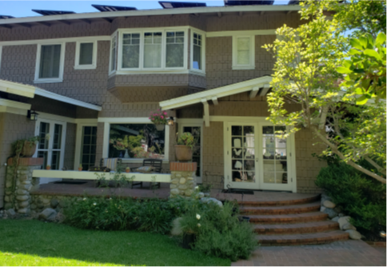
Mandatory Findings
GP Consistency
Cultural Heritage Ordinance
Secretary of Interior Standards
Notes:
Architectural Style
The home exhibits many of the character-defining elements of the Craftsman architectural style. The proposed addition incorporates these elements including a low slope gable, wide overhanging eaves with supporting structural braces, and open ventilation at the top of the gable. The proposed addition also includes elements that are unique to the home such as retaining the semi-circular stair and rear porch. The existing windows and doors will be reused.
Scale and Massing
The one story addition is visually subordinate to the original building and helps to breaks up the south elevation.
Setback / Building Placement / Orientation on Parcel
Located at the rear of the home, the proposed addition will not change existing setbacks or orientation, building placement of the single-family home.
Height and Roof Form
A new gable roof will cover the proposed addition. The roof slope of the new gable matches existing first and second story gables. The height of the gable, 13 feet is the same as the two single-story gables on the west elevation.
Fenestration – Windows and Doors
The proposed project will reuse the existing windows and door currently on the south elevation wall that will be demoed for the proposed addition.
Exterior Cladding and Roofing Materials
Specialty wood shingles that match the existing siding will be used. Although the original roofing material was wood shake, the composition shingles that cover the rest of the home will be used on the addition. Façade Treatments
The new gable and semi-circular porch and stair will provide visual interest and contribute to the overall quality of the residence.
Secondary Structures / Outbuildings
No secondary structures or outbuildings are proposed as part of the project

Slide 11
    CEQA: Categorical Exemption –
      Section 15301 Class 1 Existing Facilities
      Section 15331 Class 31 Historic Resource Restoration/Rehabilitation

Slide 12
Staff Recommendation:
Approve the Certificate of Appropriateness for 1947 Oak Street, subject to conditions of approval.
Notes:
CHC adopt a finding that . . .
The property does not meet the national, state, or local criteria for historic designation, and
The project may proceed through the city’s application process without any further restrictions under the Cultural Heritage Ordinance for the demolition of a 839 square-foot single-family home and attached garage at 23 Short Way.

Slide 13
Cultural Heritage Commission Options:
Approve with additional conditions
Continue the public hearing
Deny the project
Notes:
Three Options:

Slide 14
Questions?
Notes:
This concludes staff presentation.

