Slide 1

Notes:
Good evening, commissioners. This item is for Project No. 2388-Certificate of Appropriateness, for 2002 Oak Street

Slide 2
    PROJECT DESCRIPTION
COA for a 28 square foot addition to an existing single-story, 1,309 square-foot single-family residence located at 2002 Oak Street(Assessor’s Parcel Number: 5321-004-002).
Built in 1924, is a contributor to the 1900-2000 Block Oak Historic District
Notes:
This project is for a 28 sq ft addition and alterations to a single-story, 1,309 square-foot residence
Built in 1924, the residence is a contributor to the 1900-2000 Block Oak Historic District

Slide 3
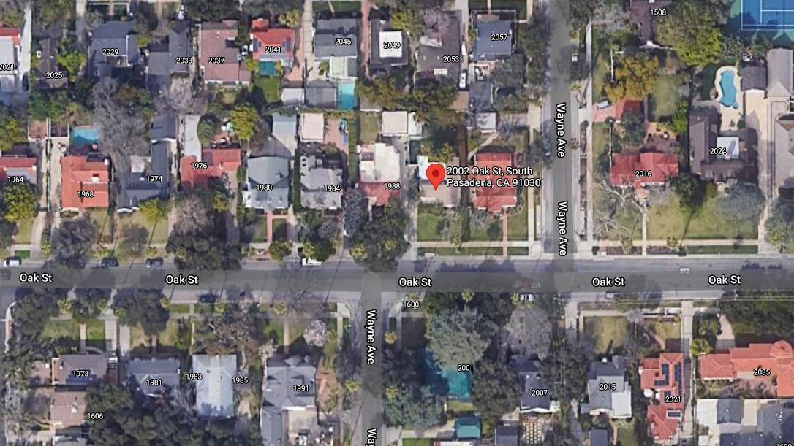
    Figure 1: LOCATION
Notes:
Figure 1 shows the location of the subject property, on the north side of Oak street, between Wayne Avenue.

Slide 4
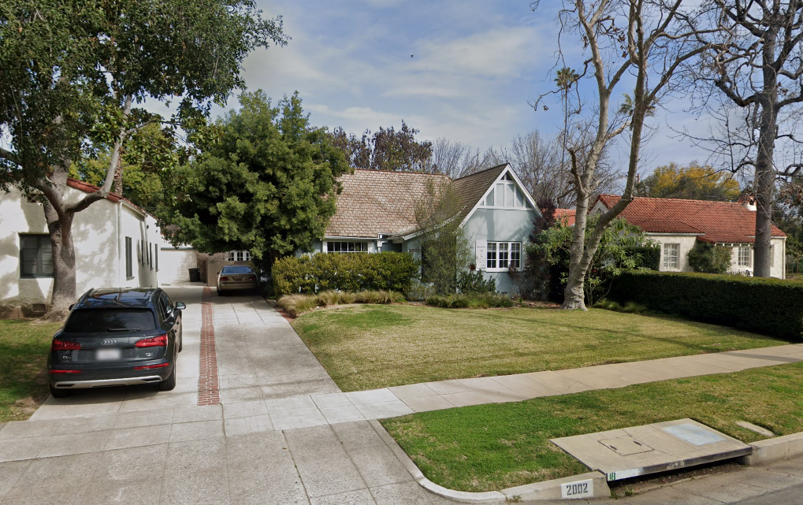
    Figure 2: STREET VIEW
Notes:
Figure 2 provides an overview of the street-level view of the home.

Slide 5
    PROPERTY INFORMATION
Notes:
Table 1 summarizes the historic property information for 2002 Oak.
The Sanborn Fire Insurance Map is shown on the right.

Slide 6
    PROJECT OVERVIEW
Add 28 square-feet of habitable space by enclosing front porch.
Reuse and relocate original front door;
Fill in an existing arched opening with a custom window
Reuse of salvaged brick found on property to be restored at front walkway
Notes:
This project includes adding 28 square feet of habitable space by enclosing the front porch
The front porch enclosure entails reusing the original front door;
Filling in the existing arched opening with a new custom wood window
The salvaged bricks found on property will be used to restore the front walkway

Slide 7
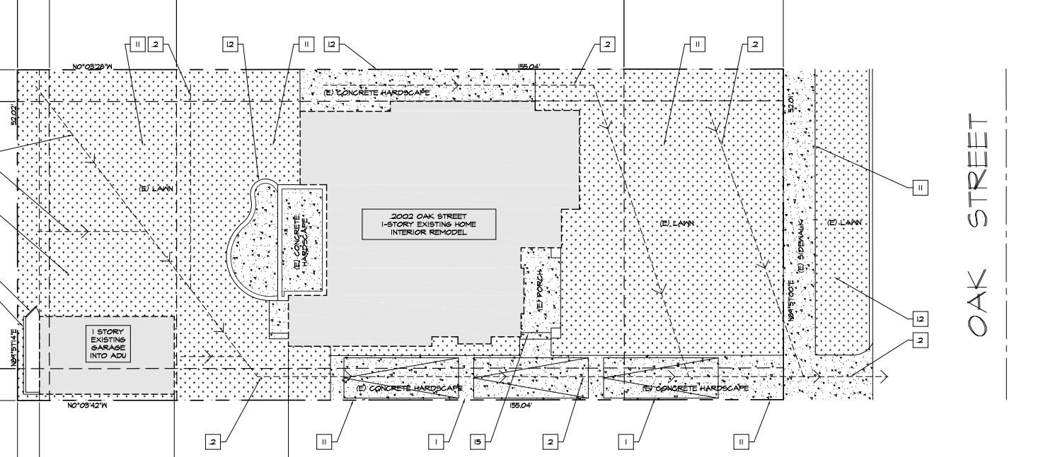
    PROPOSED SITE PLAN
Notes:
This slide shows the proposed site plans, which doesn’t change much from the existing other than the removal of the trellis to the garage..

Slide 8
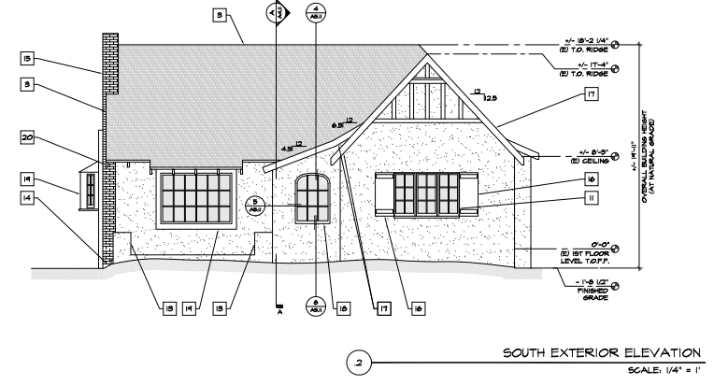
    SOUTH ELEVATIONS
Notes:
Here we see the proposed plans for the south elevation, showing the new custom window covering the existing open arch.

Slide 9
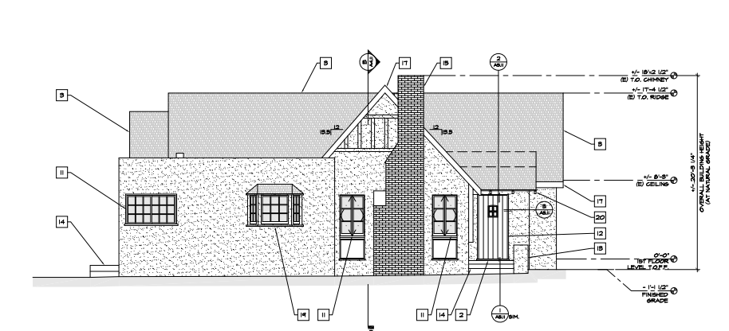
    WEST ELEVATIONS
Notes:
Here we see the proposed plans for the west elevation, which shows the existing door moved into the position to enclose the porch.

Slide 10
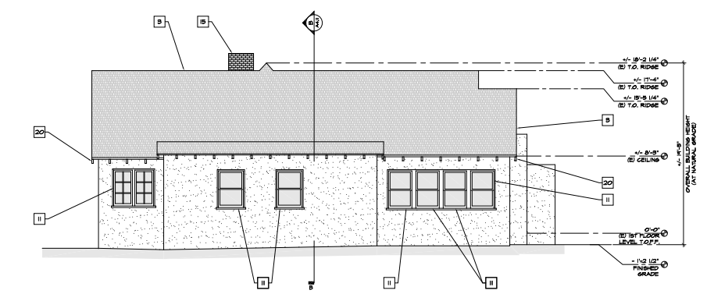
    EAST ELEVATIONS
Notes:
The is the east elevation, the windows will remain and be repainted

Slide 11
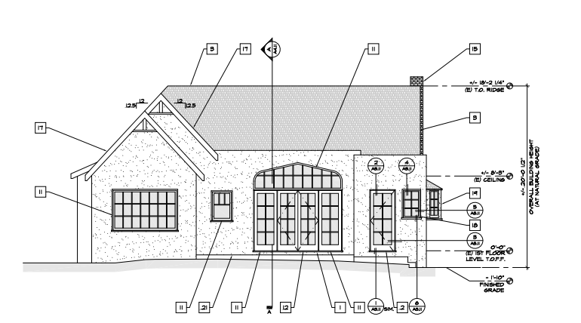
    NORTH ELEVATIONS
Notes:
Here we see the proposed plans for the north elevation facing the back yard, showing the location of the new wood window in the laundry room

Slide 12
    PROJECT ANALYSIS
The project complies relevant Secretary of Interior Standards (Nos. 9 and 10) and the City’s Design Guidelines.
Porch enclosure reuses original materials with custom wood window. Enclosure is reversible.
Notes:
The project complies with the City’s design guidelines and most relevant secretary of interior standards No. 9 and 10.
The proposed porch enclosure reuses original materials with a custom wood window that retains the original Tudor arch opening. The porch enclosure does not alter the body of the residence and is reversible, so it can easily be removed without damaging the house and its original materials.

Slide 13
STAFF RECOMMENDATION:
The Cultural Heritage Commission approve the project.
Notes:
Staff recommends that the Cultural Heritage Commission approve the project.

Slide 14
Cultural Heritage Commission Options:
If the Commission does not agree with staff’s recommendation, the following options are available:
The Cultural Heritage Commission can Approve the project with additional condition(s) added; or
The Cultural Heritage Commission can continue the project, providing the applicant with clear recommendations to revise the proposal; or
The Cultural Heritage Commission can Deny the project.
Notes:
If the commission does not agree, the commission has the option to approve the project with additional conditions added, or…

Slide 15
Questions?

