Slide 1
Notes:
Good Evening this present ation is for 807 Bank Street

Slide 2
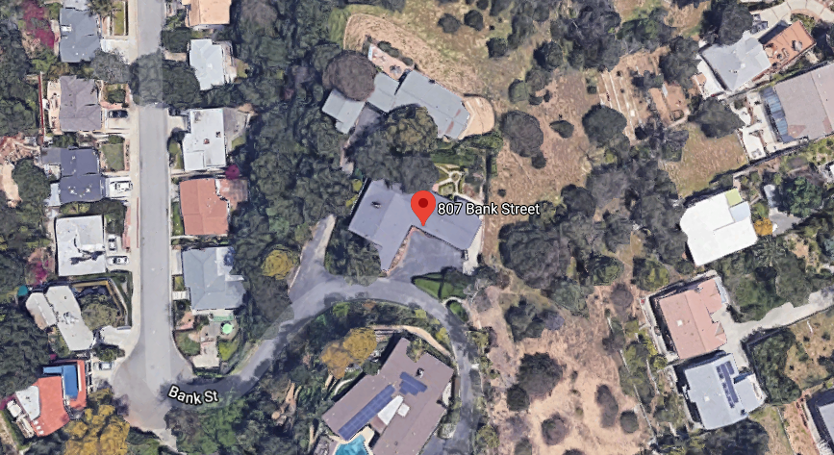
PROJECT
Request for Landmark Historic Designation located at 807 Bank Street
Notes:
The property owner is requesting consideration for a Landmark historic designation located at 807 Bank Street .
Here in ariel image of the home located on a hillside outlined in green
Monterey road to the north
Meridian Avenue is located on the east
flores del oro to the south
and via del rey to the west

Slide 3
Background
On June 11, 2020 - city received a request from property owners to designate their home as a historic landmark property.
On August 20, 2020 - request was presented to the Cultural Heritage Commission and subcommittee was created composed of Commissioners William Cross and Kristin Morrish
On January 14, 2021- the subcommittee conducted a virtual-site meeting with the homeowner to inspect the property.
On February 8, 2021 an application formally requesting Historic Landmark Designation was submitted
On February 9, 2021 the landmark subcommittee determined that the property merits consideration by the Commission.

Slide 4
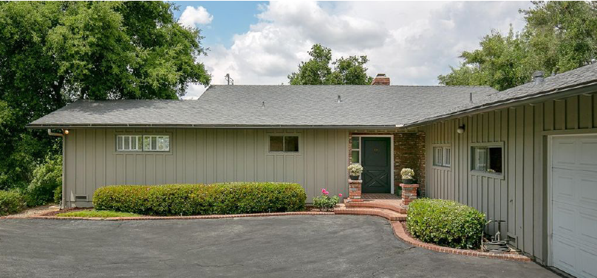
Built in 1959 – Modern Ranch Home
Notes:
The proposed home for the landmark designation, was built in 1959 and was designed by Theodore Pletsch and architectural style is modern ranch home

Slide 5
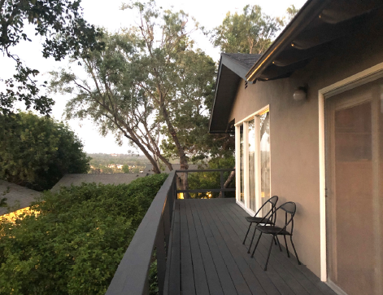
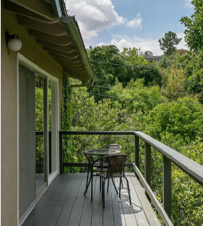
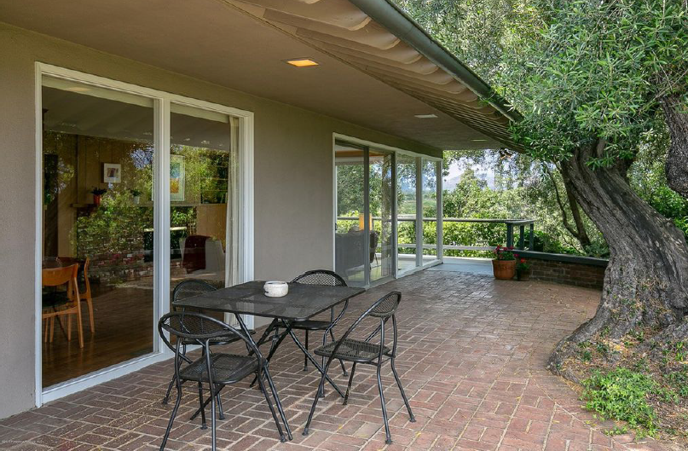
Notes:
.” The home’s plan is a rotated “L” and faces to the south and west with a street facing façade. The two-car garage is located at the south end of the west elevation and faces toward the the front. The home is designed with board and batten siding, overhang eaves with exposed and rounded rafter ends. The main entry has laid out brick in semi-circles to be used as a landing with decorative brick pedestals and motor-court planter beds made of brick. The east elevation has floor to ceiling glass sheets and aluminum glass door. Other features include folding wood shutters, wood deck, stucco finishes built in cabinets, and patio seating wall.

Slide 6
Criteria for Historic Designation
Its character, interest or value as a part of the heritage of the community;
Its location as a site of a significant historic event;
Its identification (such as the residence, ownership, or place of occupation, etc.) with a person, persons or groups who significantly contributed to the culture and development of the city, state or United States;
Its exem/plification of a particular architectural style of an era of history of the city;
Its exemplification of the best remaining architectural type in a neighborhood;
Its identification as the work of a person or persons whose work has influenced the heritage of the city, the state or the United States;
Its embodiment of elements of outstanding attention to architectural design, engineering, detail design, detail, materials or craftsmanship;
It is either a part of or related to a square, park or other distinctive area which should be developed or preserved according to a plan based on a historic cultural or architectural motif;
Its unique location or singular physical characteristic representing an established and familiar visual feature of a neighborhood;
Its potential for yielding information of archaeological interest; or
In designating a historic district, its significance as a distinguishable neighborhood or area whose components may lack individual distinction.
Notes:
Purusant to the South Pasadena Municipal Code (SPMC) Section 2.63(b), the Commission shall use any or all of the following criteria in making a recommendation to the City Council for designation of Landmark Designtation. The Subcomitte report states that the project qualifies qualifies for designation under criteria (1), (4), (6), and (7).

Slide 7
Staff Recommendation:
Cultural Heritage Commission to review and recommend Historic Landmark Designation for 807 Bank Street to the City Council.

Slide 8
Thank you

