Slide 2
Background History
November 19, 2020 – CHC first sees project and continues to the January 21, 2021 meeting.
January 21, 2021 – Staff requested that the project be continued to this meeting.

Slide 3
CHC Changes Requested
Step-in and reduce the size/square footage of the rear addition so that it is visually subordinate to the historic building; and
Remove the curved bay window with stained glass lights; and
Work with the existing pergola for better design flow.

Slide 4
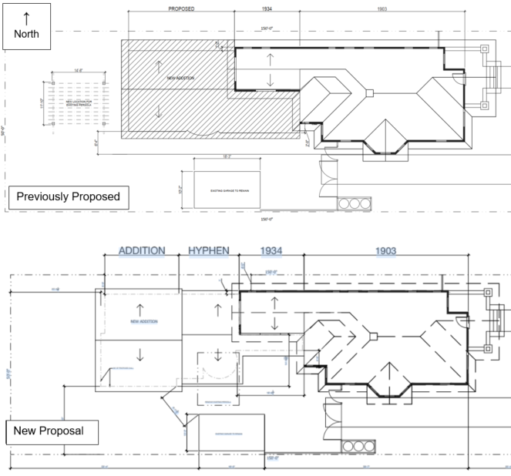
Site Plan

Slide 5
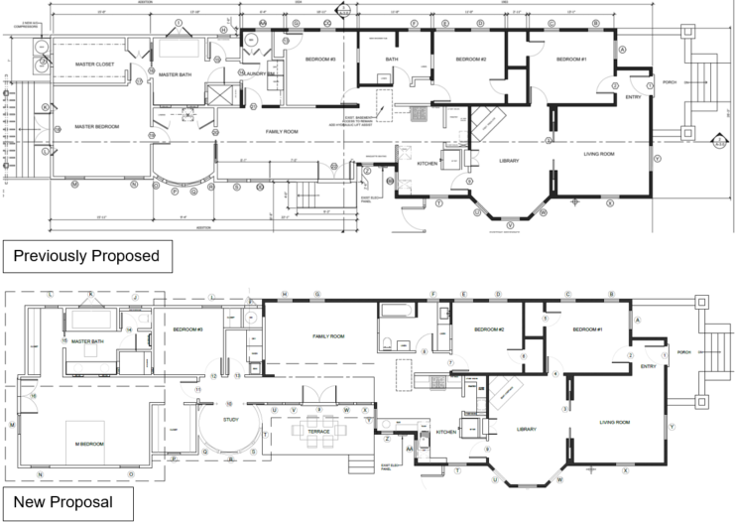
Floor Plan

Slide 6
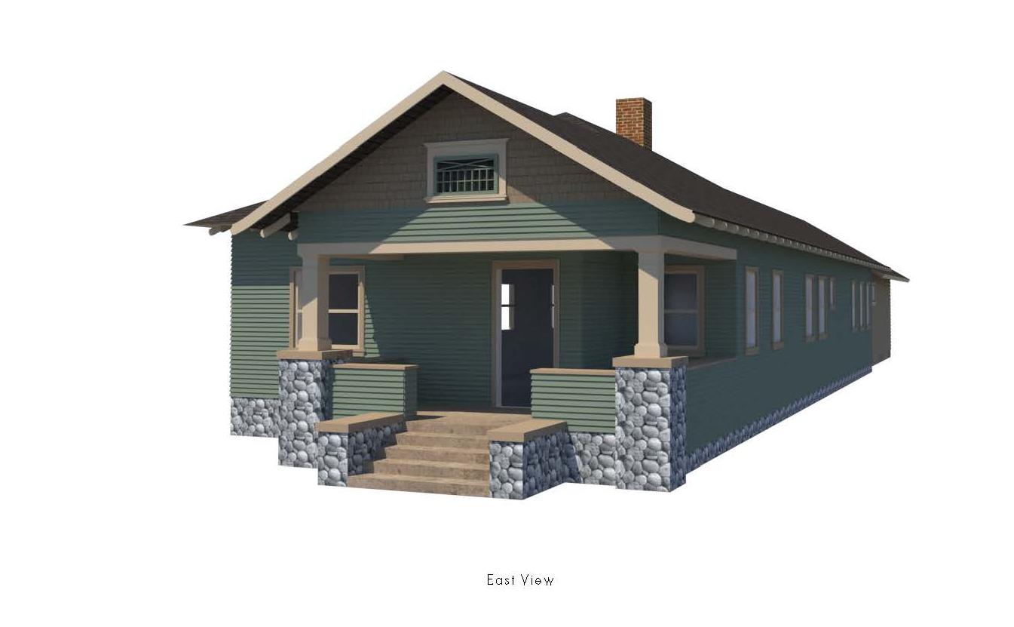
Front Elevation (East)

Slide 7
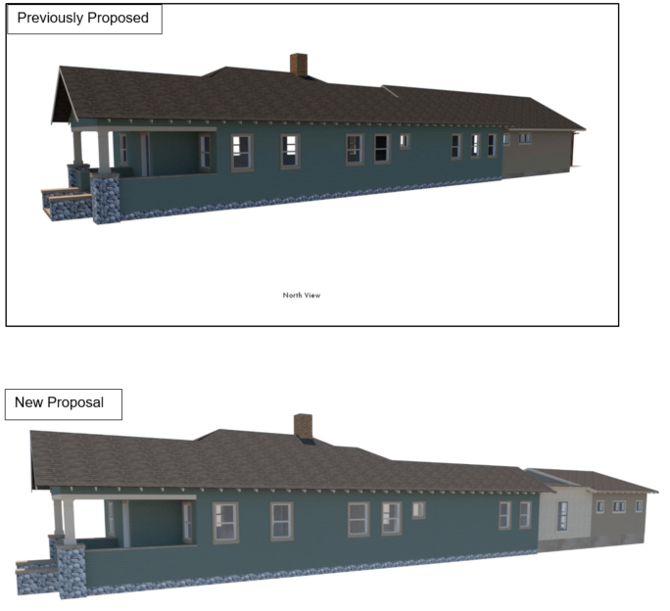
Side Elevation (North)

Slide 8
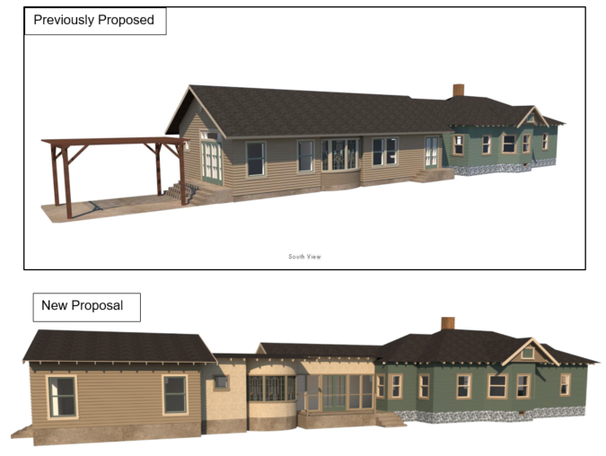
Side Elevation (South)

Slide 9
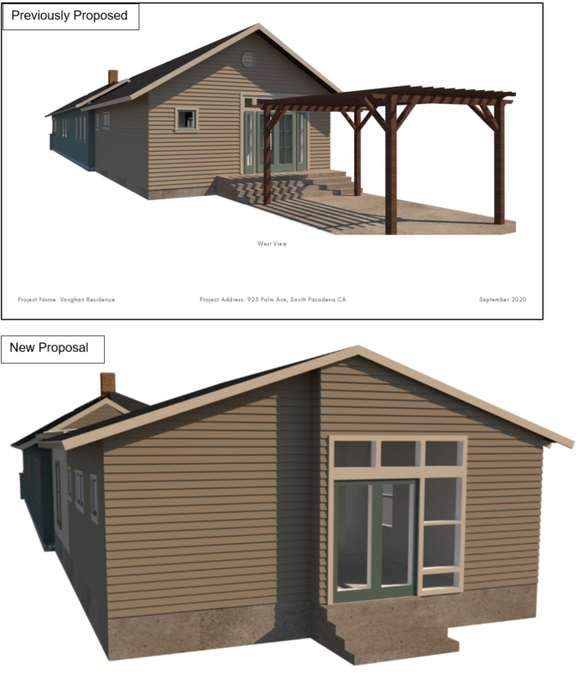
Rear Elevation (West)

Slide 10
Staff Recommendation:
Formation of a sub-committee and continue the project to a date certain.

Slide 11
Questions?

