Slide 2
Background History
March 18, 2021 – Subcommittee formed of Commissioners Cross and Lopez
March 23, 2021 – Subcommittee met with applicant and architect
Wanted railing details and rafter tails
Like height of the master bedroom
Would like to see stain glass windows element kept

Slide 3
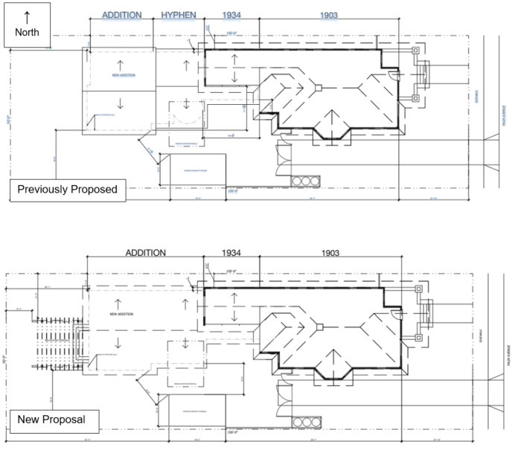
Site Plan

Slide 4
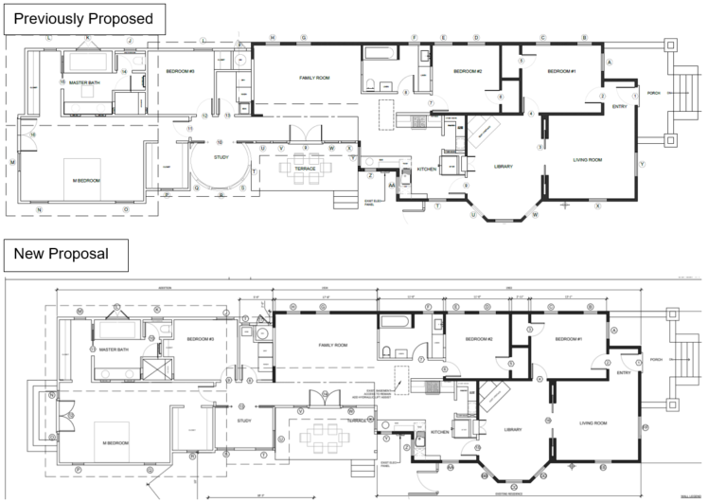
Floor Plan

Slide 5
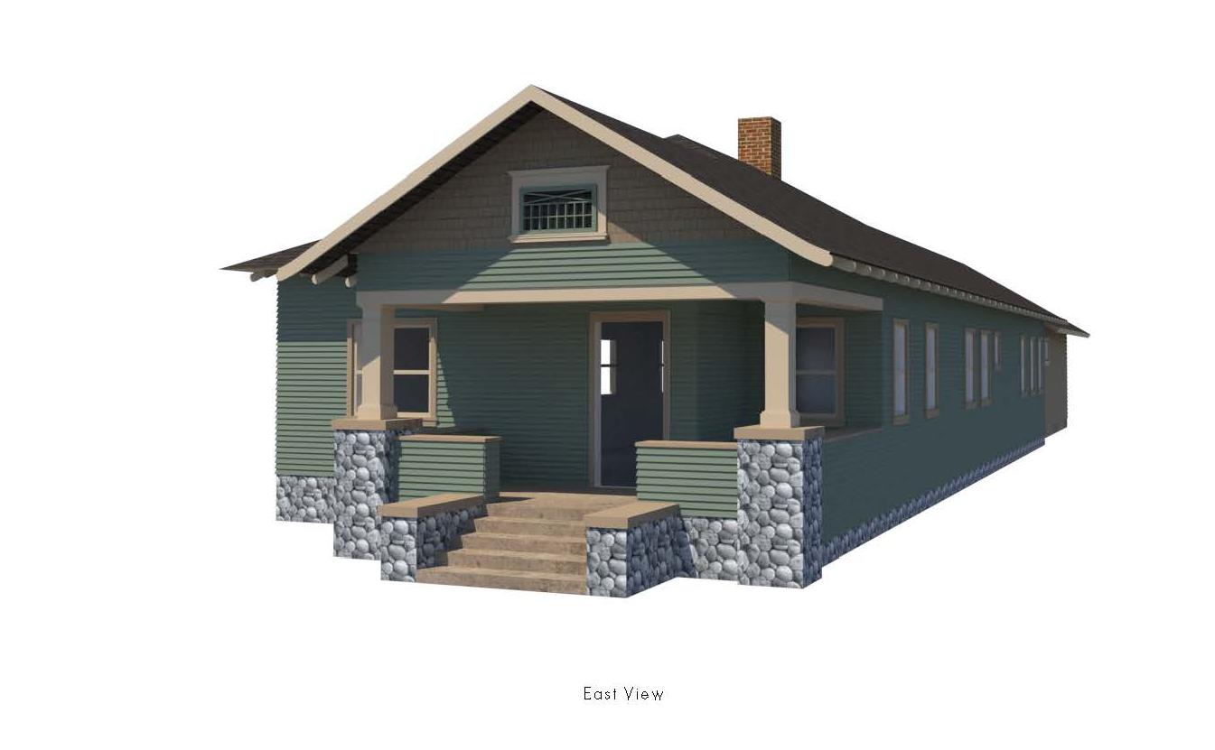
Front Elevation (East)

Slide 6
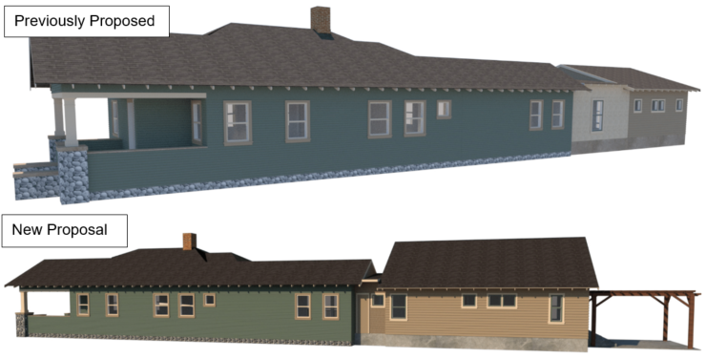
Side Elevation (North)

Slide 7
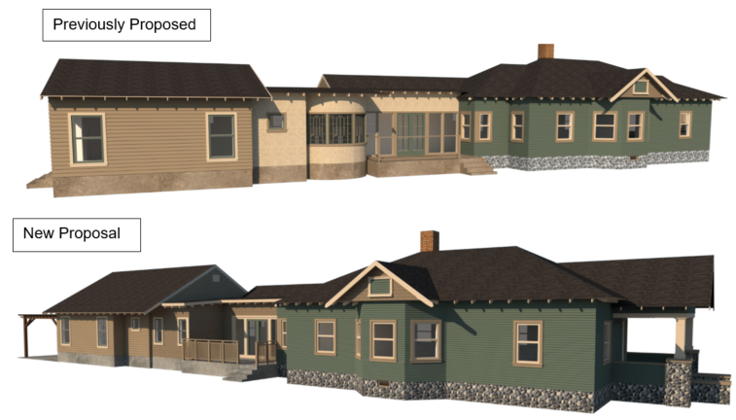
Side Elevation (South)

Slide 8
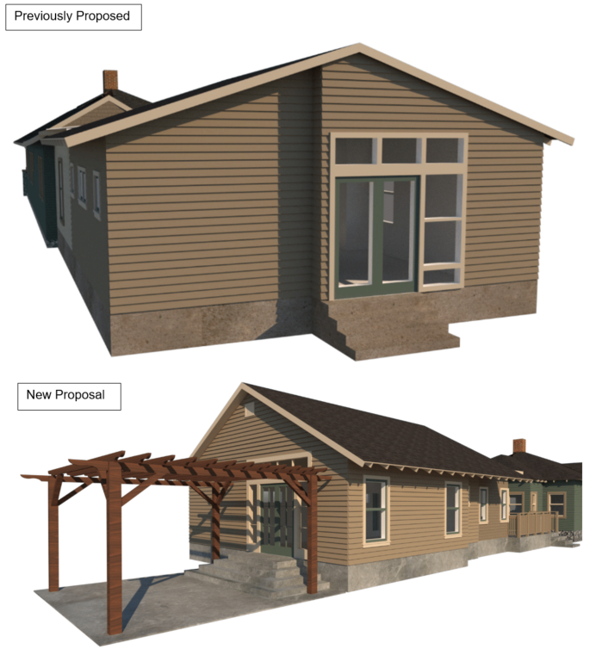
Rear Elevation (West)

Slide 9
Staff Recommendation:
Approve the Certificate of Appropriateness and Administrative Use Permit, subject to conditions of approval.

Slide 10
Questions?

