Slide 1


Slide 2
    PROJECT DESCRIPTION
    Proposal: The applicant is requesting CHC concurrence on a historic resource evaluation and determination of ineligibility for their residence and garage at 1502 Bank Street.

Slide 3
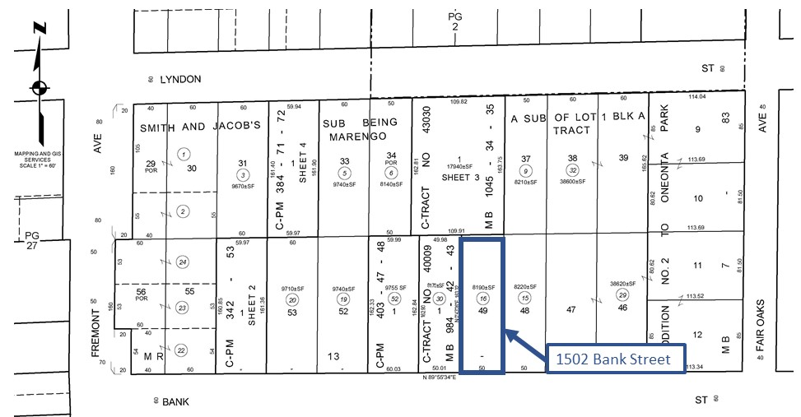
N

Slide 4
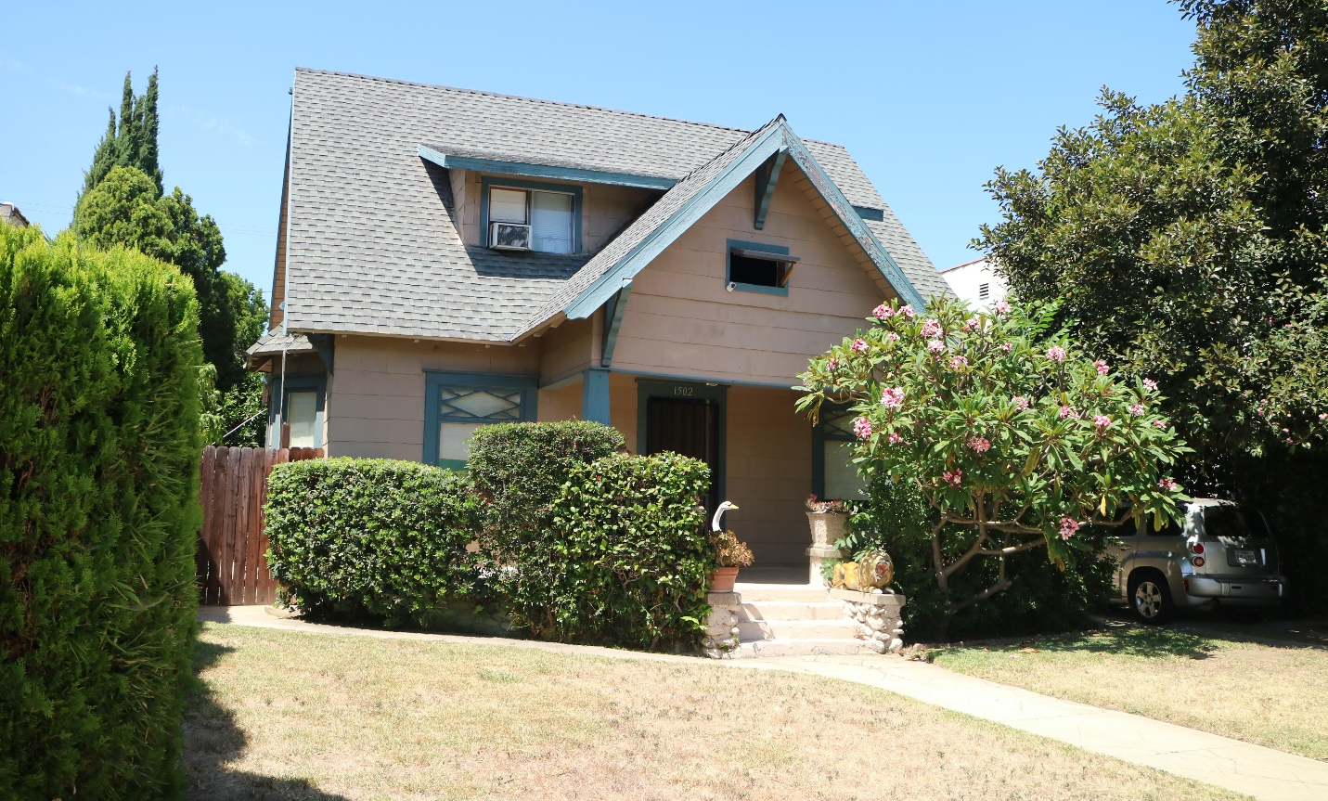

Slide 5
CEQA: Categorical Exemption –
Section 15301 Class 1 Existing Facilities
Section 15303 Class 3 New Construction or Conversion of Small Structures

Slide 6
STAFF RECOMMENDATION:
Cultural Heritage Commission make a determination that the property does not meet the national, state, or local criteria for historic designation and the project may proceed through the city’s application process without any further restrictions under the Cultural Heritage Ordinance for the demolition of the 1,442 square-foot single-family home and 240-square-foot garage located at 1502 Bank Street.

Slide 7
CULTURAL HERITAGE COMMISSION OPTIONS:
Determine that the property does not meet the national, state, or local criteria for historic designation and the project may proceed through the city’s application process without any further restrictions under the Cultural Heritage Ordinance.
Continue public hearing.
Determine the property does meet the national, state, or local criteria for historic designation and the project may proceed through the restrictions under the Cultural Heritage Ordinance.

Slide 8
Questions?

