Slide 1
Notes:
Hello, this presentation is for 807 Bank Street.

Slide 2
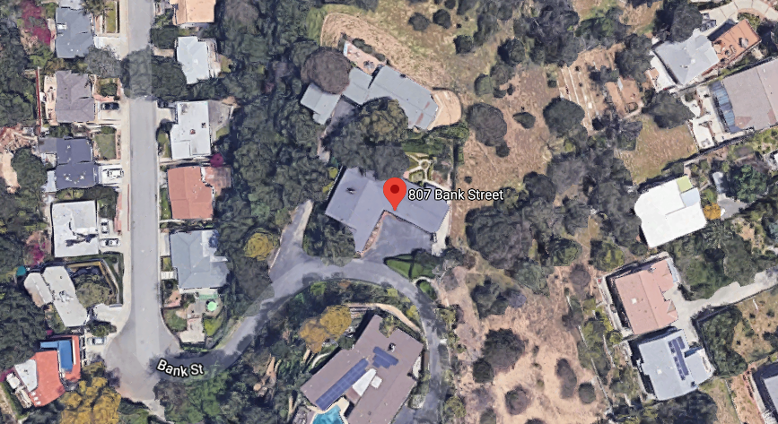
PROJECT
Request for Landmark Historic Designation located at 807 Bank Street
Notes:
The property owner is requesting consideration for Landmark Historic Designation. The is an Ariel image of the home located on a hillside. Meridian Avenue is located on the east side of the property.

Slide 3
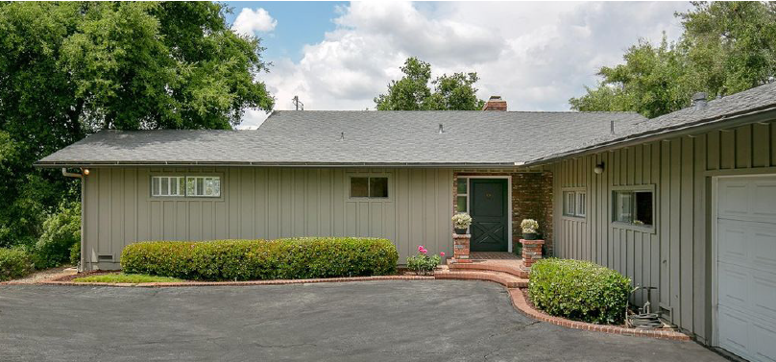
Built in 1959 – Modern Ranch Home
Notes:
The home was built in 1959 The architectural style of the home is Modern Ranch and was designed by Theodore Pletsch.

Slide 4
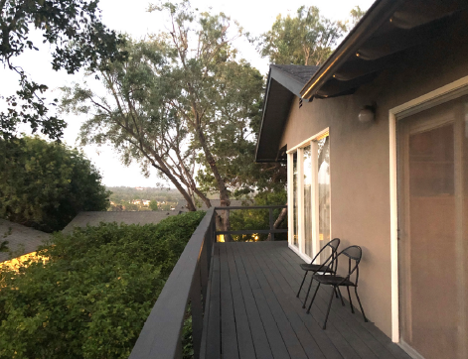
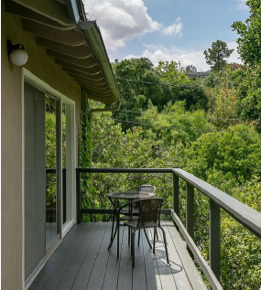
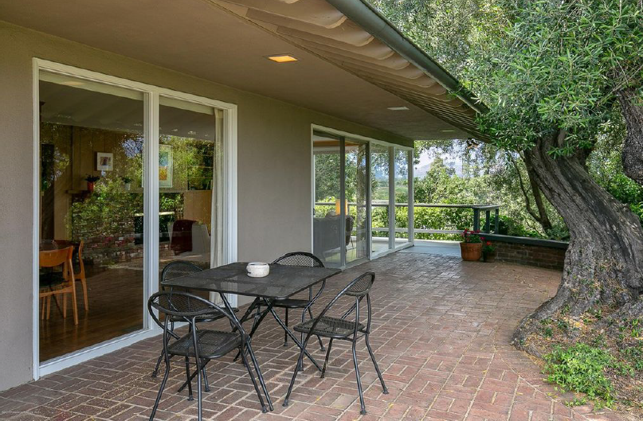
Notes:
The home’s plan is a rotated “L” and faces to the south and west. The front of the home is dominantly designed with vertical boards and battens, horizontal windows, two on each face which recede from view under extended eaves. The main entry has laid out brick in semi-circles to be used as a landing with decorative brick pedestals. Other elevations are finished with stucco and defining features include a deep roof overhang, wood deck, and full height window wall

Slide 5
Staff Recommendation:
It is recommended that the Cultural Heritage Commission appoint a subcommittee to review a request for a Landmark Historic Designation.

Slide 6
Questions?

