Slide 1
Notes:
Good Evening this presentation is for 1016 Orange Grove Avenue , which the property owner is requesting consideration for a Landmark historic designation and a Mills Act Contract.

Slide 2
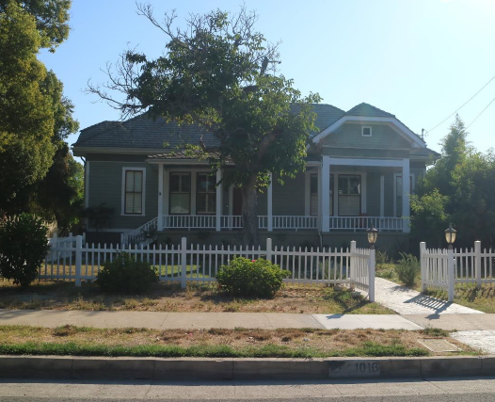
PROJECT
Landmark Designation and Mills Act Contract Request for property located at 1016 Orange Grove Avenue.
Built in 1885 – Orange Grove Schoolhouse
Notes:
“Orange Grove Schoolhouse” was built in 1885 and was used as one of South Pasadena’s earliest public schoolhouses from 1885-1918. The architectural style is Transitional Late Victorian-Craftsman

Slide 3
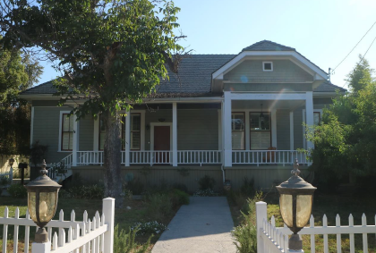
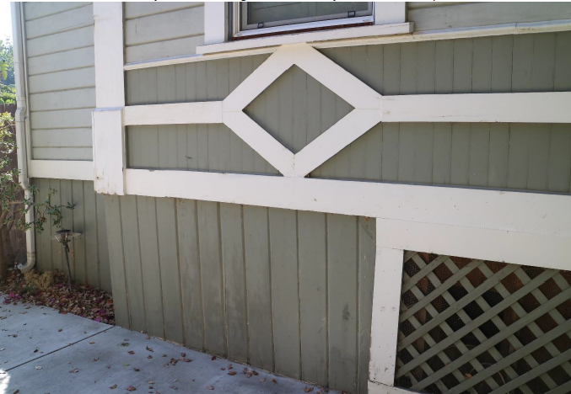
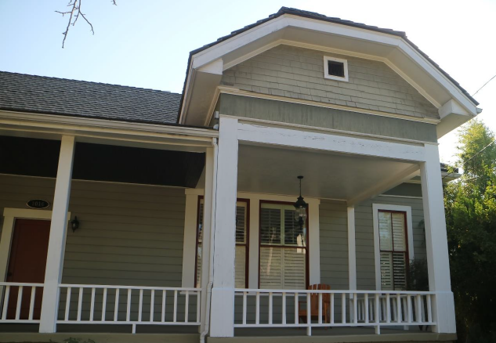
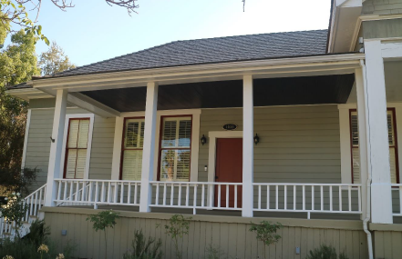
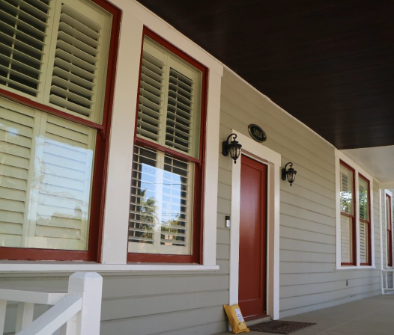
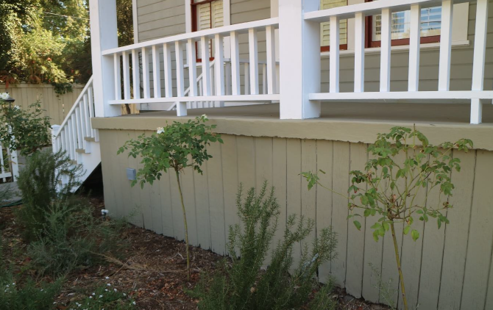
Notes:
Some of the character defining features of the home include :
• roof characteristics are (hipped roof with clipped gable ends, medium/high-pitched eaves, shallow boxed eaves)
•Elevated, partial-length porch with simple wood posts, vertical, wood-plank ceiling, and low wood railing
•Sheathing materials such as wood shiplap siding
The letter of intention for Mills Act indicates damages to some of those features that need to be repaired or restored. Some items include retrofitting the foundation, repair exterior siding, replacement and repairs of windows and repair or replacement of the roof beam.

Slide 4
Recommendation: Staff recommends that the Commission appoint a subcommittee to review both of these requests in further detail before the property owner formally applies for the Historic Landmark Designation and Mills Act.
Notes:
Staff recommends that the Commission appoint a subcommittee to review both of these requests in further detail before the property owner formally applies for the Historic Landmark Designation and Mills Act.

Slide 5
Thank you

