Slide 1
Notes:
Good Evening this presentation is for 1016 Orange Grove Avenue , which the property owner is requesting consideration for a Landmark historic designation and a Mills Act Contract.

Slide 2
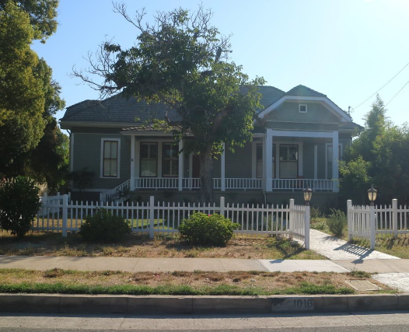
PROJECT
Historic Landmark Designation and Mills Act Contract Request for property located at 1016 Orange Grove Avenue.
Built in 1885 – Orange Grove Schoolhouse
Notes:
“Orange Grove Schoolhouse” was built in 1885 and was used as one of South Pasadena’s earliest public schoolhouses from 1885-1918. The architectural style is Transitional Late Victorian-Craftsman

Slide 3
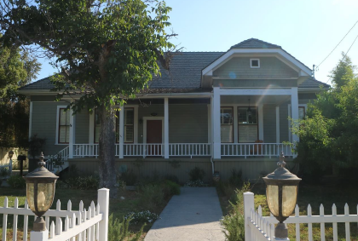
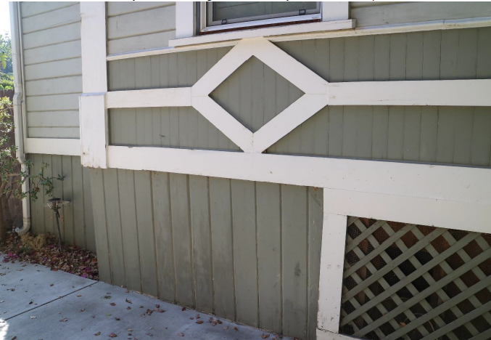
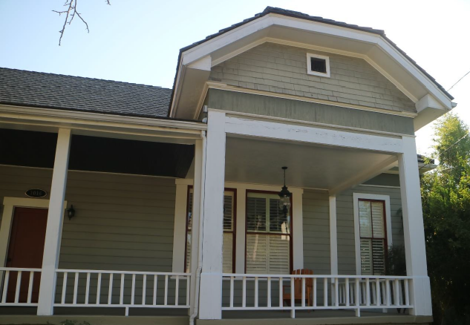
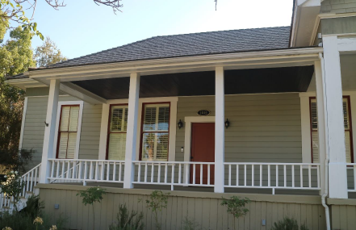
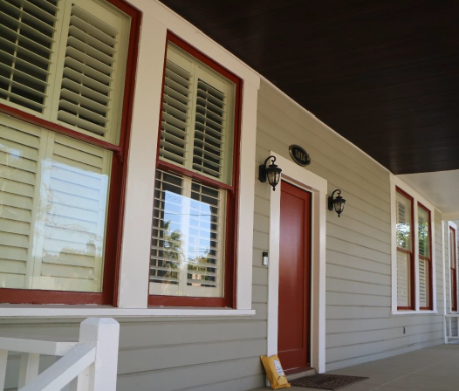
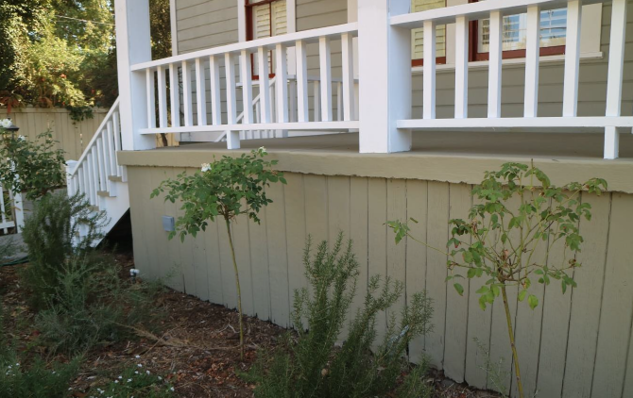
Notes:
Some of the character defining features of the home include :
• roof characteristics are (hipped roof with clipped gable ends, medium/high-pitched eaves, shallow boxed eaves)
•Elevated, partial-length porch with simple wood posts, vertical, wood-plank ceiling, and low wood railing
•Sheathing materials such as wood shiplap siding

Slide 4
Criteria for Historic Designation
Its character, interest or value as a part of the heritage of the community;
Its location as a site of a significant historic event;
Its identification (such as the residence, ownership, or place of occupation, etc.) with a person, persons or groups who significantly contributed to the culture and development of the city, state or United States;
Its exem/plification of a particular architectural style of an era of history of the city;
Its exemplification of the best remaining architectural type in a neighborhood;
Its identification as the work of a person or persons whose work has influenced the heritage of the city, the state or the United States;
Its embodiment of elements of outstanding attention to architectural design, engineering, detail design, detail, materials or craftsmanship;
It is either a part of or related to a square, park or other distinctive area which should be developed or preserved according to a plan based on a historic cultural or architectural motif;
Its unique location or singular physical characteristic representing an established and familiar visual feature of a neighborhood;
Its potential for yielding information of archaeological interest; or
In designating a historic district, its significance as a distinguishable neighborhood or area whose components may lack individual distinction.
Notes:
Purusant to the South Pasadena Municipal Code (SPMC) Section 2.63(b), the Commission shall use any or all of the following criteria in making a recommendation to the City Council for designation of Historic Landmark. The Subcommittee report states that the project qualifies for designation under criteria (1)

Slide 5
Criteria for Mills Act Contract
Financial investment. Tax benefit would not exceed applicant’s proposed financial investment
Public Benefit. Work plan will provide a benefit to the public (rehabilitation for continued occupancy or reuse, systems and structural reinforcement upgrades, preserving, maintaining, restoring character-defining features)
Retroactive Limitation. Tax benefit will not be used for work that was previously completed or initiated
Limitation on Maintenance. Tax benefit will not be used for routine maintenance work
Limitations on Interior Work. Tax benefit will not be used for interior work unless it is necessary for structural integrity, preservation, maintenance, restoration of character-defining features.
Limitations on Landscaping. Tax benefit will not be used for landscape unless for specific landscape features

Slide 6
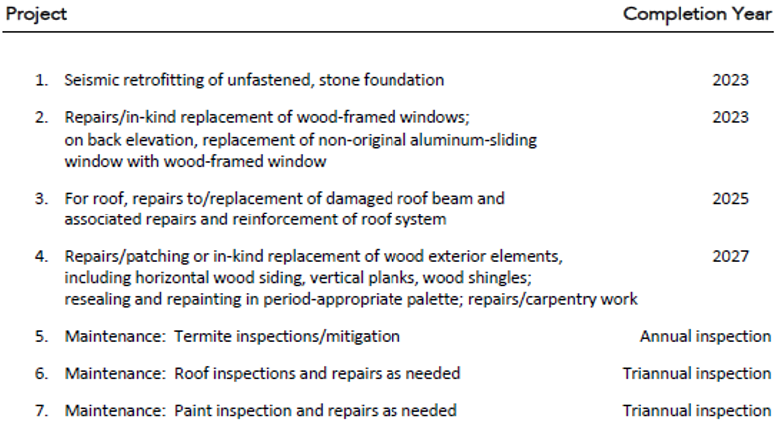
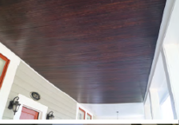
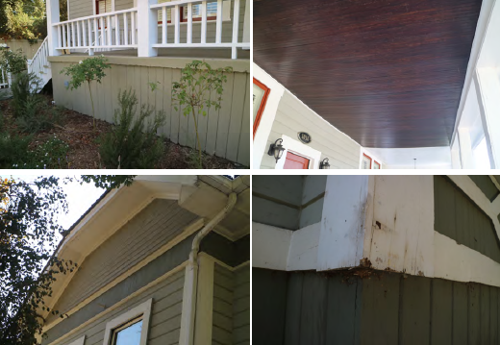
Notes:
The applicant has provided information regarding the condition of the historic property and the proposed rehabilitation and maintenance work plan. The following is a list of restoration items including seismic retrofitting, window and wood/beam repairs.
The total cost of the proposed scope of work is $210,000. The total tax savings for the owners is estimated at $126,000. The financial analysis for the project is included in the rehabilitation and restoration plans and maintenance program.

Slide 7
Recommendation: Cultural Heritage Commission to review and recommend Historic Landmark Designation and Mills Act Contract for 1016 Orange Grove to the City Council.

Slide 8
Thank you

