Slide 1

Notes:
k
Hello, this presentation is for 1506 Rollin Street, for recommendation of a Mills Act Contract.

Slide 2
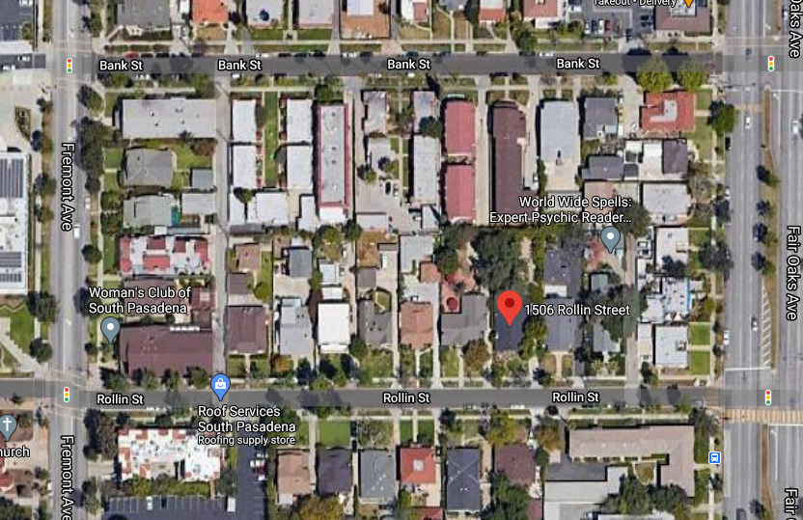
    PROJECT
    Mills Act Contract for 1506 Rollin Street
    Contributor to Rollin Craftsman district
Notes:
k
1506 Rollin Street is a contributing property to historic the Rollin Craftsman Cluster District.

Slide 3
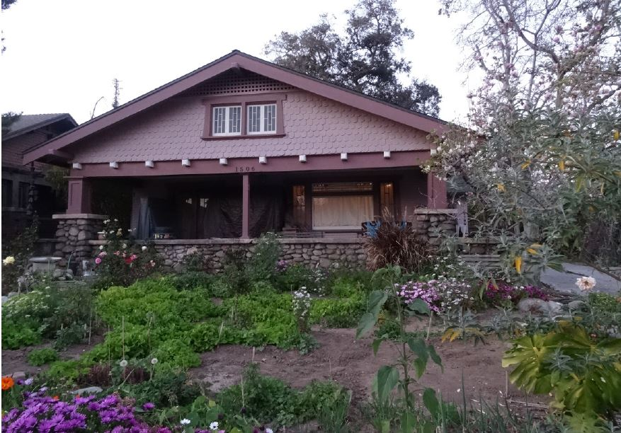
Built in 1914 – Craftsman Style Home
Notes:
k
This property was built in 1914 and the architectural style of the home is Craftsman.

Slide 4
Criteria for Mills Act Contract
Financial investment. Tax benefit would not exceed applicant’s proposed financial investment
Public Benefit. Work plan will provide a benefit to the public (rehabilitation for continued occupancy or reuse, systems and structural reinforcement upgrades, preserving, maintaining, restoring character-defining features)
Retroactive Limitation. Tax benefit will not be used for work that was previously completed or initiated
Limitation on Maintenance. Tax benefit will not be used for routine maintenance work
Limitations on Interior Work. Tax benefit will not be used for interior work unless it is necessary for structural integrity, preservation, maintenance, restoration of character-defining features.
Limitations on Landscaping. Tax benefit will not be used for landscape unless for specific landscape features
Notes:
k

Slide 5
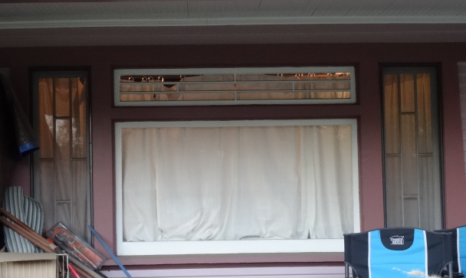
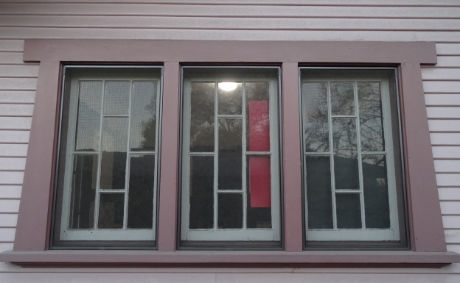
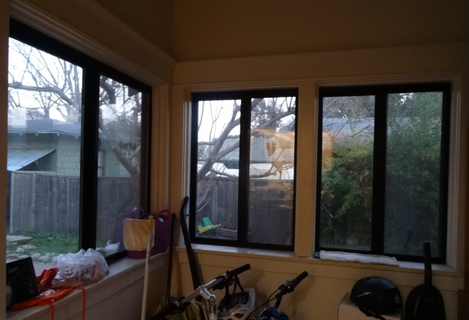
Work Plan 2021:
Restore original wood windows and French doors ($7,800)
Replace non-original sliding aluminum windows on the east side of the house with wood windows identical to the original ($ 8,500)
Notes:
k

Slide 6
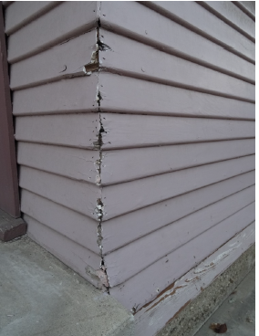
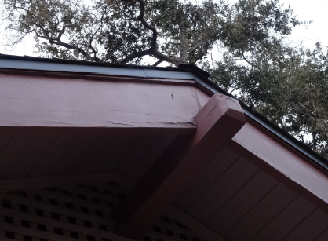
Work Plan 2022:
Restore damaged wood siding and repaint the house ($19,300)
Work Plan 2023:
Repair the roof frame including a spit rafter ($4,500)

Slide 7
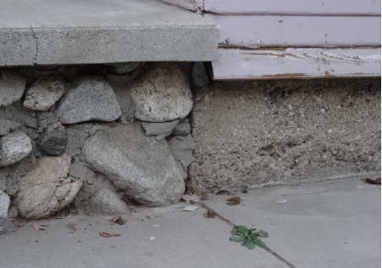
Work Plan 2024:
• Reinforce foundation, including bolting the walls per state requirement, and excavating the 18” crawlspace to provide access to plumbing ($13,800)

Slide 8
Work Plan 2025:
Repair cracks in the concrete porch and stone porch wall ($39,100)
Repair damaged driveway ($7,900)
Notes:
These images illustrate the current state of the property. The
Top Left image shows deteriorating front gable fascia and wood siding
Top Right picture indicates damaged stone and concrete foundation.
Bottom left picture Original wood windows to be repaired as needed
And lastly bottom right picture shows 8 Non-original aluminum windows to be replaced.

Slide 9
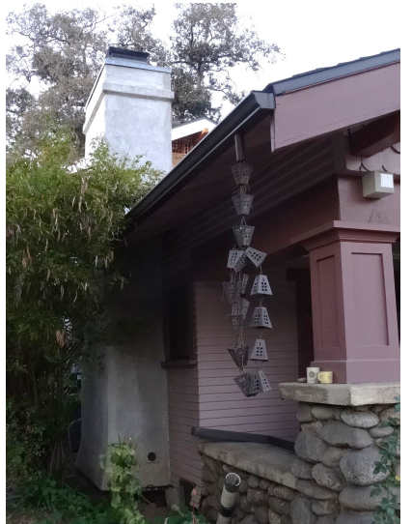
Work Plan 2026:
Inspect chimney, repair cracks or restore to the original appearance if possible ($250, inspection) ($28,000 restoration, not included in overall scope of work)
Notes:
These images illustrate the current state of the property. The
Top Left image shows deteriorating front gable fascia and wood siding
Top Right picture indicates damaged stone and concrete foundation.
Bottom left picture Original wood windows to be repaired as needed
And lastly bottom right picture shows 8 Non-original aluminum windows to be replaced.

Slide 10
Work Plan 2027:
Preserve interior wood trim and paneling – ($3,800) Does not qualify for Mills Act Contract, the cost has been deducted from overall scope of work
Work Plan 2028:
Replace outdated plumbing and electricity ($16,200)
Annually:
Maintenance work, such as yearly inspection of wood structure for termites and treatment if necessary . Does not qualify for Mills Act Contract, the cost has been deducted from overall scope of work. ($150, inspection; $6,000 fumigation treatment)

Slide 11
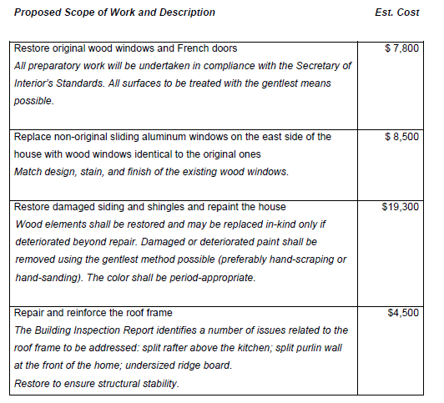
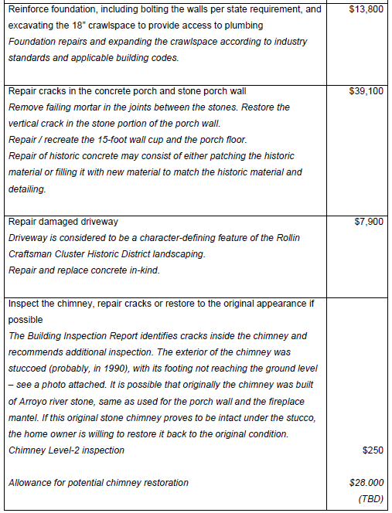
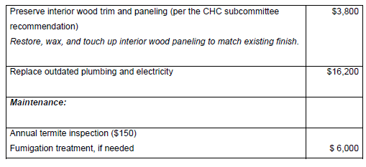

Slide 12
Recommendation: Staff recommends the applicant re-evaluate their financial analysis and work plan

Slide 13
Questions?

