Slide 1
Notes:
Good evening commissioners, I will be giving an overview of project No. 2296-COA for a Certificate of Appropriateness. The project representative is Patrick Szurpicki.

Slide 2
Project Description
Proposal: Demolition of 295 square feet to the rear of existing house and demolition of a 274 sq. ft. garage; a single-story addition of approx. 1,080 square feet and construction of a new 400 square foot detached carport
CEQA: Categorical Exemption –
Section 15301 Class 1 Existing Facilities
Section 15331 Class 31 Historical Resource Restoration/Rehabilitation

Slide 3
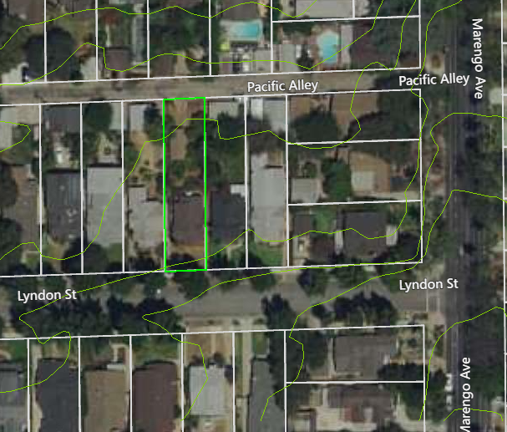
N
Notes:
The home is located in the Marengo School Craftsman District The project site is a rectangular lot that is surrounded by single-family homes; an alley runs behind the property
Marengo avenue is located to the east and Pacific alley is located towards the north.

Slide 4
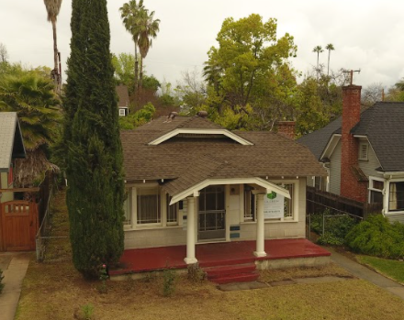
Notes:
Here is a photograph of the existing home. The existing historic structure is an 890 square-foot, single-story bungalow. built in 1922. in a Craftsman Bungalow style.

Slide 5
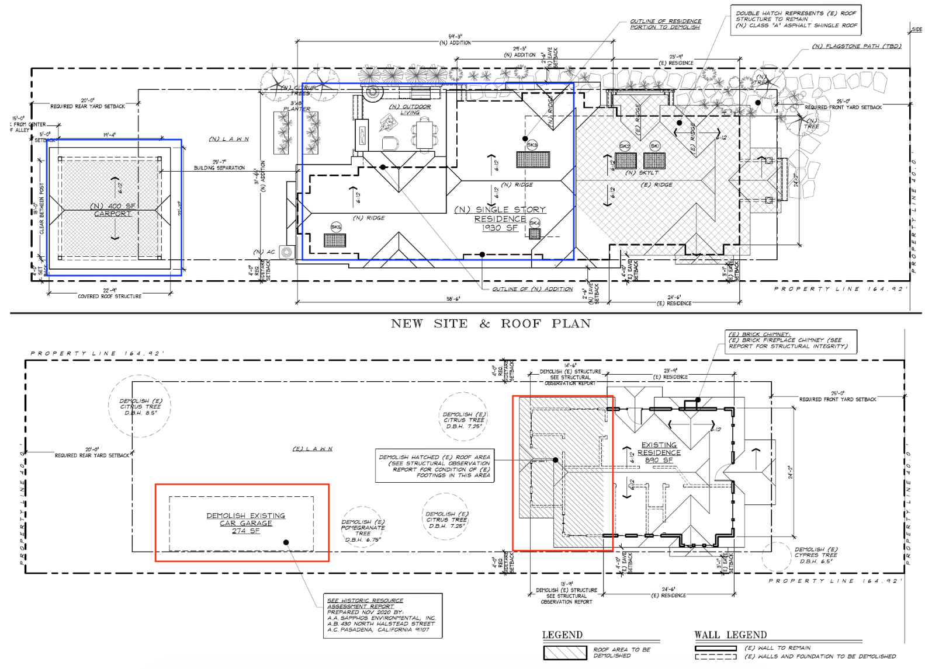
Proposed & Existing Site Plans
N
Notes:
Here is an image of the existing and proposed site plan for the project; the red boxes are the proposed areas to be demolished and the blue boxes are the proposed additions

Slide 6
Proposed & Existing Roof Plans
N
Notes:
Here is an image of the existing and proposed roof plan for the project; the red box is the proposed area to be demolished and the blue box is the proposed addition
The proposed single-story addition to the rear of the home would include hip roofs, and will be partially visible from the street. The new roof will follow the same pitch as the existing roof
Asphalt shingles will match existing roof and new eaves will be identical to the existing.

Slide 7
Existing & Proposed South Elevations (Front)
Existing
Proposed
Notes:
These are the existing and proposed south elevations - the front of the home. The existing height of the home is 14’-4” and proposed height is approx. 16’9”. Applicant is proposing to restore and rebuild the front porch and chimney due to structural integrity issues. All existing windows, which are not structurally damaged will be retained and preserved.

Slide 8
Existing & Proposed West Elevation (Side)
Existing
Proposed
Notes:
Here we have an image of the west elevation. The siding on the new addition will have a 6-inch spacing compared to the 3-inch spacing of the historic structure. The new roof will have the same pitch and clipped gables as the historic roof.

Slide 9
Existing & Proposed North Elevation (rear)
Notes:
Here is the north elevation, which is the rear of the home. An outside patio proposed. New shingle detail will differentiate the addition from historic structure.

Slide 10
Existing & Proposed East Elevation (Side)
Notes:
Here we have the east elevation. Due to structural damage the chimney will be restored and rebuilt. The proposed project will use restored original beveled redwood siding for the addition and will remove all existing siding panels to reveal original beveled redwood siding.

Slide 11
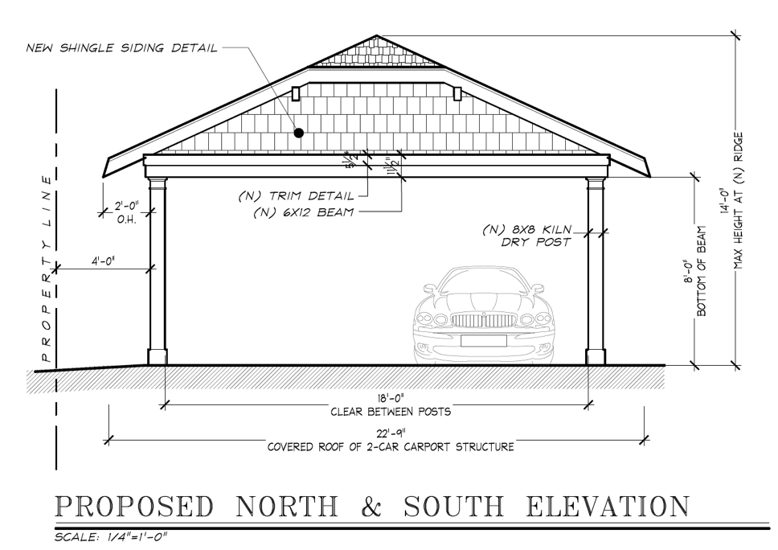
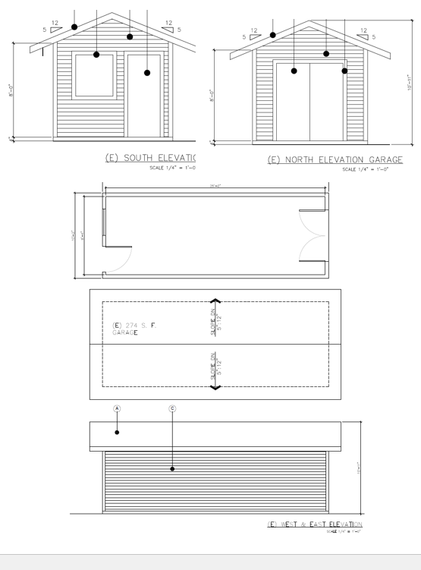
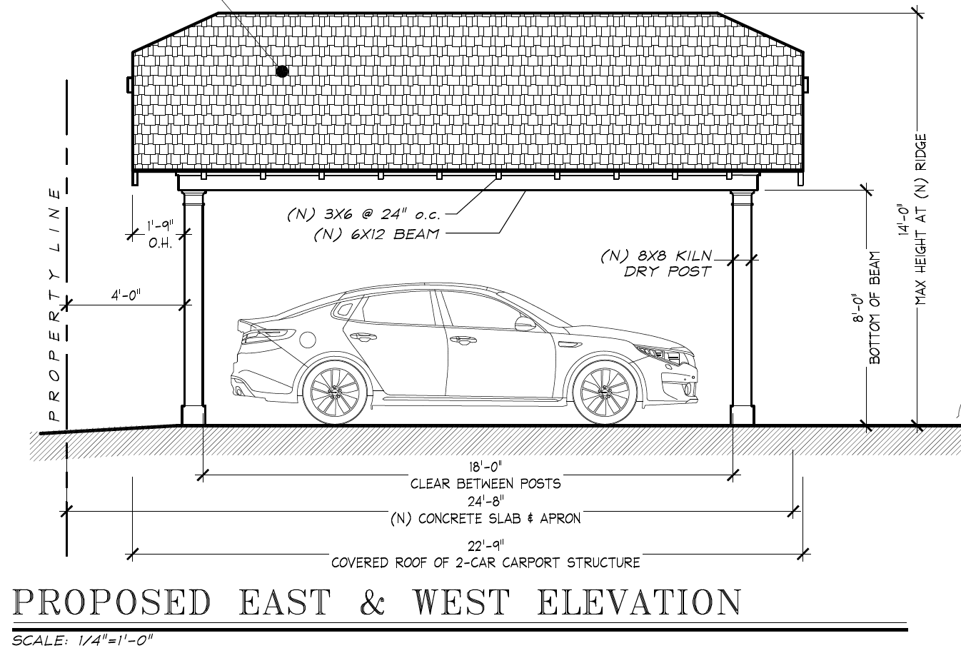
Garage & Carport
Notes:
The existing detached 274 square-foot garage is proposed to be demolished. An additional covered parking space is required for the proposed project to be in compliance with existing zoning code requirements.
An Historic Resources Evaluation was completed which found that the detached garage at the rear of the property is not a significant character-defining feature of the residence.
A new 400 square-foot carport is proposed; it will provide two-covered parking spaces. The proposed carport will match the style of the existing home and will consist of wooden posts with the roof matching the material, color, and slope of the home

Slide 12
Conditions of Approval
A revised development plans set shall be submitted for approval by the Chair of the Cultural Heritage Commission:
If chimney restoration is required the restoration shall follow the Secretary of Interior Standards for Rehabilitation. Additionally, the existing bricks will be reused or if not possible, they shall match the existing bricks. The chimney restoration will match the original details of corbel.
The restoration of the front and side porch shall follow the Secretary of Interior Standards for Rehabilitation. New concrete porches at front and side of house shall have radiused edges and hand tooled joints to match existing. Saw cut joints will not acceptable. This does not necessarily apply to new deck at rear of house.
If lateral bracing at new carport will be visible from outside, please submit design for chair review prior to building permit.
The wood siding on the addition in the rear shall have a 6-inch exposure compared to the 3-inch exposure seen on the historic structure.
Notes:
Staff has added the following condition of approval…

Slide 13
Staff Recommendation:
Staff recommends that the Cultural Heritage Commission approve the Certificate of Appropriateness for the proposed single-story addition of approximately 1,080 square feet for 1716 Lyndon Street, subject to conditions of approval.

Slide 14
Cultural Heritage Commission Options:
Approve the project.
Continue the public hearing and direct the applicant to make revisions.
Deny the project.

Slide 15
Questions?
Notes:
This concludes staff presentation.

