Slide 1
Notes:
Hello, this presentation is for 1506 Rollin Street, for recommendation of a Mills Act Contract.

Slide 2
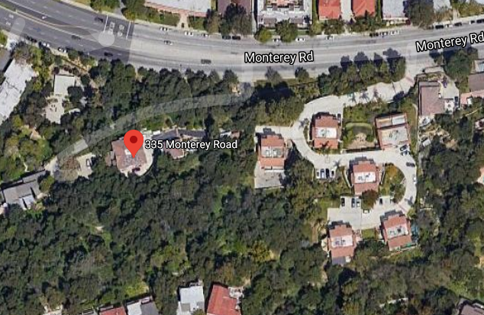
PROJECT
Mills Act Contract for 335 Monterey Road
Landmark No. 47 - Burwood House
Notes:
1506 Rollin Street is a contributing property to historic the Rollin Craftsman Cluster District.

Slide 3
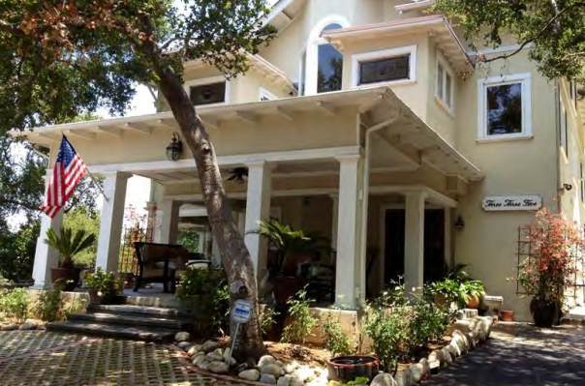
Built in 1908 – Craftsman Style Home with Greek Revival Influences
Notes:
This property was built in 1914 and the architectural style of the home is Craftsman.

Slide 4
Criteria for Mills Act Contract
Financial investment. Tax benefit would not exceed applicant’s proposed financial investment
Public Benefit. Work plan will provide a benefit to the public (rehabilitation for continued occupancy or reuse, systems and structural reinforcement upgrades, preserving, maintaining, restoring character-defining features)
Retroactive Limitation. Tax benefit will not be used for work that was previously completed or initiated
Limitation on Maintenance. Tax benefit will not be used for routine maintenance work
Limitations on Interior Work. Tax benefit will not be used for interior work unless it is necessary for structural integrity, preservation, maintenance, restoration of character-defining features.
Limitations on Landscaping. Tax benefit will not be used for landscape unless for specific landscape features

Slide 5
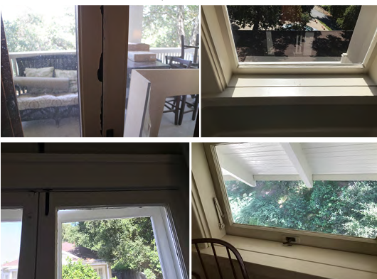
Work Plan 2023:
• Windows rehabilitation/repairs, all elevations: glazing, wood-frames, surrounds and sills ($65,000)

Slide 6
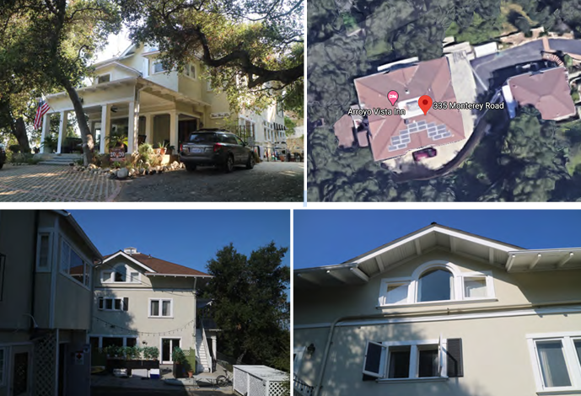
Work Plan 2025:
• Residence roof: re-roofing to include removal of sheathing; repairs as needed to roof system structure; re-sheathing of roof with composition shingles; repairs and carpentry to address failing/detreated wood rafters, fascia, and framing ($85,000)

Slide 7
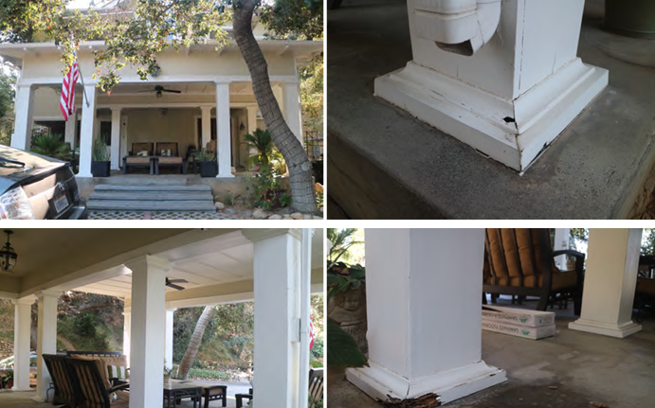
Work Plan 2025:
• Main entrance porch: repairs/reinforcement of porch supports ($35,000)

Slide 8
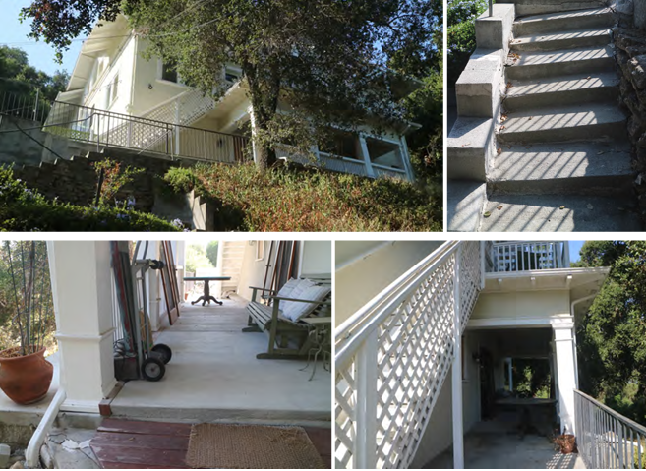
Work Plan 2028:
Site: Geological study identify plan for site remediation/stabilization ($35,000)..

Slide 9
Biannual Maintenance:
• Termite inspection/mitigation. Does not qualify for the Mills Act Contract, the cost has not been included in overall scope of work.
Triannual Maintenance:
• Roof inspection and repairs as needed. The cost has not been included in overall scope of work.
• Paint inspection and repairs as needed. The cost has not been included in overall scope of work.

Slide 10
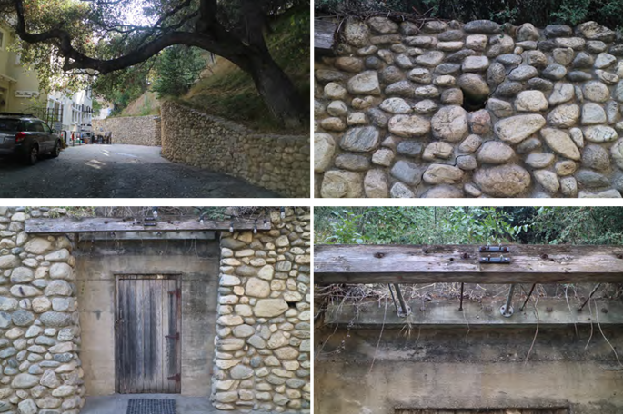
Optional:
• Optional- site: repairs/reinforcement of arroyo stone wall and wine cellar ($45,000). The cost has not been included in overall scope of work.

Slide 11
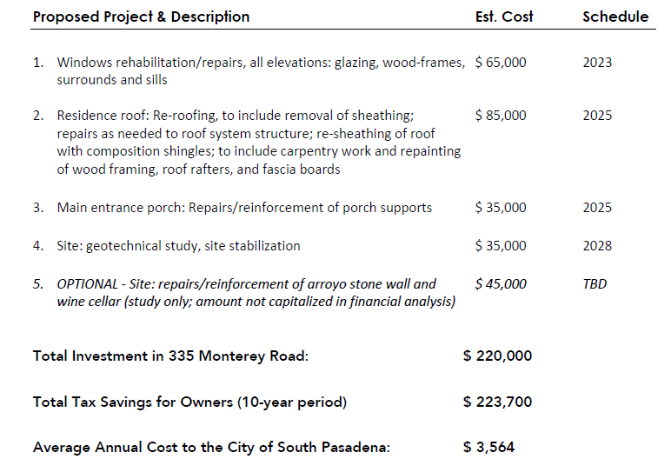
Notes:
The total cost of the proposed scope of work is $220,000. The total tax savings for the owners is estimated at $223,700. The financial analysis for the project is included in the rehabilitation and restoration plans and the maintenance program.

Slide 12
Recommendation: Staff recommends the applicant re-evaluate their financial analysis and work plan.

Slide 13
Questions?

