Slide 1
Notes:
Hello, this presentation is for 704 Meridian Avenue , which the property owner is requesting consideration for a Mills Act Contract.

Slide 2
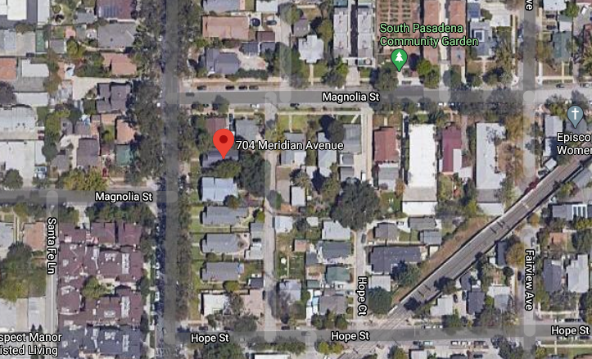
PROJECT
Mills Act Contract for 704 Meridian Avenue
Contributor to North of Mission District
Notes:
704 Meridian Avenue Rollin Street is a contributing property to historic the North of Mission Street.

Slide 3
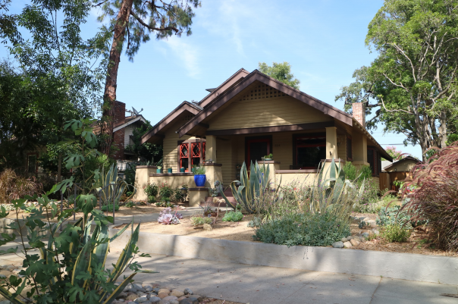
Built in 1912 – Craftsman Style Home
Notes:
This property was built in 1914 and the architectural style of the home is Craftsman.

Slide 4
Criteria for Mills Act Contract
Financial investment. Tax benefit would not exceed applicant’s proposed financial investment
Public Benefit. Work plan will provide a benefit to the public (rehabilitation for continued occupancy or reuse, systems and structural reinforcement upgrades, preserving, maintaining, restoring character-defining features)
Retroactive Limitation. Tax benefit will not be used for work that was previously completed or initiated
Limitation on Maintenance. Tax benefit will not be used for routine maintenance work
Limitations on Interior Work. Tax benefit will not be used for interior work unless it is necessary for structural integrity, preservation, maintenance, restoration of character-defining features.
Limitations on Landscaping. Tax benefit will not be used for landscape unless for specific landscape features

Slide 5
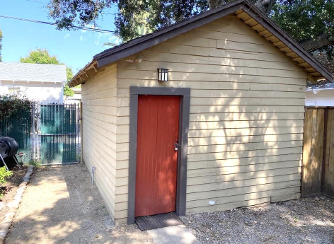
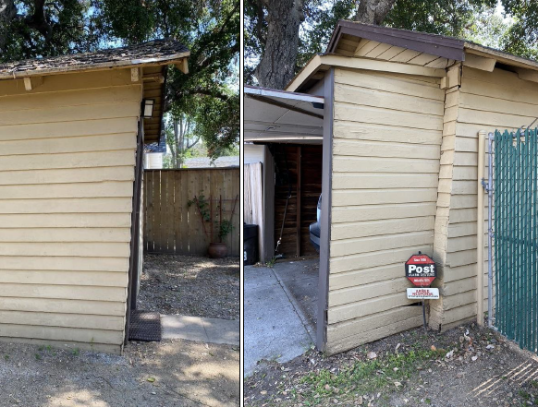
Work Plan 2022:
Garage: Structural retro-fitting, repair of wood framing, sheathing removal and re-sheathing of roof, and repainting ($25,000)

Slide 6
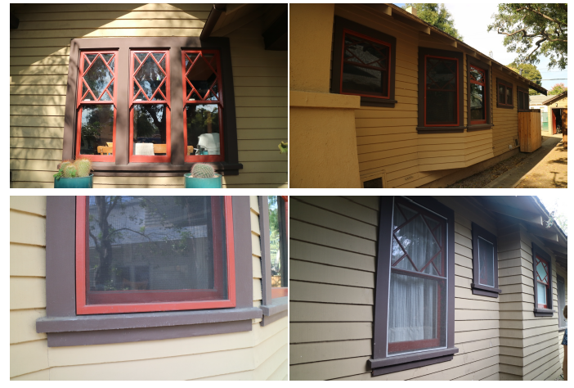
Work Plan 2023
Window repair and repainting ($25,000)
Work Plan 2024
Replace window screens on north elevation ($5,000)
Notes:
These images illustrate the current state of the property. The
Top Left image shows deteriorating front gable fascia and wood siding
Top Right picture indicates damaged stone and concrete foundation.
Bottom left picture Original wood windows to be repaired as needed
And lastly bottom right picture shows 8 Non-original aluminum windows to be replaced.

Slide 7
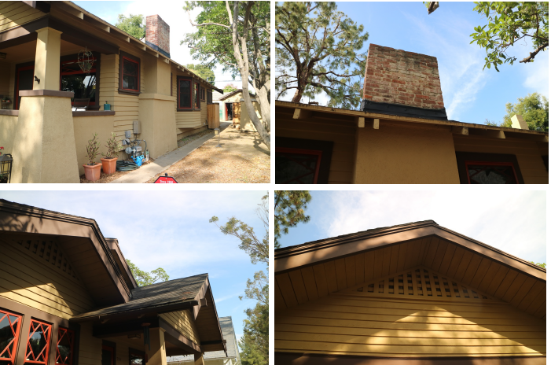
Work Plan 2025:
Re-roof residence with installation of plywood decking and uninstall/reinstall solar panels ($35,000)
Reinforce and repair brick chimney ($5,000)
Notes:
These images illustrate the current state of the property. The
Top Left image shows deteriorating front gable fascia and wood siding
Top Right picture indicates damaged stone and concrete foundation.
Bottom left picture Original wood windows to be repaired as needed
And lastly bottom right picture shows 8 Non-original aluminum windows to be replaced.

Slide 8
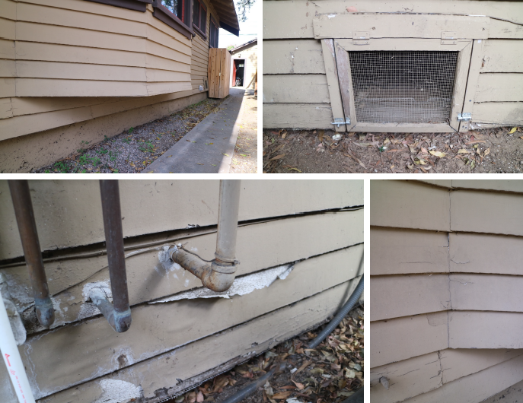
Work Plan 2028:
Exterior of the house: Repair/patch damaged/deteriorated wood siding, reseal and repaint, repair and repainting of wood sheathing ($40,000)
Notes:
These images illustrate the current state of the property. The
Top Left image shows deteriorating front gable fascia and wood siding
Top Right picture indicates damaged stone and concrete foundation.
Bottom left picture Original wood windows to be repaired as needed
And lastly bottom right picture shows 8 Non-original aluminum windows to be replaced.

Slide 9
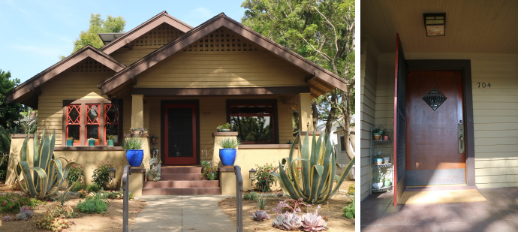
Work Plan 2029:
Repair hardware and clean leaded glass window at the front door ($10,000)
Notes:
These images illustrate the current state of the property. The
Top Left image shows deteriorating front gable fascia and wood siding
Top Right picture indicates damaged stone and concrete foundation.
Bottom left picture Original wood windows to be repaired as needed
And lastly bottom right picture shows 8 Non-original aluminum windows to be replaced.

Slide 10
Biannual Maintenance:
Termite inspection/mitigation. Does not qualify for the Mills Act Contract, the cost has not been included in overall scope of work.
Triannual Maintenance:
Roof inspection and repairs as needed. The cost has not been included in overall scope of work.
Paint inspection and repairs as needed. The cost has not been included in overall scope of work
Notes:
These images illustrate the current state of the property. The
Top Left image shows deteriorating front gable fascia and wood siding
Top Right picture indicates damaged stone and concrete foundation.
Bottom left picture Original wood windows to be repaired as needed
And lastly bottom right picture shows 8 Non-original aluminum windows to be replaced.

Slide 11
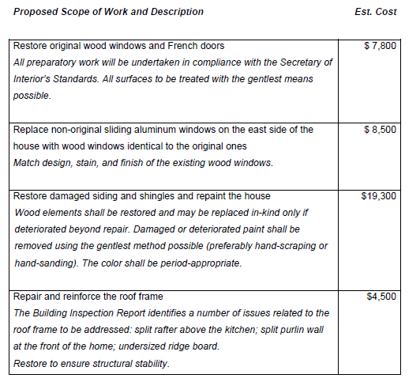
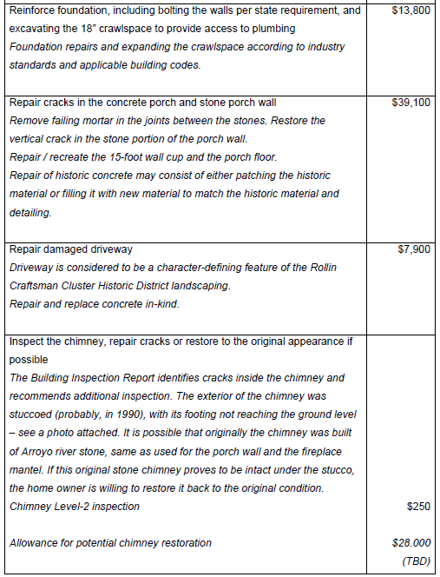
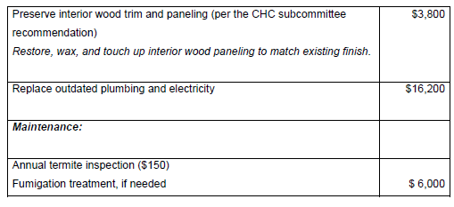
Notes:
These images illustrate the current state of the property. The
Top Left image shows deteriorating front gable fascia and wood siding
Top Right picture indicates damaged stone and concrete foundation.
Bottom left picture Original wood windows to be repaired as needed
And lastly bottom right picture shows 8 Non-original aluminum windows to be replaced.

Slide 12
Recommendation: Approve of the Mills Act Contract to City Council.
Alternatives:
Recommend approval with condition(s).
Recommend denial.
Notes:
The Commission to appoint a subcommittee to review this request in further detail before the homeowners prepare the plan and program for rehabilitation maintenance of the property.
Try reading this.

Slide 13
Questions?

