Slide 2
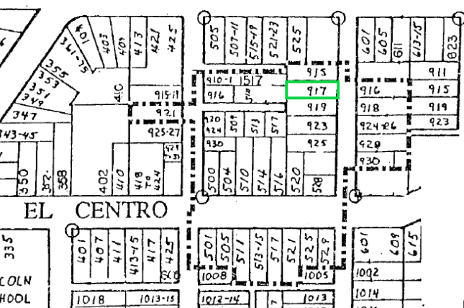
PROJECT
Mills Act Contract Request for 917 Palm Avenue
Part of a historic district within the city, El Centro/Indiana/Palm Historic District.

Slide 3
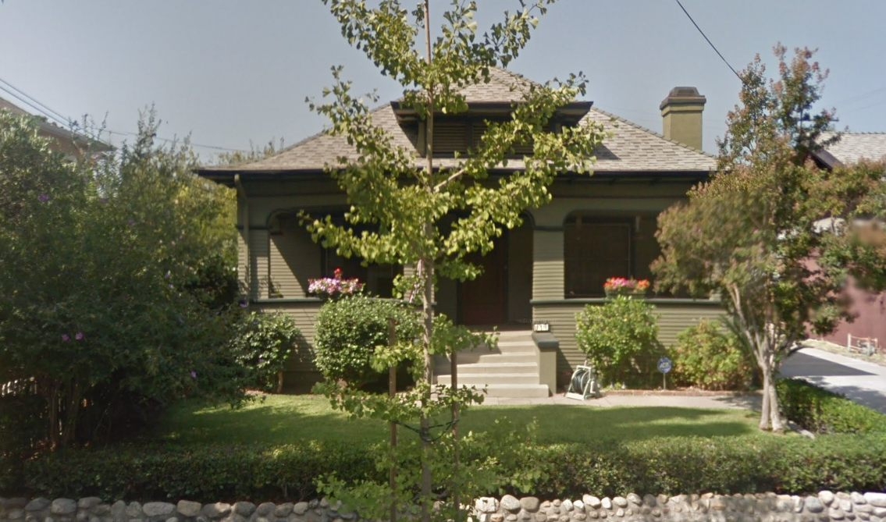

Slide 4
Staff Recommendation:
The Commission to appoint a subcommittee to review this request in further detail before the homeowners prepare the plan and program for rehabilitation maintenance of the property.

Slide 5
Thank you

