Slide 1


Slide 2
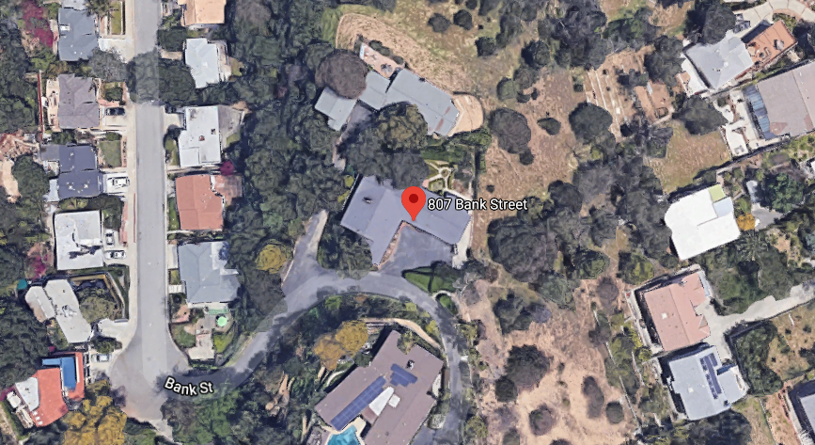
    PROJECT
    Mills Act Contract Request for 807 Bank Street
    The property will qualify for the Mills Act incentive program if the landmark designation request is approved by City Council on April 7, 2021.

Slide 3
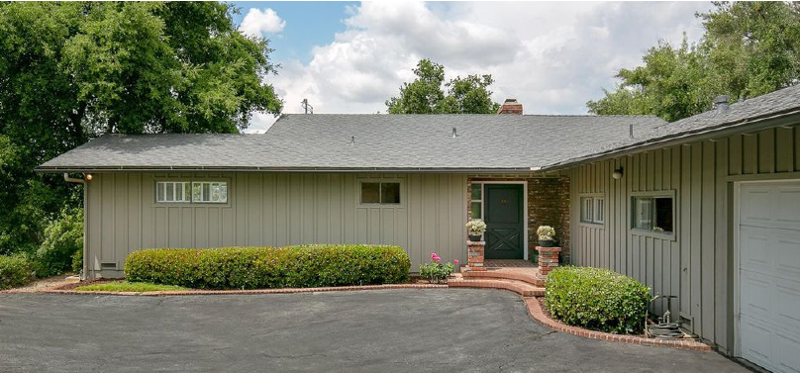
Notes:
The home, was built in 1959 and was designed by Theodore Pletsch and it’s are architectural style is modern ranch home

Slide 4
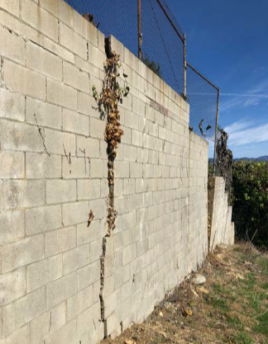
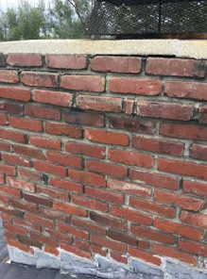
Notes:
Some of the proposed repairs included in the Letter of Intent include
Roof replacement
Window replacement
Wood and batten maintenance
Retaining wall replacement
Brick Seating wall stabilization
Original light fixture rehabilitation/re-installation

Slide 5
Staff Recommendation:
Staff recommends that the Commission appoint the subcommittee used for Landmark Historic Designation for said property, composed of Commissioners William Cross and Kristin Morrish to review this request in further detail before the homeowners prepare rehabilitation and restoration plans and maintenance program.

Slide 6
Thank you

