Slide 1
Notes:
Good Evening this presentation is for 1601 Marengo Avenue

Slide 2
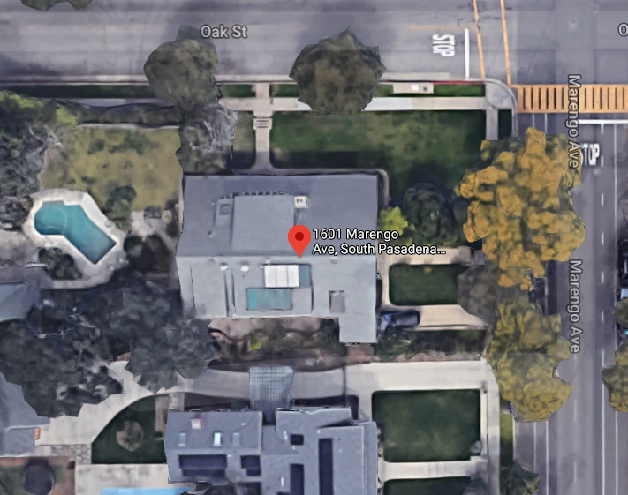
PROJECT
Request for Historic Landmark Designation located at 1601 Marengo Avenue
Notes:
The property owner is requesting consideration for a historic Landmark designation located at 1601 Marengo Avenue
Here in ariel image of the home
Oak Street is Located to the north
Marengo Avenue is located on the east

Slide 3
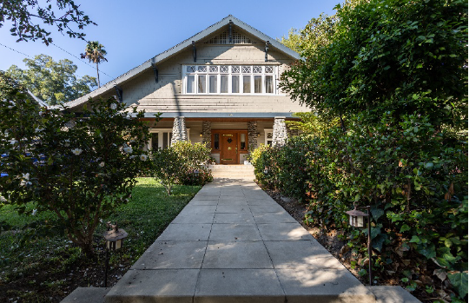
Notes:
The home was built in 1907 The architectural style of the home is Craftsman

Slide 4
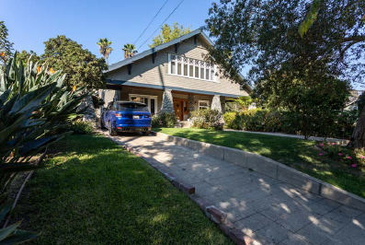
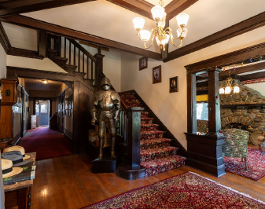
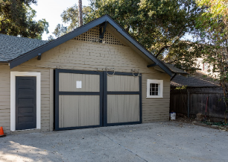
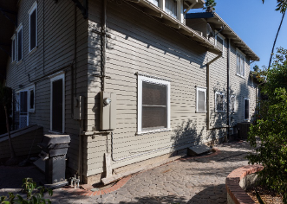
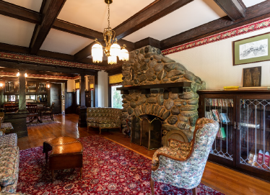
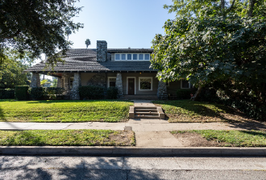
Notes:
In accordance with the report, some of the primary character defined features found in the home are:
• • Front gable roof with composition shingle roofing
• Exterior arroyo stone chimney
• Latticed attic vents
• Heavy, battered porch piers of arroyo stone with concrete caps

Slide 5
Staff Recommendation:
It is recommended that the Cultural Heritage Commission appoint a subcommittee to review a request for a Historic Landmark Designation.

Slide 6
Thank you

