Slide 2
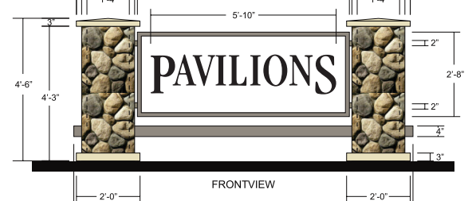
PROJECT DESCRIPTION
Three (3) new wall signs facing Fair Oaks Avenue
One(1) new wall sign facing Monterrey Avenue
Reface existing monument sign and repaint to match building.

Slide 3
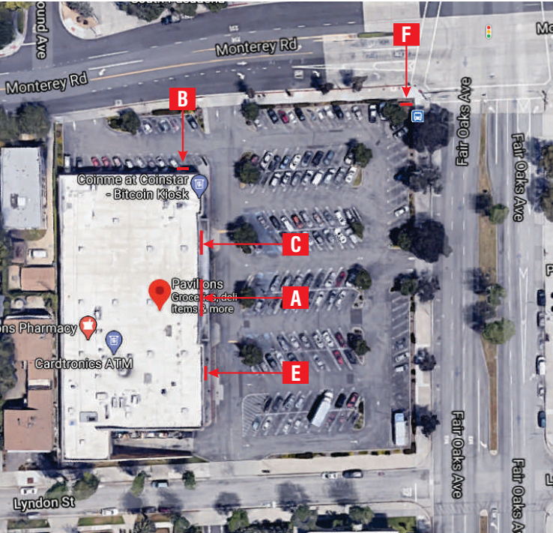
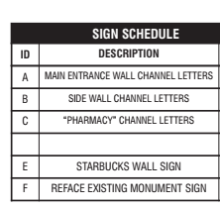
N

Slide 4
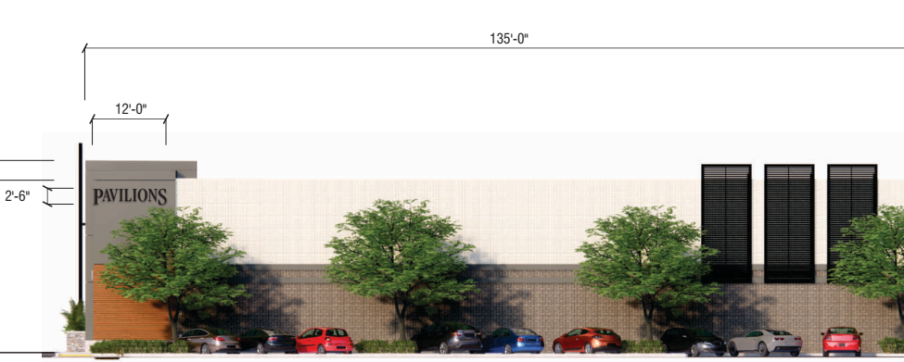
Previous Sign Plans

Slide 5
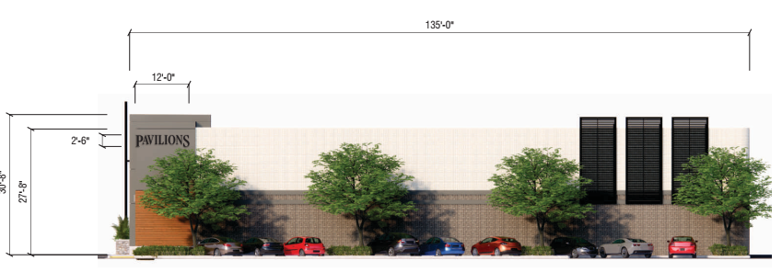
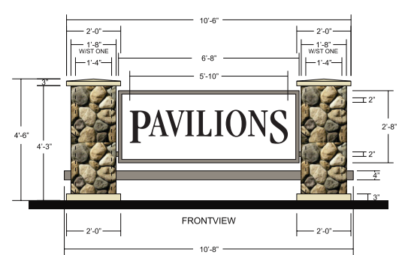
Maximum Sign Area Allowed
200 sq. ft.
17.7 sq. ft.
30 sq. ft.
1 sf for each linear foot of primary frontage plus 0.5 sf for each foot of one additional secondary frontage
The total area of all signs on a single building frontage shall not exceed the total linear feet in that frontage.
No more than 200 sf is allowed for each use.

Slide 6
Maximum Number of Signs Allowed
Single tenant site: 3 of any combination of allowed sign types per primary building frontage. 1 of any allowed sign type per secondary frontage.

Slide 7
Wall Signage

Slide 8
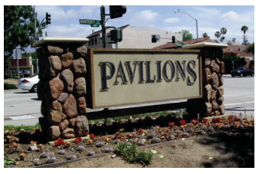
Signage: Existing and Proposed Refacing

Slide 9
Existing Wall Signs

Slide 10
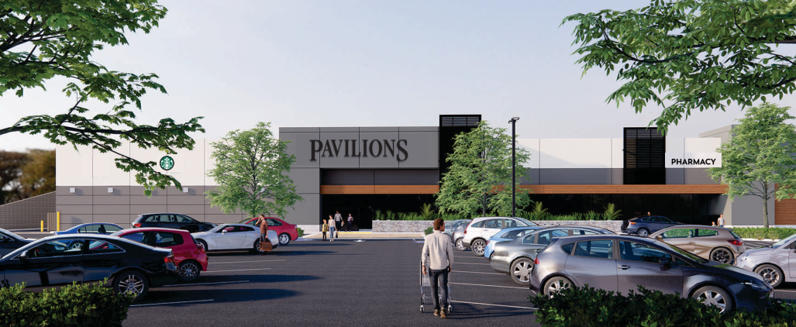
Signage

Slide 11
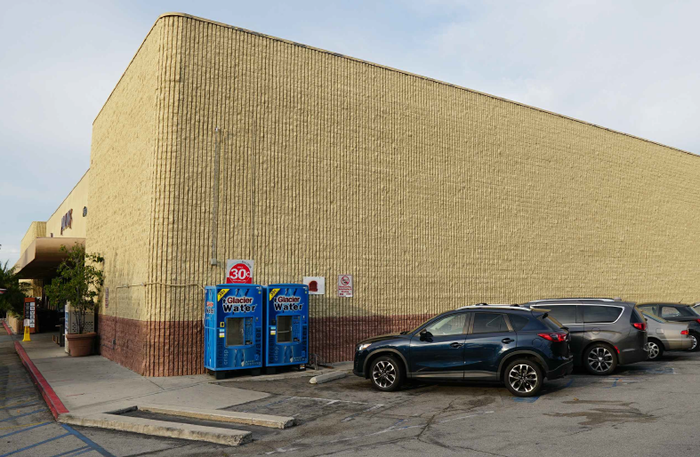
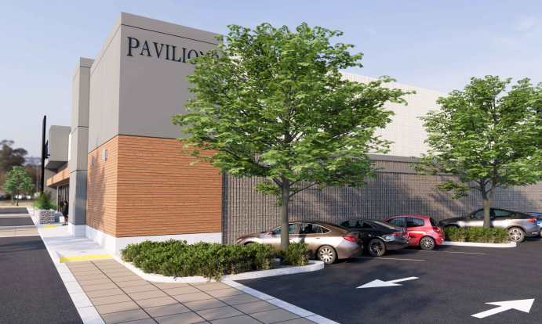
Existing vs. New North Elevation Sign

Slide 12
STAFF RECOMMENDATION:
Approve the project subject to conditions - including reduction in total sign area by 47.7 square feet with the review and approval by the DRB Chair.

Slide 13
Design Review Board Options:
Approve with condition(s) added;
Continue the project to address comments discussed; or
Deny the project.

Slide 14
Questions?

