Slide 2
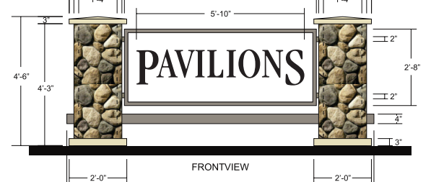
PROJECT DESCRIPTION
Three (3) new wall signs facing Fair Oaks Avenue
One(1) new wall sign facing Monterrey Avenue
Reface existing monument sign and repaint to match building.

Slide 3
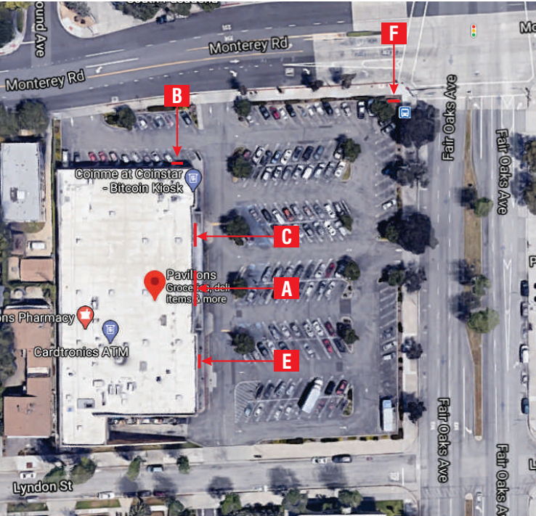
N

Slide 4
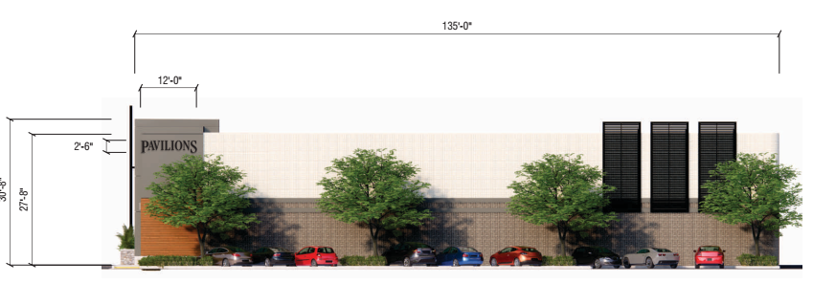
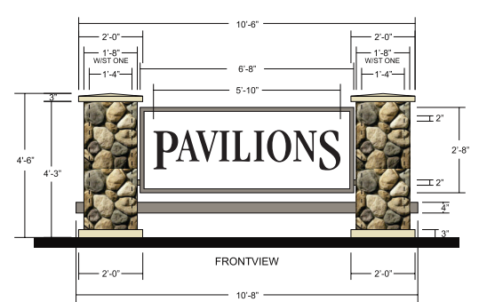
Sign Area Interpretation
200 sq. ft.
+17.7 sq. ft.?
+30 sq. ft.?
Sign Ordinance “use” Interpretation meeting
No more than 200 sf is allowed for each use?
Each use would be separate tenants, not individually licensed product/business within

Slide 5
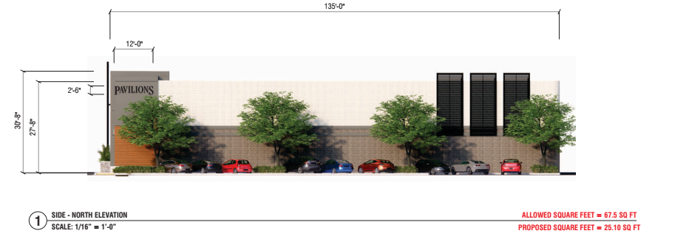
Reduced Sign Size

Slide 6
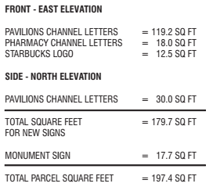
Reduced Sign Size

Slide 7
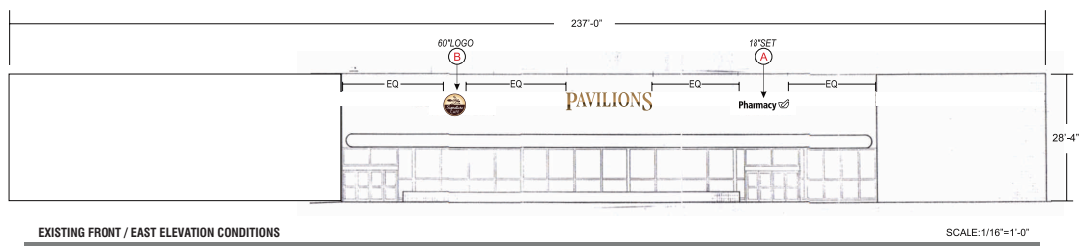
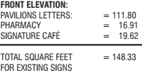
Existing Sign

Slide 8
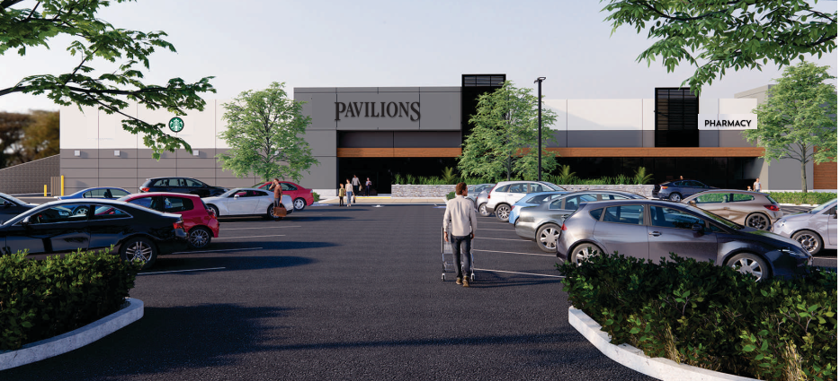
Reduced Sign Size

Slide 9
Overlay Comparison

Slide 10
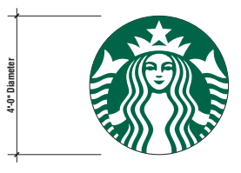
Wall Signage

Slide 11
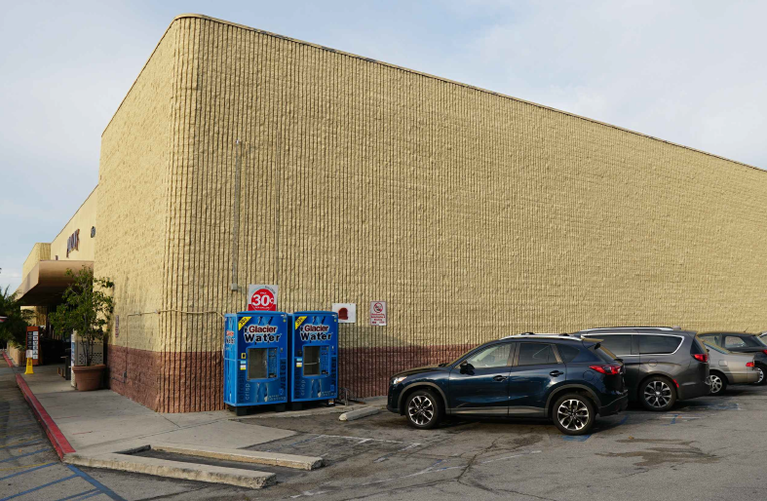
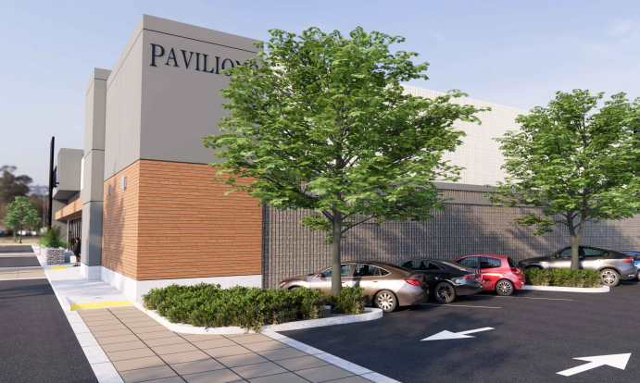
Existing vs. New North Elevation Sign

Slide 12
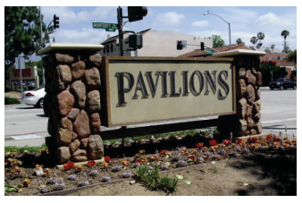
Signage: Existing and Proposed Refacing

Slide 13
STAFF RECOMMENDATION:
Approve the Reduced Sign Plan subject to conditions .

Slide 14
Design Review Board Options:
Approve with condition(s) added;
Continue the project to address comments discussed; or
Deny the project.

Slide 15
Questions?

