Slide 2
PROJECT DESCRIPTION
Proposal: Design Review for the remodel of an existing 33,355 square-foot grocery store. No new square footage proposed.
Includes: modification of the front and side exterior building elevations, repainting, upgrading accessible path to the public right-of-way, lighting, bicycle parking, new planters and trees, and updating signage.

Slide 3
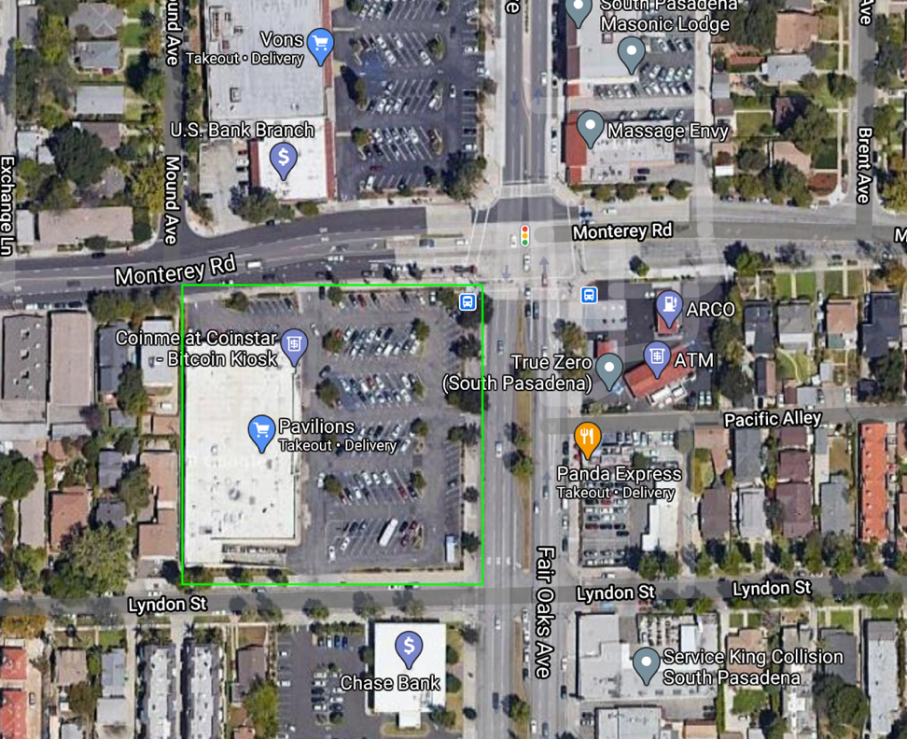
N

Slide 4
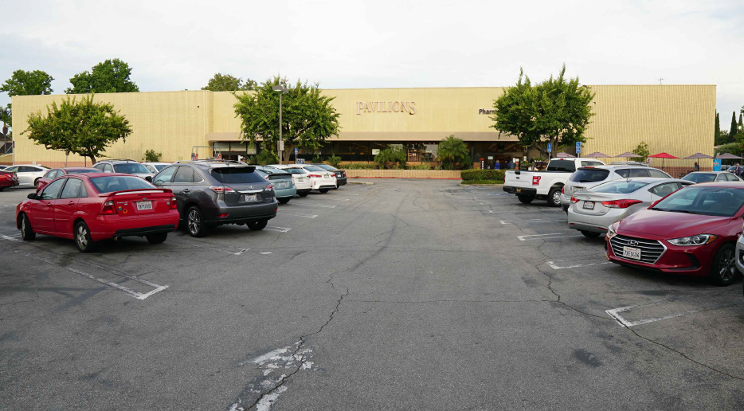
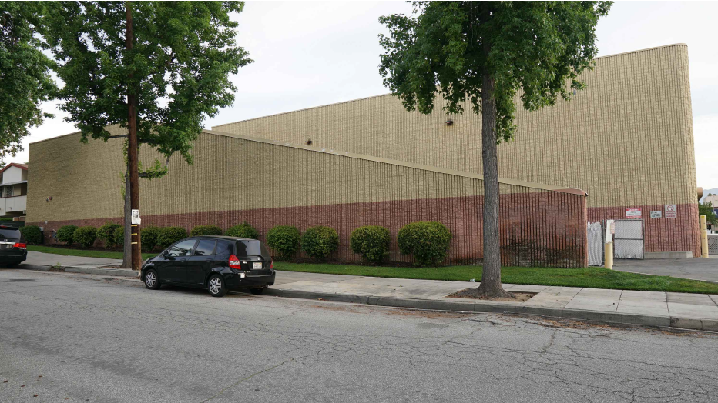
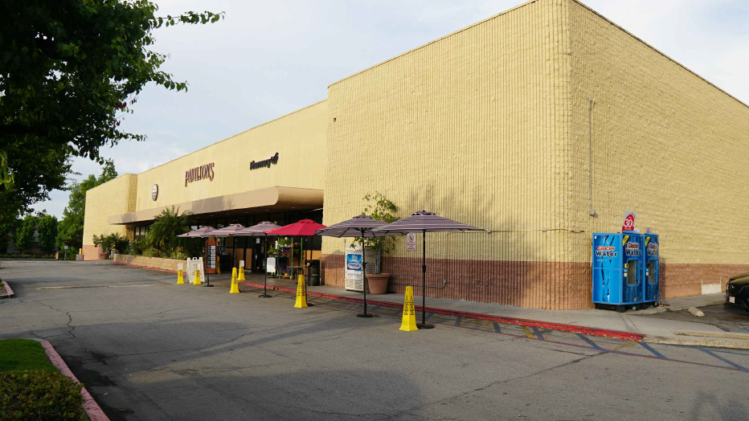
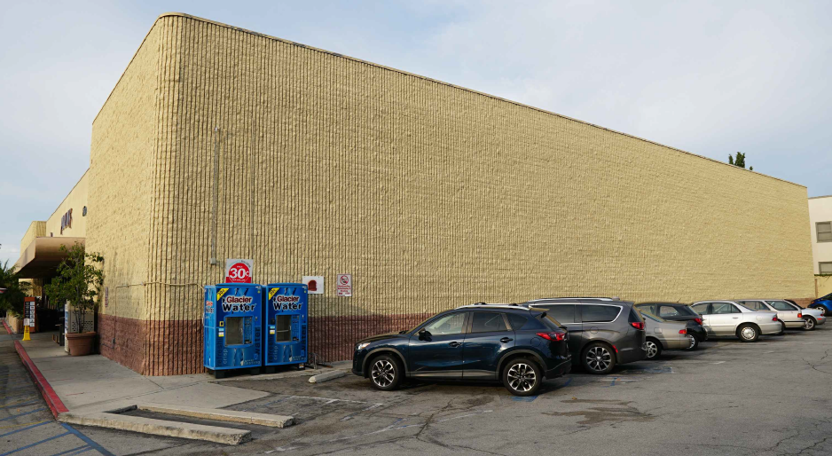
Front (facing Fair Oaks Avenue)
South side (facing Lyndon Street)
Front of store
North side (facing Monterey Road)

Slide 5
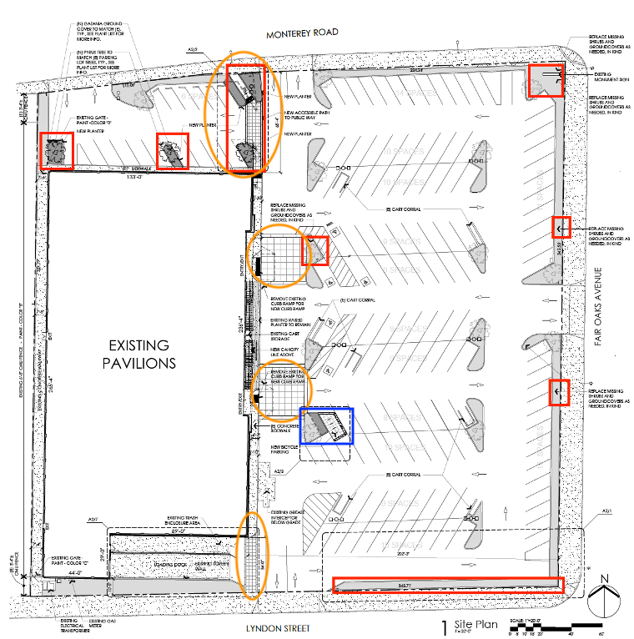
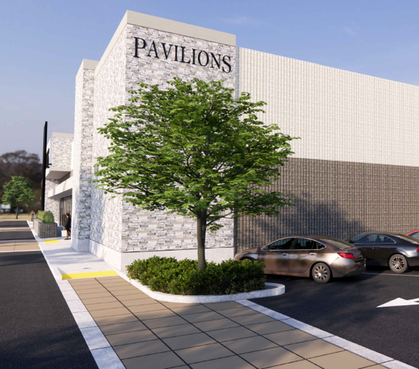
Previous Site Plan
Orange – Pedestrian Pathway Improvements
Red – Landscaping Improvements
Blue – New Bike Parking

Slide 6
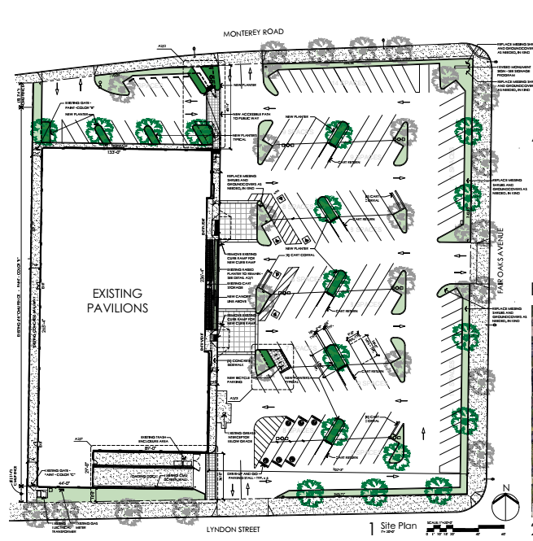
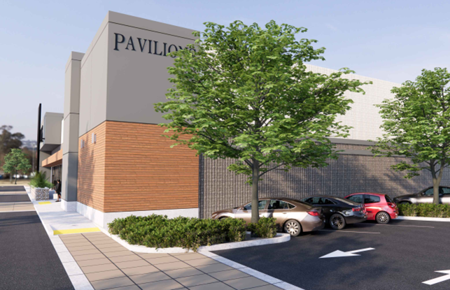
Proposed Site Plan
Orange – Pedestrian Pathway Improvements
Red – Added Trees
Blue – New Bike Parking

Slide 7
Existing vs. Proposed East Elevation (Front)

Slide 8
Revised East Elevation (Front)
vs. Previous East Elevation

Slide 9
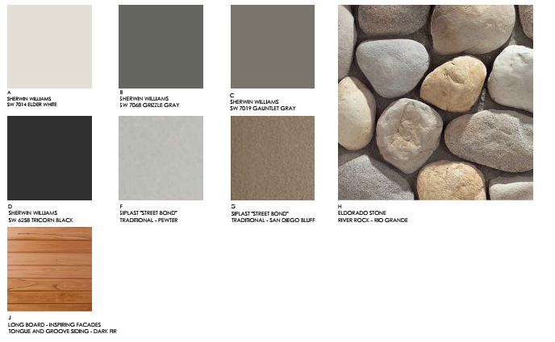
Revised Color and Material Board

Slide 10
Existing vs. Revised North Elevation (Side)

Slide 11
Revised vs. Previous Proposed North Elevation (Side)
vs. Previously Proposed

Slide 12
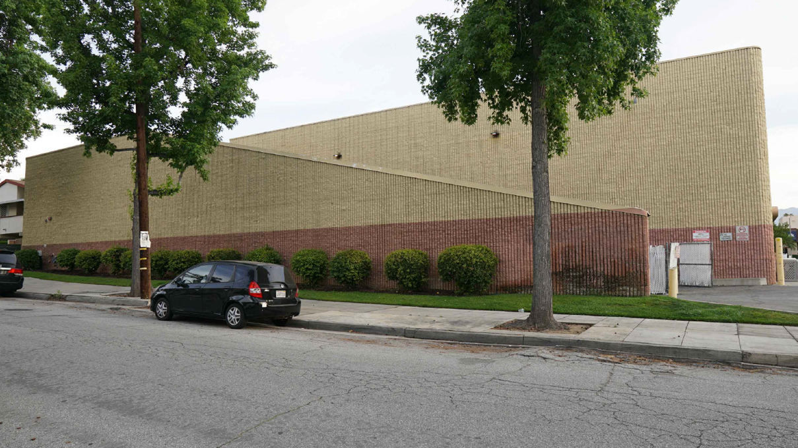
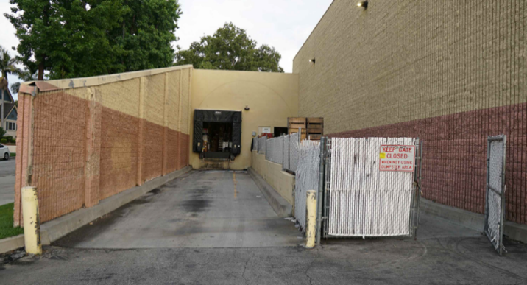
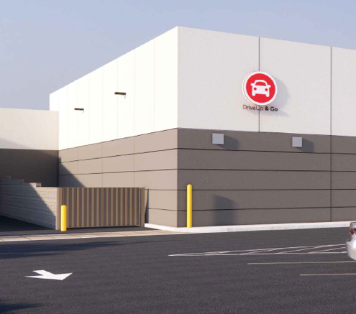
Existing vs. Proposed South Elevation (Side)

Slide 13
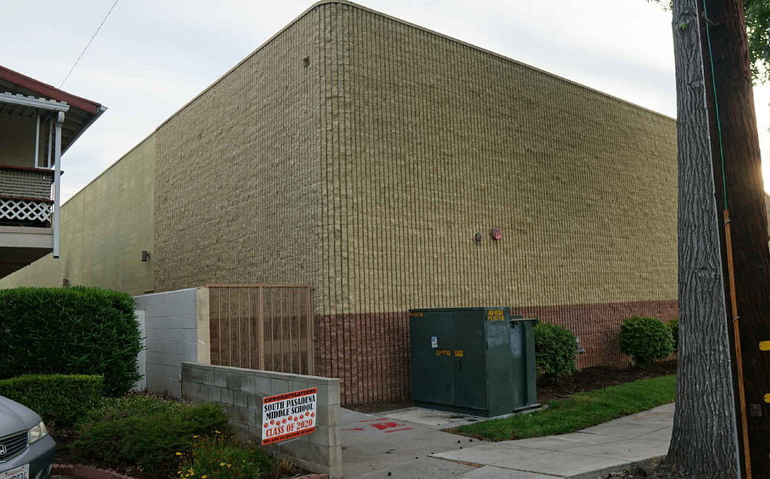
Existing vs. Proposed West Elevation (Rear)

Slide 14
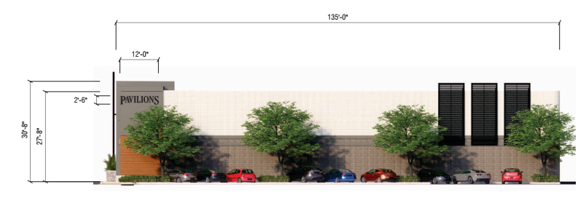
Signage

Slide 15
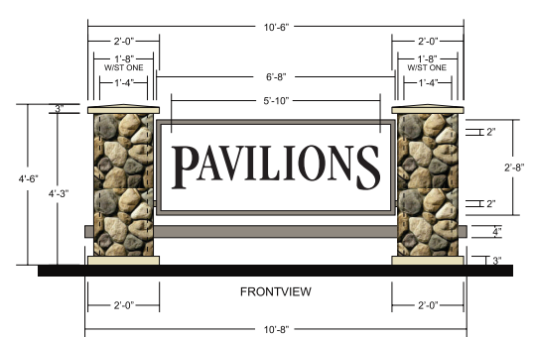
Signage

Slide 16
STAFF RECOMMENDATION:
Continue the project to form a subcommittee to review and refine details for the proposed remodel at 1213 Fair Oaks Avenue.

Slide 17
Design Review Board Options:
Approve with condition(s) added;
Continue the project to address comments discussed; or
Deny the project.

Slide 18
Questions?

