Slide 1
1230 Kolle Avenue
Four Bedroom, Two Bath Second Story Addition to Rear of Existing Home

Slide 2
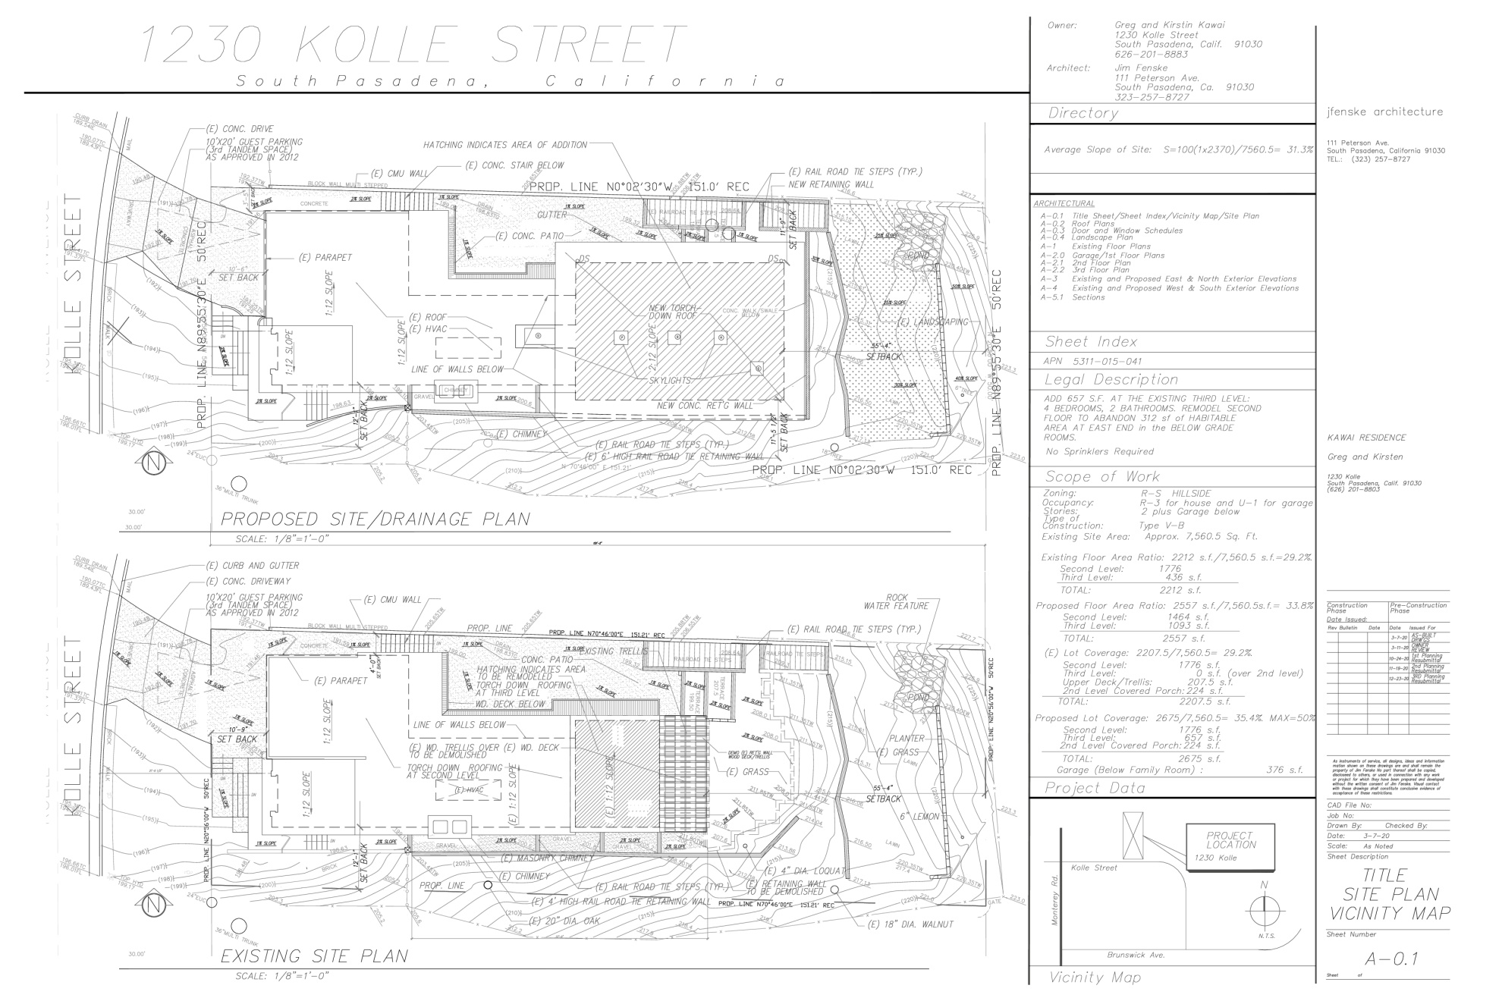

Slide 3
