Slide 1


Slide 2
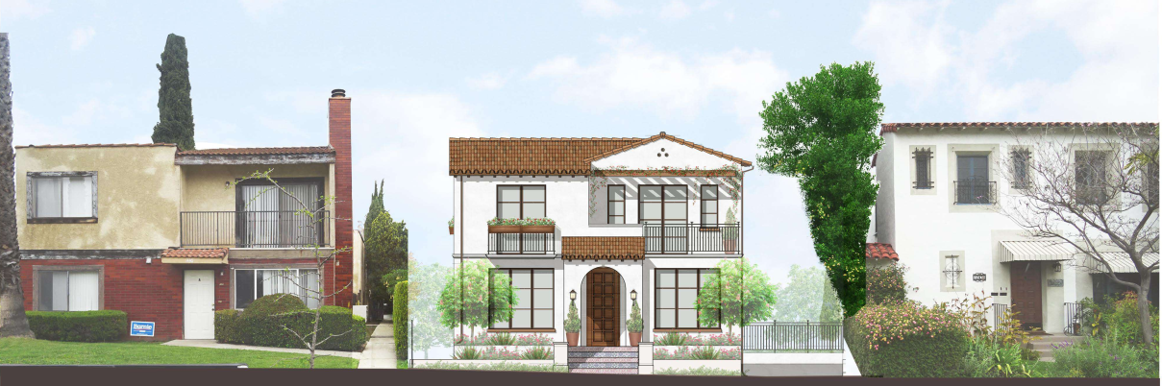
    PROJECT DESCRIPTION
    Notice of Demolition -1,442 square-foot single-family home and 240 square-foot detached 1-car garage built in 1908. (CHC reviewed Aug. 20)
    Design Review to allow for construction of two new detached two-story single-family residences.

Slide 3
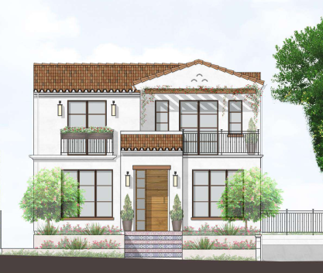
    South (Front) Elevation of Building A
Previous
Lower building/garage
Improve front entry
Change door style
Extend eaves/rafter tails
Remove excess lighting
Wrought iron details

Slide 4
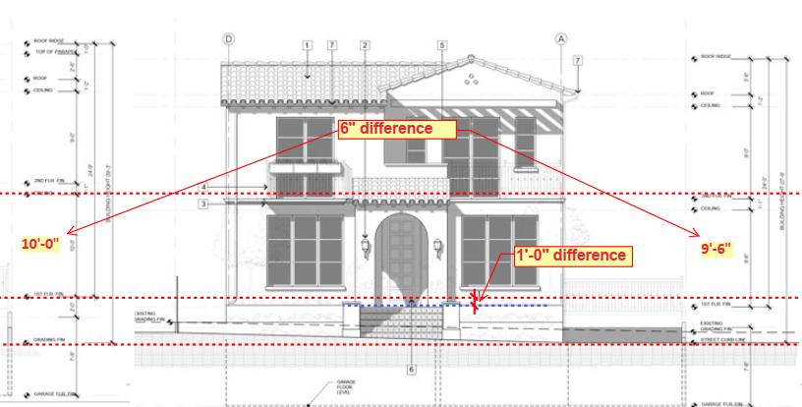
    South (Front) Elevation of Building A

Slide 5
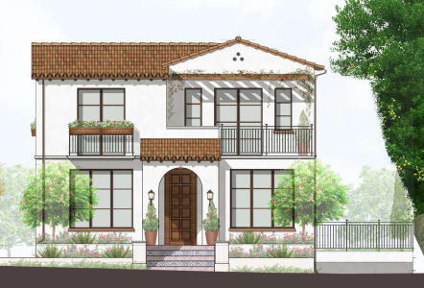
    South (Front) Elevation of Building A
Revised
Lower roofline on entryway
New door
12” eaves/rafter tails
Removed excess lighting
Wrought iron details

Slide 6
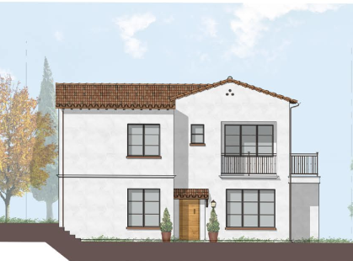
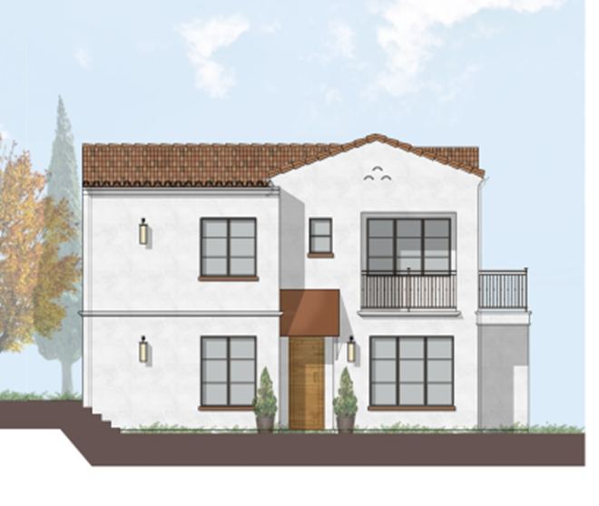
    South Elevation (Building B)
Revised
Previous

Slide 7
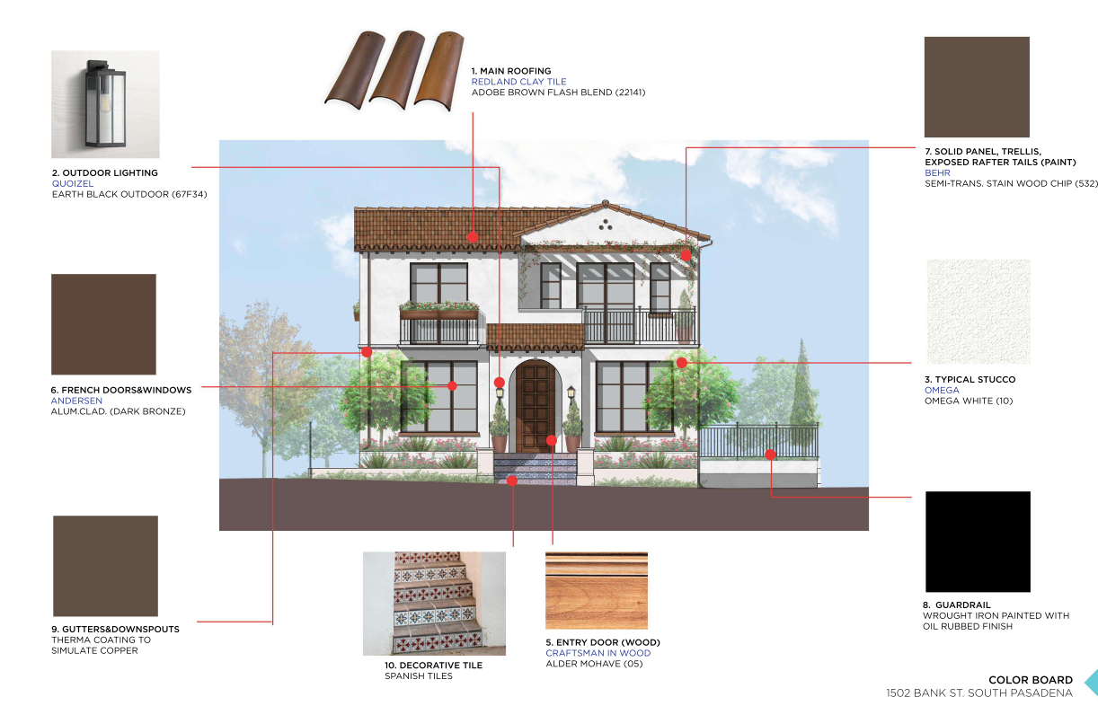
    Color Board

Slide 8
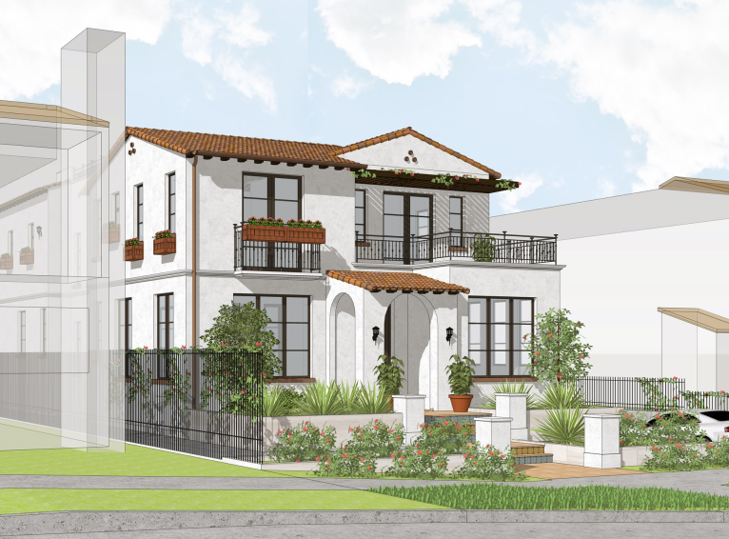
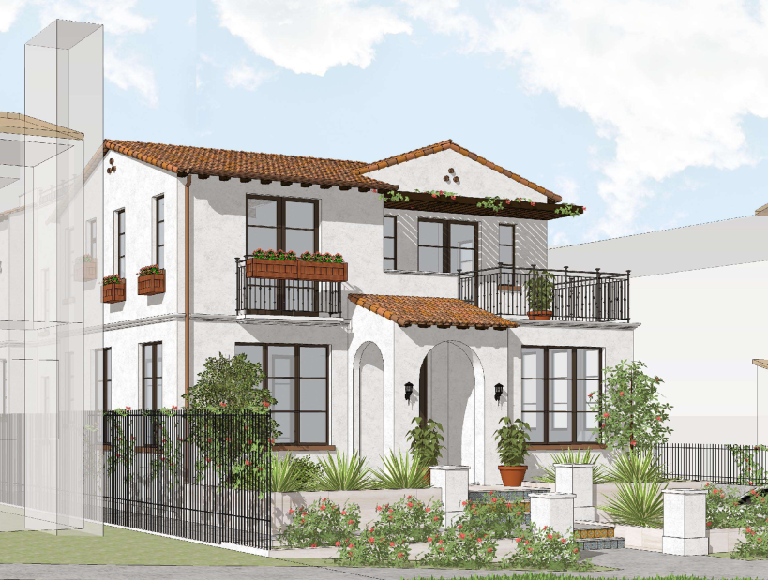
    South (Front) Elevation of Building A
Alternative
Proposed

Slide 9
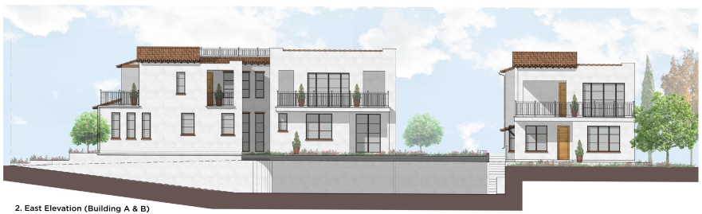
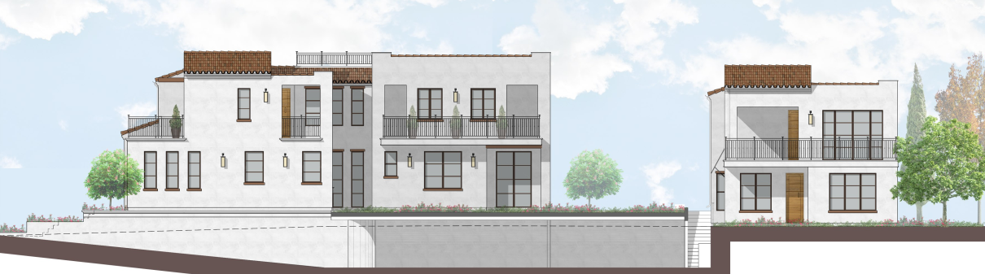
    East (Side) Elevation
Revised
Building A
Building B
Previous

Slide 10
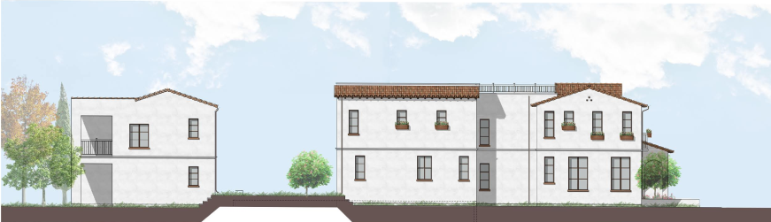
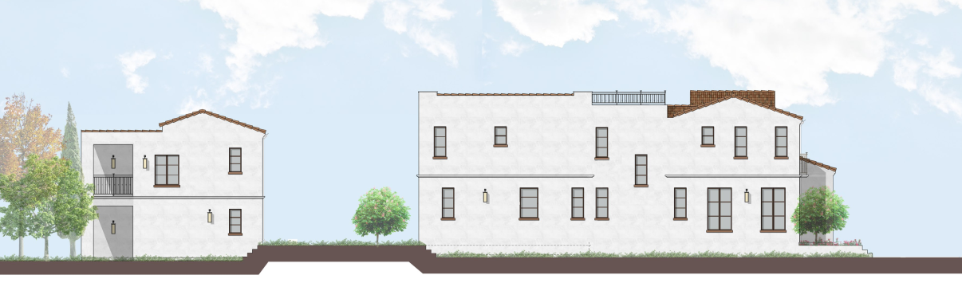
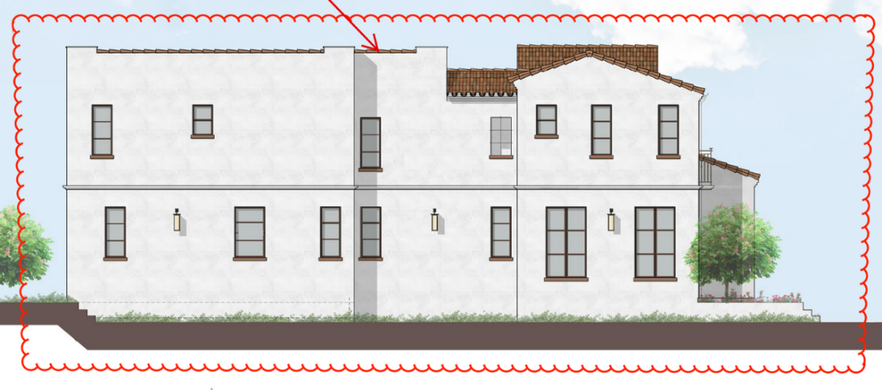
    West (Side) Elevation
Revised
Sloped roof
2.5’ recess
Building B
Building A
Previous

Slide 11
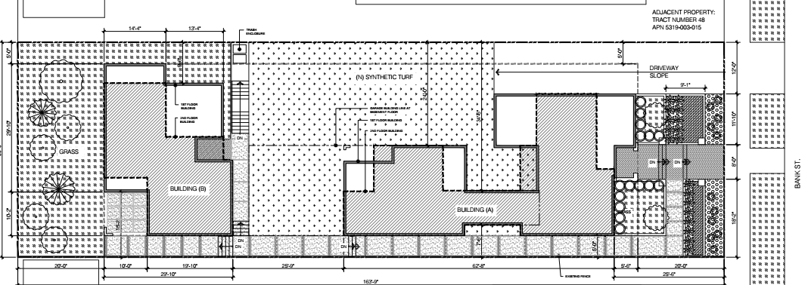
    Site Plan

Slide 12
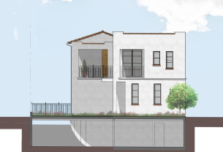
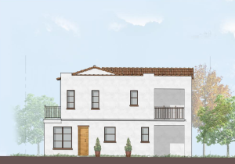
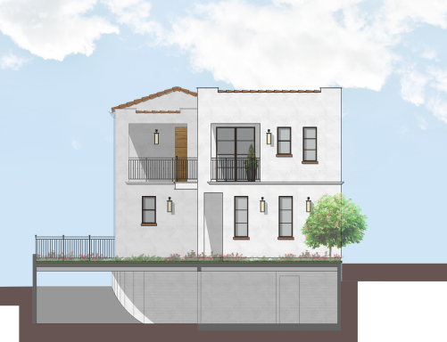
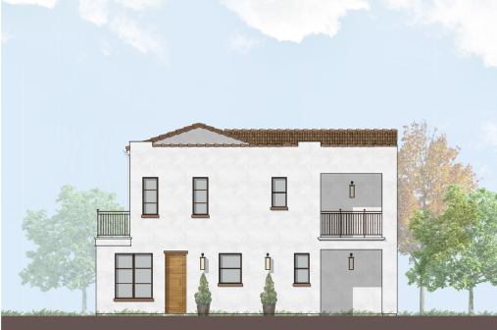
    North (Rear) Elevation
Revised
Building A
Building B
Previous

Slide 13
CONDITION OF APPROVAL:
The applicant shall submit revised plans for review and approval by the Chair of the Design Review Board to incorporate the alternative entryway design with the following:
  Building A, South Elevation. Further lower the clay-tile roof above the front door such that the top of the roof slope aligns with the bottom of the balcony to create a pedestrian scale design and continue the wrought iron metal railing for the balcony along the second floor.

Slide 14
STAFF RECOMMENDATION:
Staff recommends that the Design Review Board approves the demolition of the existing house and garage and approve the Design Review Permit and the alternative entryway design, subject to conditions of approval.

Slide 15
Questions?

