Slide 2
Project Description
Application(s):
Design Review
CEQA: Categorical Exemption –
Section 15301 Class 1 Existing Facilities

Slide 3
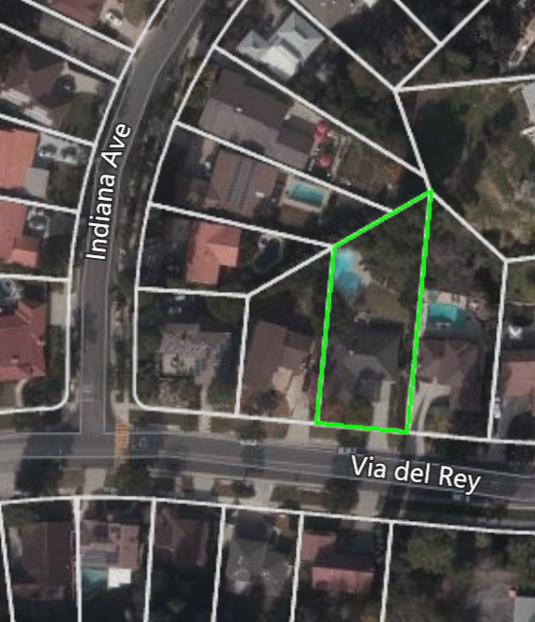
Aerial View
N

Slide 4
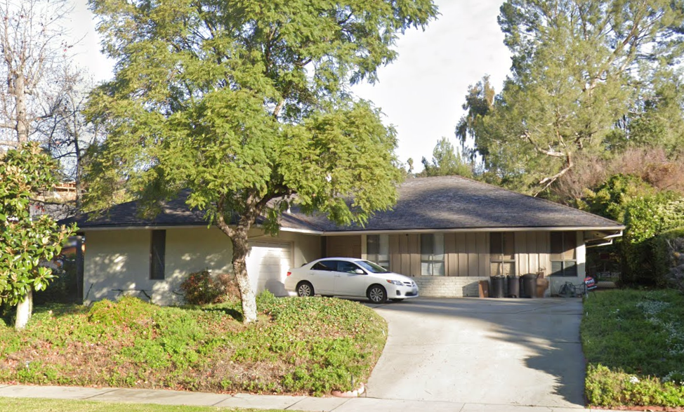
Street View

Slide 5
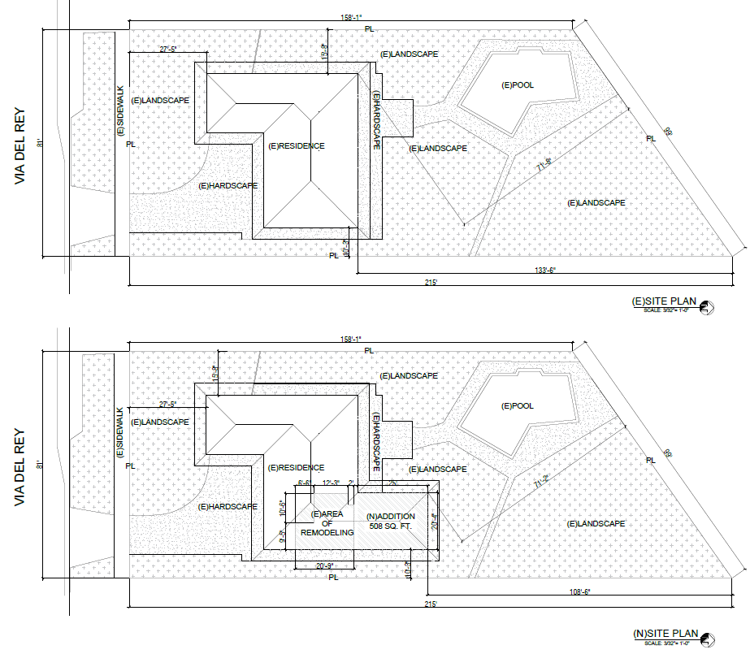
Existing & Proposed Site Plan
N

Slide 6
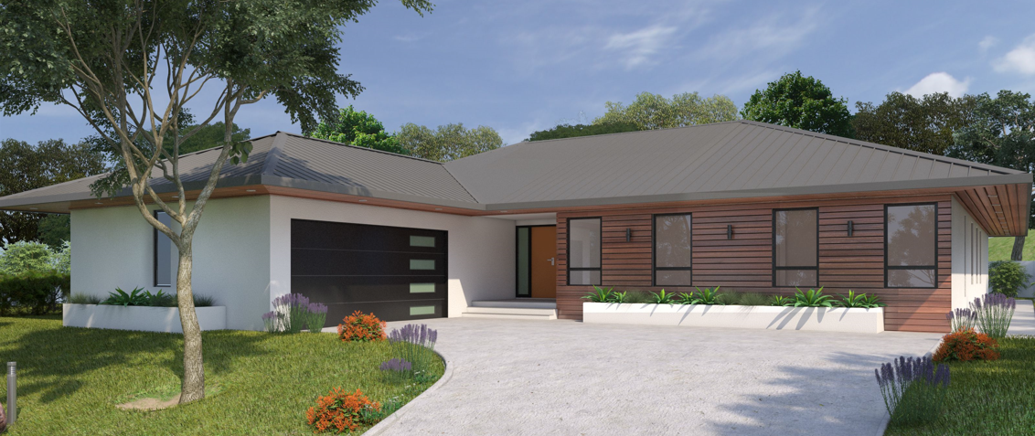
Proposed South (Front) Elevation

Slide 7
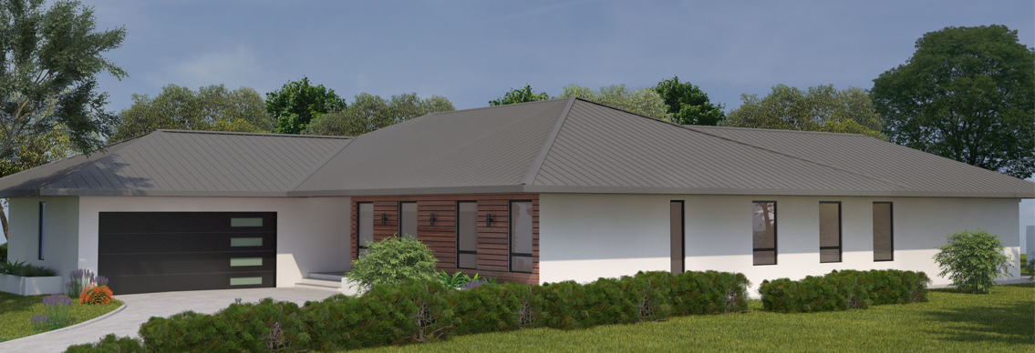
Proposed South and East (Front & Side) Elevations

Slide 8
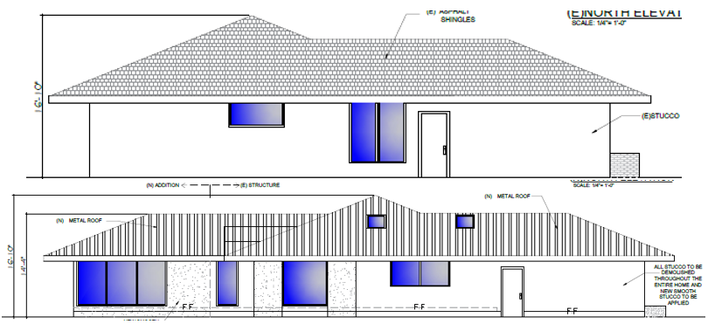
Existing and Proposed West Elevation

Slide 9
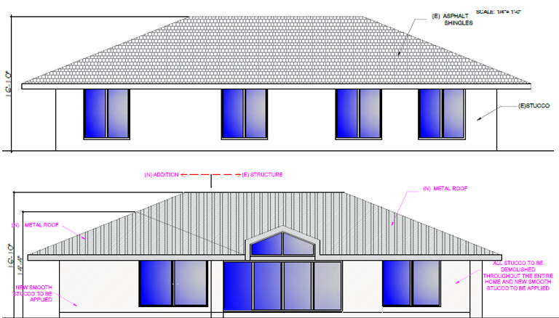
Existing & Proposed North Elevation

Slide 10
Staff Recommendation:
Approving Project No. 2381-DRX Design Review for the property located at 1659 Via Del Rey, subject to conditions of approval.

Slide 11
Design Review Options:
Approve with condition(s) modified/added.
Identify other issues or concerns with the proposed project and provide the applicant with direction to further modify the project and continue the public hearing to a date certain
Deny the project.

Slide 12
Questions?
Notes:
This concludes staff presentation.

