Slide 2
    Project Description
    Application(s):
      Design Review
    CEQA: Categorical Exemption –
      Section 15301 Class 1 Existing Facilities

Slide 3
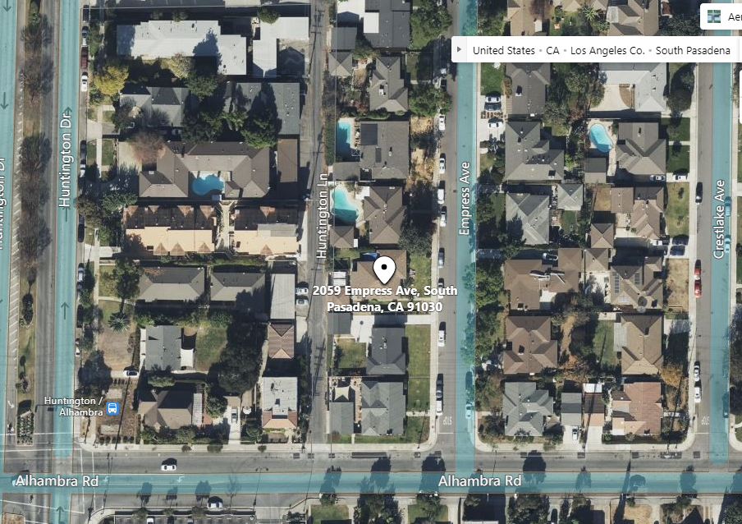
Aerial View
N

Slide 4
Street View

Slide 5
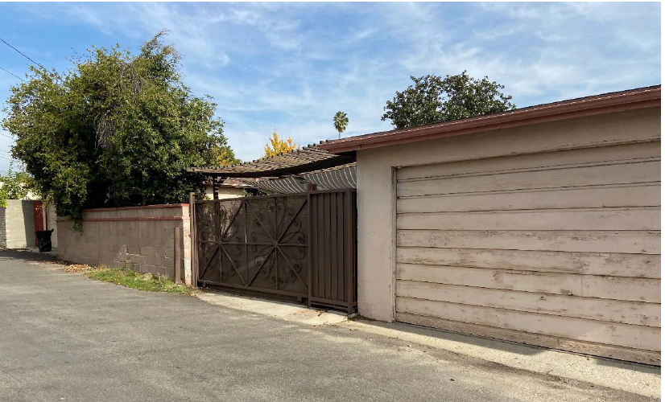
Alley View

Slide 6
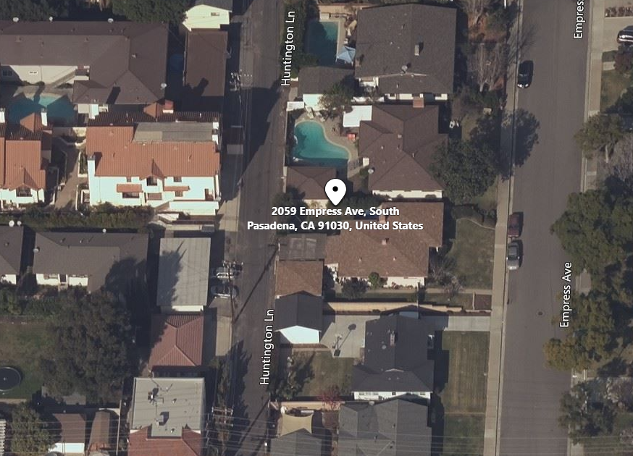
Bird’s Eye View

Slide 7
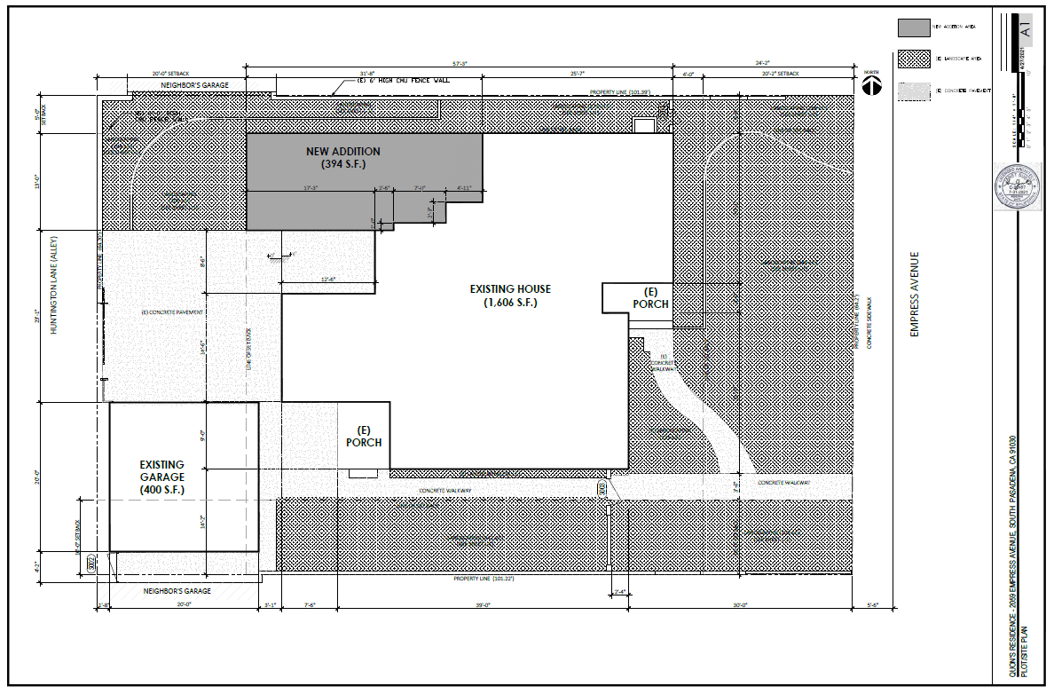
Existing & Proposed Site Plan
N

Slide 8
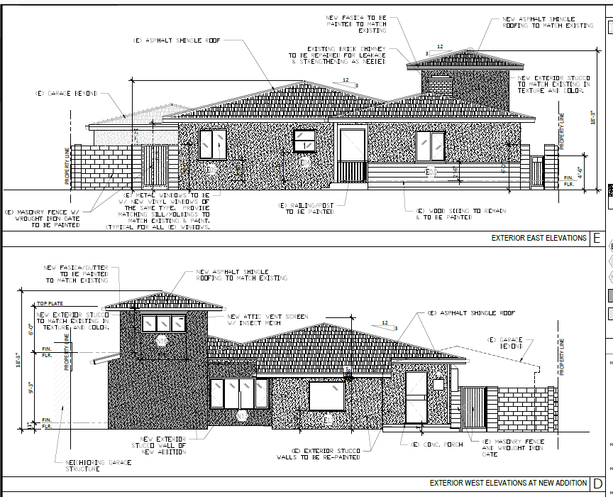
Proposed East (Front) Elevation
Proposed West (Rear) Elevation – garage not shown

Slide 9
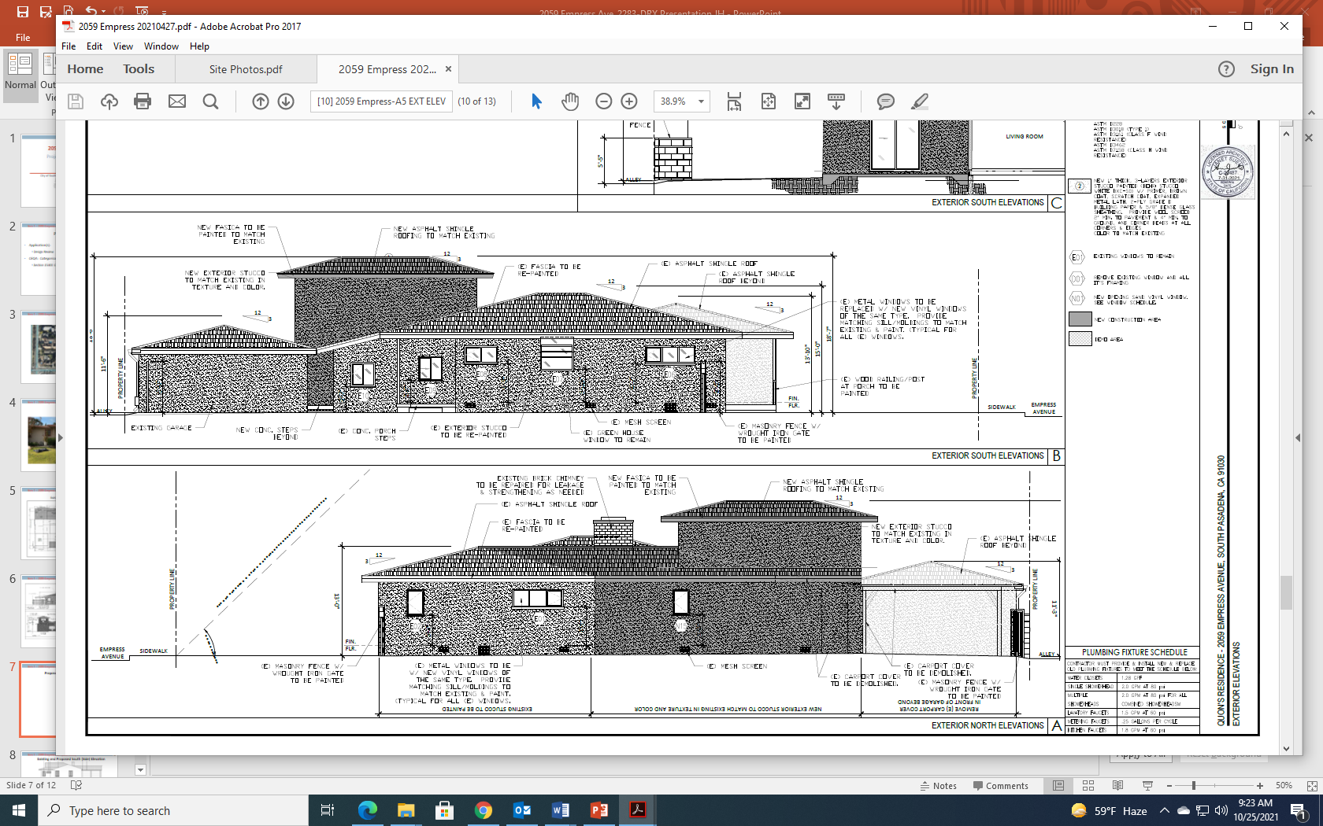
Proposed South (Side) Elevation

Slide 10
Proposed North (Side) Elevation

Slide 11
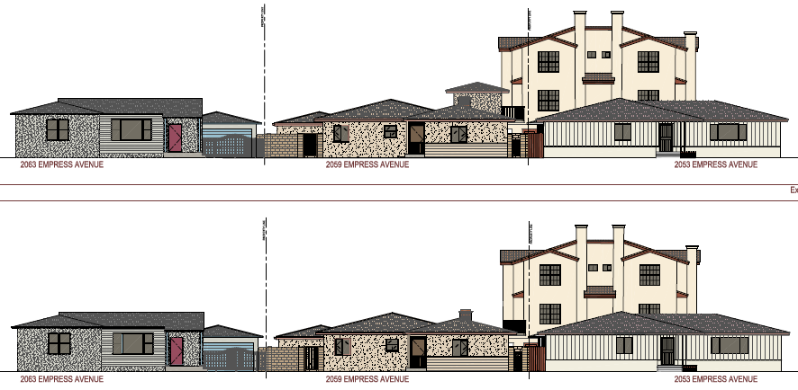
Proposed Street Elevation
Existing Street Elevation

Slide 12
Design Changes Recommended by Staff as Conditions of Approval
Provide visual interest through the break-up of the building plane or by adding decorative elements.
Building dimensions should show a proportional relationship of length, width, and height.
Lower the attic ceiling height to be compatible with the existing structure to avoid the addition as an “added-on” feature. This would lower the profile of second-story attic addition as viewed from the street and from the adjacent properties.

Slide 13
Staff Recommendation
Approving Project No. 2483-DRX Design Review for the property located at 2059 Empress Avenue, subject to conditions of approval.

Slide 14
Design Review Options:
Approve with condition(s) modified/added.
Identify other issues or concerns with the proposed project and provide the applicant with direction to further modify the project and continue the public hearing to a date certain.
Deny the project.

Slide 15
Questions?

