Slide 1
Notes:
Good evening Board members. This project is for 5049 Collis Avenue Project Number 2297- Design Review
.

Slide 2
PROJECT
Design Review for a 583 square-foot addition with a 140 square-foot covered front porch and a 50 square-foot rear deck located at 5049 Collis Avenue.
This item is exempt from any California Environmental Quality Act (CEQA) analysis based on State CEQA Guidelines Section 15301, Class 1 – Existing Facilities.
Notes:
This is a proposal for a 583 square-foot addition with a 140 square-foot covered front porch and a 50 square-foot rear deck.
The project is categorically exempt from CEQA under Section 15301 Class 1 existing facilities
.

Slide 3
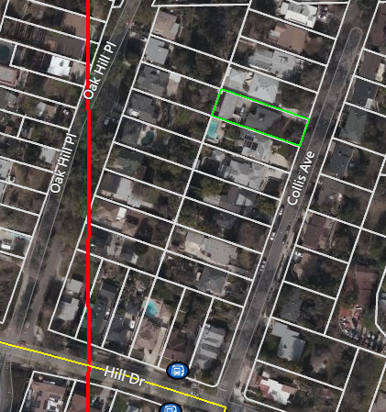
N
Notes:
The project site is located on an 8,210 square-foot lot with Monterey Road located to the north, Oak Hill Place to the West, Hill Drive to the south, and the home located on the east side of Collis Avenue. The property is surrounded by one-and two-story single-family homes. This image is an aerial view of the project site with the property outlined in green below
.

Slide 4
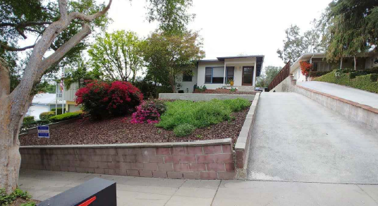
Notes:
This image shows a view from the street of the existing home. The home was built in 1953.
The existing exterior façade consists of a stucco finish, torch down roof, and wood and aluminum windows and a front porch.
.

Slide 5
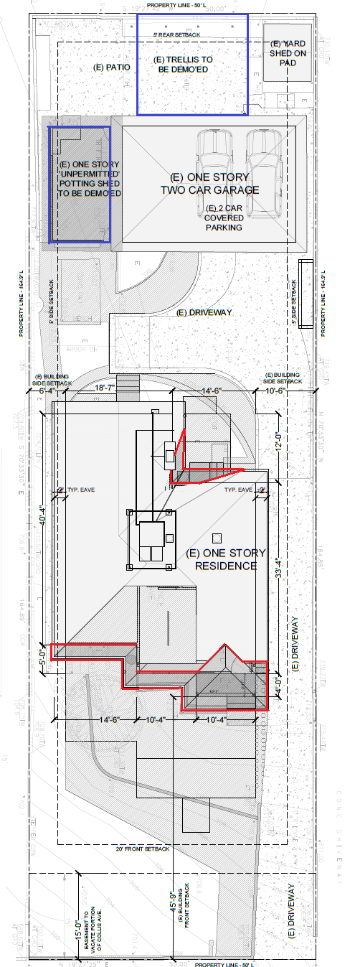
Existing Site Plan
Proposed Site Plan
Notes:
The existing site plan with proposed demolitions to the house are outlined in red and the proposed demolitions to the potting shed and trellis are outlined in blue.
The proposed site plan with proposed additions are outlined in green.
.

Slide 6
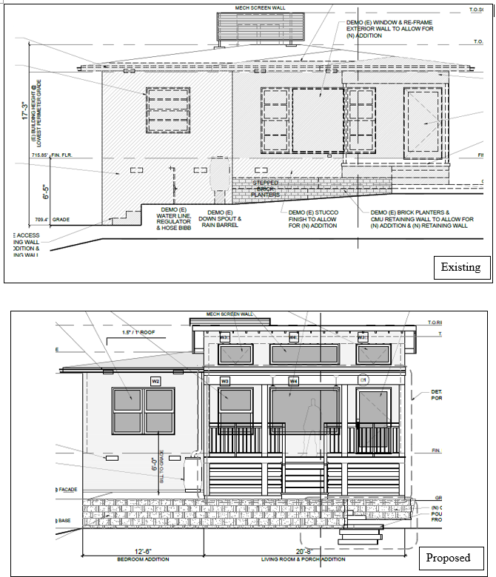
Existing and Proposed East Elevation (Front)
Notes:
EAST
The proposed additions to the house will match the existing exterior materials, the stucco will be painted in a mid toned yellow,.
The addition located in front of the home will have a shed roof. A new larger covered front porch that will span approximately two-thirds of the front façade. Double hung, fixed and awning wood windows are proposed
.

Slide 7
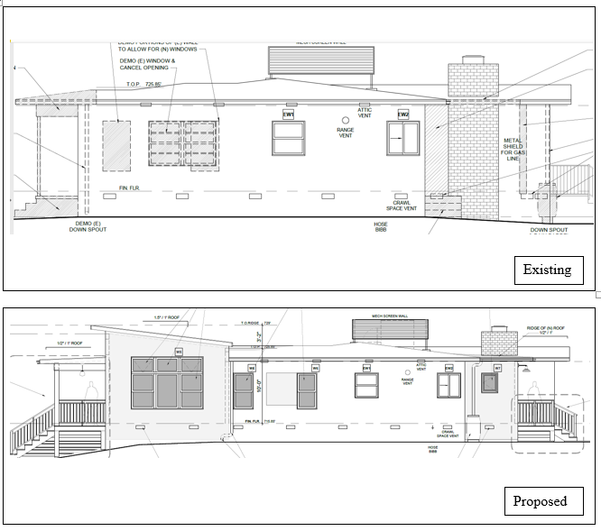
Existing and Proposed North Elevation (Side)
Notes:
Here is an image of the existing and proposed north elevation.
On this elevation one existing window will be removed for the new addition and four new double hung, awning fixed wood windows will be installed.
Two-foot roof eaves are incorporated on the proposed additions and through the entirety of the existing home.
.

Slide 8
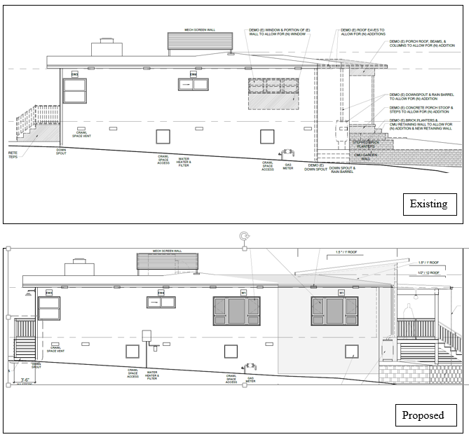
Existing and Proposed South Elevation (Side)
Notes:
The portion of the front addition on the south side will have a gable roof. The small addition towards the rear of the home will have a gable roof with the same slope
The existing windows consist of wood with an aluminum window located in the bathroom.
. For the proposed new windows, the applicant has chosen double hung and casement wood windows.
.

Slide 9
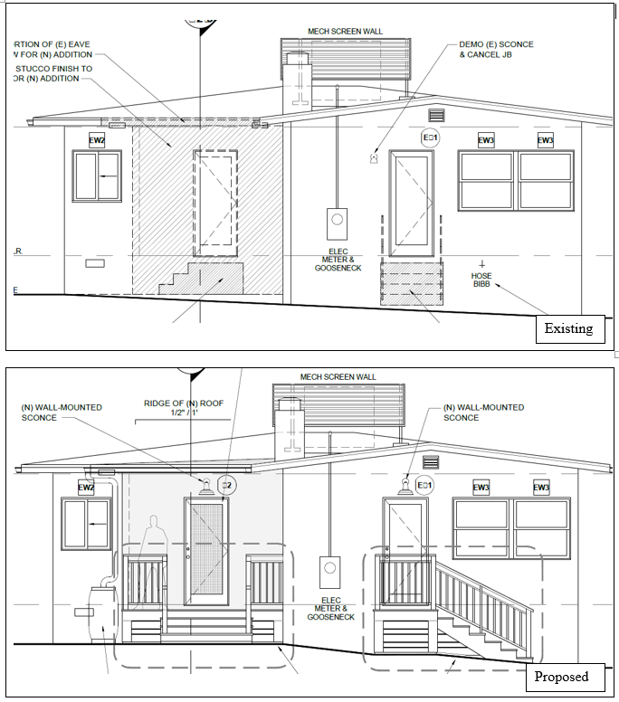
Existing and Proposed West Elevation (Rear)
Notes:
Rear deck’s Vertical railings, steps, and slats proposed material is wood. Existing windows will remain and a new wood framed door is proposed.
.

Slide 10
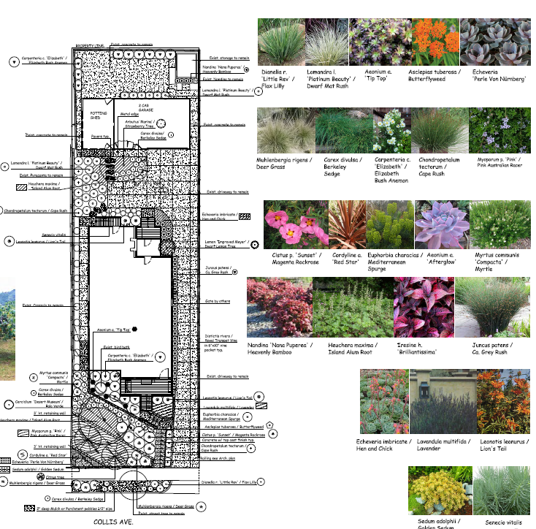
Notes:
This image is a rendering of the proposed Landscaping. The project includes removal of tree one crepe tree located in front of the residence, no tree removal permit is required.
Proposed plants and trees include: a strawberry trees, palo verde, lemon trees, magenta rockrose, red star, afterglow, and deer grass.
.

Slide 11
Staff Recommendation:
Staff recommends that the Design Review Board approve the Design Review for the additions, subject to conditions.
Notes:
.

Slide 12
Design Review Board Options:
Recommend approval of the project.
Continue the project to address comments discussed.
Recommend denial of the project.
Notes:
.

Slide 13
Questions?
Notes:
.

