Slide 2
PROJECT DESCRIPTION
Design Review for an exterior remodel of a 1,672 square-foot commercial building. New Construction or modification of the building size is not proposed.
Sign Permit to allow installation of two wall signs.
Zoning: Commercial General (CG)
Environmental Review: Categorically Exempt from CEQA – Section 15301, Class 1 “Existing Facilities”.

Slide 3
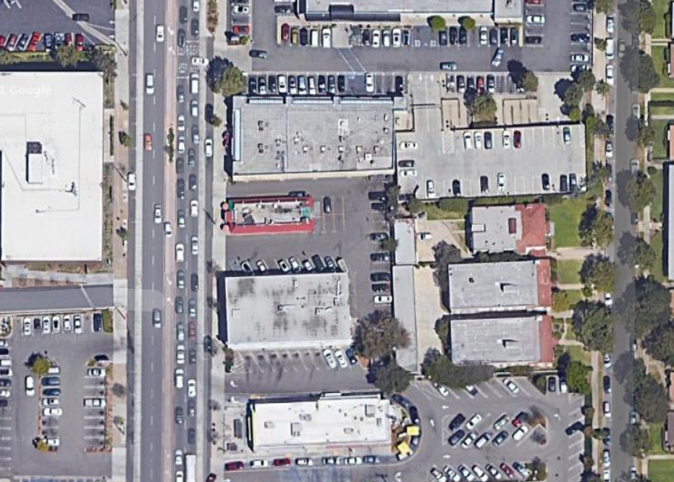
Aerial View
Fair Oaks Avenue
Brent Avenue
Monterey Road
Kole Avenue
Brunswick Ave.
N
710 Fair Oaks Avenue – Upper Fair Oaks Corridor

Slide 4
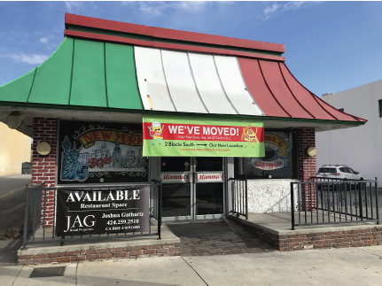
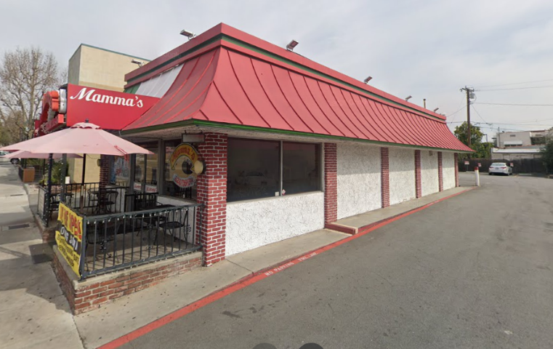
Street And Side View

Slide 5
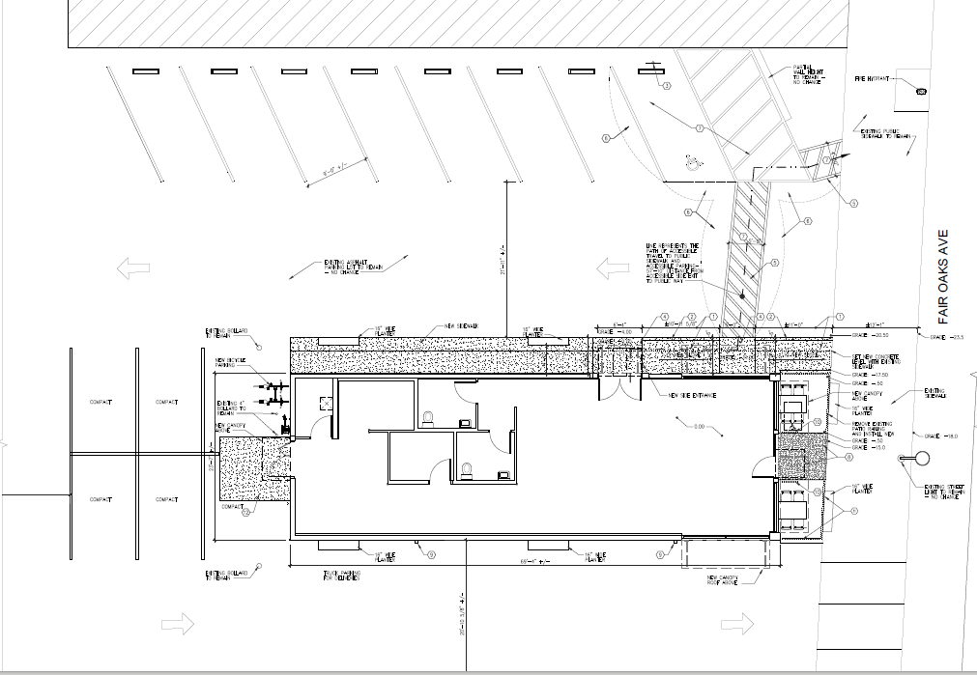
CLOSE UP VIEW
SITE PLAN
712, 714 Fair Oaks Ave. – ATT & Martial Arts
j
(P) Striped
Walkway
(P) Main Entrance and New Sidewalk
Fair Oaks Avenue
Existing Building
710 Fair Oaks Ave.
j
(P) Bicycle
Parking

Slide 6
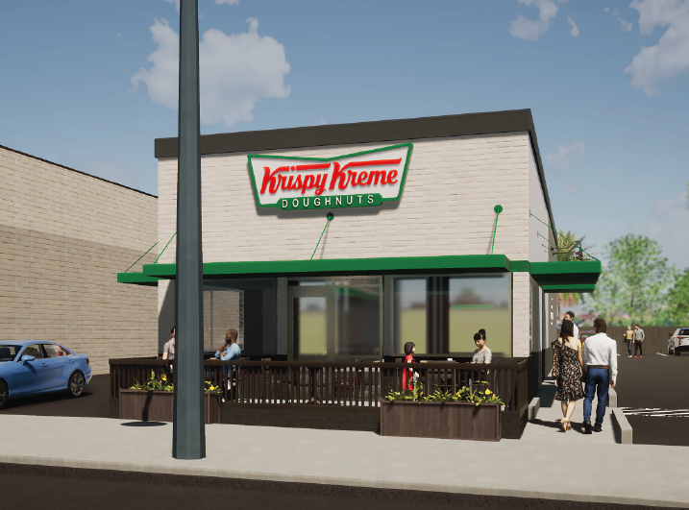
West Elevation (Front)
EXISTING
Remove:
Mansard Roof & Brick Feature
Replace Stucco Throughout
Replace Windows
Remove Walkway Ramp
Replace Patio Railing
Replace Front Doorway
Relocate Main Entrance
PROPOSED
Install:
Brick Veneer in White
Planters
Green Canopies w/Can Lights
Channel Letter Wall Sign
Metal Roof Cap (6 in. wide)
New Paint

Slide 7
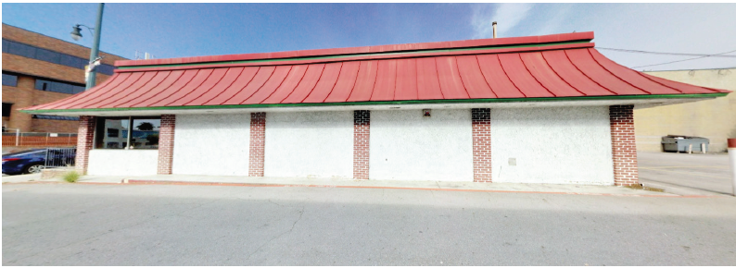
South Elevation (Side View)
EXISTING
PROPOSED
Install:
Relocated Main Entrance
Canopies & Roof Cap
Sidewalk Connecting to City Sidewalk
New Brick Veneer, Stucco, and Paint
Wall Sign
Goose Neck Lamps
Wall Light Fixtures
Planters

Slide 8
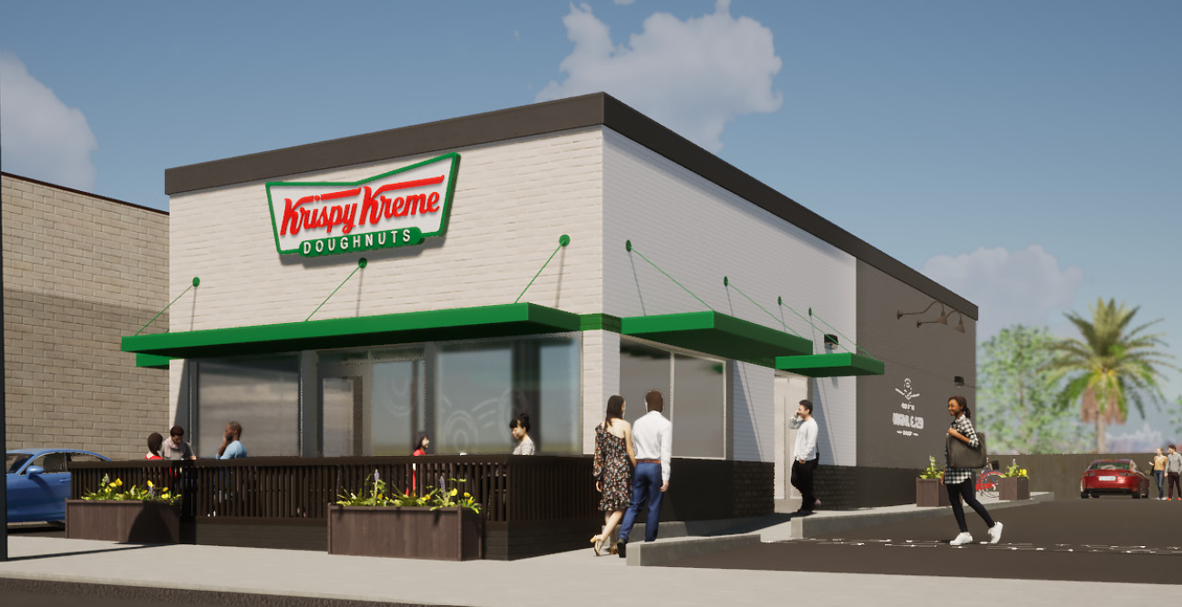
Proposed Southwest Elevation

Slide 9
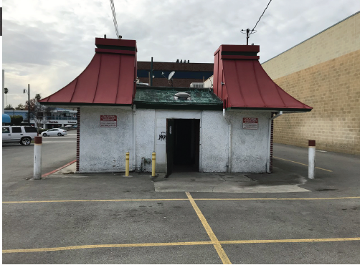
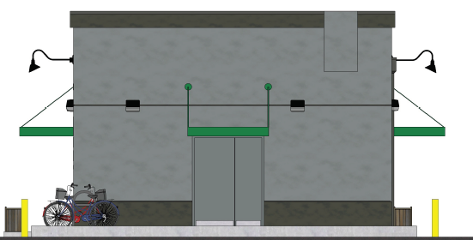
East Elevation (Rear)
EXISTING
PROPOSED
Install:
Roof Cap
Replace Back Door
Canopy
Wall Light Fixtures
New Stucco and Paint
Existing Bollards to be Painted

Slide 10
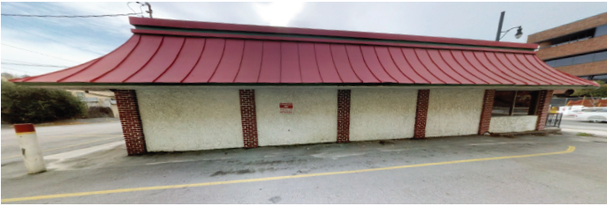
North Elevation (Side)
EXISTING
PROPOSED
Install:
New Stucco, Paint
Planters
Downspouts
Rolling Doughnuts, 4 feet tall, Flat Metal Pieces
Goose Neck Lamps and Wall Light Fixtures
Canopy and Roof Cap

Slide 11
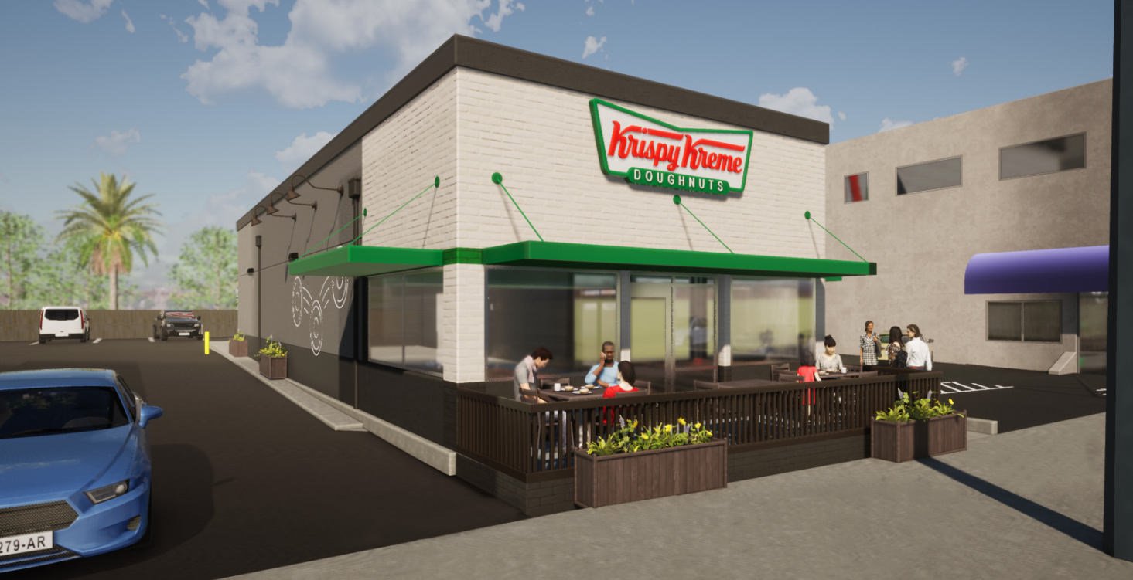
Northwest Elevation

Slide 12
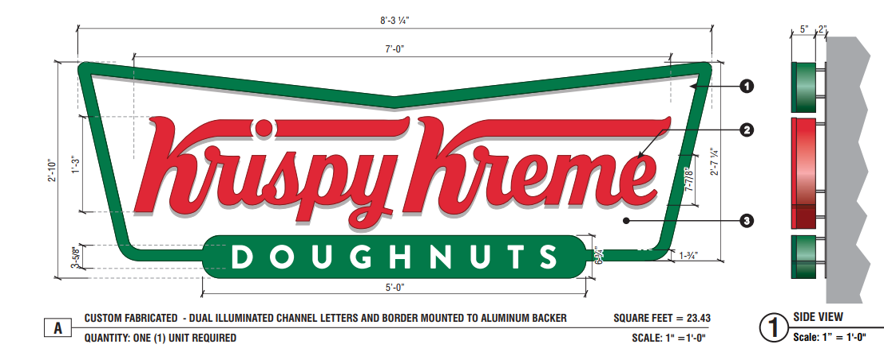
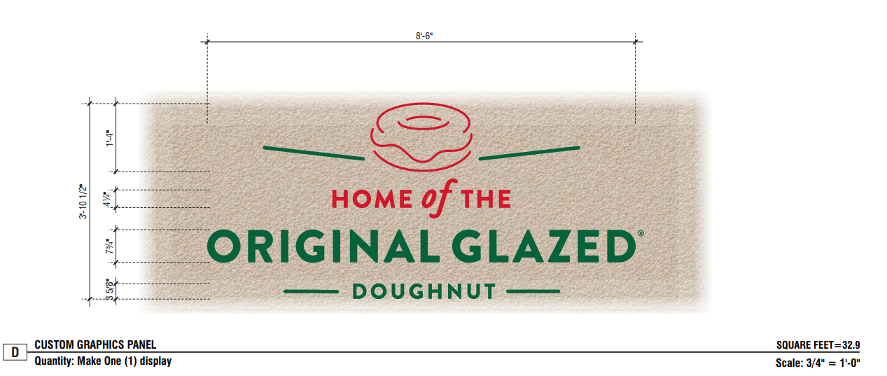
Wall Signs
Proposed on West Elevation (Front) – Channel Letter Wall Sign 23.4sq.ft.
Proposed on South Elevation
Aluminum Decals,
Indirectly Illuminated
32.9sq.ft.

Slide 13
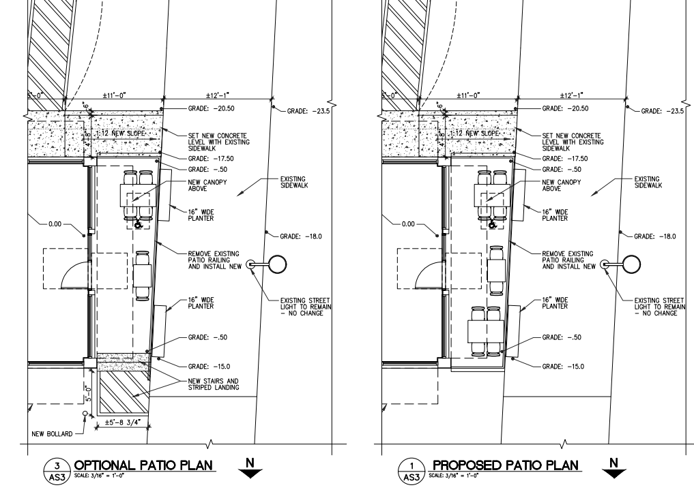
Patio Option For the Board:

Slide 14
Conditions of Approval:
The applicant shall provide public art in compliance with SPMC 36.395 if the project meets the minimum valuation to be subjected to the public art requirement prior to issuance of an occupancy permit. If the project is subject to the Public Art requirement the applicant shall pay the appropriate fee.
The building parapet wall shall be increased by at least 6 inches, but not more than 12 inches to fully screen the new roof equipment from view from the public right-of-way.
Construction plans submitted for plan check must show the driveways with a stenciled arrow to direct traffic. An “Exit Only” sign of 18 inches wide by 24 inches long facing the street must be placed on the building or other conspicuous location alerting drivers that the northside driveway is not a vehicle entrance.
Construction plans submitted for plan check must show at least three bicycle parking spaces on the northside driveway near the front patio. This area must be designed to alert drivers exiting the site of their location and protect the bicycle fixture and bicycles by using bollards and/or a raised curb on which the bicycles will be parked.

Slide 15
1. Approve as proposed without changes; or
2. Approve with modifications to the conditions and/or design(s); or
3. Continue the project to a future public hearing and direct the applicant to make changes to the project; or
4. Deny the project.
Design Review Board Options:

Slide 16
The Design Review Board approve the project as proposed and issue Design Review approval and a Sign Permit, subject to the conditions of approval for property located at 710 Fair Oaks Avenue.
STAFF RECOMMENDATION:

Slide 17
Questions

