Slide 2
PROJECT DESCRIPTION
Remodel existing two-story, 2,623 square-foot home
457 square-foot addition to the first floor
339 square-foot addition to the second floor
191 square-foot porch with an expanded entryway
296 square-foot loggia that connects the proposed study room and the existing guest house
326 square-foot barbeque pergola adjacent to the guest house
Non-descript to Contemporary Craftsman Cottage

Slide 3
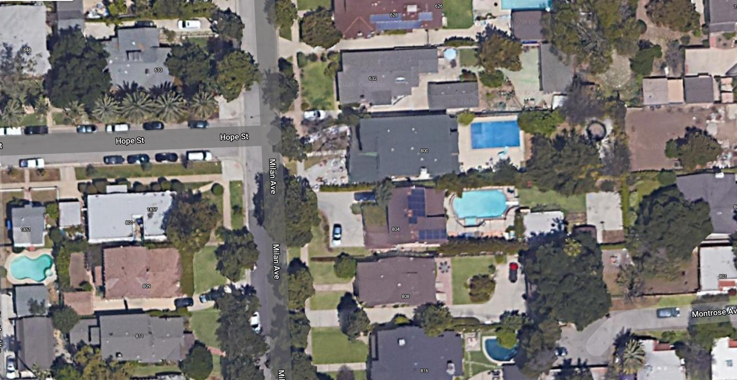
LOCATION
N

Slide 4
STREET VIEW

Slide 5
EXISTING SITE PLAN
Guesthouse
Residence
Pergola
Pergola
Existing house and guesthouse
Existing pergolas

Slide 6
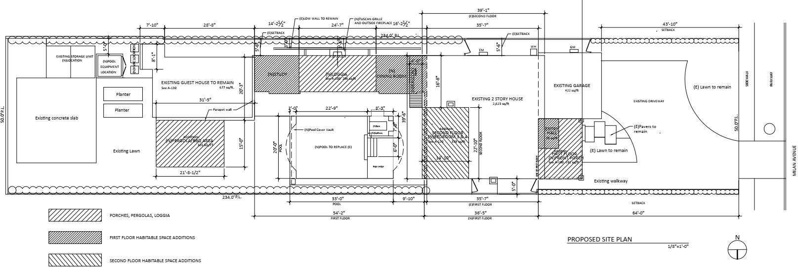
PROPOSED SITE PLAN
Pergola, Porch, Loggia
Room addition
Existing house and guesthouse

Slide 7
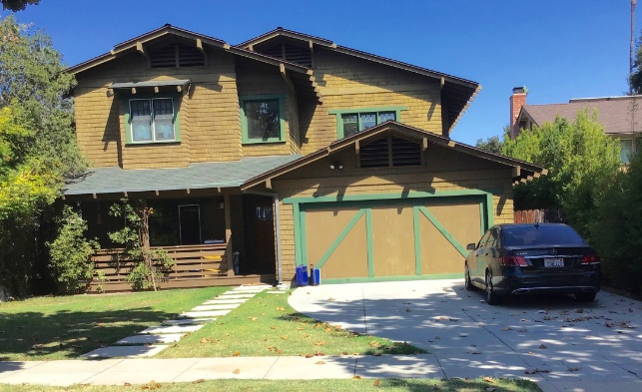
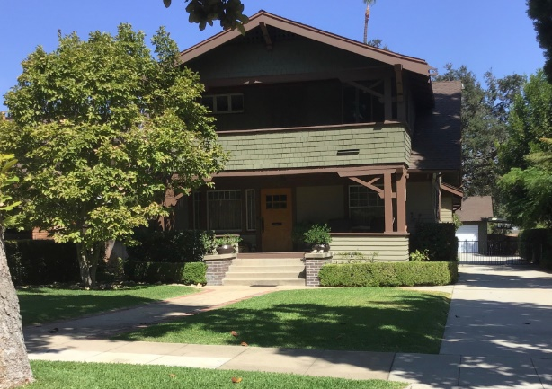
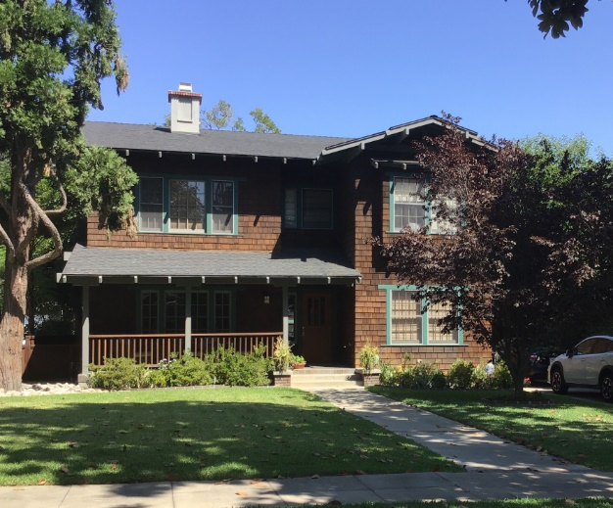
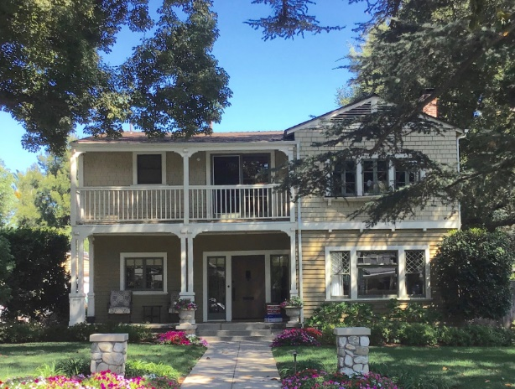
NEIGHBORING PROPERTIES

Slide 8
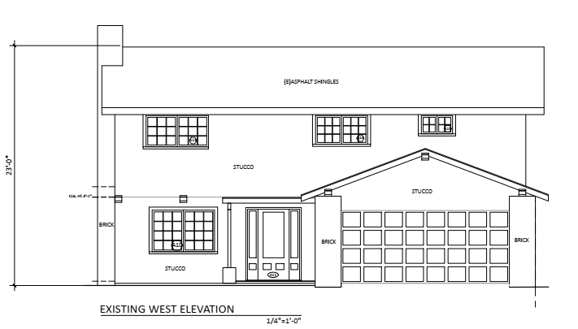
EXISTING WEST ELEVATION

Slide 9
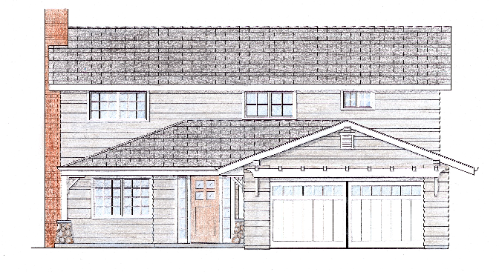
PROPOSED WEST ELEVATION (FRONT)

Slide 10
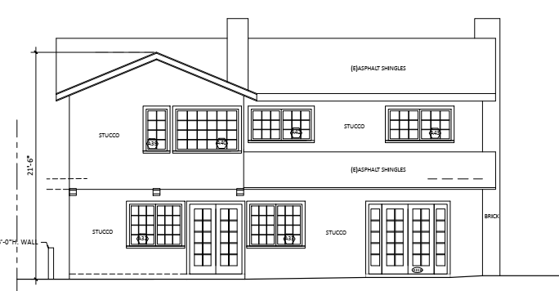
EXISTING EAST ELEVATION (REAR)

Slide 11
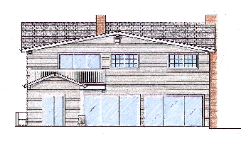
PROPOSED EAST ELEVATION (REAR)
Condition sliding glass doors to match window style

Slide 12
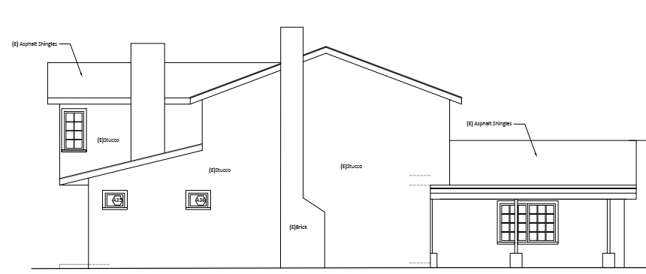
EXISTING NORTH ELEVATION (SIDE)
Front

Slide 13
PROPOSED NORTH ELEVATION (SIDE)
Guesthouse Loggia Main Residence

Slide 14
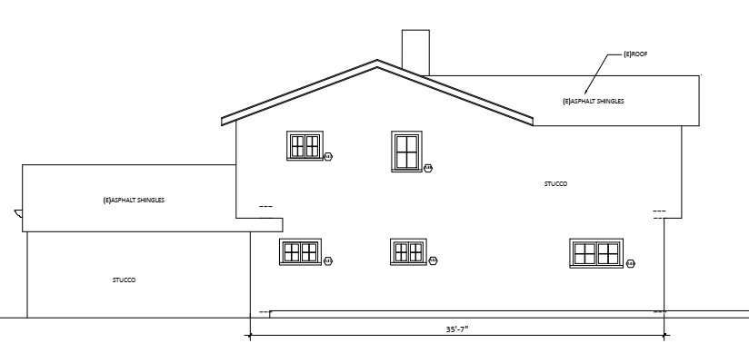
EXISTING SOUTH ELEVATION (SIDE)
Front

Slide 15
PROPOSED SOUTH ELEVATION (SIDE)
Loggia Guesthouse
Front

Slide 16
STAFF RECOMMENDATION
The Design Review Board approve the Design Review, subject to conditions of approval.

Slide 17
Design Review Board Options:
Approve with condition(s) added;
Continue the project to address comments discussed; or
Deny the project.

Slide 18
Questions?

