Slide 2
PROJECT DESCRIPTION
Demolition - Existing 1,154 square-foot single-family home and 1-car garage built in 1922.
Design Review - Two-story 3,467 sq. ft. single-family residence with a 13 square-foot front porch, a 218 square foot balcony, and an attached 475 square feet garage on a 7,074 square foot lot.

Slide 3
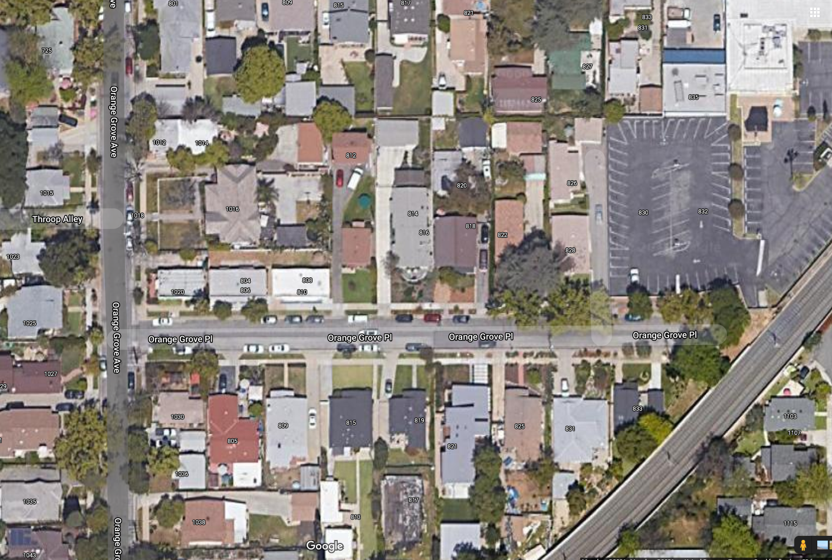
N

Slide 4
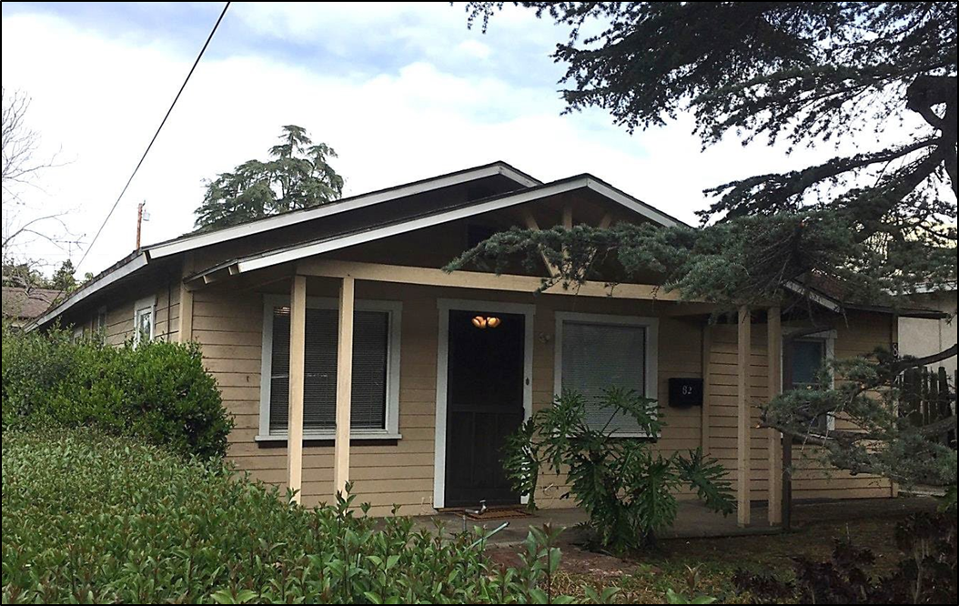

Slide 5
ZONING STANDARDS
RM Zone – 7,074 sq. ft. lot
Nonconforming lot size
Proposed project meets most zoning standards, except:
Second story setbacks from the first floor (3-ft)
Front Setback hardscaping 30% or less

Slide 6
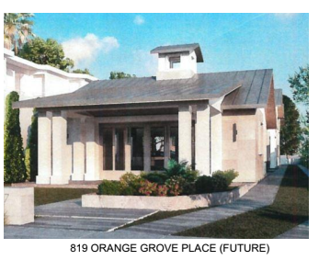
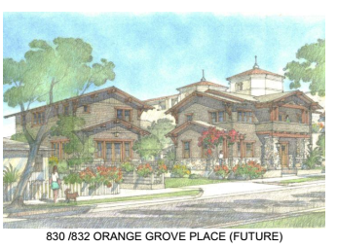
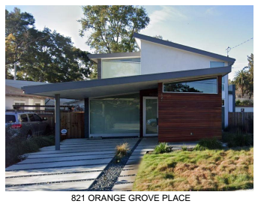
DESIGN REVIEW

Slide 7
DESIGN REVIEW

Slide 8
DESIGN REVIEW
FRONT
REAR

Slide 9
DESIGN REVIEW

Slide 10
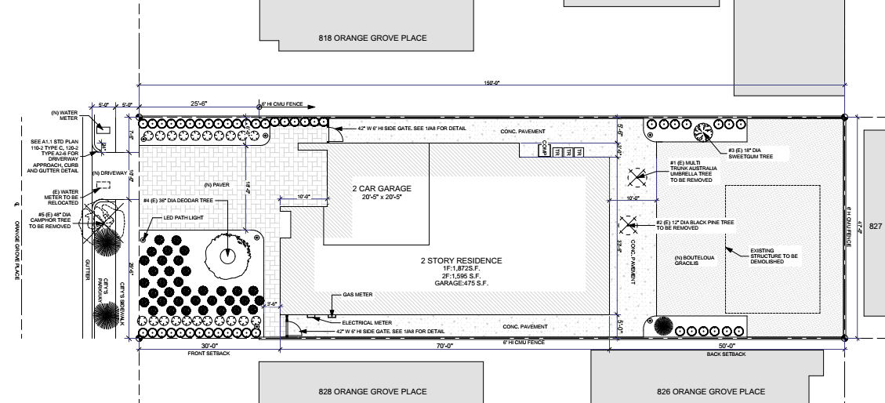
SITE PLAN

Slide 11
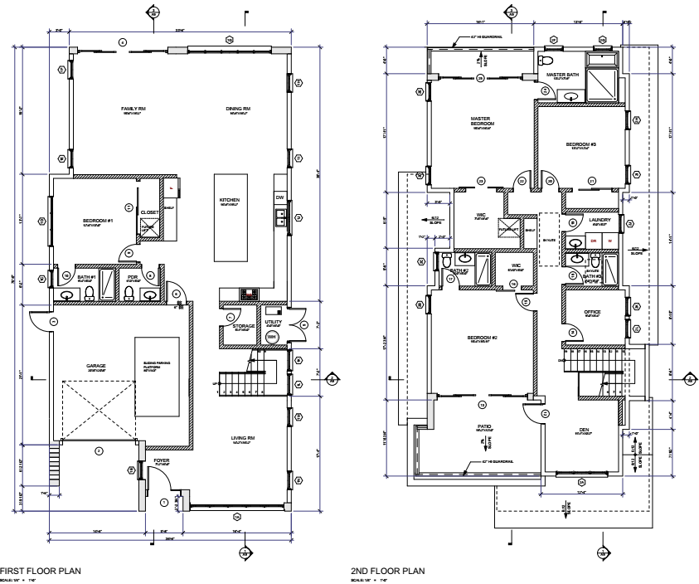
FLOOR PLAN

Slide 12
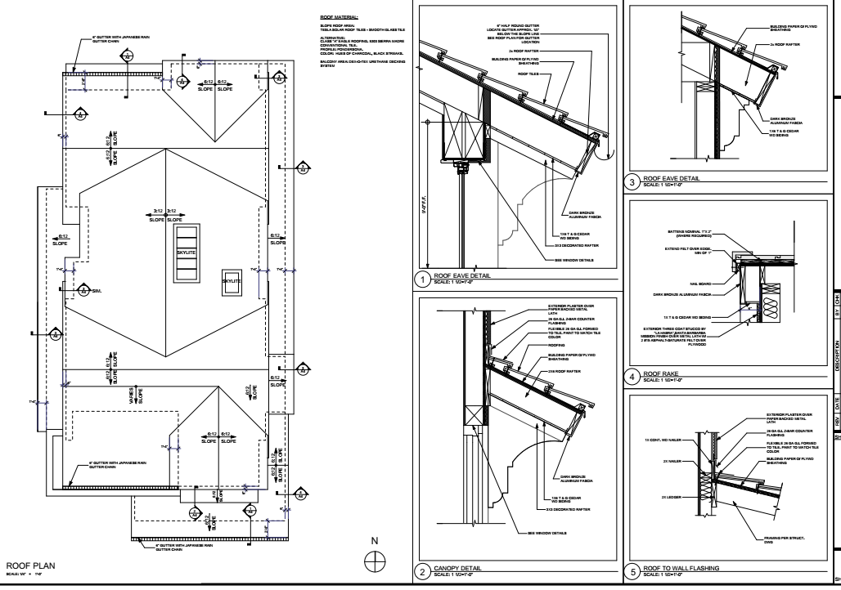
ROOF PLAN

Slide 13
ADDITIONAL DETAILS

Slide 14
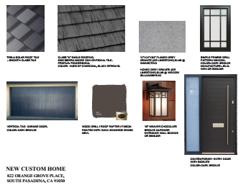
COLOR and MATERIALS

Slide 15
STAFF RECOMMENDATION
Formation of a subcommittee
Reduce scale of the second floor from (east/west elevation).
Add an additional flared gable roofline on the front elevation (south).
Extend the eaves.
Further articulate the front half of the west elevation.
Reduce hardscaping to 30% in front setback
A traditional-style entry door.
Preserve Tree/driveway location

Slide 16
Questions?

