Slide 1
Notes:
Good evening Board members the project is for 1319 Stratford Avenue, Item was continued from the July 22nd DRB meeting.

Slide 2
At the meeting, the Board expressed the following concerns about the design and provided suggestions as follows:
Blend existing and proposed roof slopes.
Consider changing the configuration of the windows, there is mix of both vertical Consider reducing the 10-foot plate height of the second floor.
and horizontal windows.
Change the style of the dormer to fit more with the existing elevation.
Consider pushing back the second floor addition, to reduce the mass in the front elevation.
Interweave the dormer in front of the home.
Notes:
At the meeting, the Board expressed the following concerns about the design and provided suggestions as follows:
Blend existing and proposed roof slopes.
Consider changing the configuration of the windows, there is mix of both vertical and horizontal windows.
Consider reducing the 10-foot plate height of the second floor.
Change the style of the dormer to fit more with the existing elevation.
Consider pushing back the second floor addition, to reduce the mass in the front elevation.
Interweave the dormer in front of the home.
The Board formed a Subcommittee consisting of Commissioners Tsai and Lir to work with the applicant to address the design concerns and suggestions

Slide 3
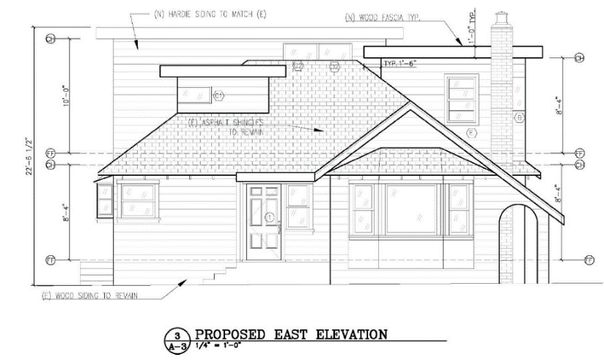
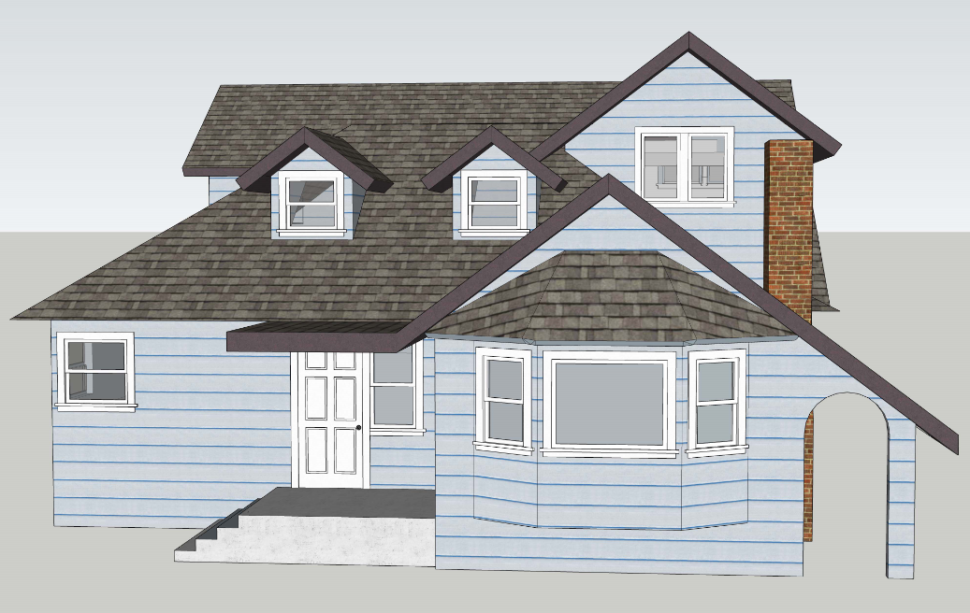
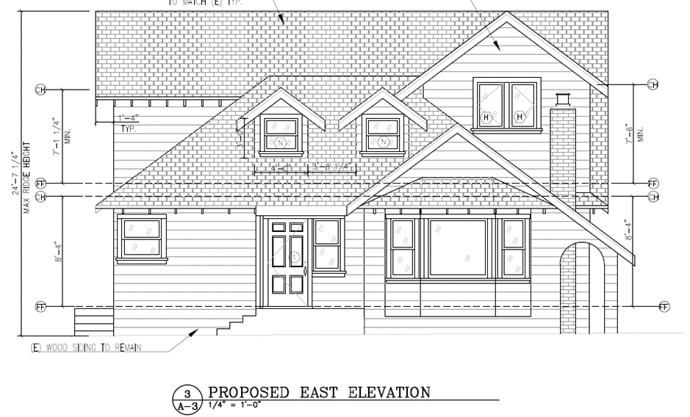
Notes:
The Board directed the applicant to redesign the project to blend the existing home with the new addition. In the original design, the second story addition proposed a flat roof with an overall height of approximately 23 feet. The new design has a gable roof design with an overall height of approximately 25 feet. The original plans included an off-centered flat roof dormer, whereas in the new plans there are two centered dormers with gable roofs and double hung clad windows

Slide 4
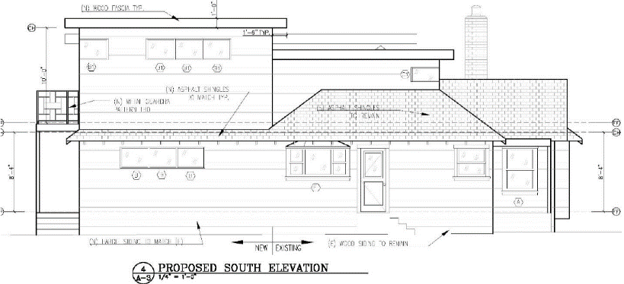
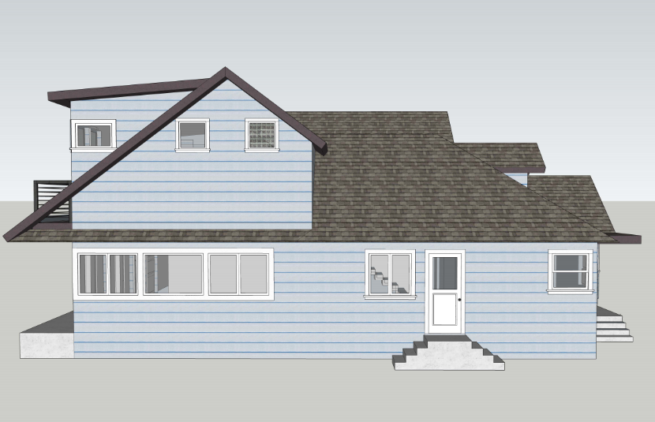
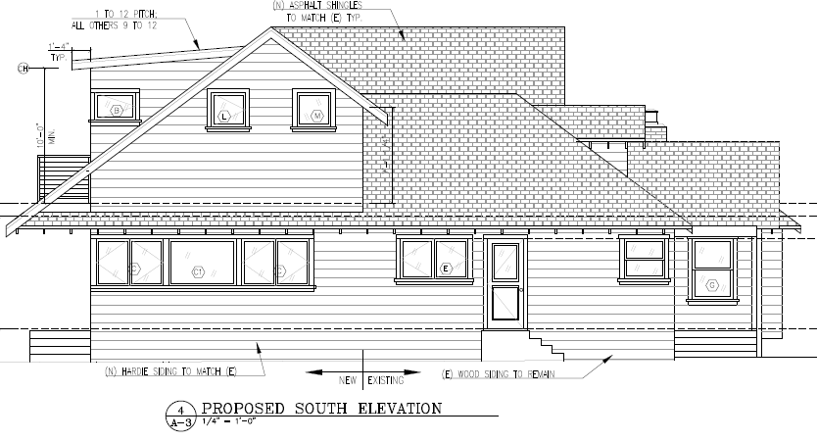
Notes:
New roofline in south elevation has significant downward slope as the front elevation. The new slopes provide articulation and overall balance to what was existing and what is new.
In the south elevation original proposed bay window in the kitchen has now changed to double casement window

Slide 5
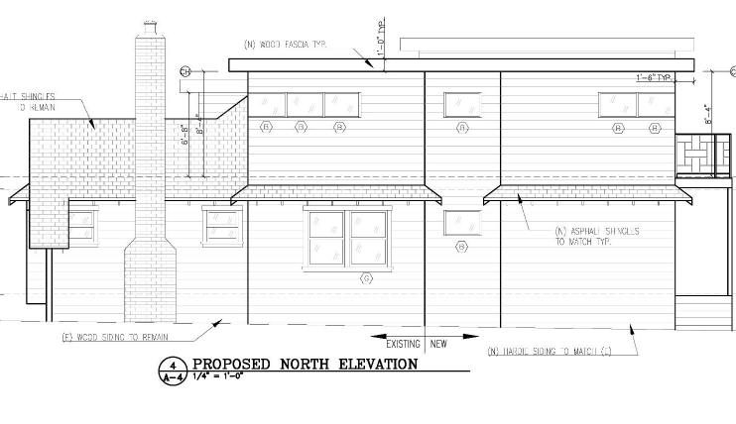
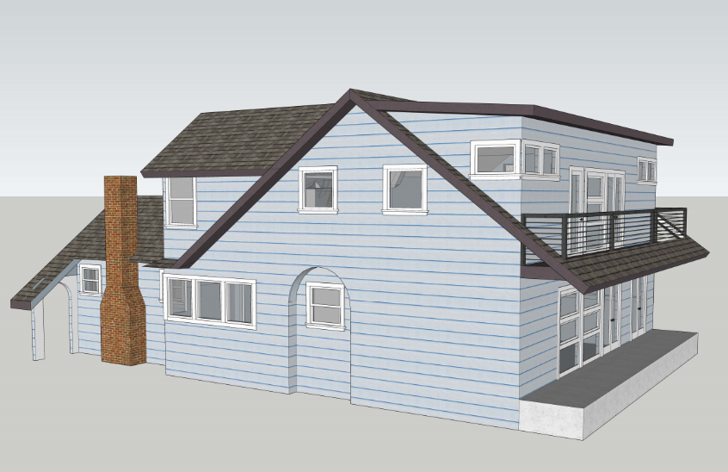
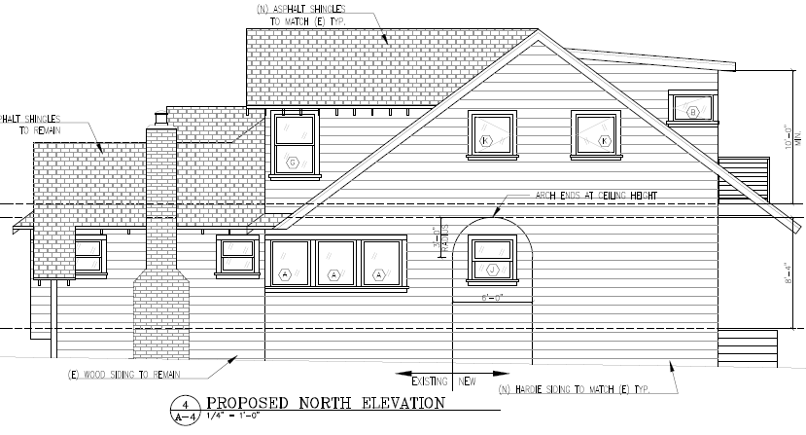
Notes:
Configuration of the windows was also changed in the first and second floor addition. The style of the windows includes fixed, double hung, casement A new arch on the north elevation has been added to coincide with the arch in front of the home.

Slide 6
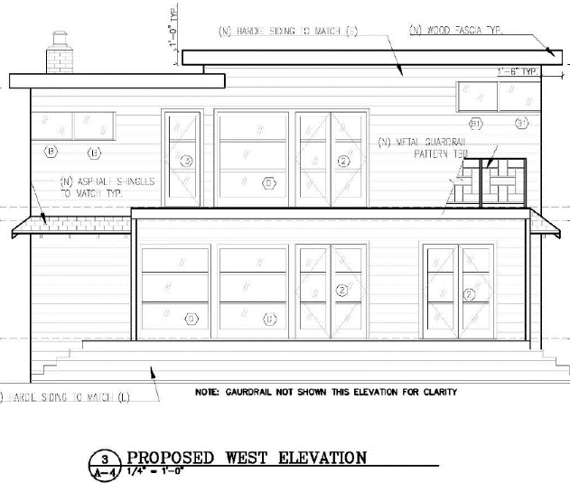
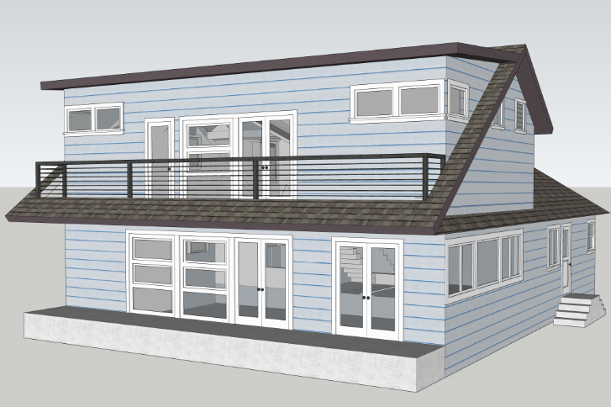
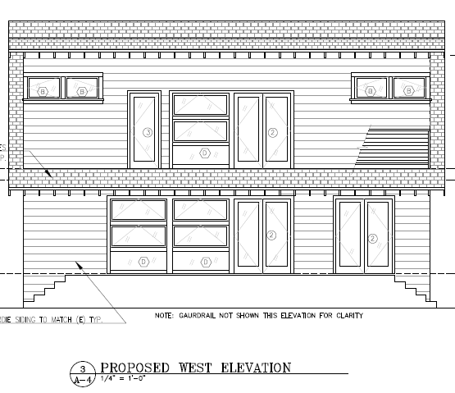
Notes:
Although the second-story addition towards the rear of the home has not been reduced and flat roof is still proposed, this portion has been improved and it will not be visible from the front of the house. The chimney will no longer be extended in height, original height will be kept.

Slide 7
The Subcommittee on August 6th, provided the following comments:
Remove the clerestory windows on both north and south side elevations from the back portion of the addition with the flat roof.
Lower the windows on the west elevation to be in line with the proposed door to allow a better view from the inside to the outside.
Move the back portion with the flat roof (area above the gable roof) in about 2 feet on the side north elevation.
These comments have been included as conditions of approval.
Notes:
The Subcommittee recommends approval of this revised design with proposed modifications as provided on August 6, 2020 (described above). These suggested modifications
Remove the clerestory windows on both north and south side elevations from the back portion of the addition with the flat roof.
Lower the windows on the west elevation to be in line with the proposed door to allow a better view from the inside to the outside.
Move the back portion with the flat roof (area above the gable roof) in about 2 feet on the side north elevation.
These comments have been included as conditions of approval.

Slide 8
Staff Recommendation:
Staff recommends that the Design Review Board approve Design Review Permit for 1319 Stratford Avenue, subject to conditions of approval.

Slide 9
Design Review Board Options:
The Design Review Board can Approve as submitted without design changes as recommended by the Subcommittee; or
The Design Review Board can Approve with modifications to condition(s); or
The Design Review Board can Continue the project for a future public hearing and direct the applicant to make changes to the project; or
The Design Review Board can Deny the project.

Slide 10
Questions?

