Slide 1


Slide 2
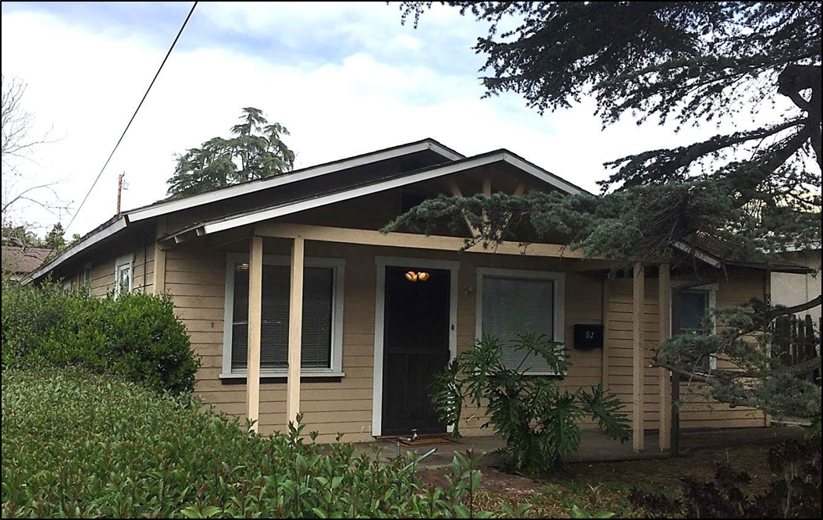
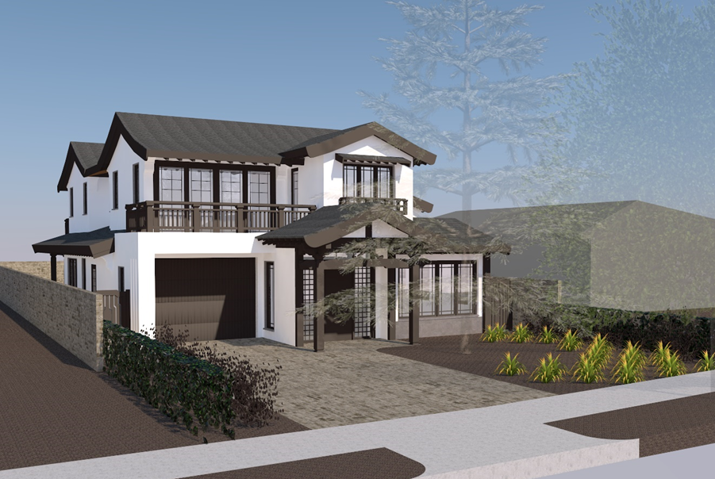
    PROJECT DESCRIPTION
Demolition - Existing 1,154 sq. ft. home and 1-car garage.
Design Review - 2-story 3,410 sq. ft. single-family residence on a 7,074 square foot lot.

Slide 3
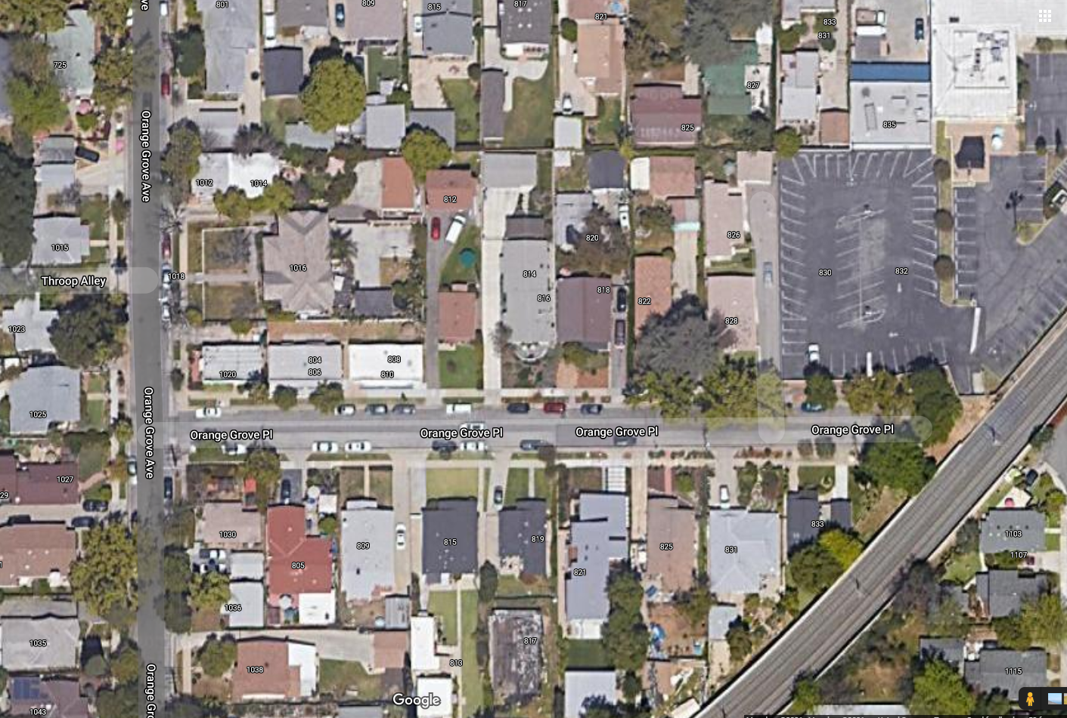
N

Slide 4
    Comments and Recommendations
Modify the front elevation so front entry is more prominent than the second floor /reduce second floor appearance above the front entrance.
Add additional flared roofing throughout.
Reduce the size of front elevation roofing.
Reduce the roof pitch and plate height to be more consistent with a craftsman style aesthetic and neighborhood.
Extend the eaves and emphasize the rafter tails to reflect a more craftsman style. (Reconsider the use of corbels).
Provide windows with appropriate size and variety.
Improve garage overhang area (appears out of sync).
Reduce the appearance of the second floor from the sides. Further articulate the west elevation near the garage.
Reduce hardscaping in front setback
A traditional-style entry door.

Slide 5
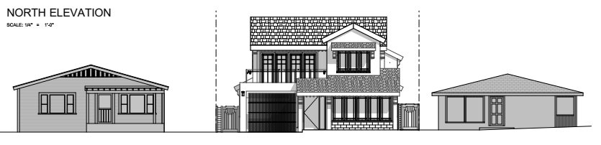
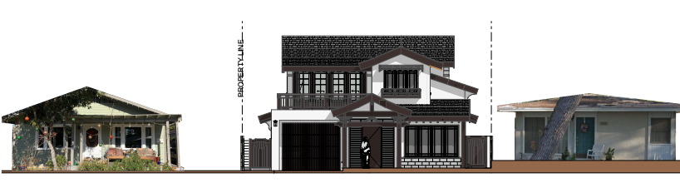
    DESIGN REVIEW
Previous
Revised

Slide 6
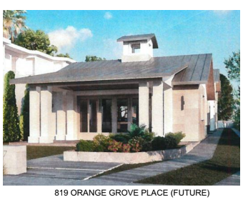
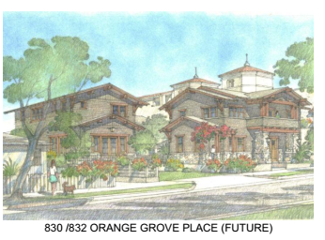
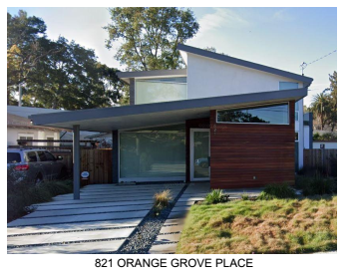
    DESIGN REVIEW

Slide 7
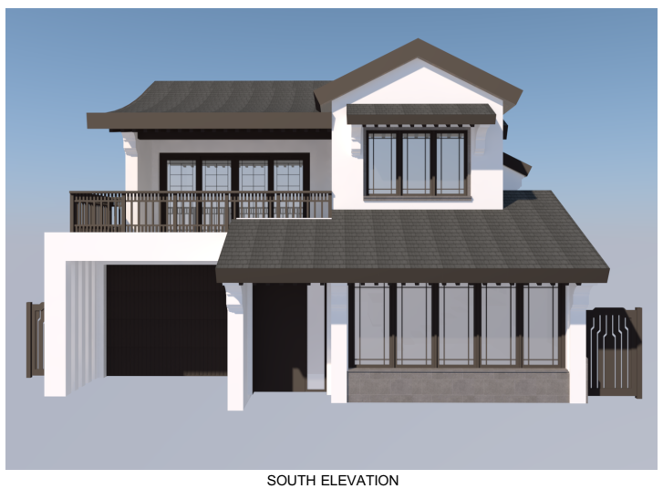
    DESIGN REVIEW
Previous

Slide 8
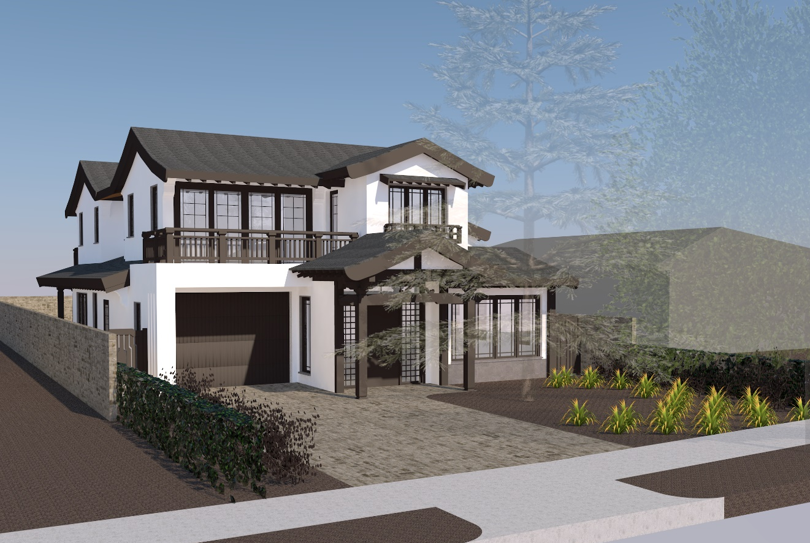
    DESIGN REVIEW
Revised

Slide 9
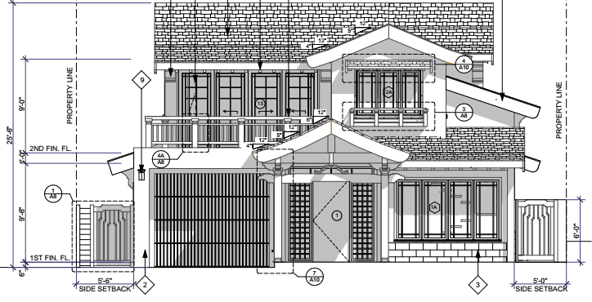
    DESIGN REVIEW

Slide 10
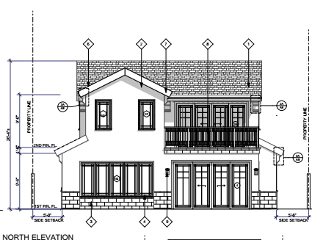
    DESIGN REVIEW
Previous
REAR

Slide 11
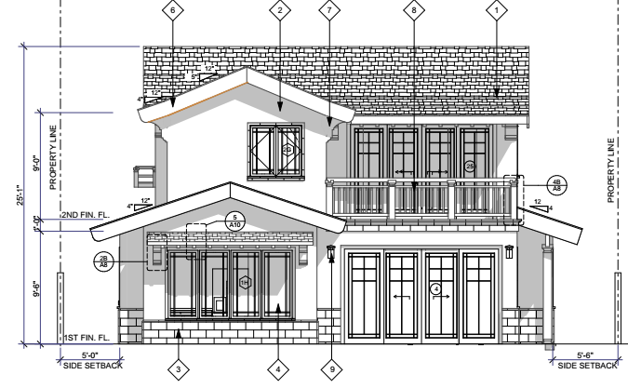
    DESIGN REVIEW
Revised
REAR

Slide 12
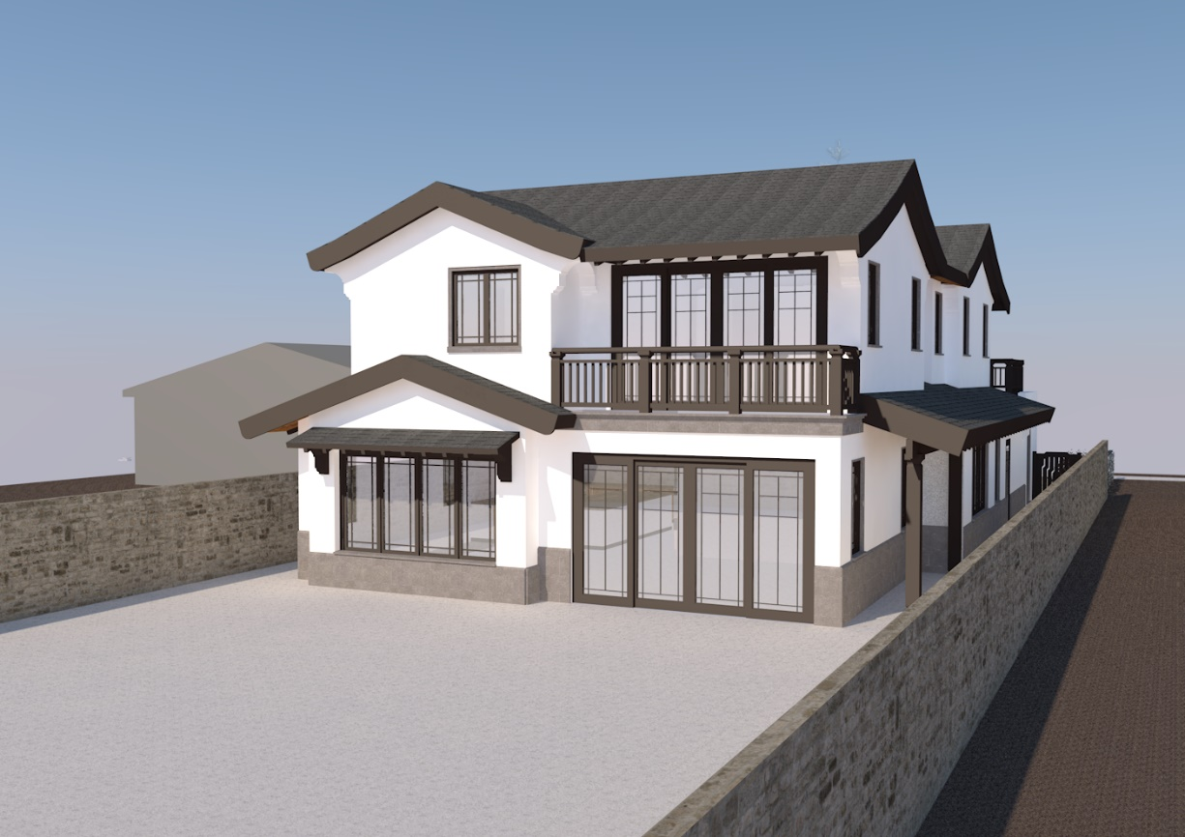
    DESIGN REVIEW

Slide 13
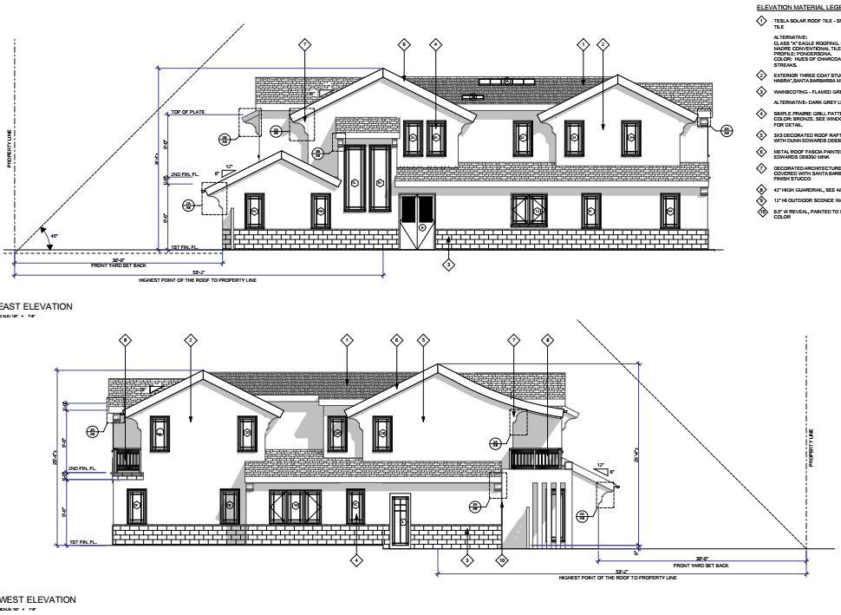
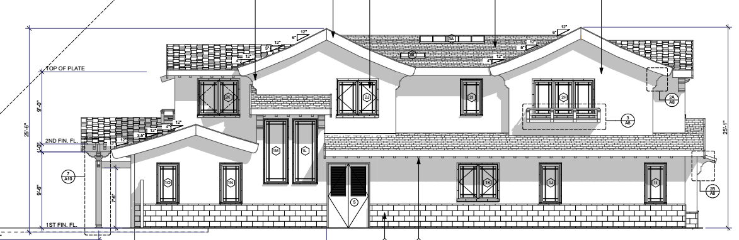
    DESIGN REVIEW
Previous
Revised

Slide 14
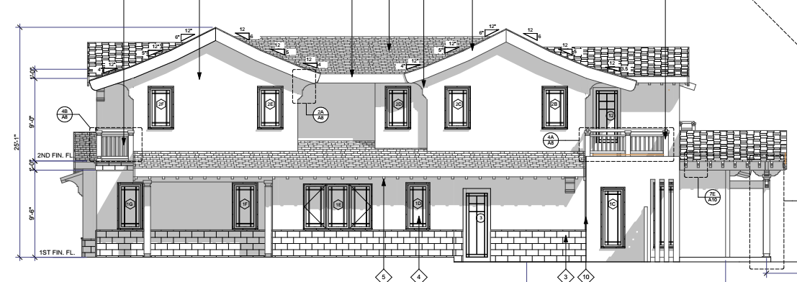
    DESIGN REVIEW
Previous
Revised

Slide 15
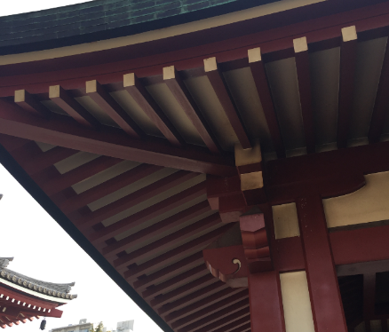
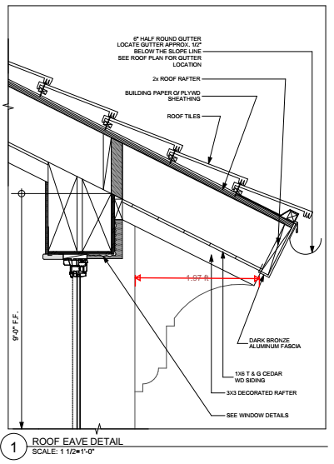
    RAFTERS AND EAVES

Slide 16
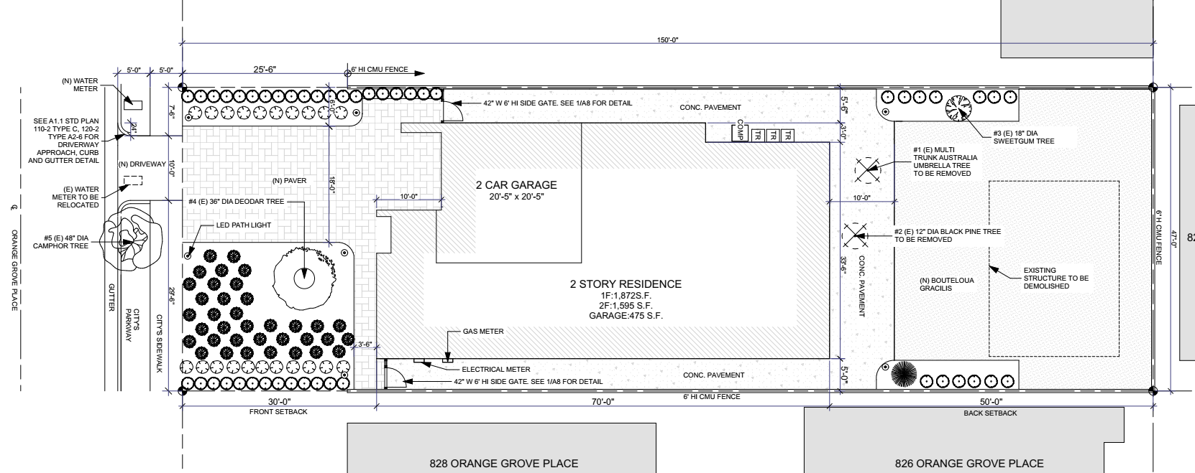
    PREVIOUS SITE PLAN

Slide 17
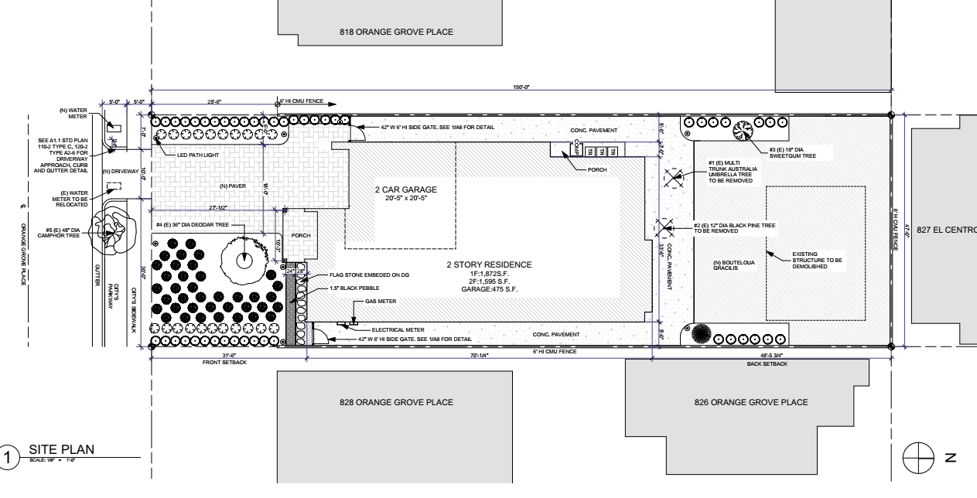
    REVISED SITE PLAN

Slide 18
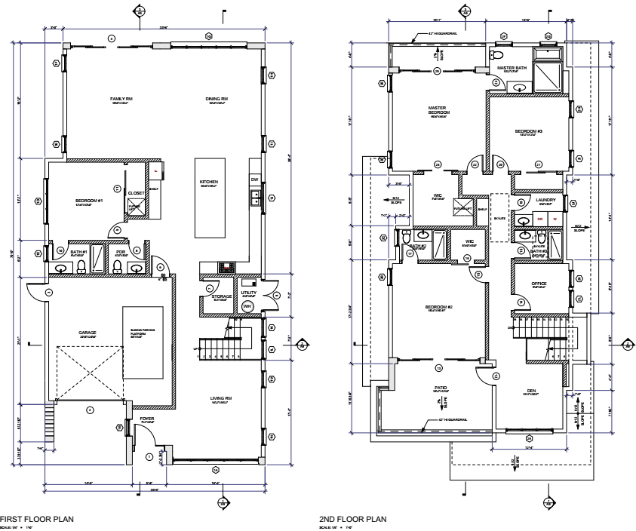
    PREVIOUS FLOOR PLAN

Slide 19
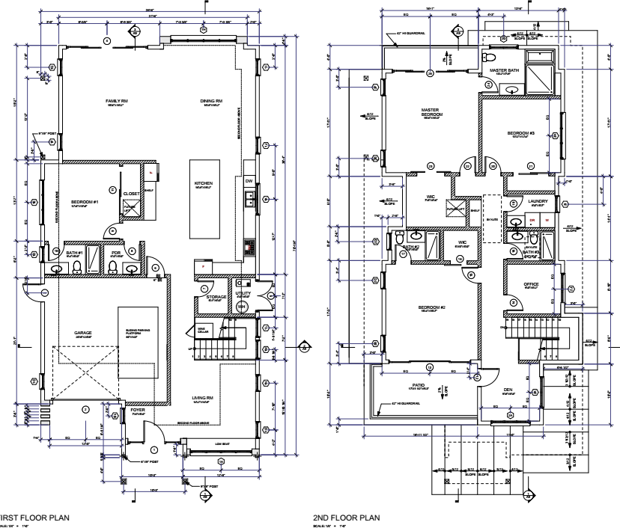
    PROPOSED FLOOR PLAN

Slide 20
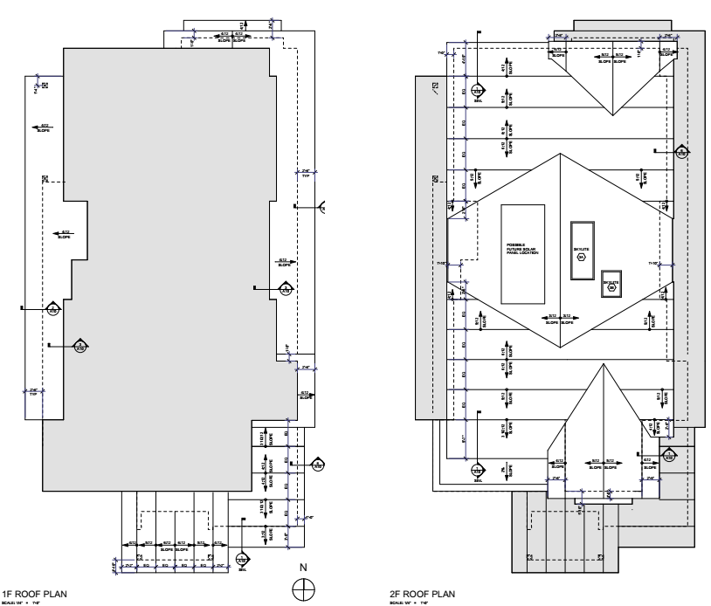
    PROPOSED ROOF PLAN
3:12
6:12
6:12
4:12
3:12
5:12
5:12
5:12
3:12

Slide 21
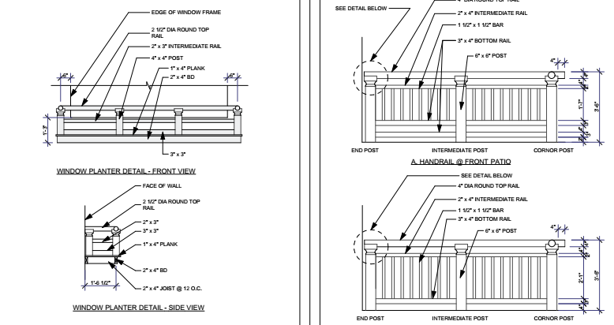
    PLANTER AND HANDRAIL DETAILS

Slide 22
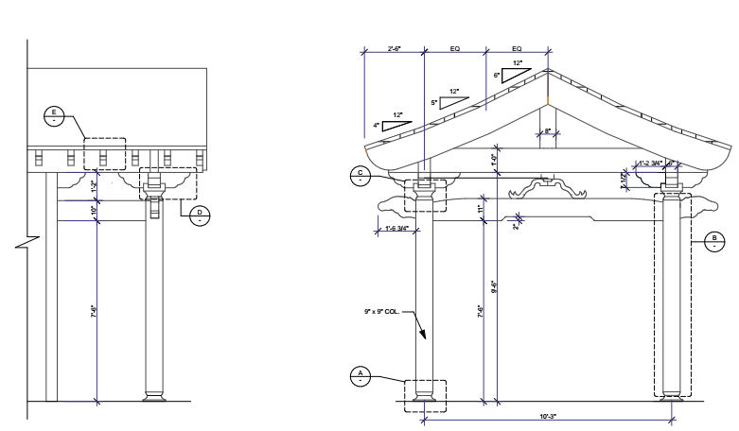
    PORCH DETAILS

Slide 23
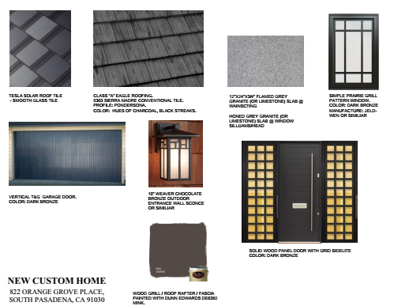
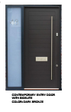
    PROPOSED COLOR and MATERIALS
Previous

Slide 24
    STAFF RECOMMENDATION
DRB approve the Design Review Permit and Notice of Intent to Demolish, subject to conditions of approval.

Slide 25
    ALTERNATIVES
Approve as submitted without design changes as recommended by staff; or
Approve with modifications to condition(s); or
Continue the project for a future public hearing and direct the applicant to make changes to the project; or
Deny the project.

Slide 26
Questions?

