Slide 1
Notes:
Good evening, this presentation is for 2016 Hanscom Drive, project number 2389-DRX/HDP, an application for Design Review and Hillside Development Permit for an addition to an existing single-family home.

Slide 2
PROJECT DESCRIPTION
Design Review for a 3,023 square-foot addition (1,992 square foot first-floor addition and a new 1,032 square foot basement) to an existing 2,540 square foot single-family home.
Hillside Development Permit to allow construction on a site with an average slope of 20% or greater.
Zoning: Residential Single Family (RS)
CEQA: Categorical Exemption – Section 15301, Class 1 “Existing Facilities”.
Notes:
The project involves an application for the Design Review for a 3,023 square foot addition to an existing 2,540 square foot single-family home. The addition includes a 1,992 square foot single-story addition and a new 1,032 square foot basement. The project also includes a Hillside Development permit to allow construction on a site with an average slope of 20% or greater.
The project is categorically exempt under CEQA Section 15301, Class 1 Existing Facilities

Slide 3
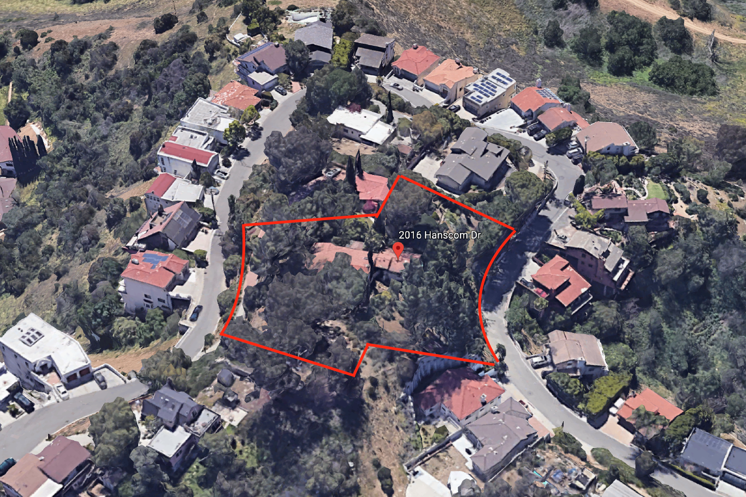
Aerial View
Monterey Road
Brunswick Ave.
N
Notes:
This slide shows an aerial of the project site outlined in red. The proposed project is located on a 46,881 square foot lot and is located on a hillside through lot on Hanscom Drive. The property is surrounded by a mix of multi-level residential buildings.

Slide 4
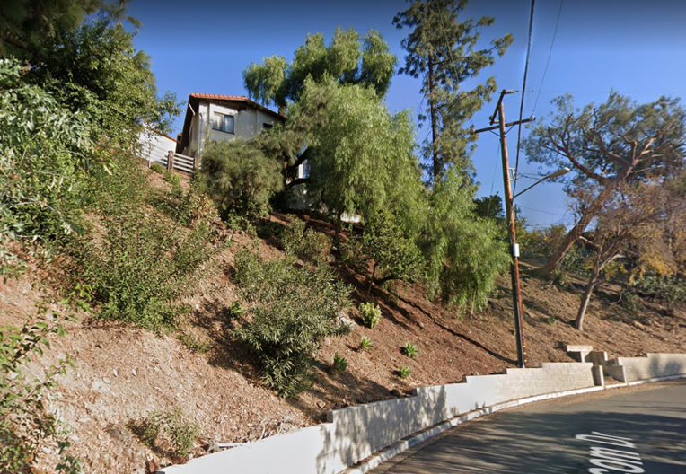
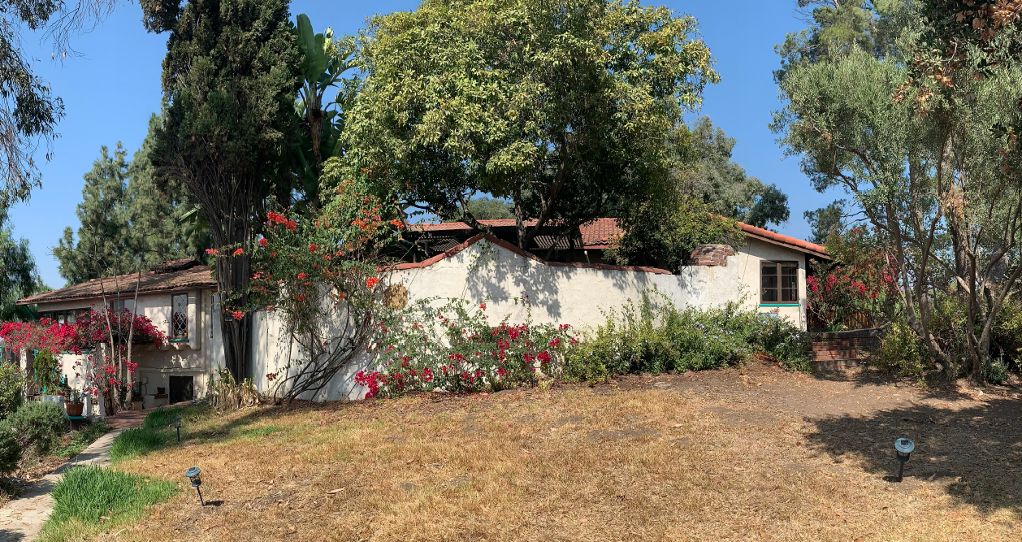
Street View (West)
Front of House (South)
Notes:
On the left you can see the street view of the existing residential structure from the Western side of the property. Due to the placement on top of the hill and the large number of trees, the residence is primarily screened from view. On the right you can see the front of the house, which is a Spanish Colonial Revival bungalow.

Slide 5
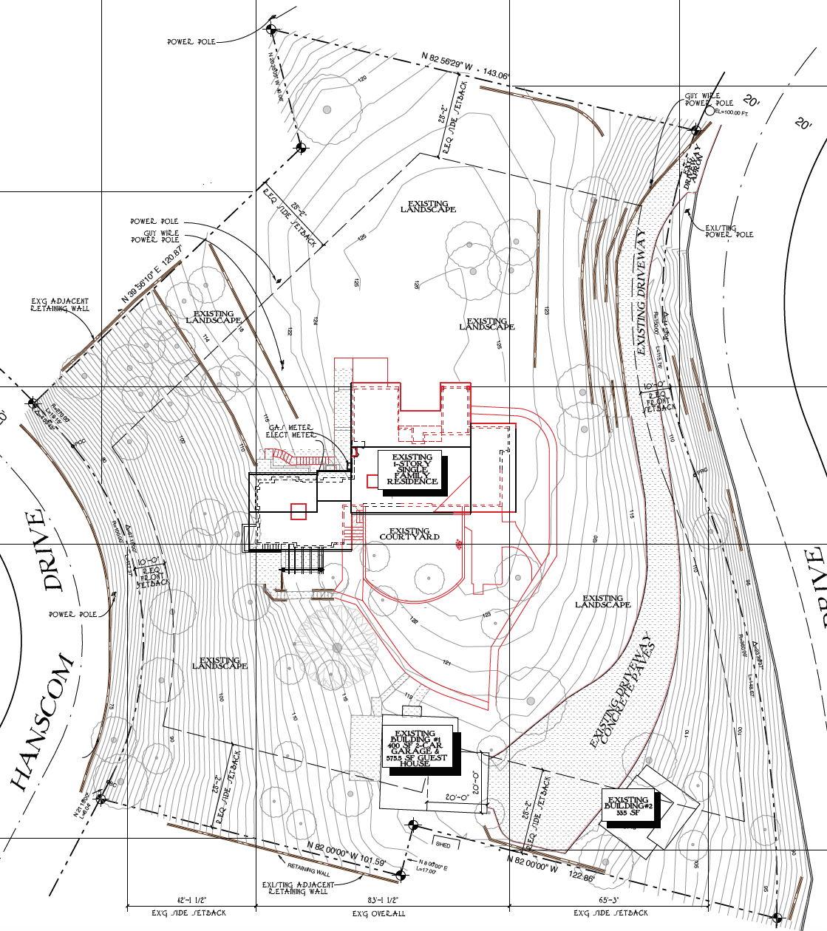
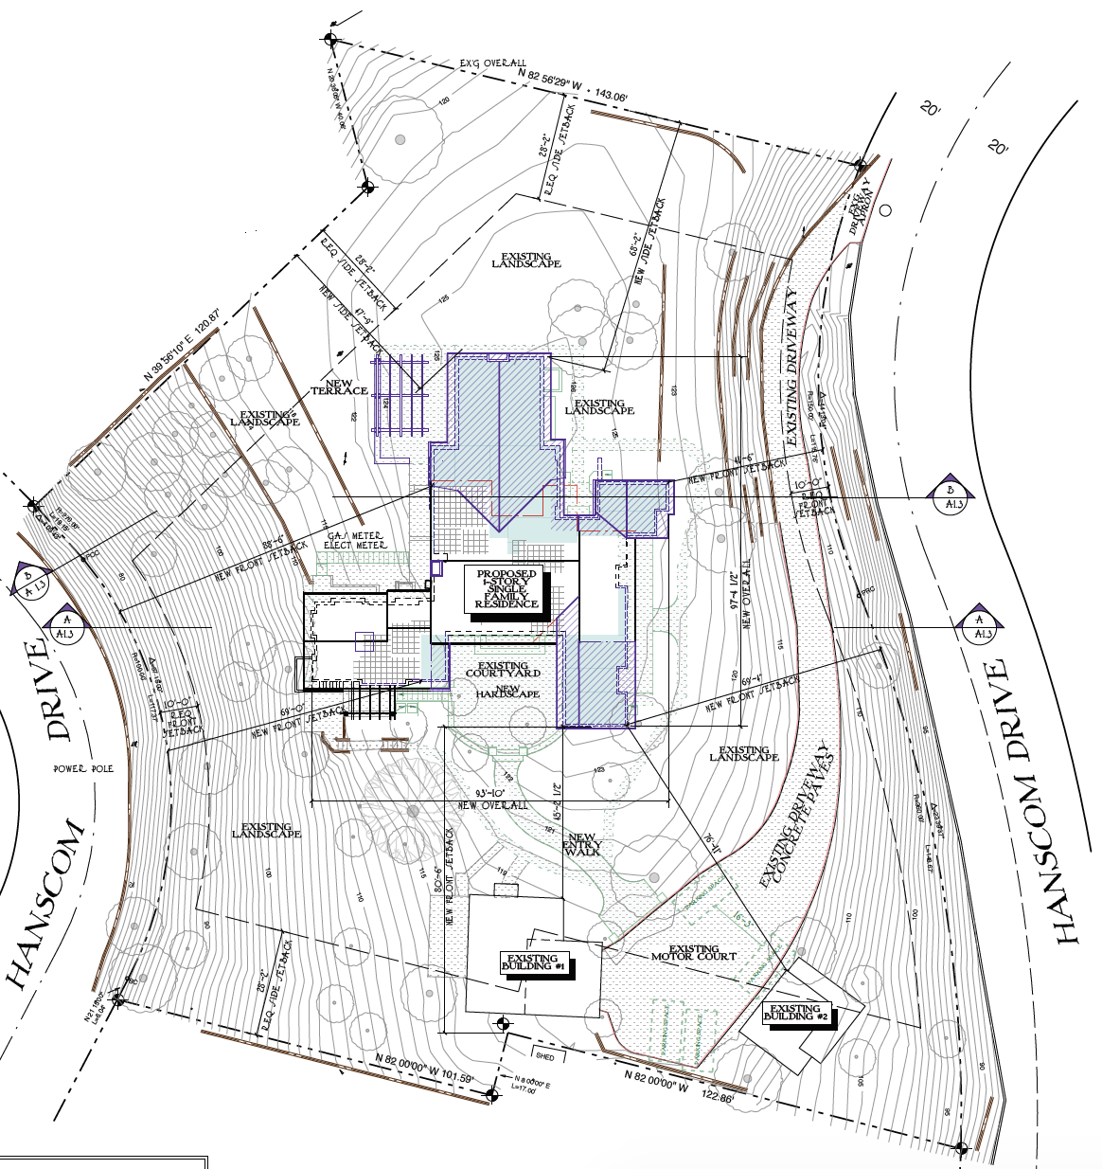
Site Plan
EXISTING
PROPOSED
Notes:
This is the site plan. The red shows the areas which will be demolished. The blue indicates the proposed additions to the house.

Slide 6
South Elevation (Front)
EXISTING
PROPOSED

Slide 7
North Elevation (Rear)
EXISTING
PROPOSED

Slide 8
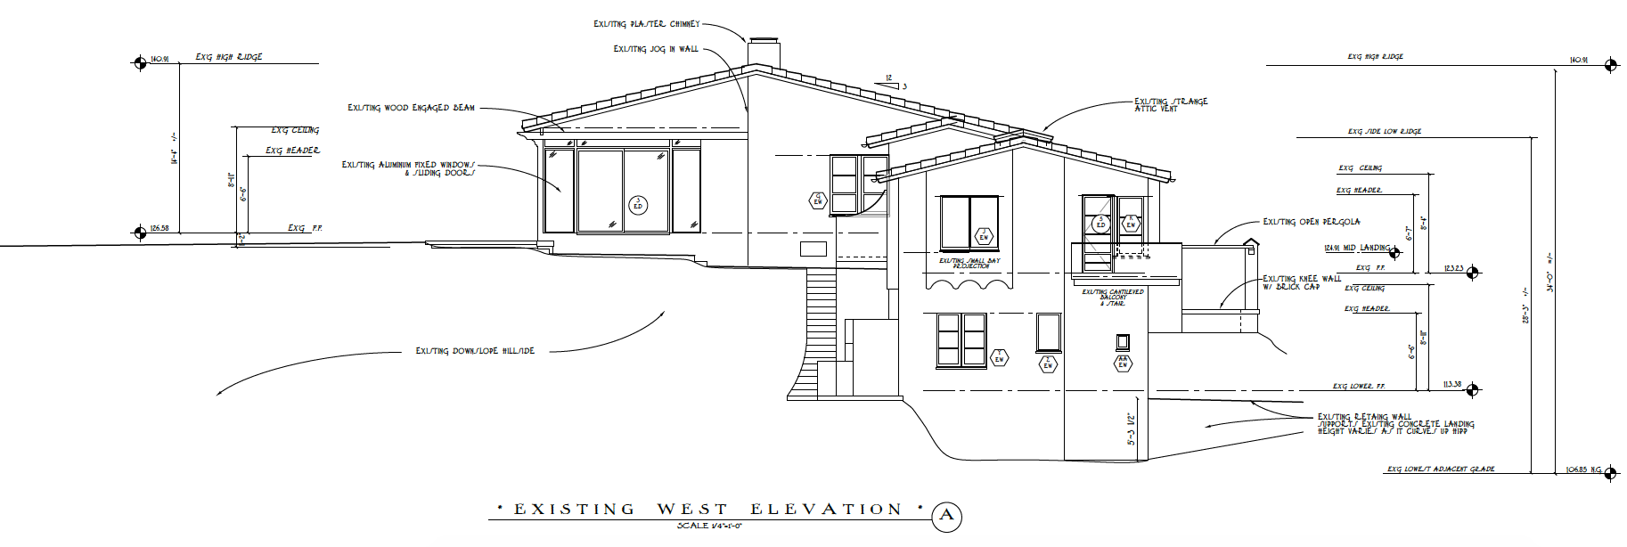
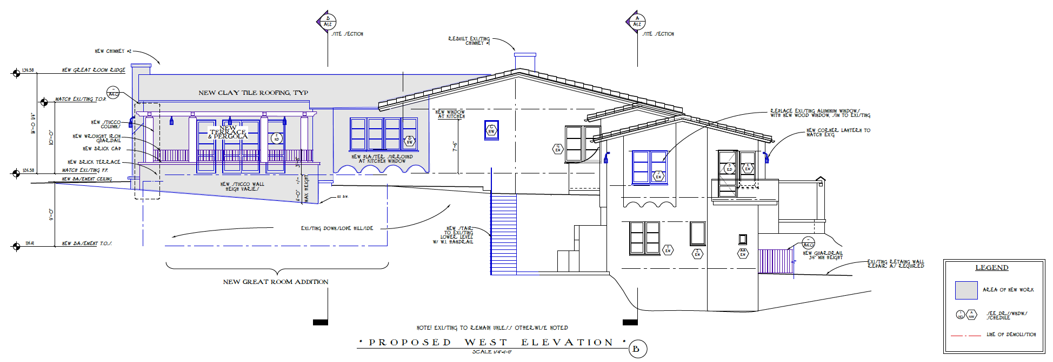
West Elevation (Side)
EXISTING
PROPOSED

Slide 9
East Elevation (Side)
EXISTING
PROPOSED
Notes:
This is the view of the existing and proposed East Elevation.

Slide 10
3-Dimensional View – South View (Front of House)
Notes:
This is a three dimensional view of the front of the proposed home. The colors and materials proposed are high quality and complement the existing structure. The roofing, which was changed in the 1950s will be replaced with barrel clay terra cotta tile. Shallow pitch gable roof forms will be maintained. Smooth and trowel stucco walls in classic white are proposed. Eaves will have shaped rafter tails. And decorative glazed tile accents are proposed.

Slide 11
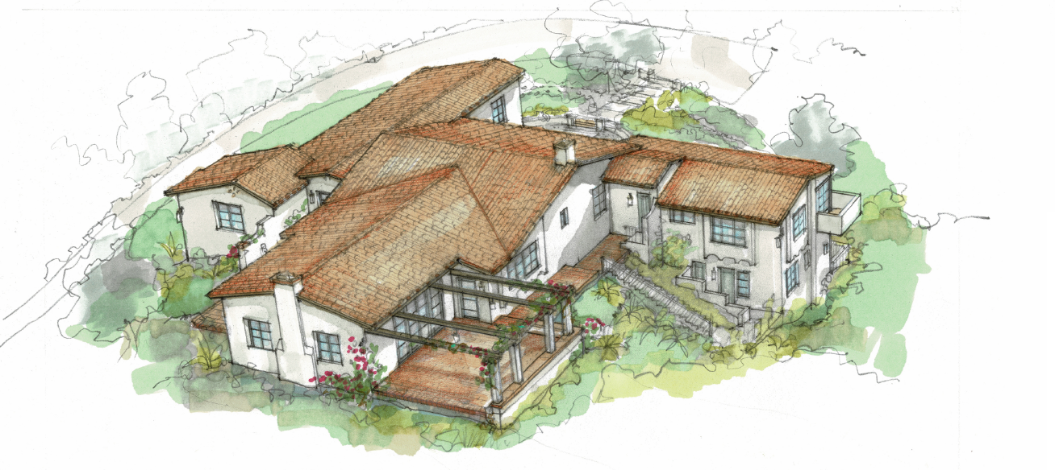
3-Dimensional View – North Bird’s Eye View
Notes:
This is the North Bird’s Eye View. Here you can see the open wood and stucco pergola
The project proposes paired wood multi-lite casement wood windows and wood multi-lite French doors.

Slide 12
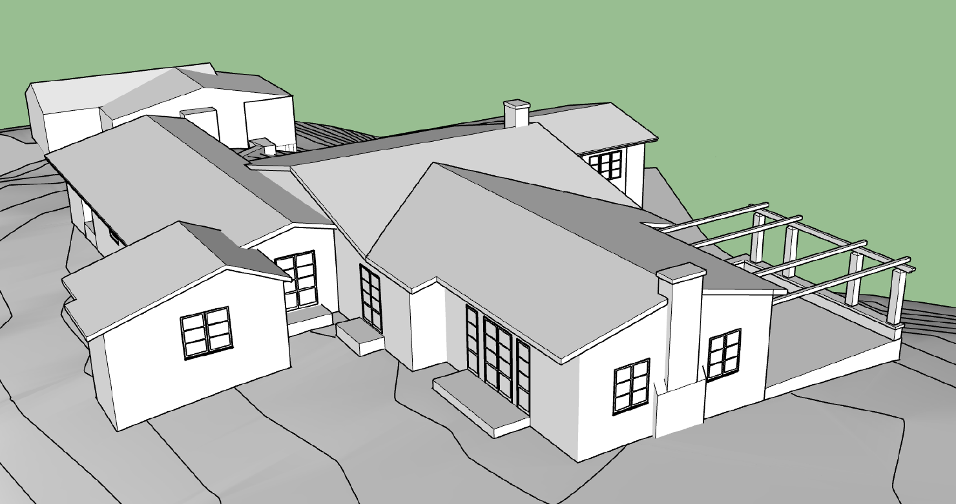
3-Dimensional View – North/East View
Notes:
Here we have a North/East model, which gives you a sense of scale of the addition.

Slide 13
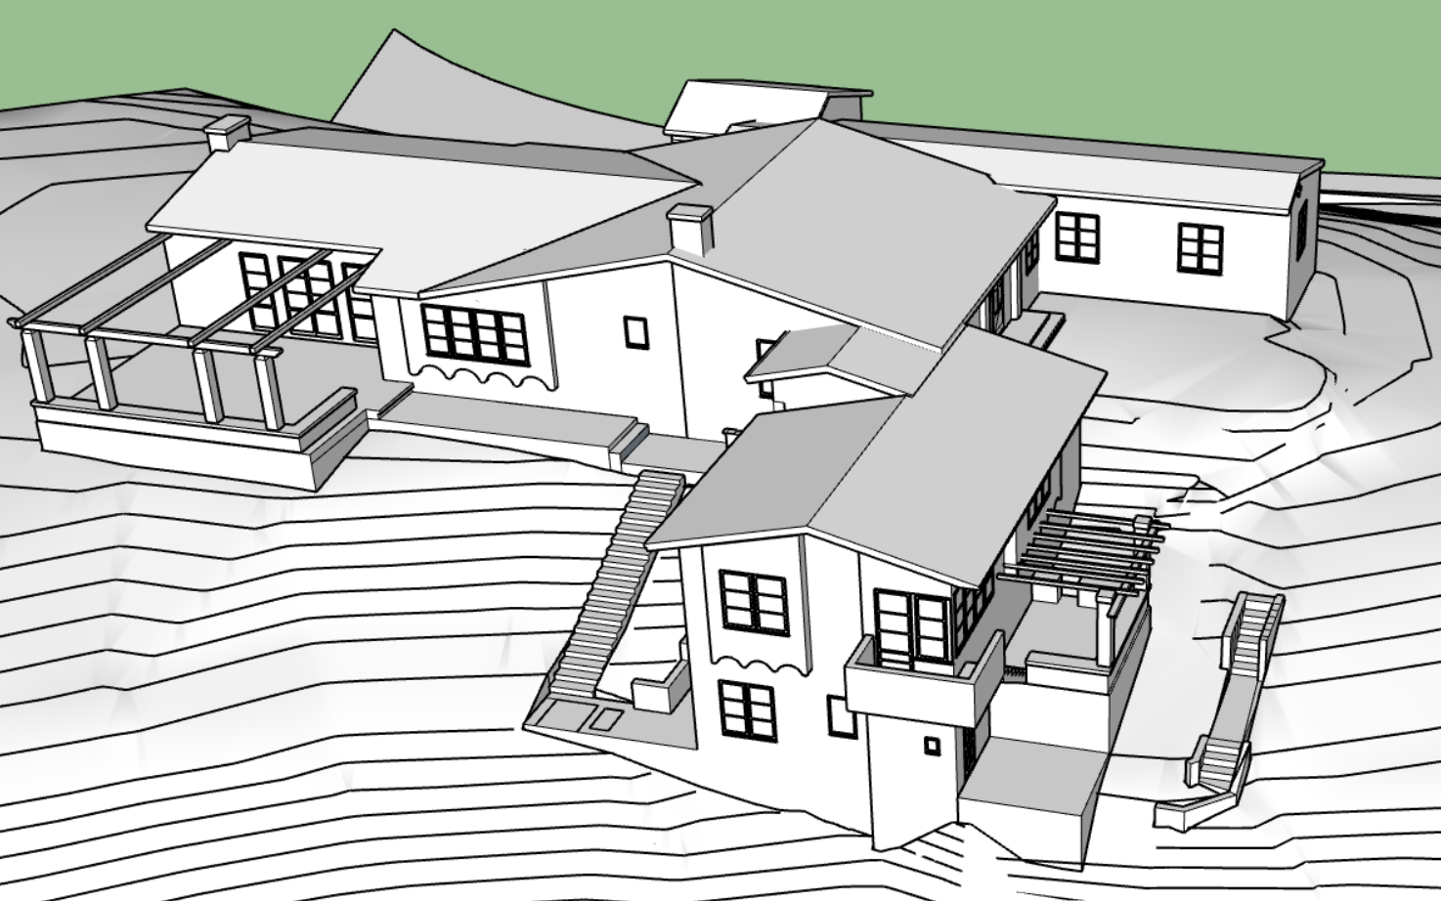
3-Dimensional View – West/South View
Notes:
And here we have the West/South 3-D view.

Slide 14
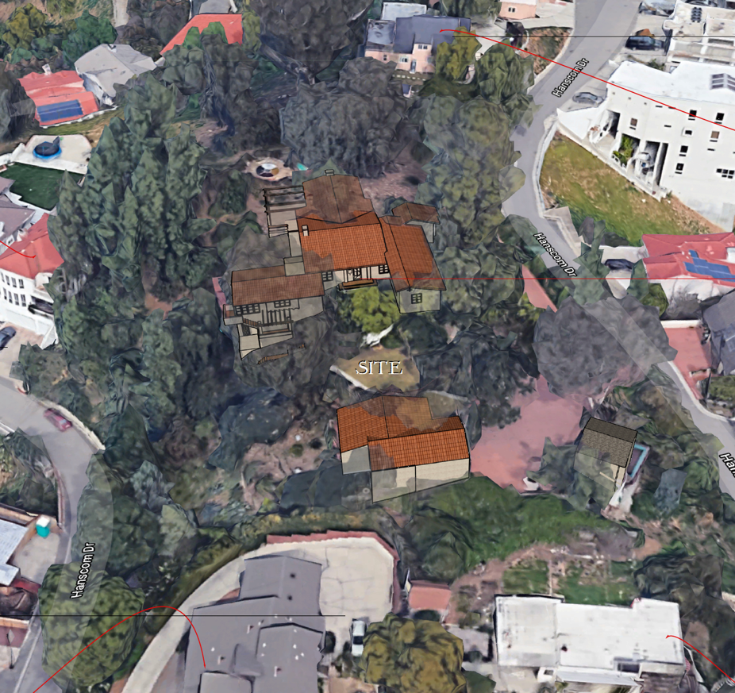
3-Dimensional Model with Adjacent Properties
Notes:
This slide shows the proposed project in the context of the neighborhood, The property is located at the top of the hill and surrounded by trees, No trees are proposed to be removed.

Slide 15
Conditions of Approval:
The applicant shall provide photographs to Planning, Building, and Public Works Departments illustrating that proper construction fencing is installed and signs describing construction and noise disturbance coordinator contact information are posted at the construction site.
The applicant shall submit a final landscape plan to the Public Works Department. Show all existing and proposed trees, including size and species, and indicate their disposition. If any trees (12” in diameter or greater and/or native trees) are to be removed, apply for a tree removal permit with the Public Works Department per City Ordinance No. 2328 amending Section 34.10 of SPMC. See SPMC Section 34.12 for the required information and process for the trees that are proposed to be removed and/or impacted during construction. Replacement trees shall be planted per SPMC Section 34.12-5. If existing trees are to remain on site, the applicant shall note on the plans methods of protecting existing trees during construction.
Notes:
Staff has included the following conditions of approval. The applicant shall …

Slide 16
1. Approve as proposed without changes; or
2. Approve with modifications to the conditions and/or design(s); or
3. Continue the project to a future public hearing and direct the applicant to make changes to the project; or
4. Deny the project.
Design Review Board Options:
Notes:
The Design Review Board has the following options…

Slide 17
The Design Review Board approve the project as proposed and issue Design Review approval and a Hillside Development Permit, subject to the conditions of approval for the property located at 2016 Hanscom Drive.
STAFF RECOMMENDATION:
Notes:
Staff recommends that the Design Review Board…

Slide 18
Questions
Notes:
This concludes staff presentation and I am here to answer any questions, as is the architect for the project.

