Slide 2
PROJECT DESCRIPTION
Proposal: Design Review for the remodel of an existing 33,355 square-foot grocery store. No new square footage proposed. Remodel includes: modification of the front and side exterior building elevations; repainting of the entire building; upgrading the accessible path to the public right-of-way (Monterey Road); and other associated improvements.
CEQA: Categorical Exemption – Section 15301 Class 1 Existing Facilities

Slide 3
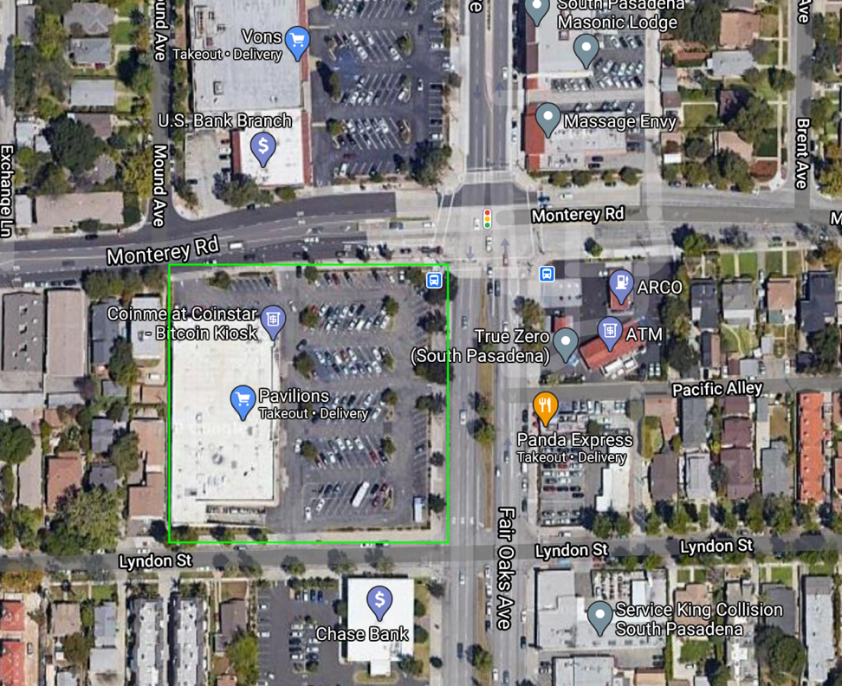
N

Slide 4
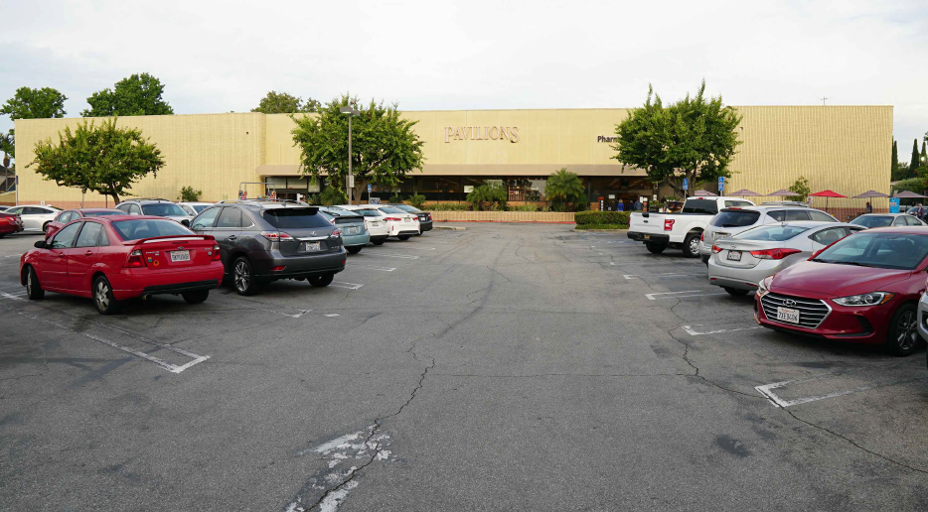
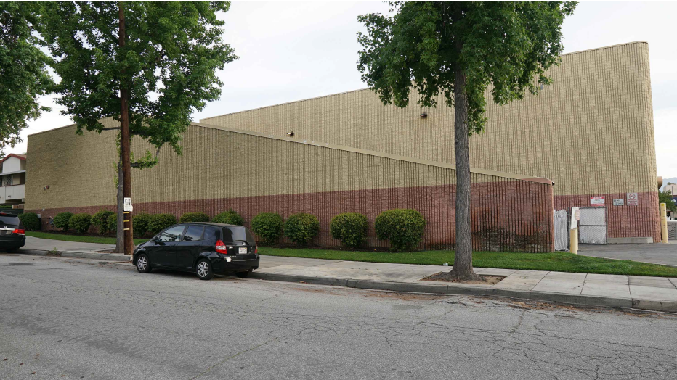
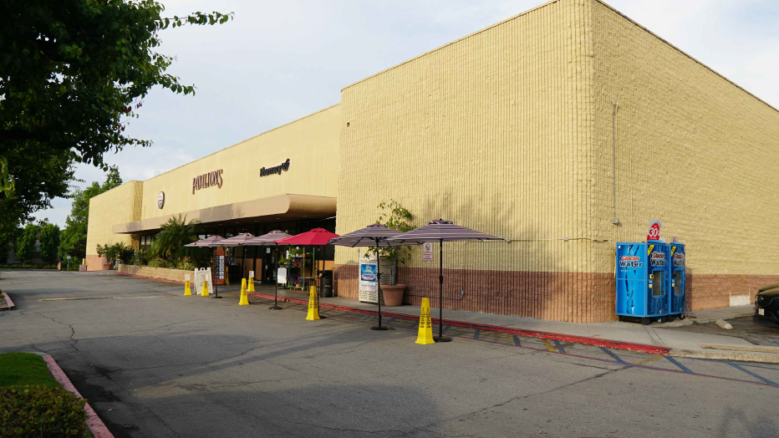
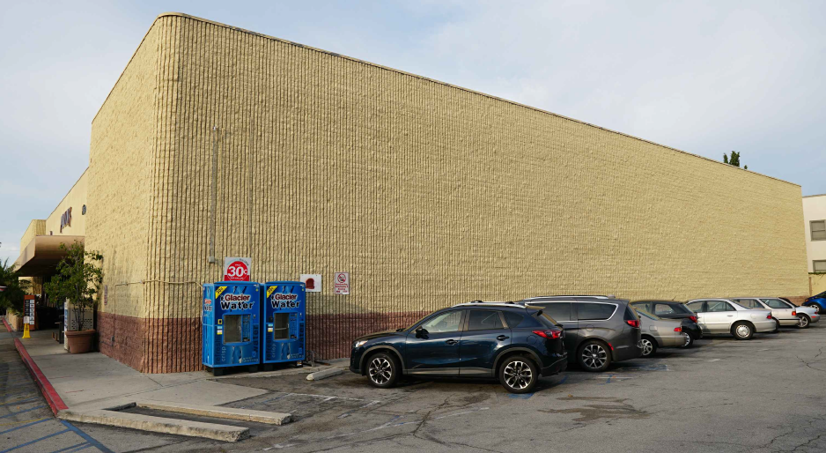
Front (facing Fair Oaks Avenue)
South side (facing Lyndon Street)
Front of store
North side (facing Monterey Road)

Slide 5
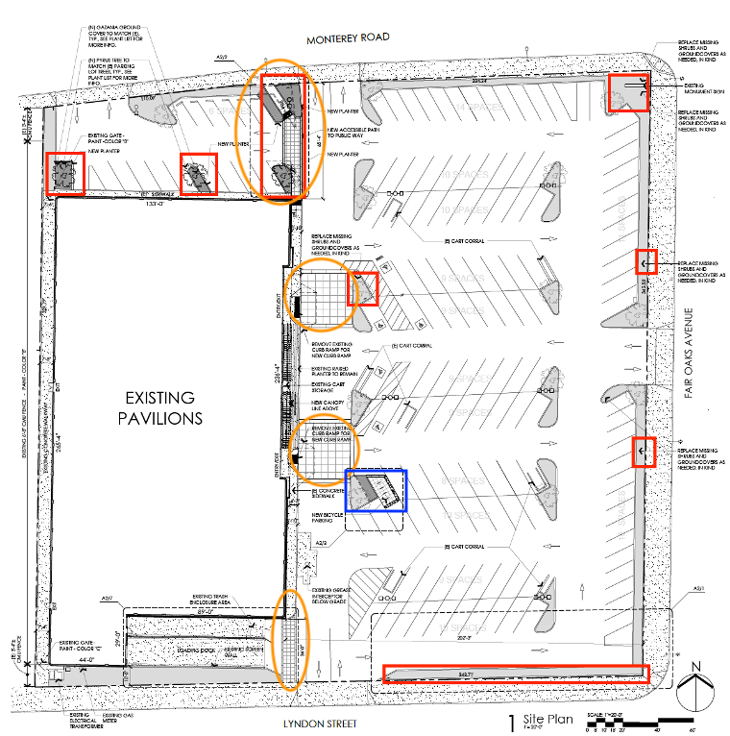
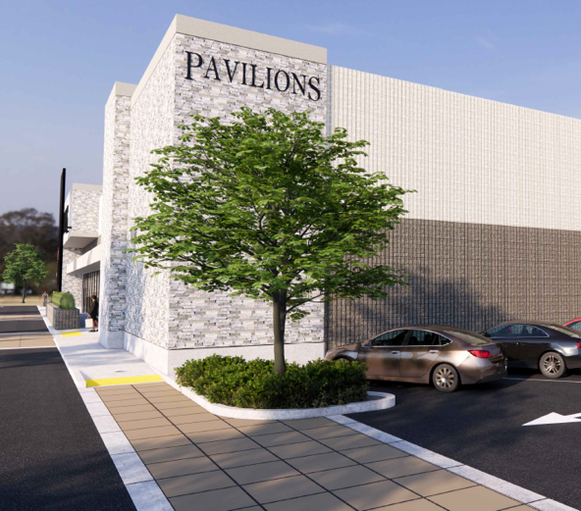
Orange – Pedestrian Pathway Improvements
Red – Landscaping Improvements
Blue – New Bike Parking

Slide 6
Existing vs. Proposed East Elevation (Front)

Slide 7
Existing vs. Proposed North Elevation (Side)

Slide 8
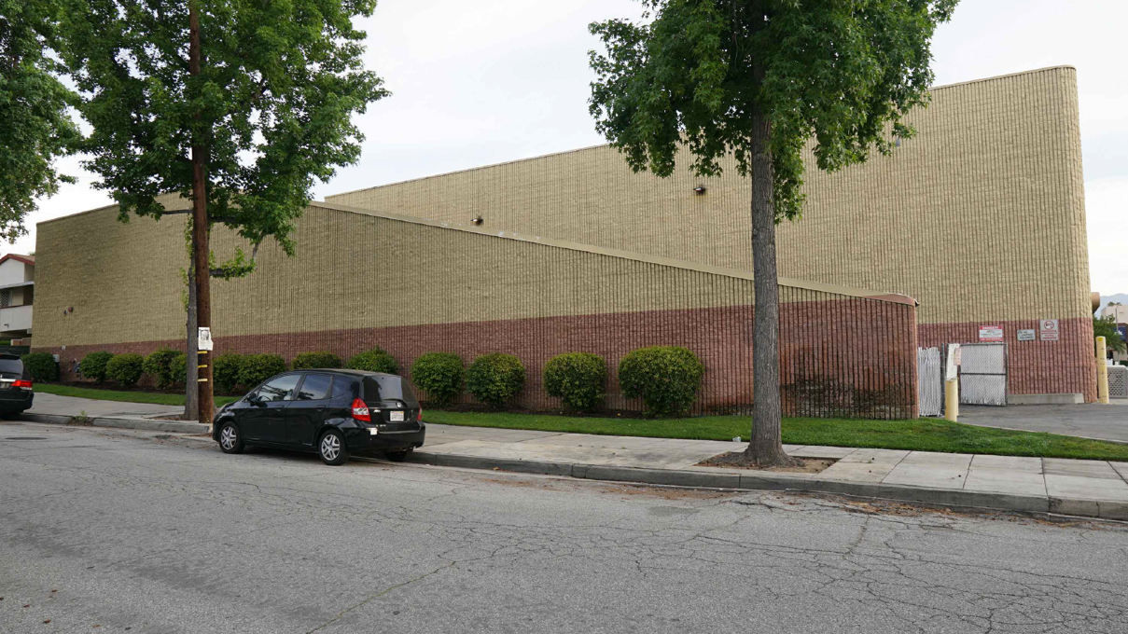
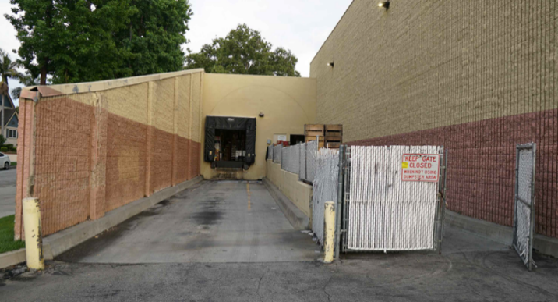
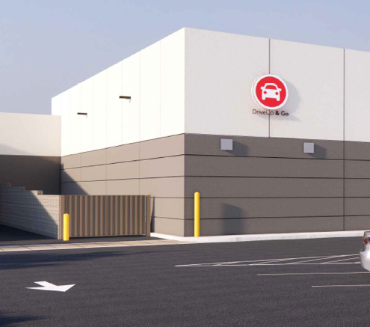
Existing vs. Proposed South Elevation (Side)

Slide 9
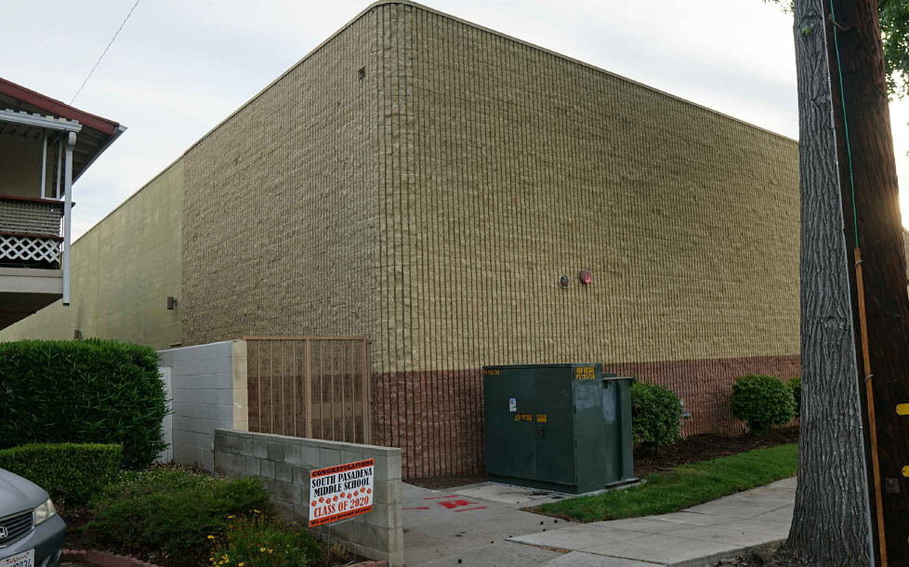
Existing vs. Proposed West Elevation (Rear)

Slide 10
The applicant shall apply for a Sign Permit Application prior to issuance of Building Permits.
The applicant shall provide public art in compliance with SPMC 36.395 if the project meets the minimum valuation to be subjected to the public art requirement prior to issuance of an occupancy permit. If the project is subject to the Public Arts requirement the graphic panels proposed on the North Elevation would be used to satisfy this requirement.
If the project is not subject to Public Art requirement, the applicant shall present the proposed graphic panels on the North Elevation to the Public Art Commission for approval of graphic art to be installed on the panels.
The applicant shall provide revised a north elevation showing that the three (3) graphic art panels on this elevation do not project over the roofline and shall provide details for the installation of these panels for review and approval by the Chair of the Design Review Board.
Conditions of Approval:

Slide 11
STAFF RECOMMENDATION:
Approve the Design Review of the proposed remodel of an existing grocery store at 1213 Fair Oaks Avenue, subject to conditions of approval.

Slide 12
Design Review Board Options:
Approve with condition(s) added;
Continue the project to address comments discussed; or
Deny the project.

Slide 13
Questions?

