Slide 2
Project Description
Proposal: Demolish the existing home and accessory structures and Design Review for the construction of 2 new single-family homes.
CEQA: Categorical Exemption –
Section 15301 Class 1 Existing Facilities and
Section 15303 Class 3 New Construction or Conversion of Small Structures

Slide 3
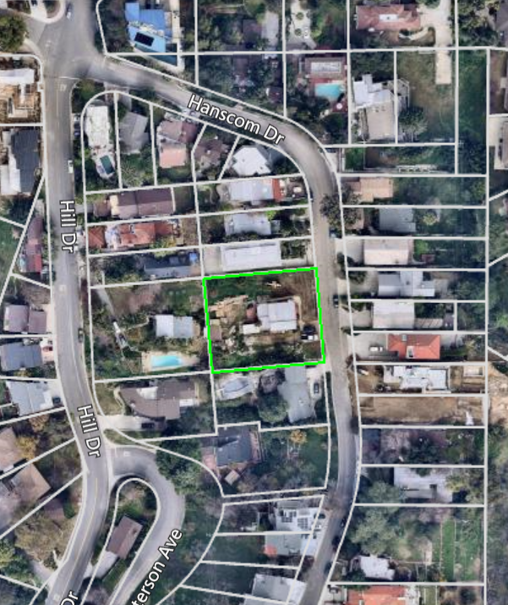
N

Slide 4
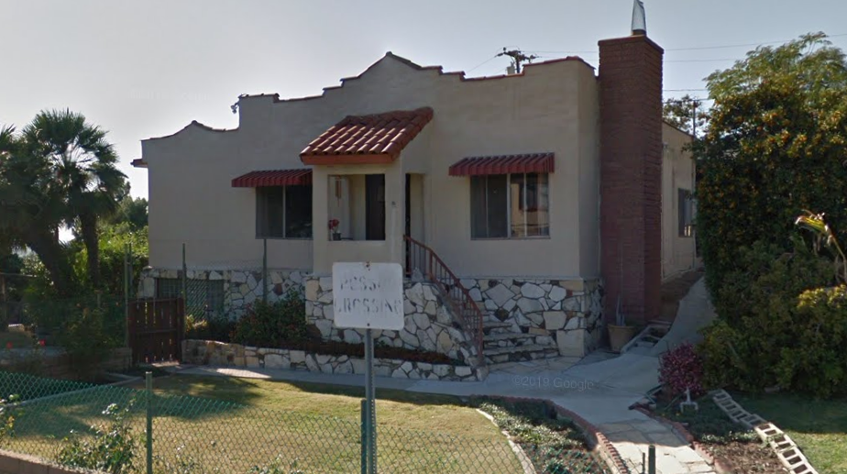

Slide 5
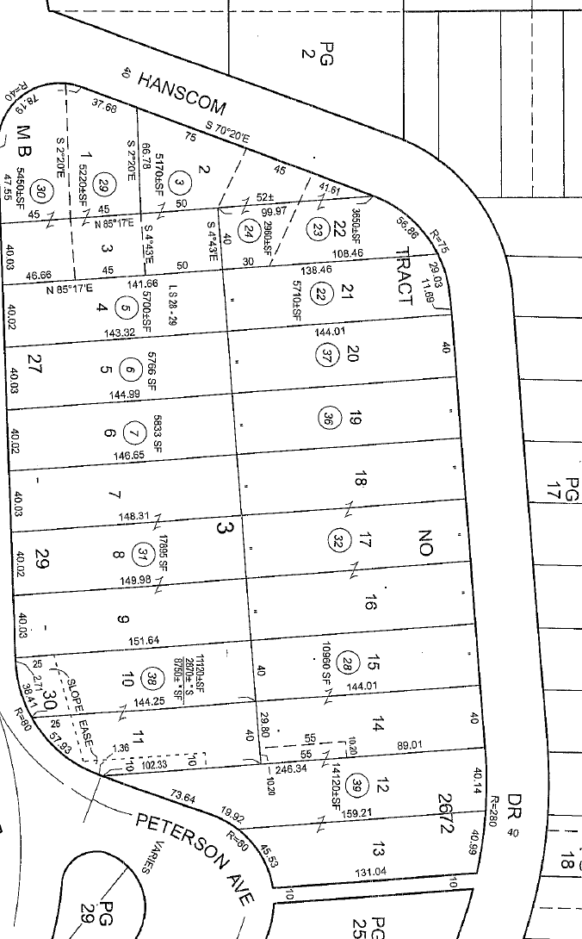
Existing Lots | 16 | 17 | 18 | Total
Square-Footage | 5,501.5 | 5,501.5 | 6,310 | 17,313
New Lots | 2 |  | 1
New Square-footage | 11,003 |  | 6,310 | 17,313

Slide 7
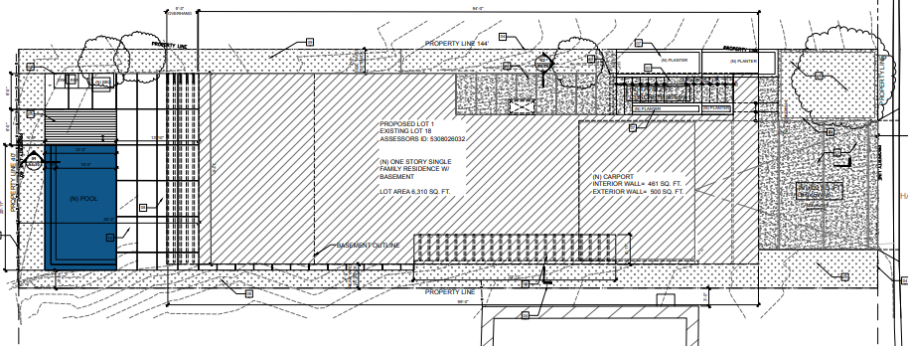
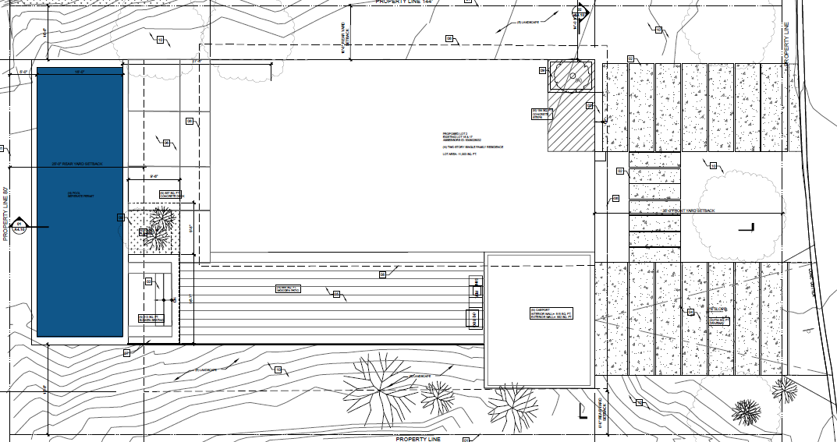
N

Slide 8
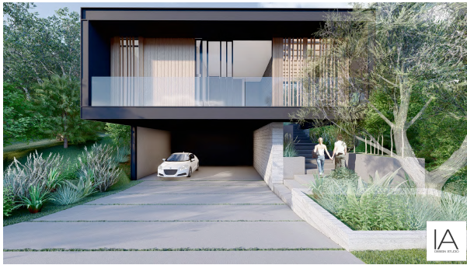
Lot 1 - Proposed East (Front) Elevation

Slide 9
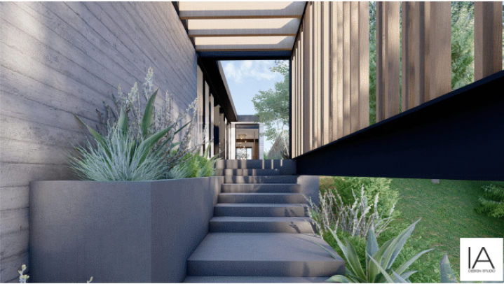

Slide 10
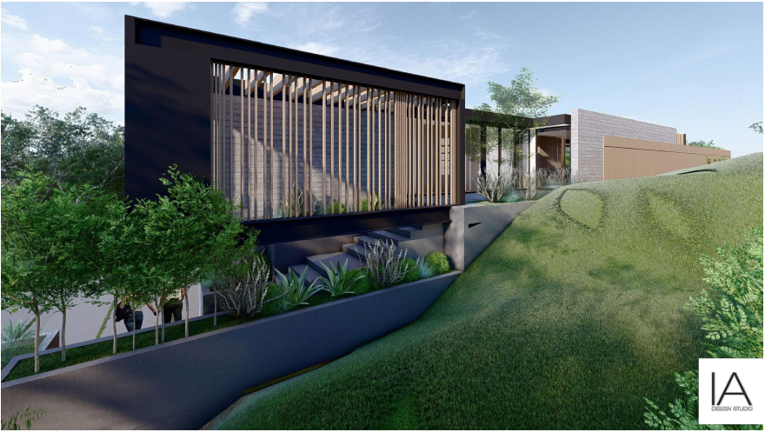
Lot 1 - Proposed North (Side) Elevation

Slide 11
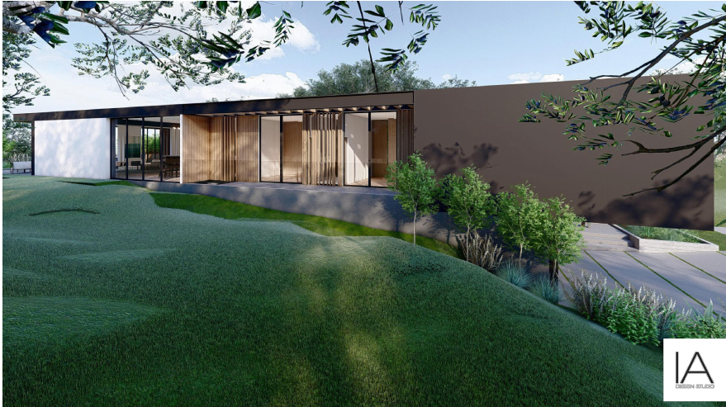
Lot 1 - Proposed South (Side) Elevation

Slide 12
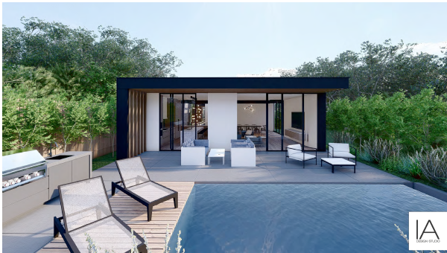
Lot 1 - Proposed West (Rear) Elevation

Slide 13
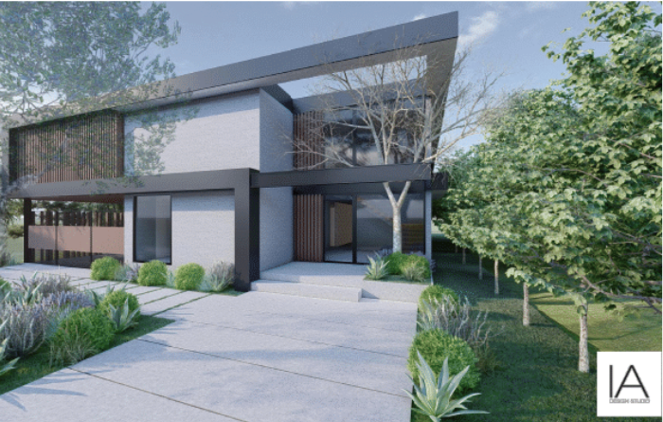
Lot 2 - Proposed East (Front) Elevation

Slide 14
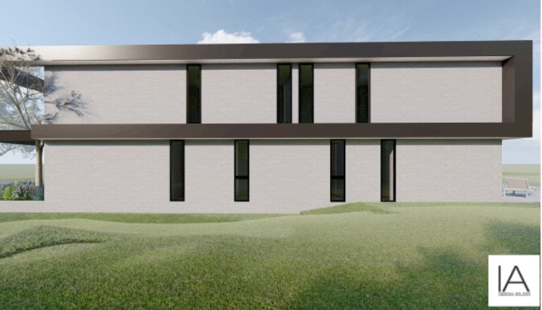
Lot 2 - Proposed North (Side) Elevation

Slide 15
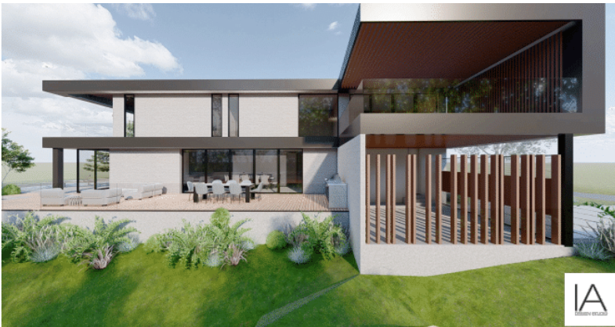
Lot 2 - Proposed South (Side) Elevation

Slide 16
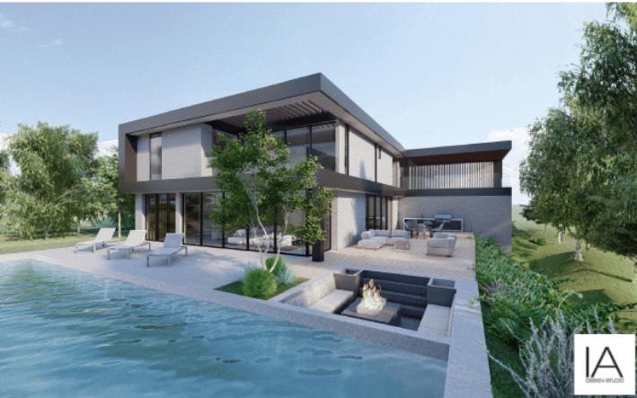
Lot 2 - Proposed West (Rear) Elevation

Slide 17
Conditions of Approval:
Record the lot line adjustment and parcel merger
Construction of each residence shall occur concurrently.
Submit a construction management plan
Pre-construction meeting with the City of South Pasadena Planning and Building Divisions, and Public Works Department.
Submit detail construction landscape and irrigation plans showing compliance with the City’s Water Efficient Landscape Ordinance (SPMC Section 35.50)

Slide 18
Staff Recommendation:
Approve the demolition of the existing home and accessory structures and Design Review of two new single-family homes at 1733 Hanscom Drive, subject to conditions of approval.

Slide 19
Design Review Board Options:
Approve with condition(s) added;
Continue the project to address comments discussed; or
Deny the project.

Slide 20
Questions?

