Slide 2
PROJECT DESCRIPTION
Proposal: Demolish the existing home and 2 car garage and Design Review for the construction of a single family home.
CEQA: Categorical Exemption –
Section 15301 Class 1 Existing Facilities and
Section 15303 Class 3 New Construction or Conversion of Small Structures

Slide 3
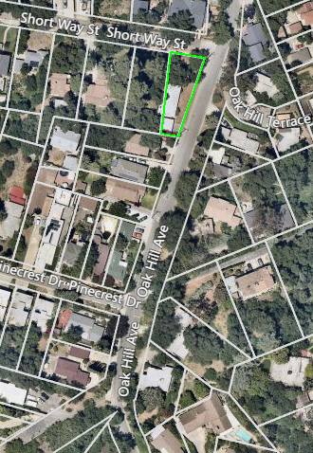
N

Slide 4
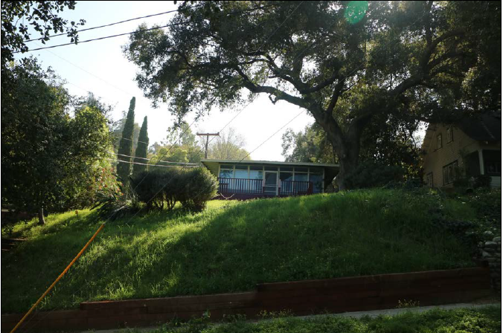

Slide 5
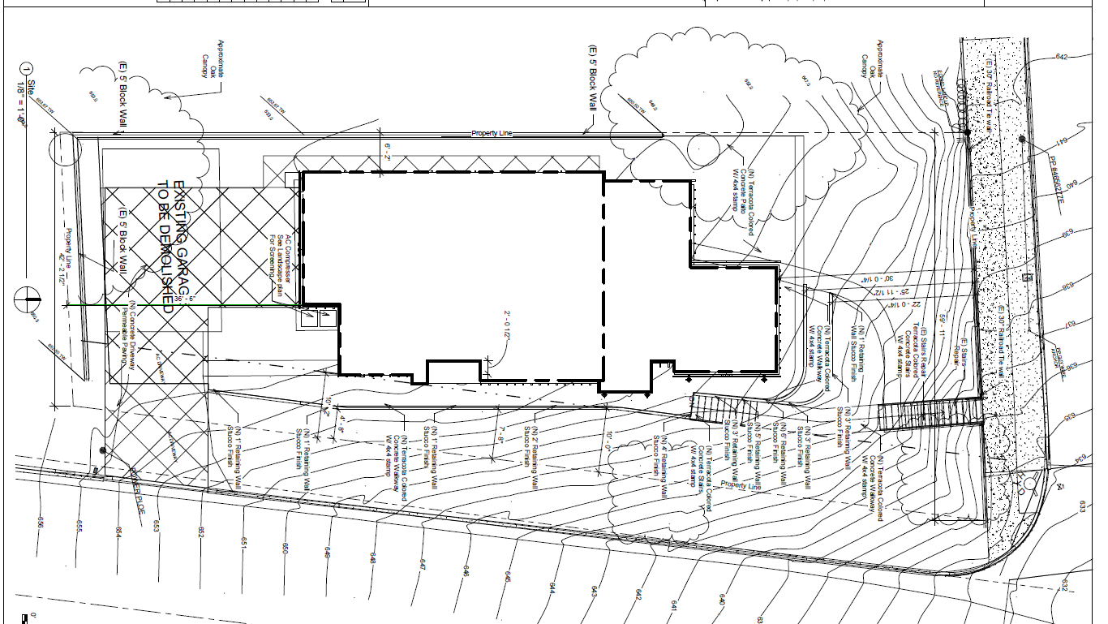

Slide 6
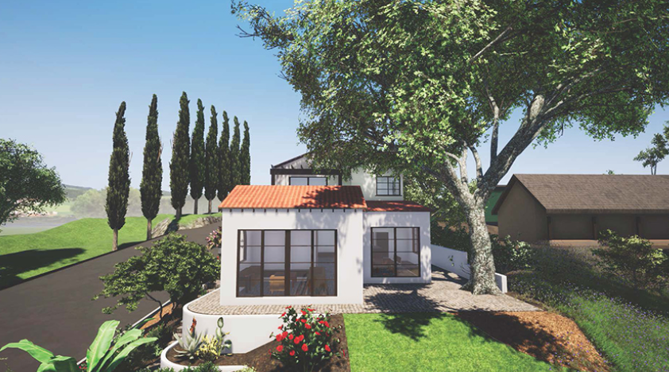
Proposed North Elevation (Front)

Slide 7
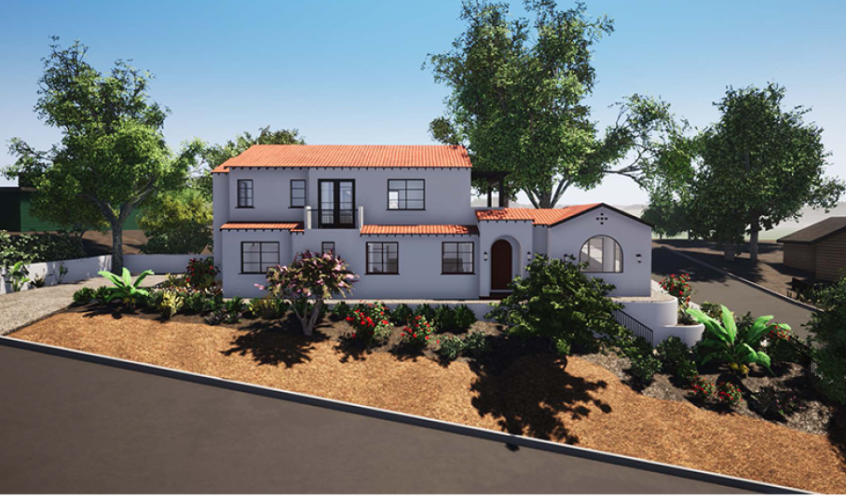
Proposed East Elevation (Side)

Slide 8
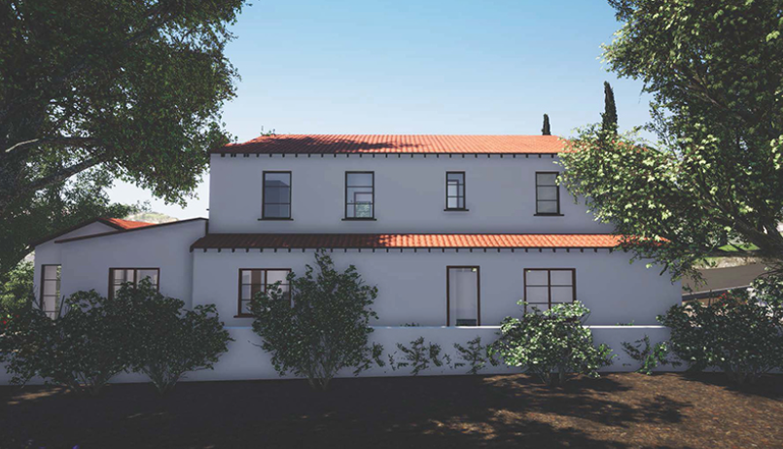
Proposed West Elevation (Side)

Slide 9
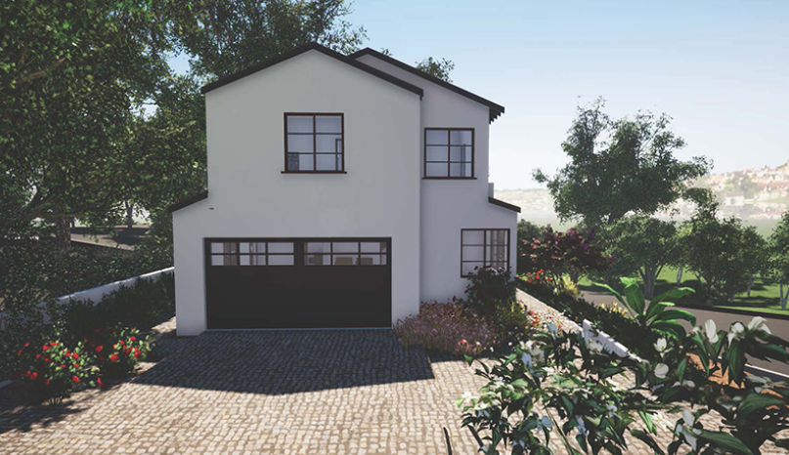
Proposed South Elevation (Rear)

Slide 10
Apply for a lot line adjustment to remove the lot tie connecting the two lots, receive approval and record.
Submit a construction management plan.
Pre-construction meeting with the City of South Pasadena Planning and Building Divisions, and Public Works Department.
Submit detail construction landscape and irrigation plans showing compliance with the City’s Water Efficient Landscape Ordinance (SPMC Section 35.50)
Revise the window schedule to include window (H) and window (S) on floor plans, elevation, and /or schedules or fix accordingly.
Show screening of the A/C condenser with a wall or other permanent structure.
Conditions of Approval:

Slide 11
STAFF RECOMMENDATION:
Approve the demolition of the existing home and 2 car garage and Design Review of new single-family home at 95 Short Way Street, subject to conditions of approval.

Slide 12
Design Review Board Options:
Approve with condition(s) added;
Continue the project to address comments discussed; or
Deny the project.

Slide 13
Questions?

