Slide 2
PROJECT DESCRIPTION
Proposal: Notice of Demolition of a 1,442 square-foot single-family home and 240 square-foot detached 1-car garage built in 1908. Design Review to allow for construction of two new detached two-story single-family residences on an 8,200 square foot lot. Front unit consists of a 2,555 square-foot living area, with a 41 square-foot first floor deck and 492 square foot second floor deck. Back unit consists of 1,543 square-foot living area, with a 426 square-foot second floor deck, and a 5-car basement level garage.
CEQA: Categorical Exemption – Section 15301 Class 1 Existing Facilities & Section 15303, Class 3, New Construction or Conversion of Small Structures.

Slide 3
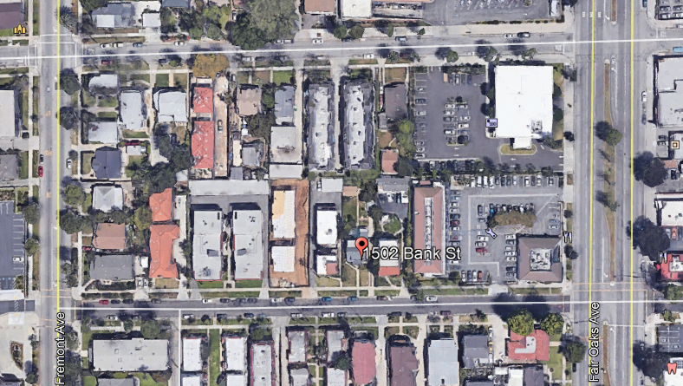
N

Slide 4
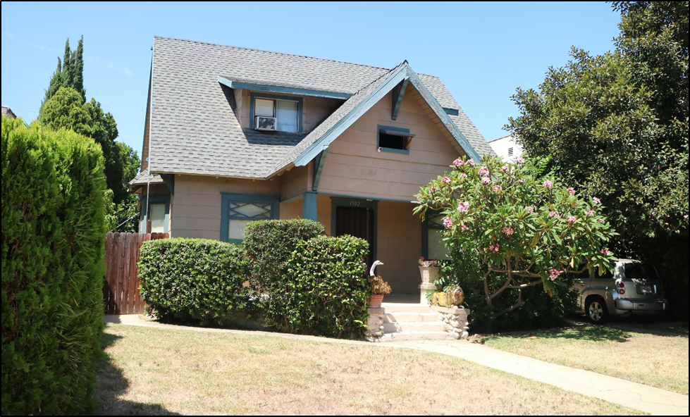

Slide 5
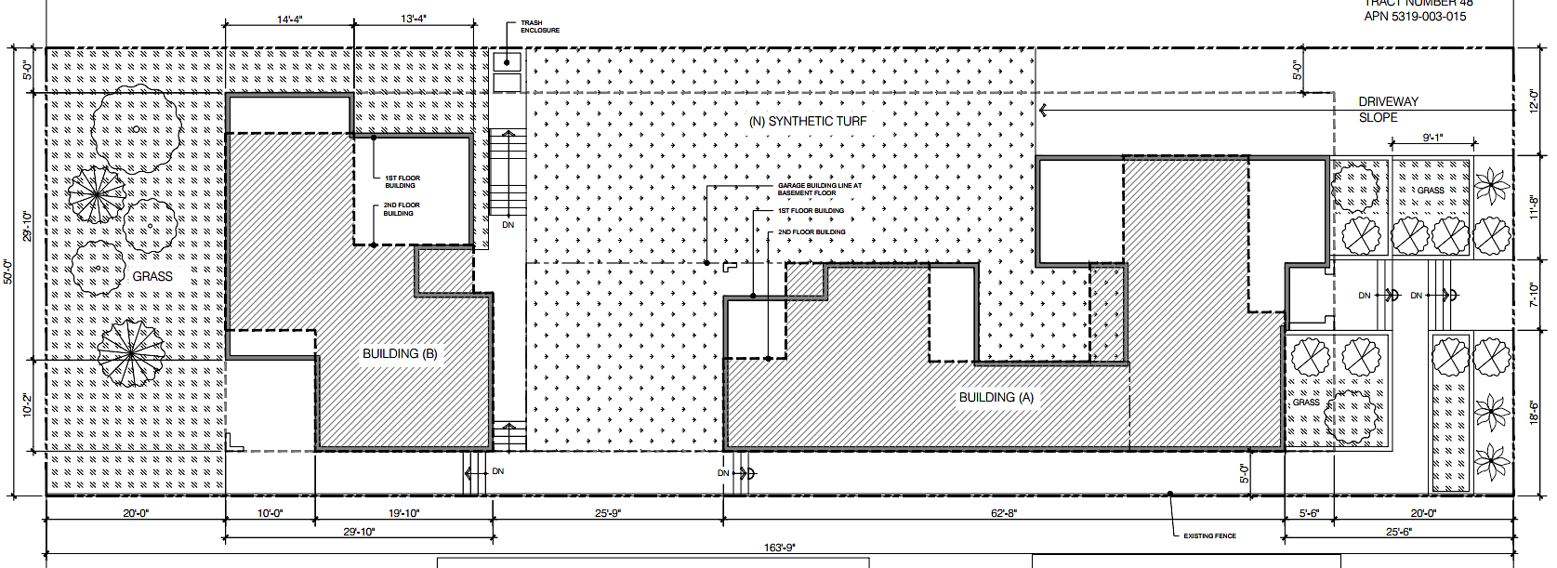
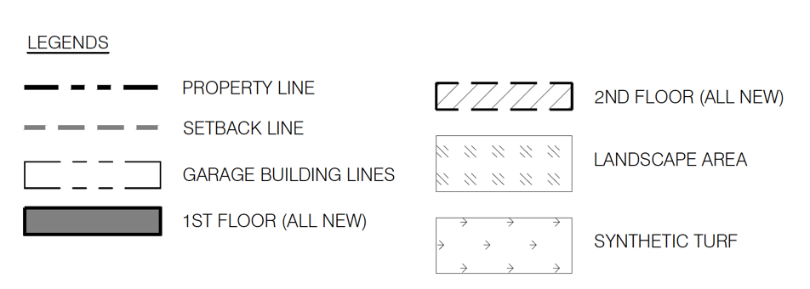
Bank Street

Slide 6
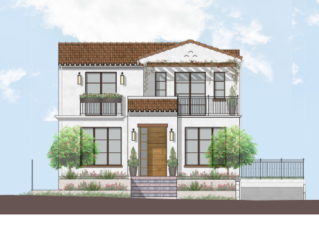
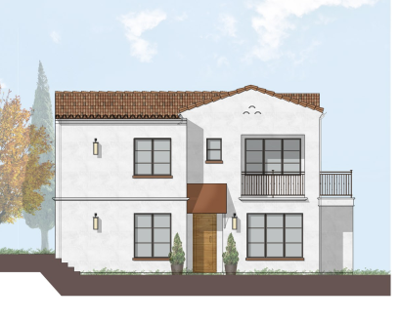
Proposed South Elevation (Front)
Building A
Building B

Slide 7
Proposed East Elevation (Side)
Building A
Building B

Slide 8
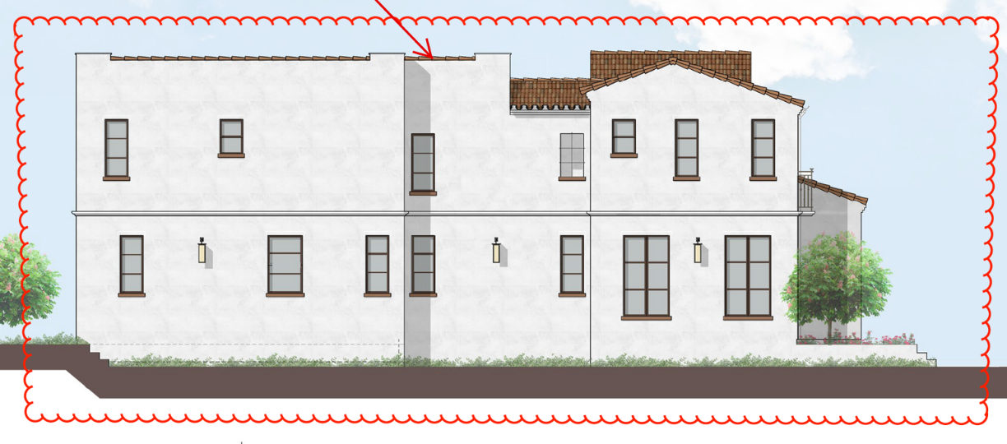
Proposed West Elevation (Side)
Building B
Building A
Building A revised 10/22/20

Slide 9
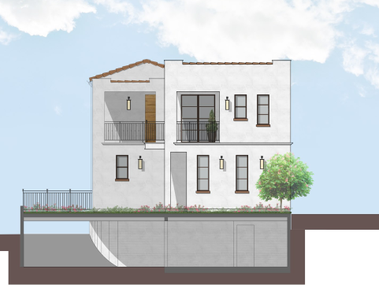
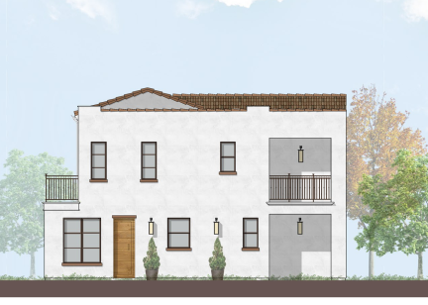
Proposed North Elevation (Rear)
Building A
Building B

Slide 10
The applicant shall submit revised plans for review and approval by the Chair of the Design Review Board that incorporate the following changes:
Building A, West Elevation.
Incorporate a two-story vertical recession of at least 3 feet on the West Elevation to further break up the building plane and mass of the west elevation.
Incorporate a sloped roof element at the rear side portion of the building.
Building A, South Elevation. Lower the clay-tile roof above the front door such that the top of the roof slope aligns with the bottom of the balcony to create a pedestrian scale design and continue the wrought iron metal railing for the balcony along the second floor.
Building B, North Elevation. Add a horizontal trim between the first and second floor.
Building B, South Elevation. Indicate that a clay tile roof will be used for the front entryway awning for easy maintenance.
Provide a cross-section for the proposed window recessions.
Provide a revised 3-D rendering of Building A.
Conditions of Approval:

Slide 11
STAFF RECOMMENDATION:
Staff recommends that the Design Review Board approves the demolition of the existing house and garage and approve the Design Review Permit for the construction of two new single-family homes, located at 1502 Bank Street, subject to conditions of approval.

Slide 12
Design Review Board Options:
Approve as submitted without design changes as recommended by staff;
Approve with modifications to condition(s); or
Continue the project for a future public hearing and direct the applicant to make changes to the project; or
Deny the project.

Slide 13
Questions?

