Slide 2
Project Description
Design Review
CEQA: Categorical Exemption –
Section 15301 Class 1 Existing Facilities

Slide 3
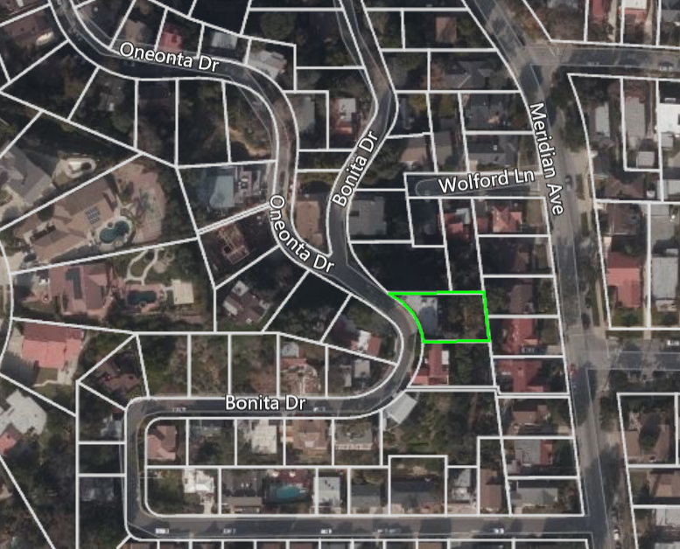
Aerial View
N

Slide 4
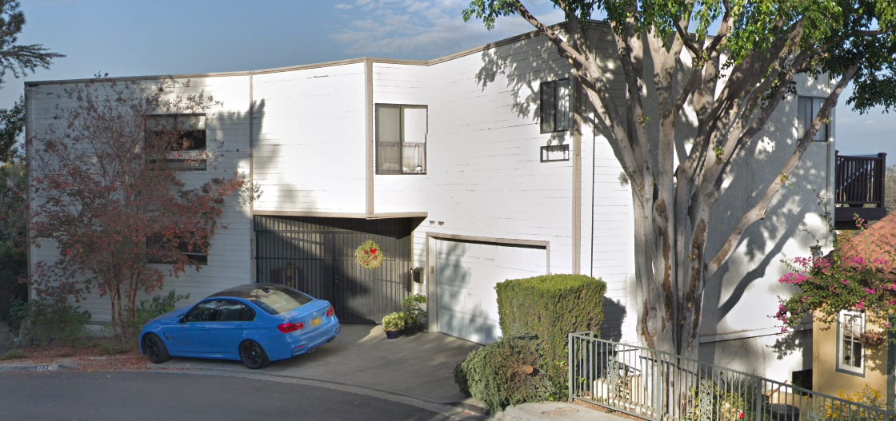
Street View

Slide 5
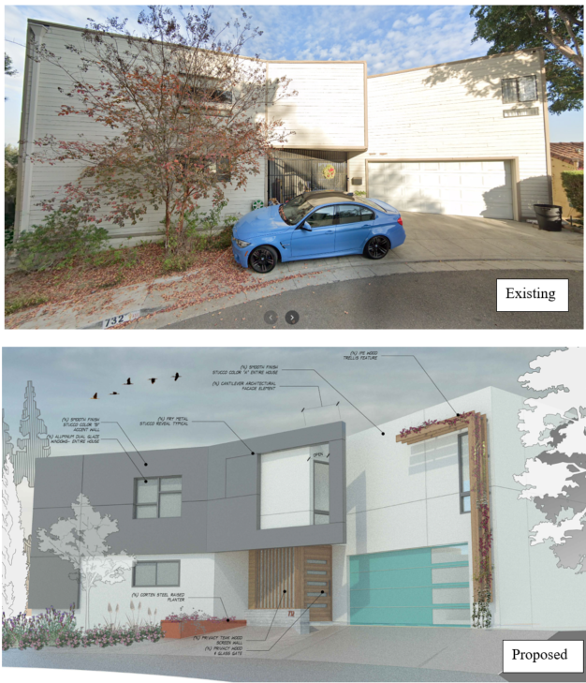
Existing & Proposed West (Front) Elevation

Slide 6
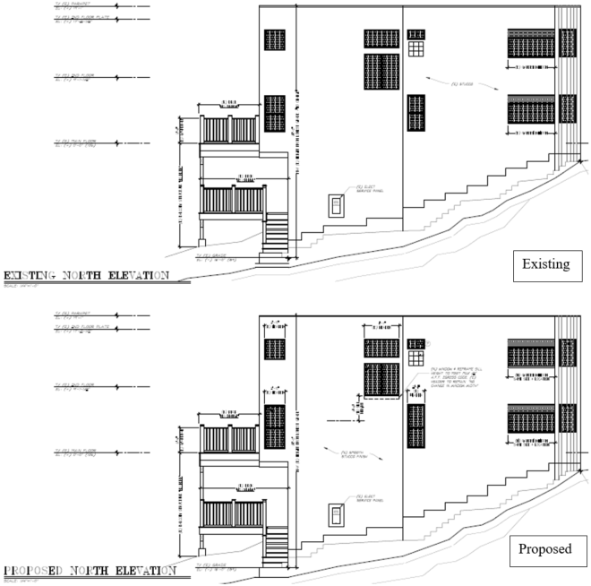
Existing & Proposed North Elevation

Slide 7
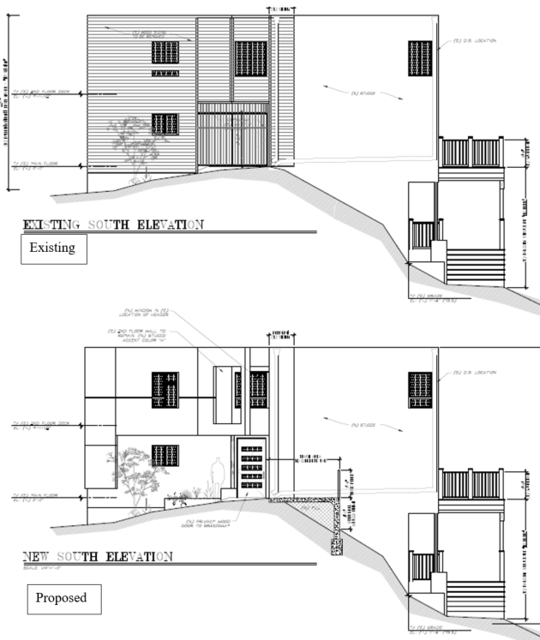
Existing & Proposed South Elevation

Slide 8
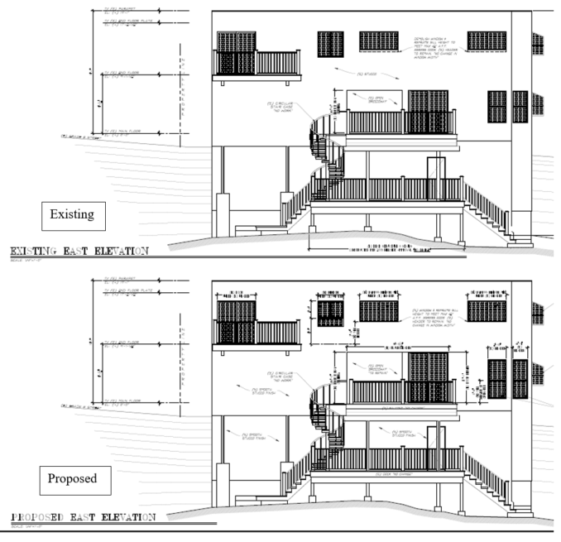
Existing & Proposed East (Rear) Elevations

Slide 9
Staff Recommendation:
Approve the design review for the proposed façade improvements, subject to conditions of approval.

Slide 10
Design Review Board Options:
Approve with condition(s) added.
Continue to address comments discussed.
Deny the project.

Slide 11
Questions?
Notes:
This concludes staff presentation.

