Slide 2
Project Description
Applications:
Notice of Intent to Demolish
Hillside Development Permit
Design Review
Variances
CEQA: Categorical Exemption –
Section 15301 Class 1 Existing Facilities

Slide 3
Additional Background Information
Presented to the Planning Commission on October 13, 2020
Concern with design
Took the following actions:
Directed Applicant to work with Vice-Chair Lesak
Seek DRB recommendation
Continued the project to the next PC meeting
Notes:
The Planning Commission and public had design concerns and suggestions which are listed below:
From the Planning Commission:
Lower the roof height;
Reduce the height of the garage;
Reduce the scale of the south elevation;
Reconsider the exterior stairs on the south elevation;
Reduce the size of the windows on the south elevation; and
Difficulty in making the findings for the downhill building variance request.
From the Public:
Break-up the massing of the roof and house from the street;
Do not increase the height of the structure;
Fenestration, i.e., the new windows, should replicate and look like the existing wood divided lite windows;
The existing half timbering design should be applied to the new front gables;
Extra attention should be focused on the north gable and minimized on the south/garage gable; and
The new garage door should be the same style as the existing and should not have windows.

Slide 4
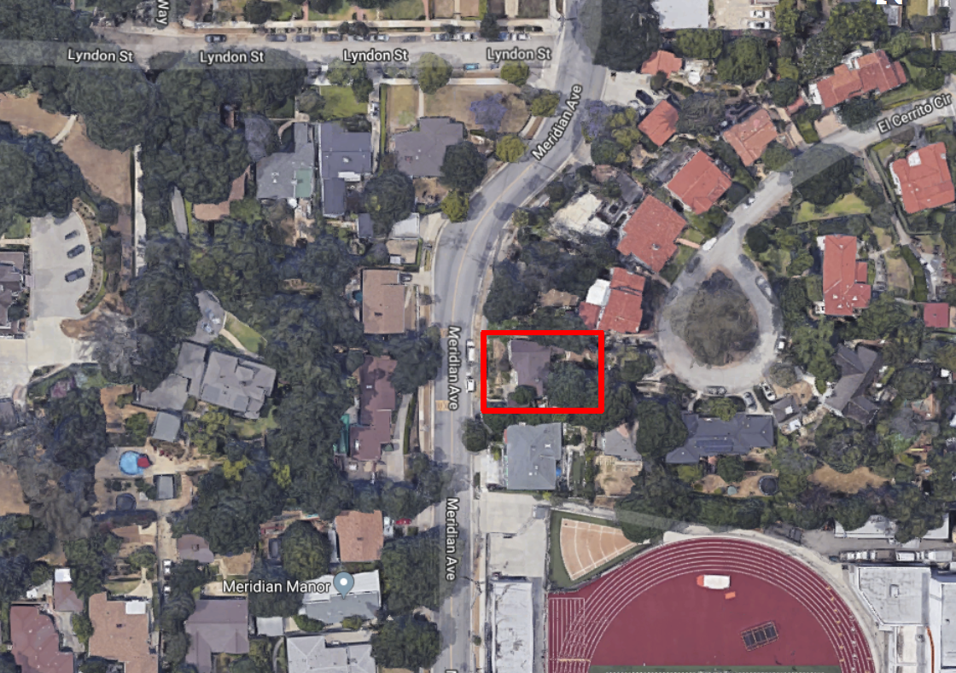
Aerial View
N

Slide 5
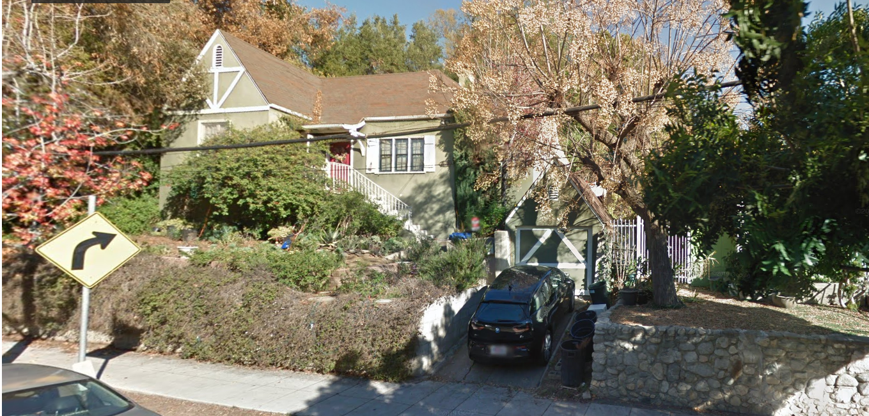
Street View

Slide 6
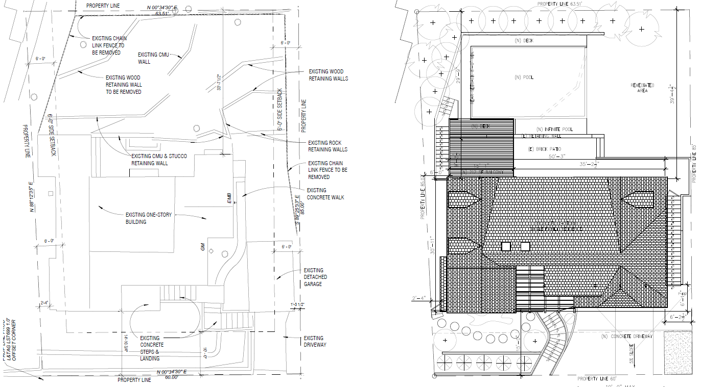
Existing Site Plan
New Proposed Site Plan
N

Slide 7
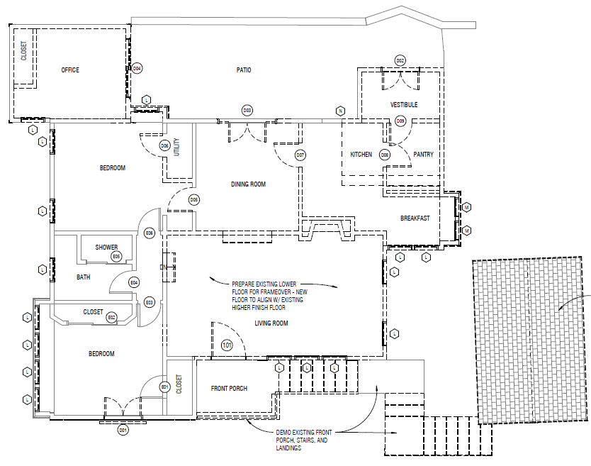
Demo Plan

Slide 9
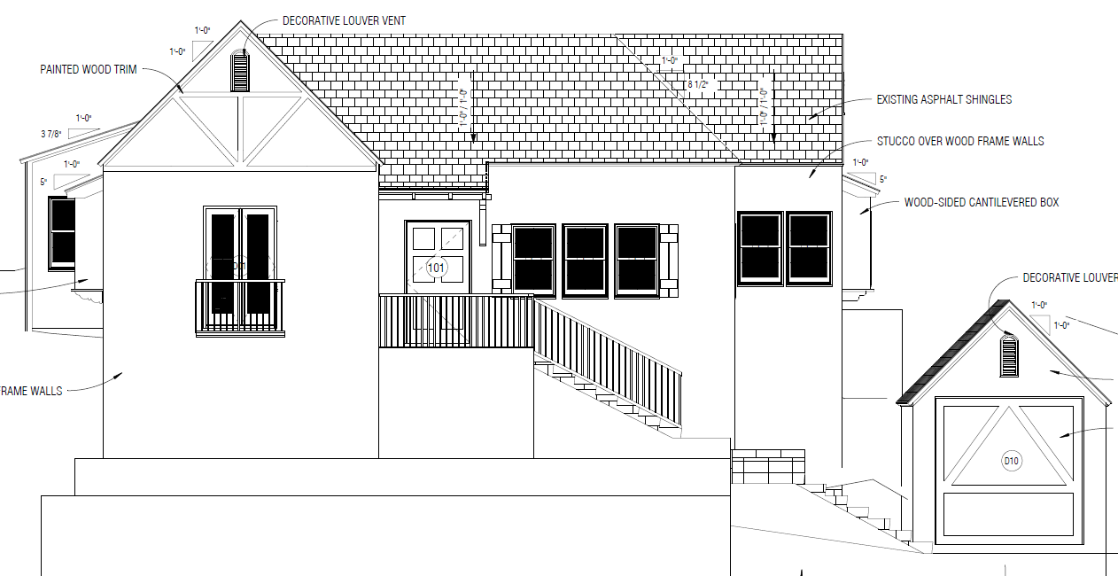
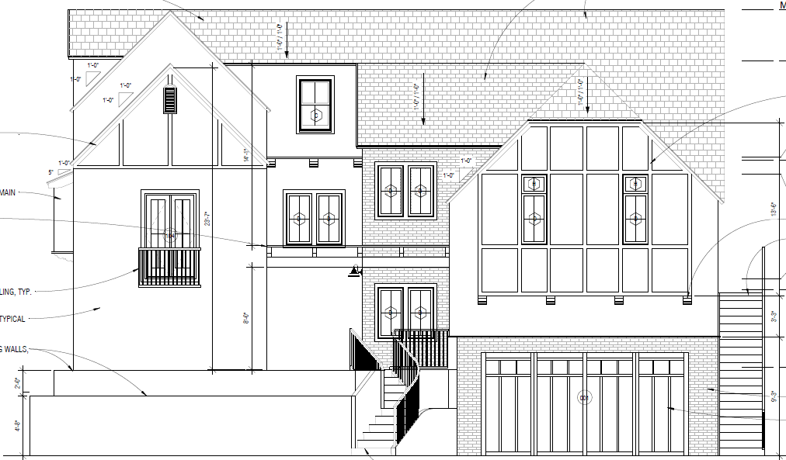
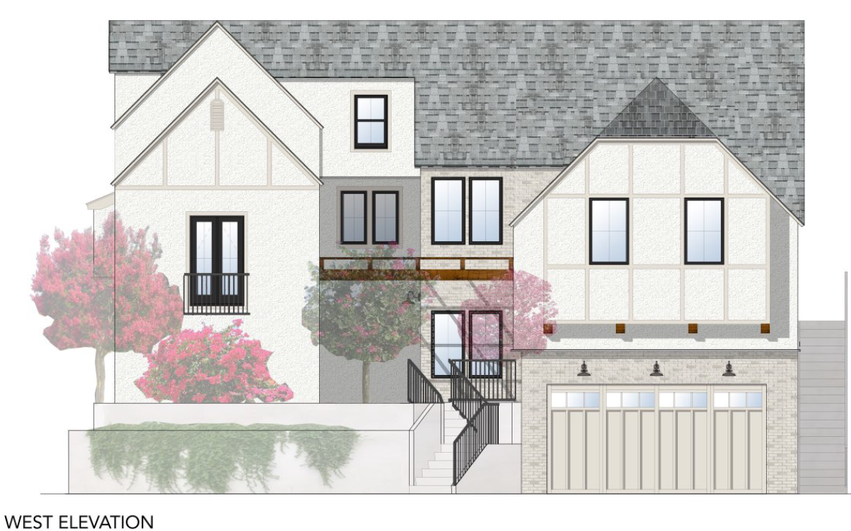
Existing & Proposed West (Front) Elevation
Existing
New Proposal
Seen by PC on 10-13-20

Slide 10
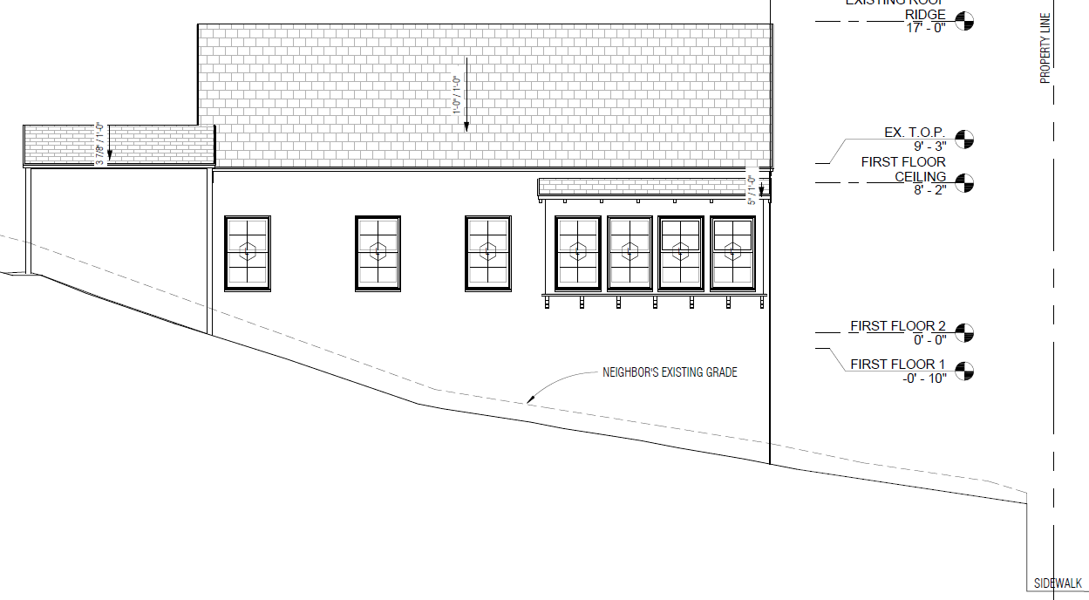
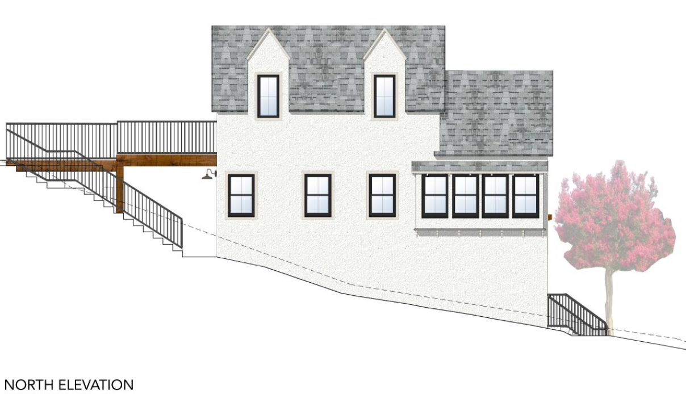
Existing & Proposed North Elevation
Existing
Proposed

Slide 11
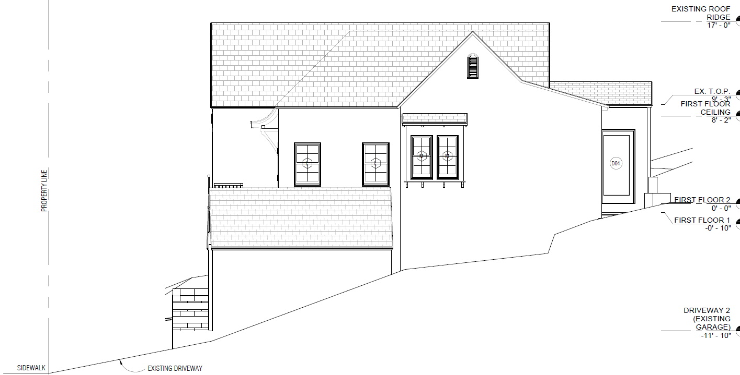
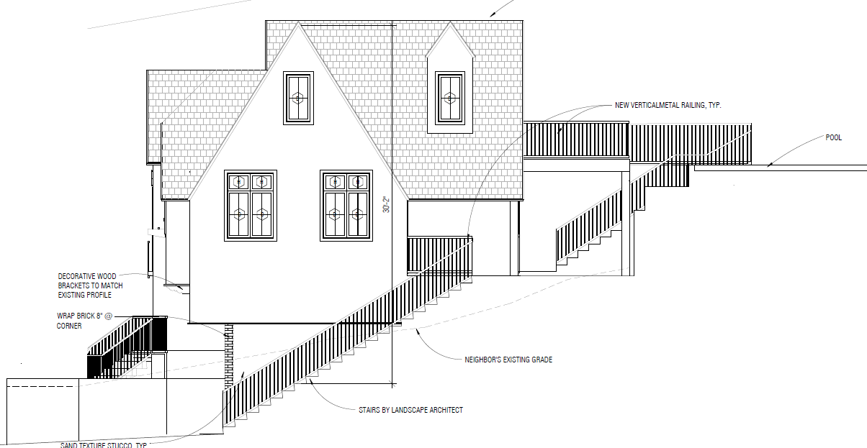
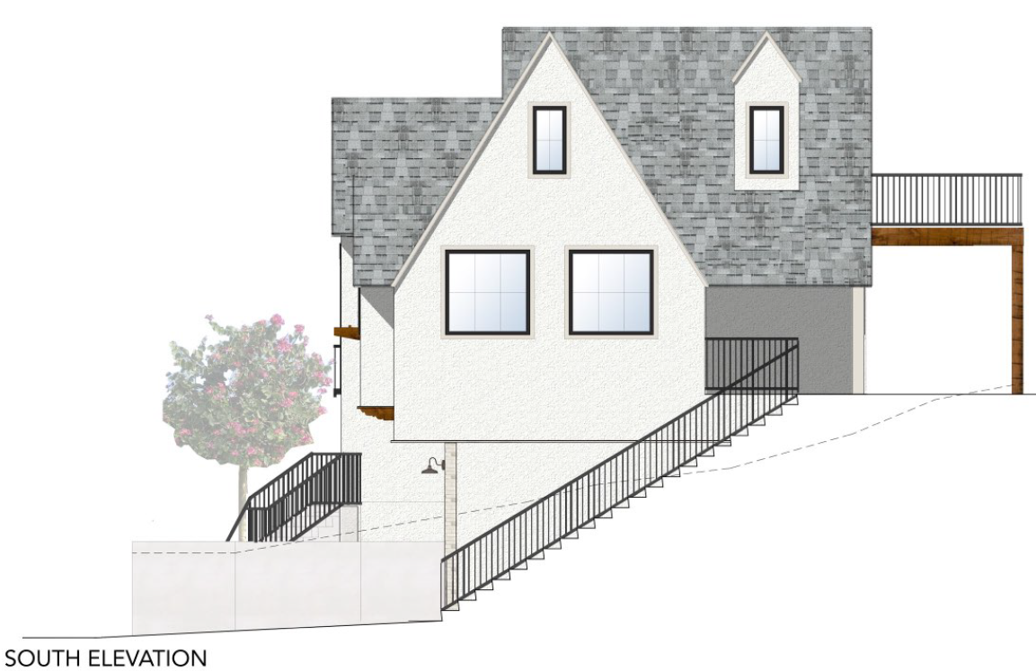
Existing & Proposed South Elevation
Existing
New Proposal
Seen by PC on 10-13-20

Slide 12
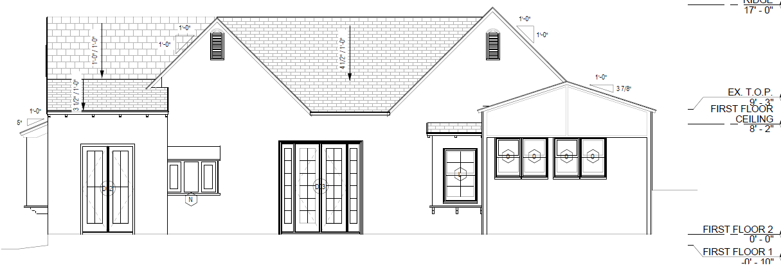
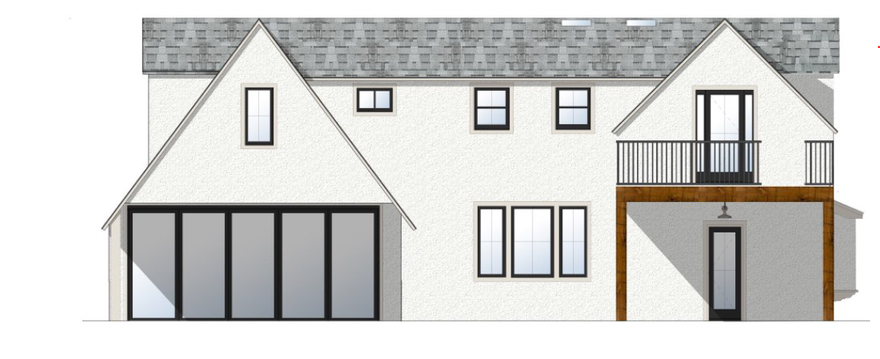
Existing & Proposed East (Rear) Elevations
Existing
Proposed

Slide 13
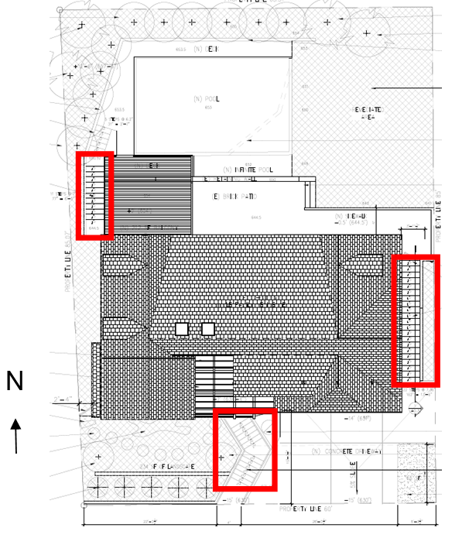
Variance - Exceed Three (3) Feet High and Over 10 Feet in Length Exterior Staircase Within the Front and Side Yard Setback

Slide 14
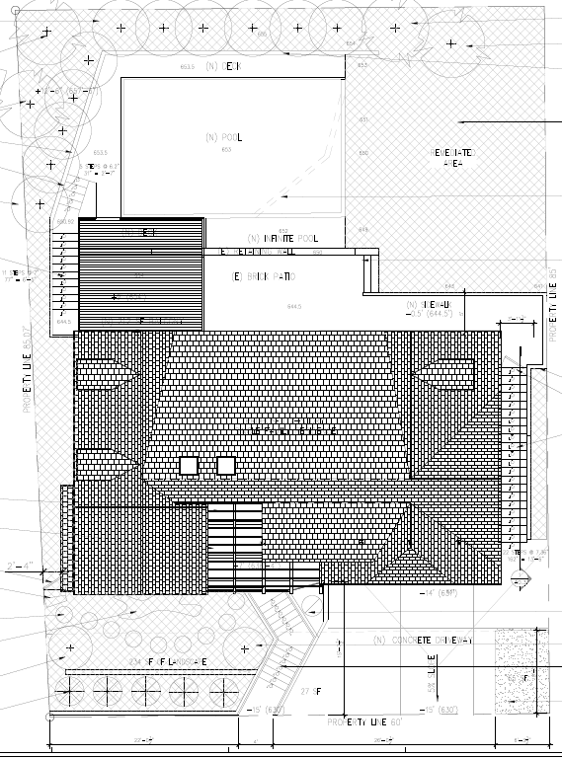
Variance - To Reduce the Percentage of Lot to Natural State

Slide 15
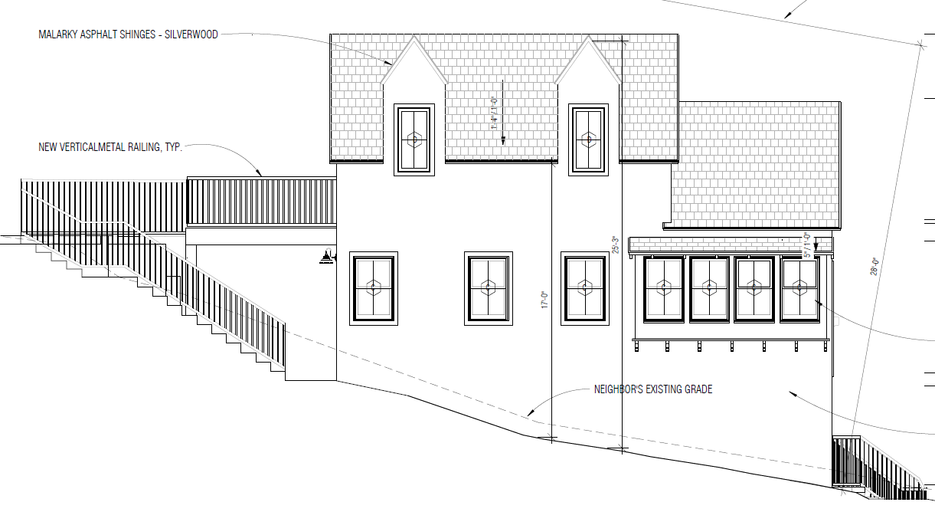
Variance - For Downhill Building Wall to Exceed 15 Feet in Height

Slide 16
Staff Recommendation:
For the Design Review Board provide a recommendation to the Planning Commission on both the design review and the requested variances.

Slide 17
Design Review Board Options:
Approval of the revised design as submitted.
Approval of the revised design with conditions for design changes.
Denial of the revised design.

Slide 18
Questions?
Notes:
This concludes staff presentation.

