Slide 2
PROJECT DESCRIPTION
Design Review for a 657 square-foot addition to an existing tri-level single-family home and removal of a wood deck and covered patio on the third level.
Hillside Development Permit to allow construction on a site with an average slope of 20% or greater.
Zoning: Residential Single Family (RS)
CEQA: Categorical Exemption – Section 15301, Class 1 “Existing Facilities”.

Slide 3
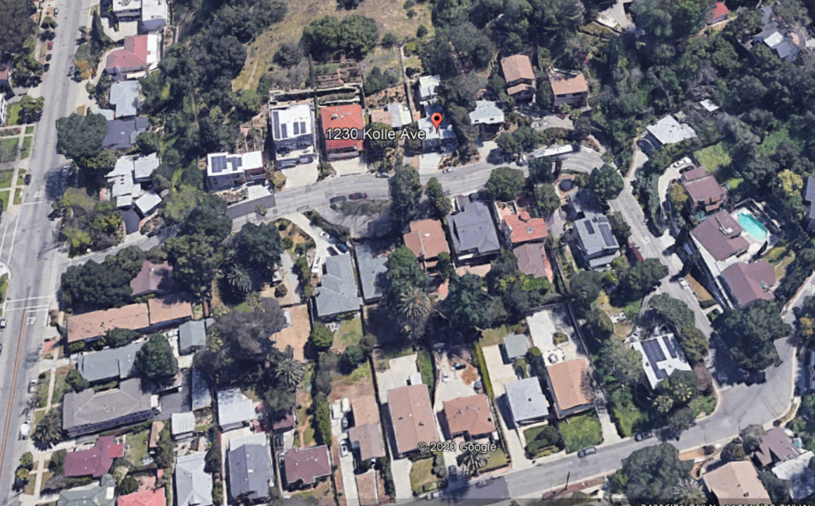
Aerial View
Monterey Road
Kolle Avenue
Brunswick Ave.
N

Slide 4
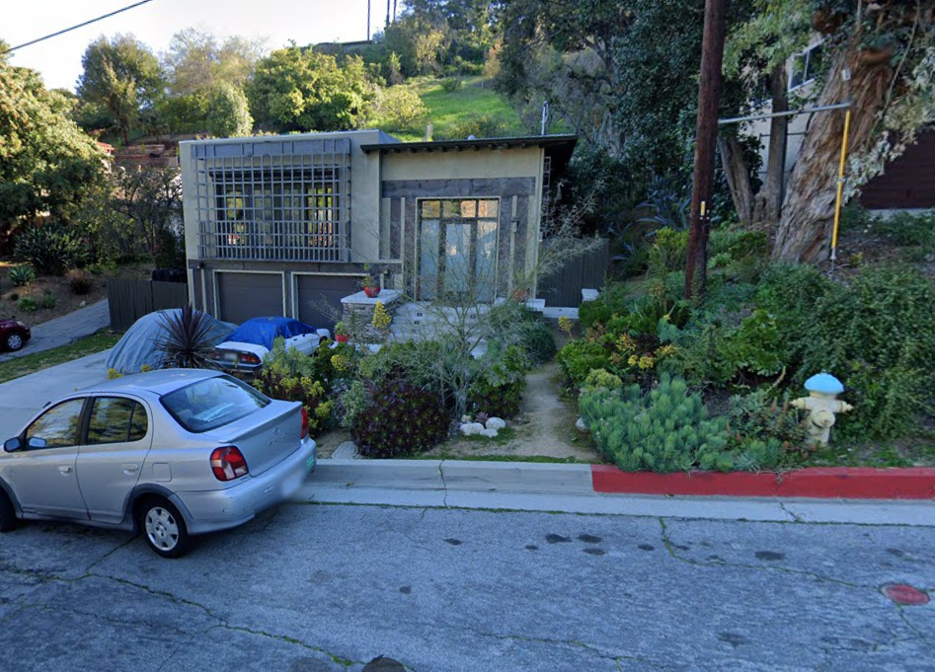
Street View

Slide 5
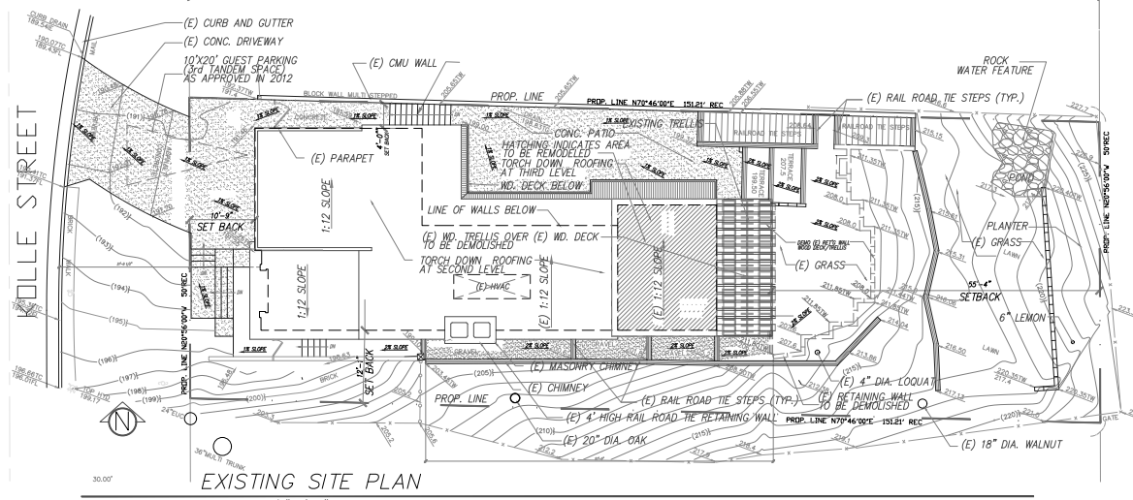
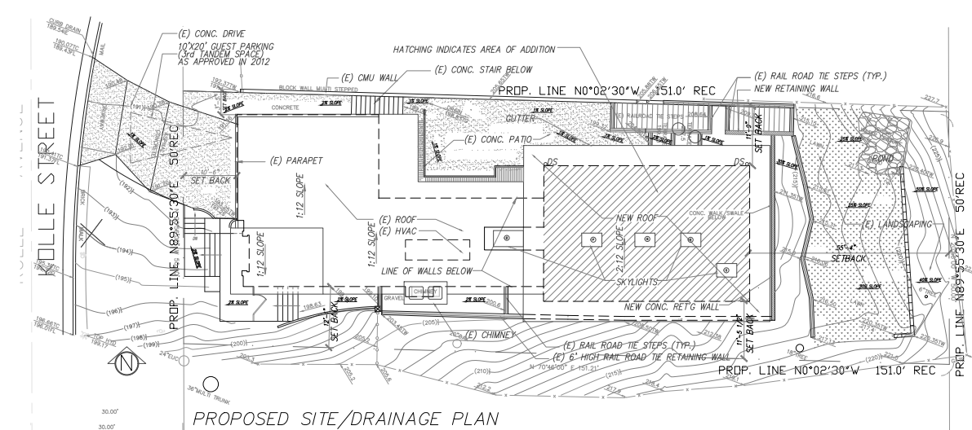
EXISTING
PROPOSED

Slide 6
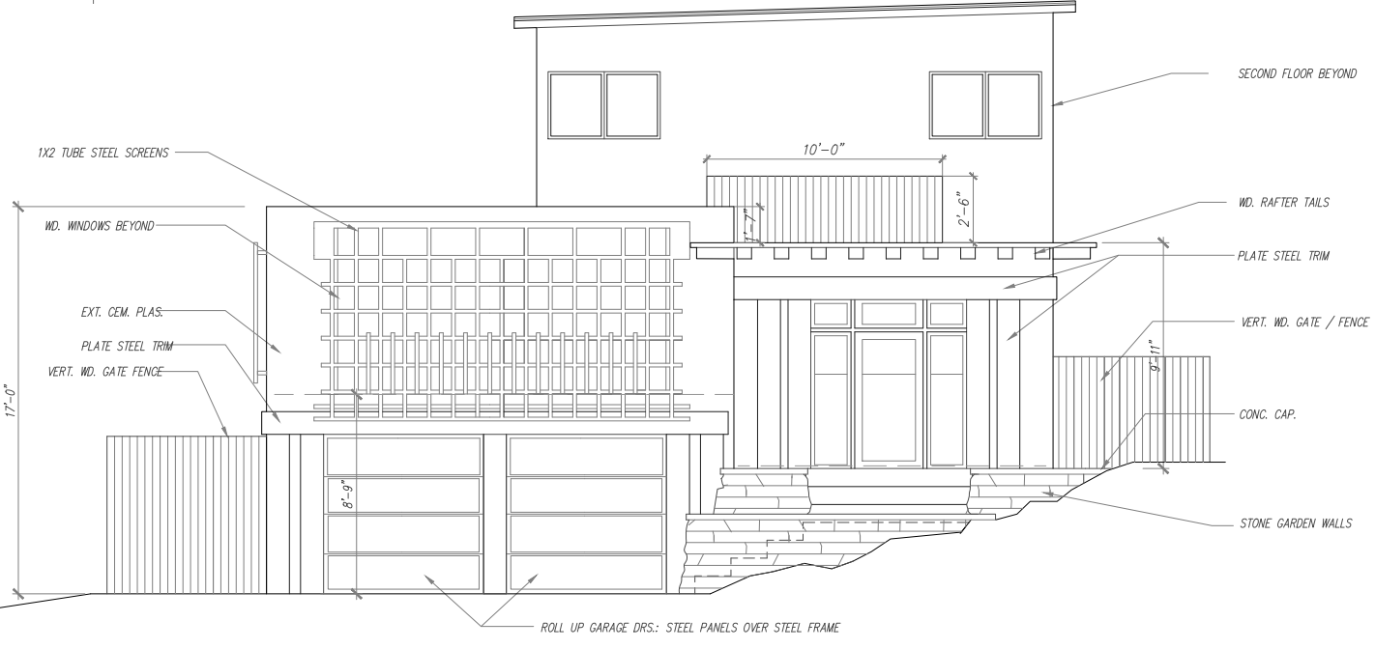
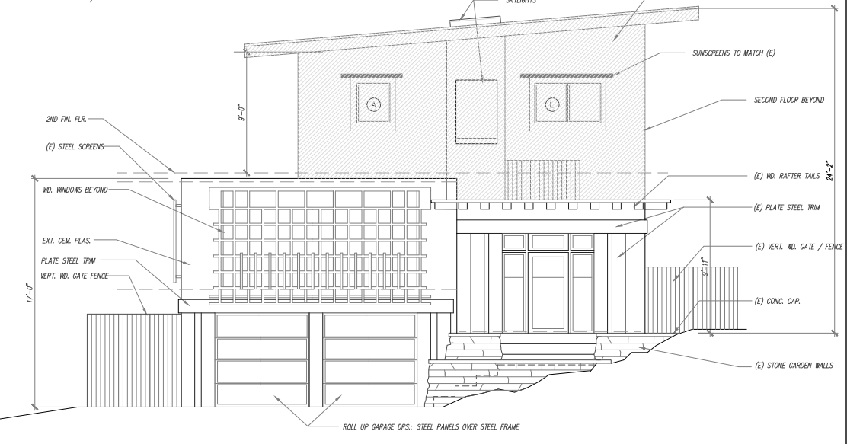
West Elevation (Front)
EXISTING
PROPOSED

Slide 7
North Elevation (Side)
EXISTING
PROPOSED

Slide 8
South Elevation (Side)
EXISTING
PROPOSED

Slide 9
East Elevation (Rear)
PROPOSED
EXISTING

Slide 10
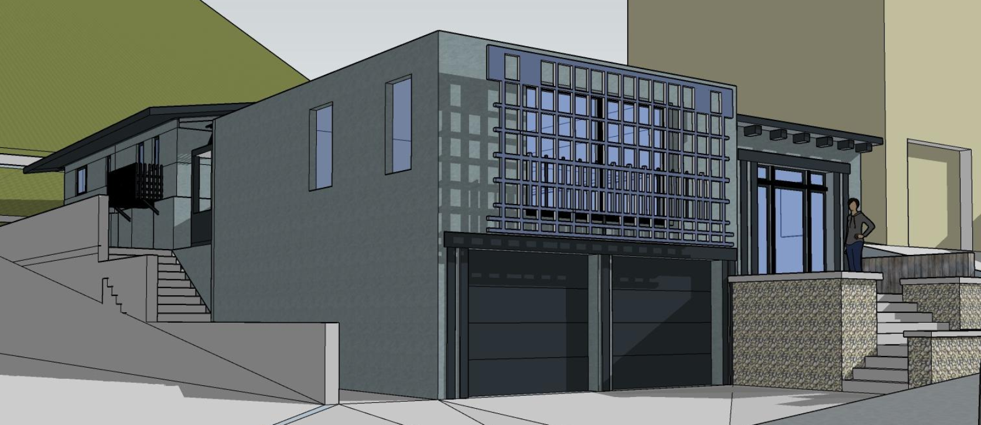
3-Dimensional View – Front View

Slide 11
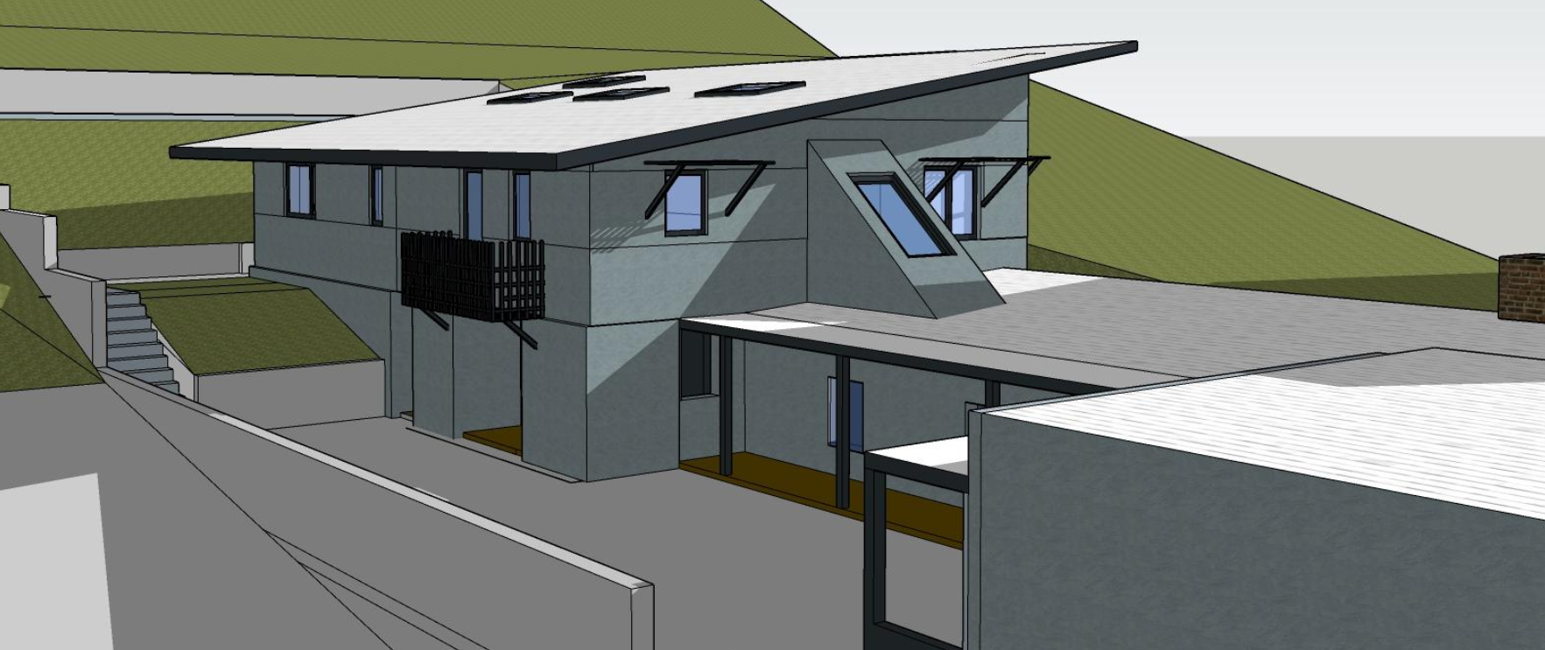
3-Dimensional View – Northerly Elevation

Slide 12
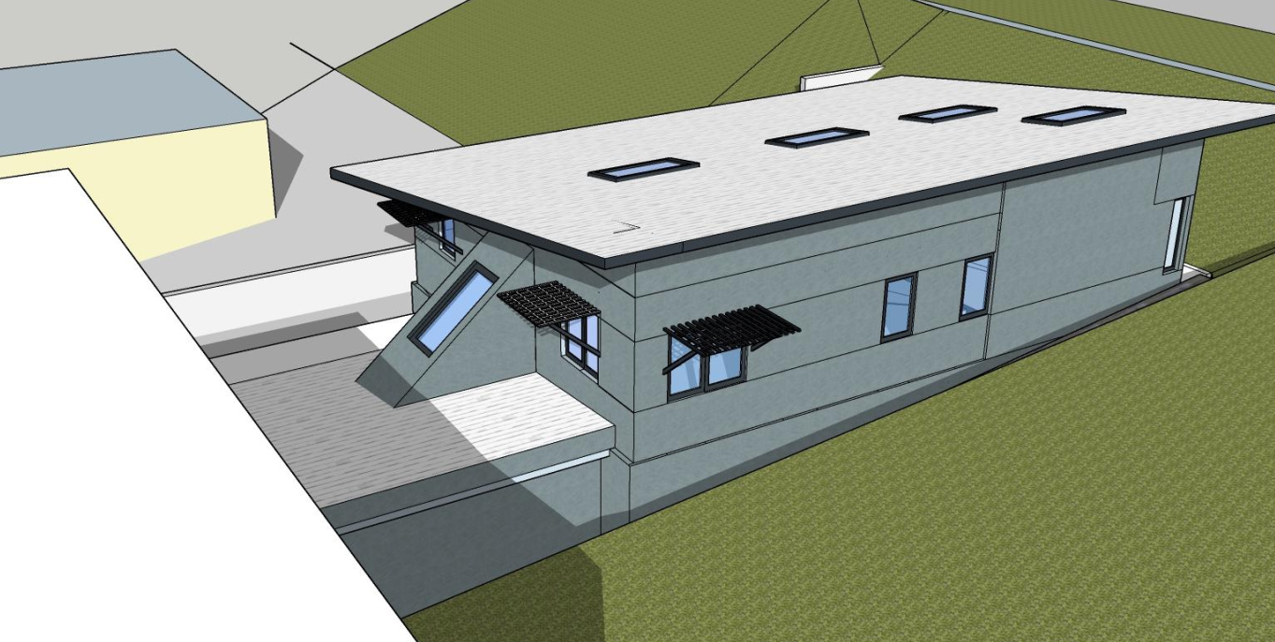
3-Dimensional View – Southerly Elevation

Slide 13
3-Dimensional View – Southerly Elevation

Slide 14
Conditions of Approval:
Construction plans submitted for plan check must clearly show all existing, proposed for removal, and new retaining walls. A detail plan showing footing, height, type of material, and exterior color and finish of new walls must be included. All retaining walls visible from the public right-of-way must not exceed 3 feet in height and must be screened with landscaping material. All other retaining walls not visible from the public street shall not exceed 6 feet in height.
Construction plans must show the HVAC equipment to be in a location not visible from the street and must not be on the roof top.
Construction plans submitted for plan check must be in substantial conformance with the approved plans by the Design Review Board including but not limited to floor plans, elevations plan, exterior colors and materials, roof type and design, ornate/decorative building elements. Given that the floor area ratio calculated for this project is at .34 and the maximum allowed is .35, the applicant and/or future owners cannot apply to convert the unhabitable space on the second level into habitable space as this will exceed the maximum allowed floor area ratio.

Slide 15
1. Approve as proposed without changes; or
2. Approve with modifications to the conditions and/or design(s); or
3. Continue the project to a future public hearing and direct the applicant to make changes to the project; or
4. Deny the project.
Design Review Board Options:

Slide 16
The Design Review Board approve the project as proposed and issue Design Review approval and a Hillside Development Permit, subject to the conditions of approval for property located at 1230 Kolle Avenue.
STAFF RECOMMENDATION:

Slide 17
Questions

