Slide 1
Notes:
Good evening Board members.

Slide 2
PROJECT
Design Review and Hillside Development Permit for a first floor, and second floor addition an addition to the garage and a Tree Removal Permit for one tree located at 845 Rollin Street.
This item is exempt from any California Environmental Quality Act (CEQA) analysis based on State CEQA Guidelines Section 15301, Class 1 – Existing Facilities.
Notes:
This is a proposal for a one car parking addition to an existing 3 car garage. The project is categorically exempt from CEQA under….

Slide 3
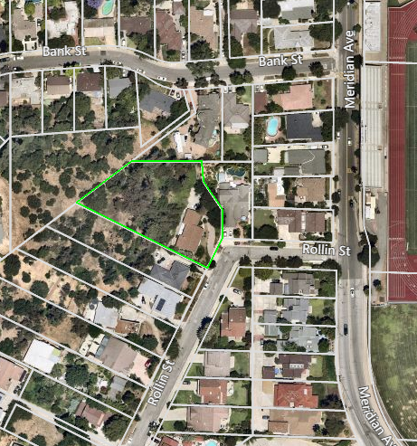
N
Notes:
The site is located north of Rollin Street, south of Bank Street, west of Meridian Avenue and is surrounded by single family homes. This image is an aerial view of the neighborhood, with the project site outlined in green.

Slide 4
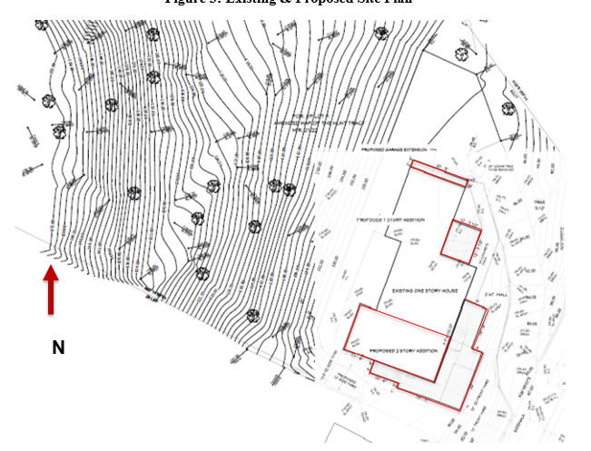
Notes:
Here is the site plan with the addition areas in gray and outlined in red.

Slide 5
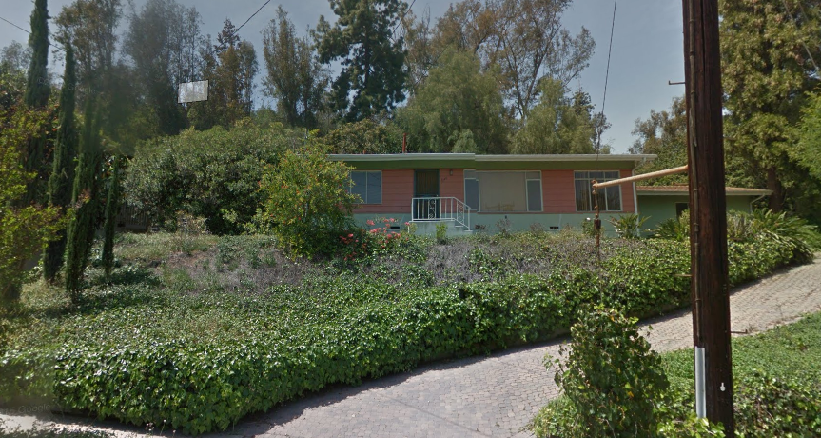
Notes:
Image is shows a view from the street of the existing home. The home was built in 1956.
The existing exterior façade consists of a stucco finish and asphalt roof shingles

Slide 6
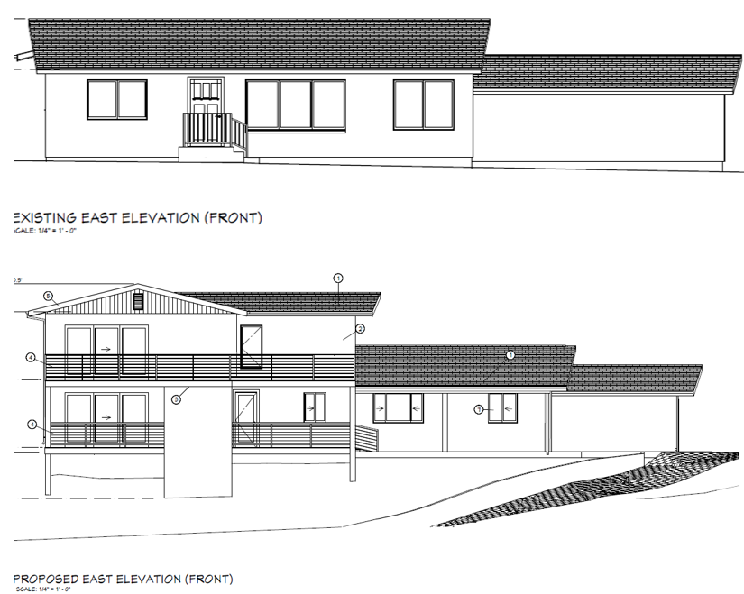
Notes:
The proposed additions to the house and garage will match the existing exterior materials, the stucco will be painted in a tan-toned color, and the existing roof pitch will remain. In the front elevation, the balcony railings will compose of a stainless steel metal and glass. Vertical siding is proposed under the gables

Slide 7
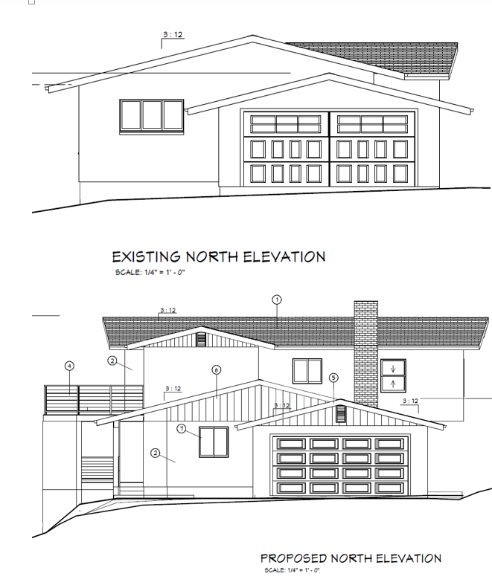
Notes:
A new brick chimney is proposed on the north elevation. Vertical siding is proposed under the gables. And they garage addition will also include a new garage door.

Slide 8
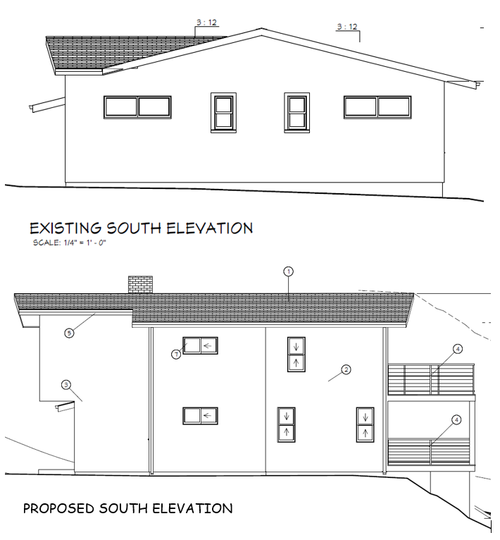
Notes:
Againg, the mataerial will be stucco, LL EXTERIOR DOORS AND WINDOWS:
JELD-WEN ALUMINUM CLAD - COLOR: CHESNUT BRONZE.
Sliding and double hung windows are proposed

Slide 9
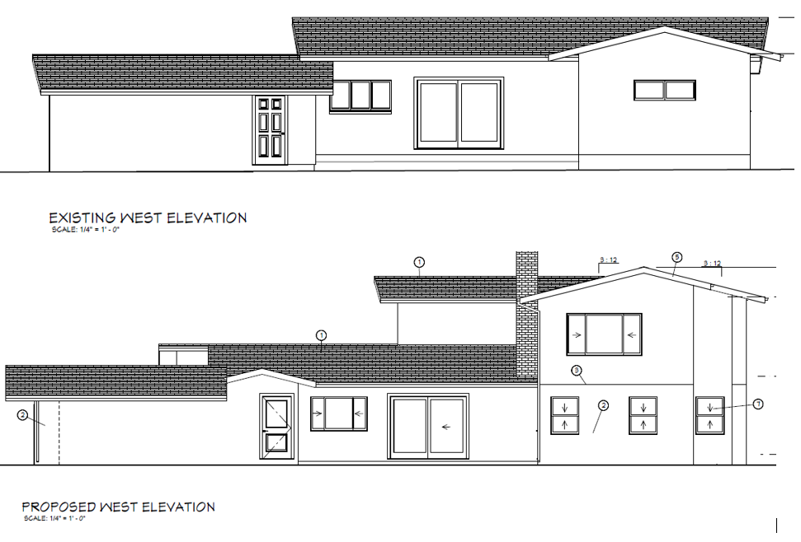
Notes:
The west elevation will include a large sliding door located on the first floor for the dining room, double hung and sliding windows.

Slide 10
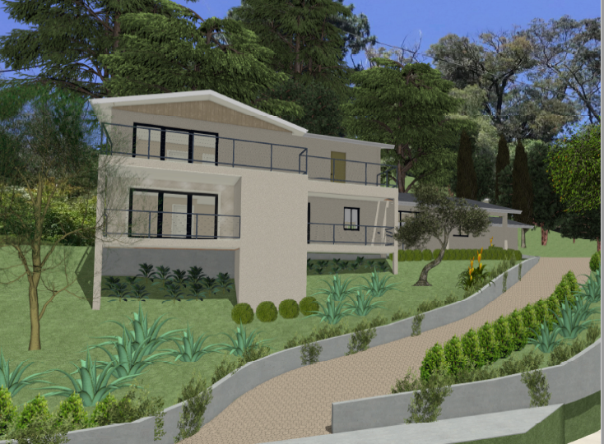
Notes:
This image is a rendering of the proposed project. Overall , The proposed design changes are in keeping with the architectural style of the existing house.

Slide 11
Staff Recommendation:
Staff recommends that the Design Review Board approve the Design Review and Hillside Development Permit for the proposed additions to the existing house and garage, and a Tree Removal Permit.

Slide 12
Design Review Board Options:
Recommend approval of the project.
Continue the project to address comments discussed.
Recommend denial of the project.

Slide 13
Questions?

