Slide 1
Notes:
Good evening commission members, tonight staff will be providing an overview of the project proposal for a design review and hillside development permit, as well as a tree removal permit at 804 Valley View Road. The applicant is architect David Streshinsky of DKY Architects.

Slide 2
Project Description
Proposal: new 3,125 square foot single-family hillside residence on a vacant lot located at 804 Valley View Road.
CEQA: An Addendum was prepared to a Negative Declaration prepared in 2017, since the proposed project is closely similar to the approved project on the same property. The new project will not result in or create any significant or potentially significant environmental impacts.
Notes:
Project Description: The applicant is resubmitting a project application for a new single-family residence that was previously approved on the same property by the Planning Commission on October 23, 2017. The approvals for the single-family residence expired in November 2019. The subject property was sold to a new owner and the same architect/applicant is submitting a revised application and new design for a single-family residence. The applicant is requesting approval to build a new three-bedroom single-family residence of 3,125 square feet including an attached 572 square foot two-car garage on the vacant upsloping hillside lot. The previous approved single-family residence was four-bedrooms with 3,085 square feet with a 460 square foot two-car garage.
CEQA: An Addendum to a Negative Declaration was prepared, since the proposed project is closely similar to the approved project in 2017 The Negative Declaration document filed with Los Angeles County in 2017 for the original project, The project will not result in or create any significant environmental impacts. No mitigation is necessary as part of the Negative Declaration because the conditions of approval contained in the Hillside Development Permit will mitigate any potential impacts to the “less than significant” level.

Slide 3
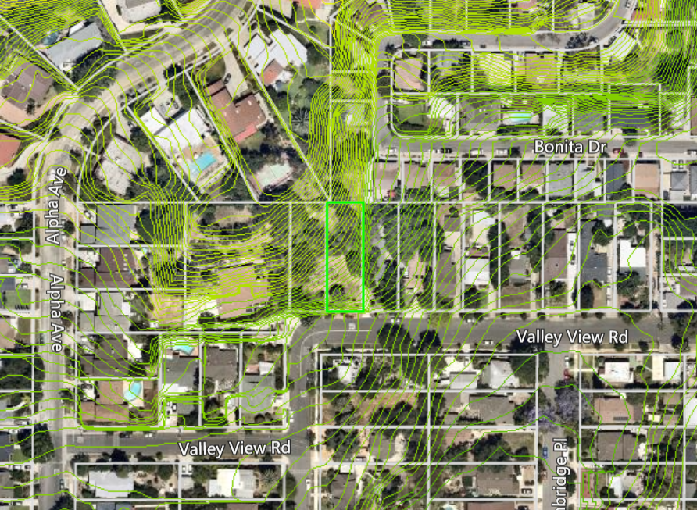
Aerial View
N
Notes:
The subject site is rectangular in shape (highlighted in green here), and is located before the bend of Valley View Road as it turns into Berkshire Ave. The approximate depth of the lot is 150 feet and the approximate width is 50 feet. The size of the lot is 7,500 square feet with an average south-facing slope of approximately 38 percent. To the immediate west of the subject site is another vacant hillside lot of similar size and description. To the north, south, and west of the subject site are existing single-family residential units on similar sized parcels.

Slide 4
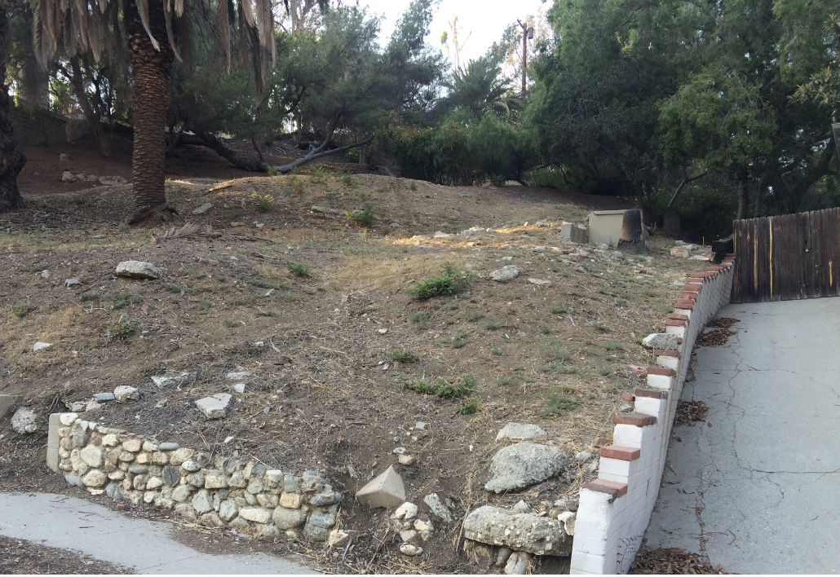
Notes:
Here is a view of the vacant property looking north. As you can see in the bottom of the photo, the front of the parcel contains a historic Arroyo stone retaining wall that will be maintained and restored, per the restoration plans approved by the Chair of the Cultural Heritage Commission in 2017.
The lot will be landscaped to augment and maintain the natural appearance of the hillside and create garden areas in several locations. The landscaping and plantings will not block views from adjacent residences. According to the Arborist Report and landscape plan provided by the project’s landscape architect, a total of four trees are proposed for removal with four native and four non-native trees being planted.

Slide 5
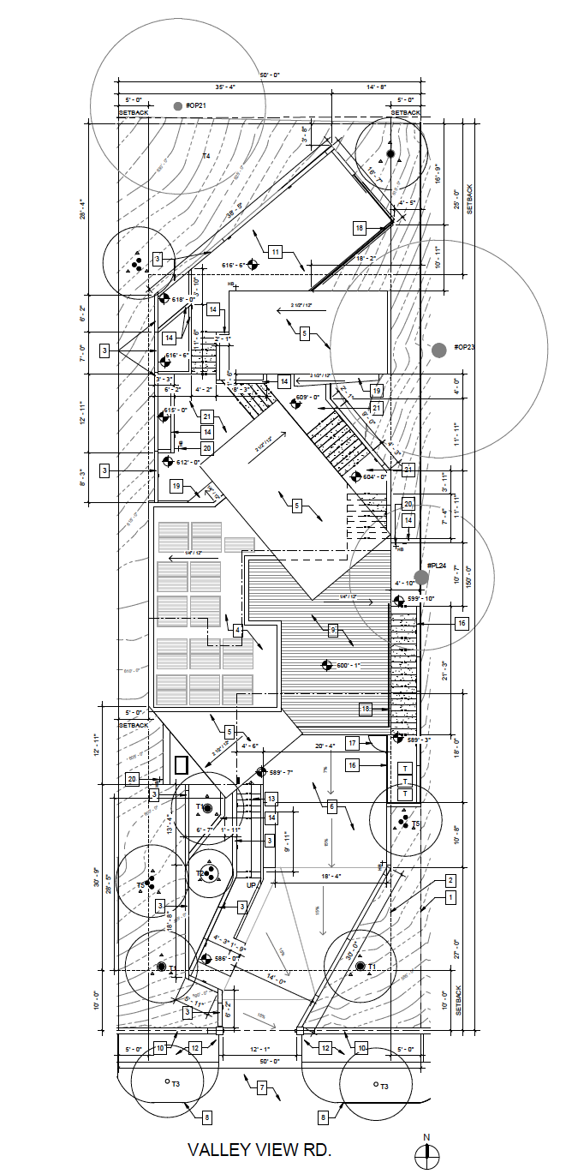
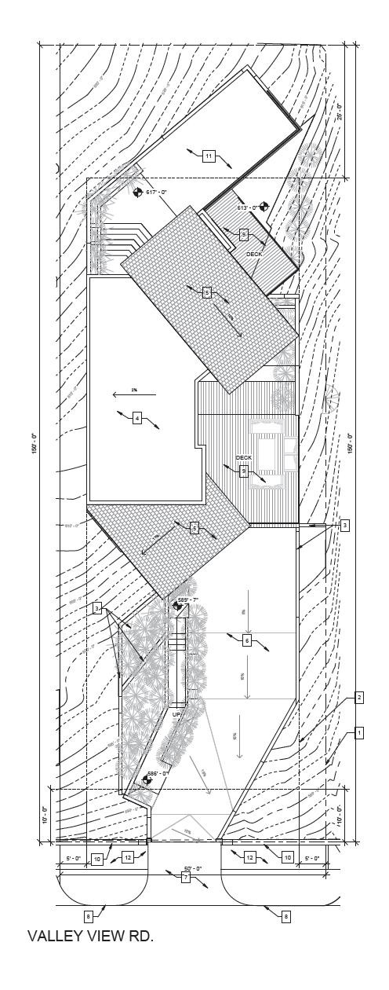
Previously Approved and Proposed Site Plan
Previously Approved
Proposed
Notes:
The house will incorporate three living levels that terrace up the hillside similar to the previous design. The new design includes an entry level with a TV room and garage. A living area with an office will be on the main floor, and three bedrooms will be located on the second level. It also includes a music/multi-purpose room that will be accessed by stairs from the second level.

Slide 6
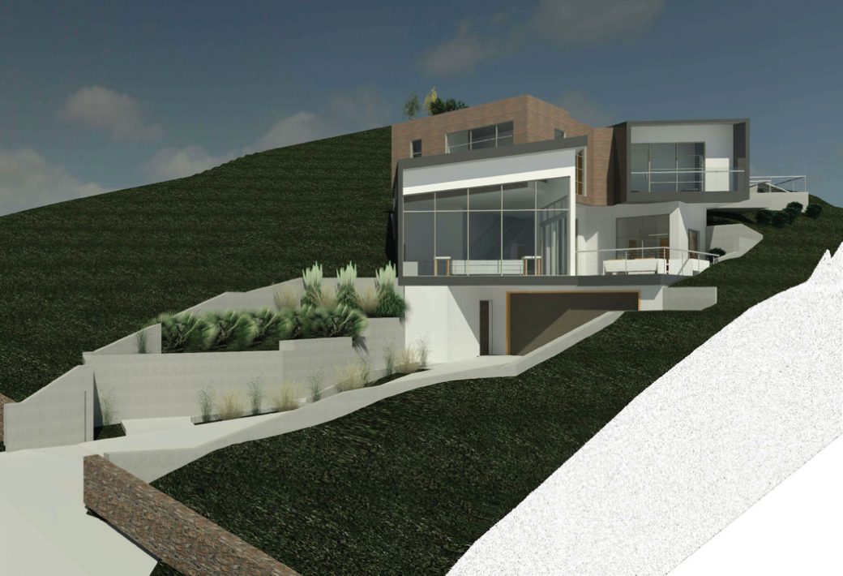
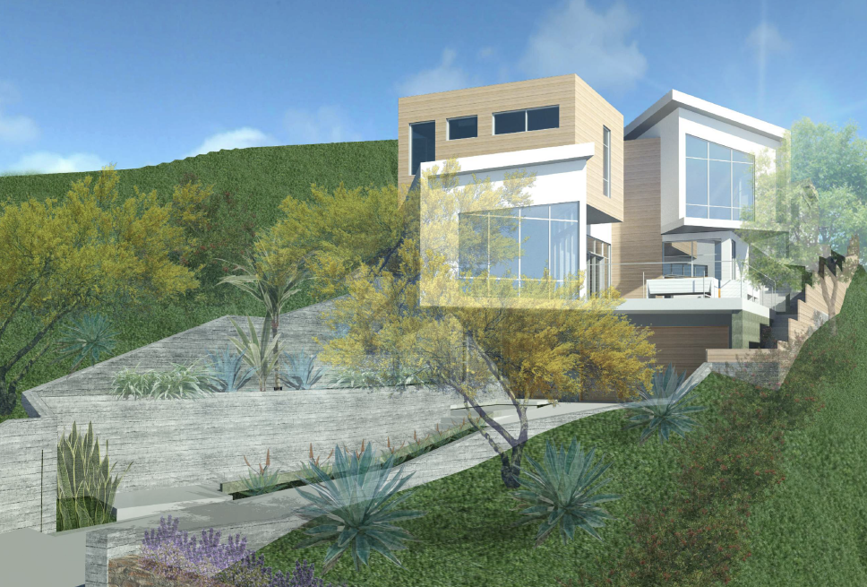
Rendering of Previous and Proposed South Elevation (Front)
Previously Approved
Proposed
Notes:
The proposed project is consistent with the City’s adopted Design Guidelines for new single-family residences on hillside sites. The proposed new hillside home is designed in consideration of the character and scale of the existing single-family developments in the vicinity and complies with FAR and height requirements of the hillside development ordinance. The house is designed in a modern style with smooth stucco, wood siding, extensive windows for light and air, and will include flat and shed-style roofing. The design of the house has simple architectural forms with differing roof heights and shapes that ascend the hillside in an effort to reduce the scale of the new house. Height limitations will be met by terracing the residence and does not exceed 22 feet from the existing slope.

Slide 7
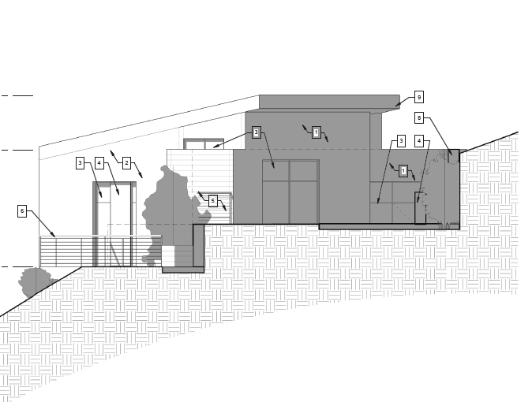
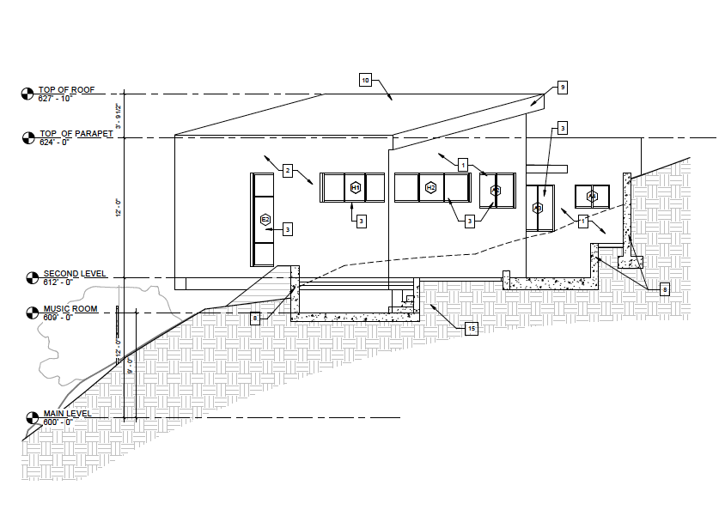
Previously Approved and Proposed North Elevation (Rear)
Previously Approved
Proposed
Notes:
This slide shows the previously approved north elevation and proposed elevation which is the rear of the house.

Slide 8
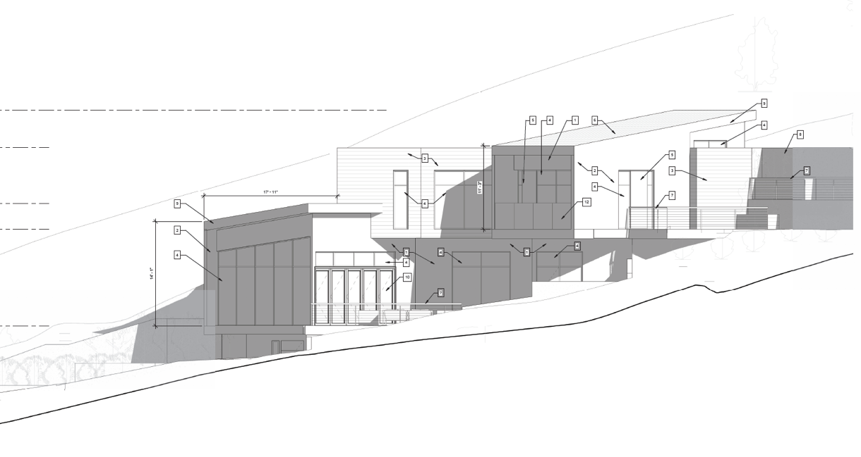
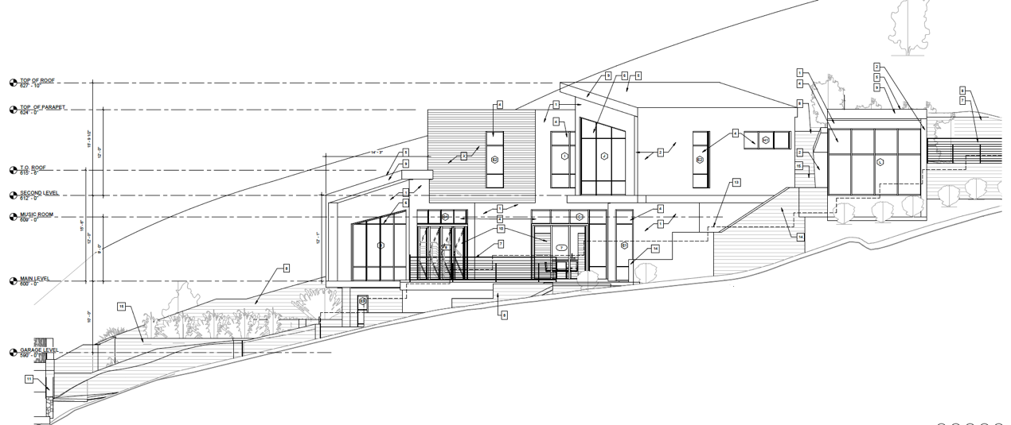
Previously Approved and Proposed East Elevation (Side)
Previously Approved
Proposed
Notes:
This slide shows the previously approved east elevation and proposed elevation, which is the side of the house. The proposed project also incorporates a rooftop deck above the ground-level 2-car attached garage to avoid two story walls near the street.

Slide 9
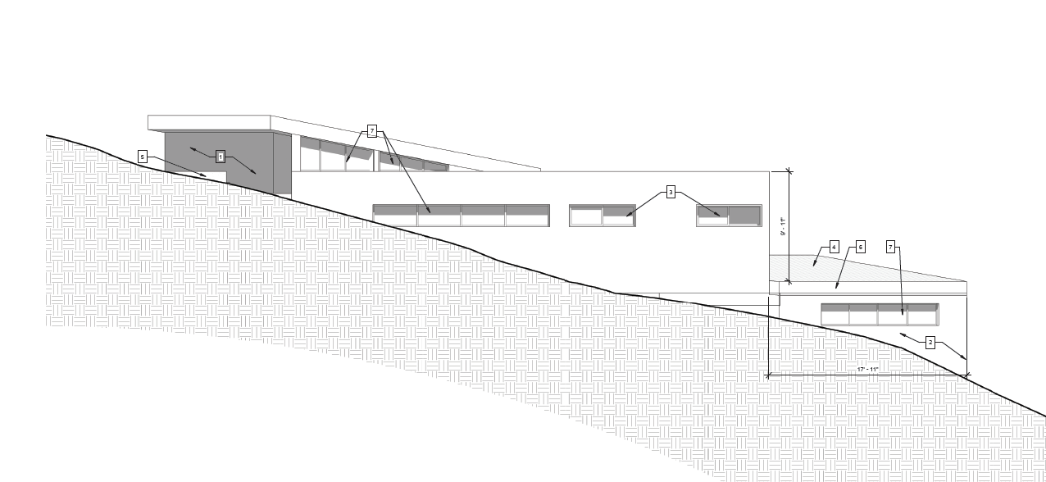
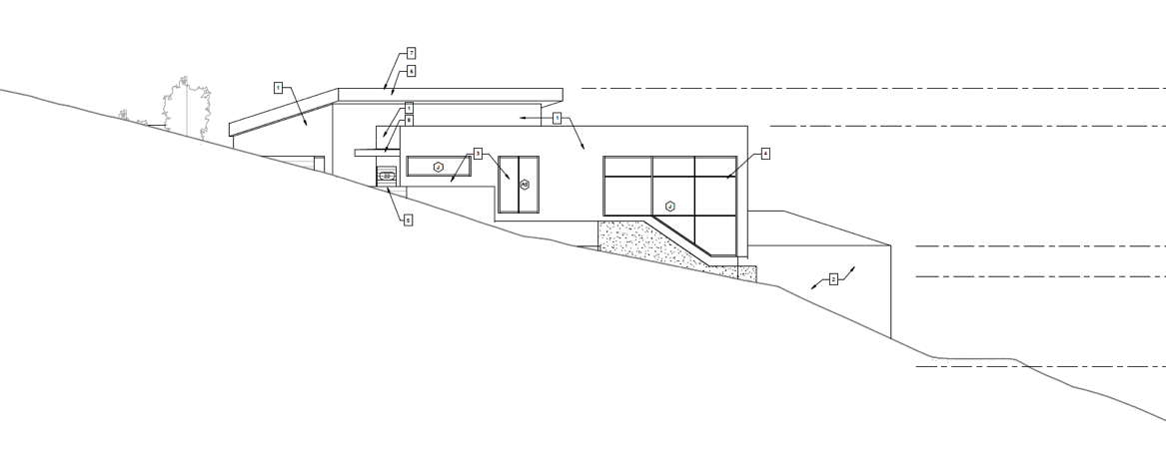
Previously Approved and Proposed West Elevation (Side)
Previously Approved
Proposed
Notes:
This slide shows the previously approved west elevation and proposed west elevation which is the other side of the house.

Slide 10
Staff Recommendation:
Approve the Hillside Development Permit and Tree Removal Permit for:
3,125 square-foot house including an attached 572 square foot two-car garage
Removal of four trees and replacement with eight trees
Addendum to the 2017 Negative Declaration

Slide 11
Planning Commission Options:
The Planning Commission can Approve with condition(s) added; or
The Planning Commission can Continue the project to address comments discussed; or
The Planning Commission can Deny the Project.

Slide 12
Questions?
Notes:
This concludes the presentation and staff is available to answer any questions if there are any. Thank you.

