Slide 2
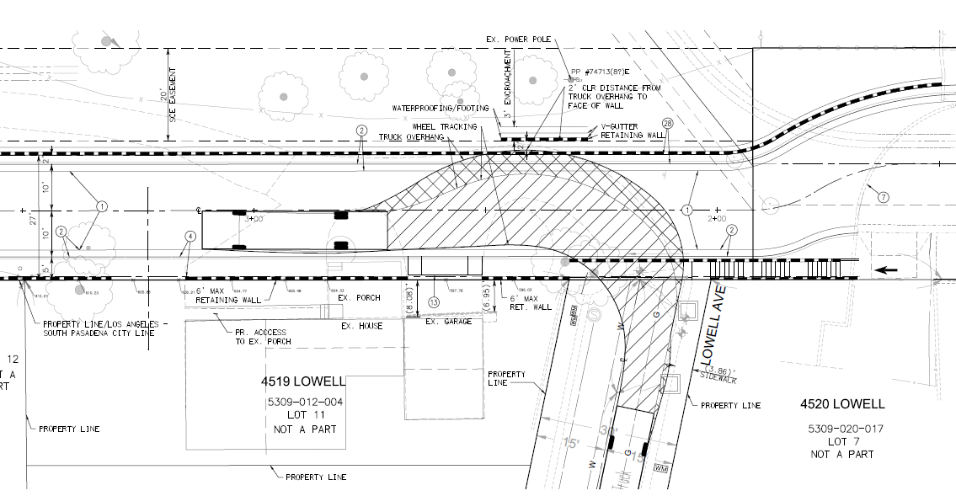
Previous Alternative Street Design

Slide 3
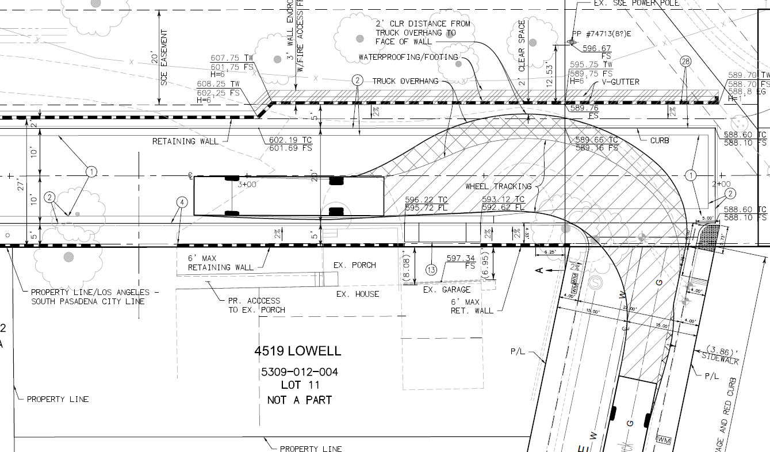
New Alternative Street Design
N

Slide 4
New Conditions of Approval
P-2. No construction traffic relating to the project shall occur on South Pasadena streets except for the proposed private street.
P-22. The applicant shall provide documentation demonstrating approval from the City of Los Angeles for the private street connection to Lowell Avenue.

Slide 5
Revised Conditions of Approval
P-15. Provide revised sStreet improvement plans for the private street for review and approval by the Planning Director and Public Works Director. The plans shall show and demonstrate the following: sidewalk, curb, and gutter connecting with the existing sidewalk, curb, and gutter located in front of the apartment building at 4520 Lowell Avenue.
Change the 5-foot wide sidewalk adjacent to the 6-foot high retaining wall along the Southern California Edison (SCE) easement at the northern portion of the street to be a 2-feet wide landscape area with climbing vines;
Provide landscaping with climbing vines for the entire length of the northern retaining wall;
A red, “No Parking” curb along the southern side at the eastern end of the private street (adjacent to 4519 Lowell Avenue). The length of the red curb shall be determined by the City of South Pasadena Public Works Director and the City of Los Angeles/City of South Pasadena Fire Department to ensure appropriate clearance for fire truck access;
The street design shall not create more surcharge load where the existing curved retaining wall (north of the apartment complex) would fail; and
There shall be no grade change in the western end of the public portion of Moffat Street which abuts the private portion of the street.

Slide 6
Removal of Conditions of Approval
Conditions PW-30, PW-34, and PW-36 through PW-38

Slide 7
Staff Recommendation:
Adopt a resolution approving Project 2191-HDP/TRP Hillside Development Permit for the street design of the private street portion of Moffat Street connecting only to Lowell Avenue and Tree Removal Permit of five trees, subject to conditions of approval.

Slide 8
Planning Commission Options:
The Planning Commission can Approve the street design as submitted with additional changes to the plans and/or conditions;
The Planning Commission can Approve the original street design with the private street connecting to the public portion of Moffat Street; or
The Planning Commission can Continue the project.

Slide 9
Questions?

