Slide 2
Project Description
Applications:
Notice of Intent to Demolish
Hillside Development Permit
Design Review
Variances
CEQA: Categorical Exemption –
Section 15301 Class 1 Existing Facilities

Slide 3
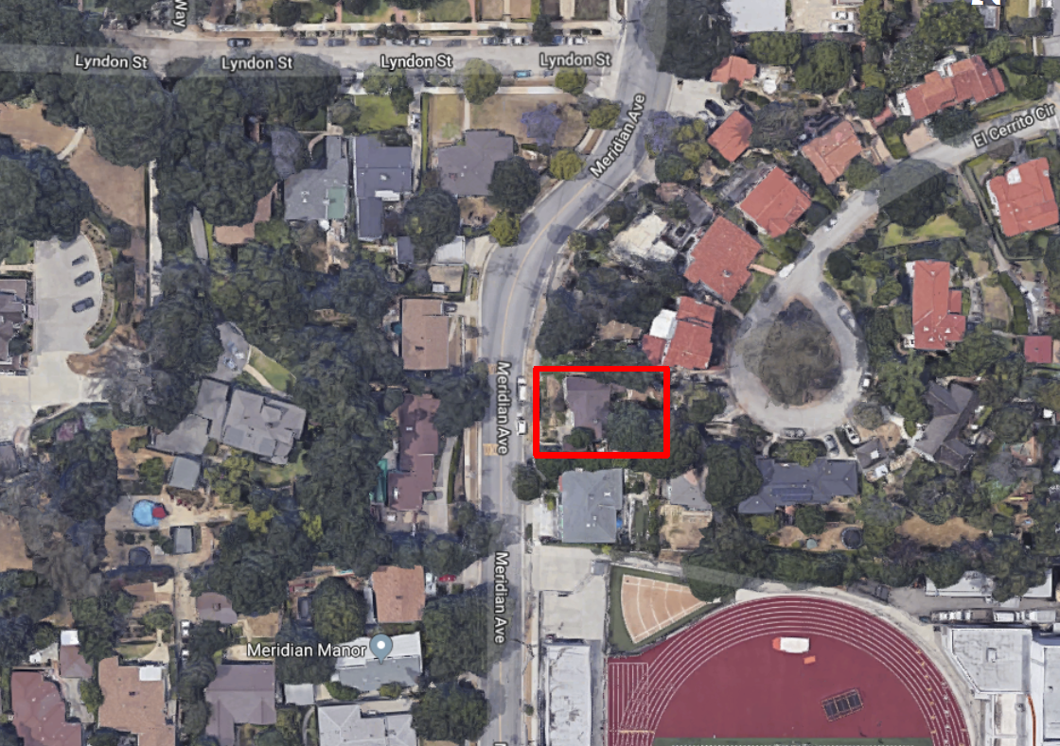
Aerial View
N

Slide 4
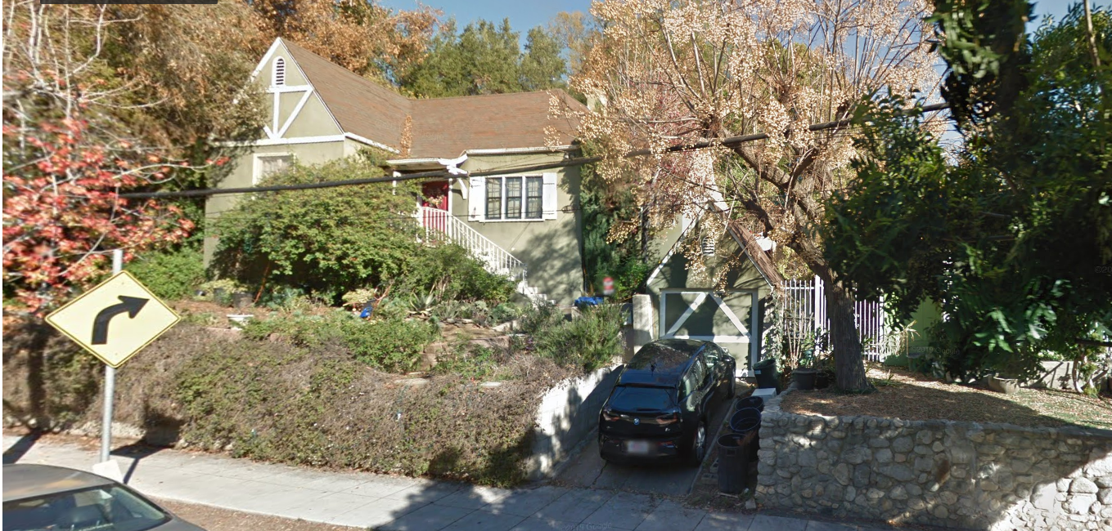
Street View

Slide 5
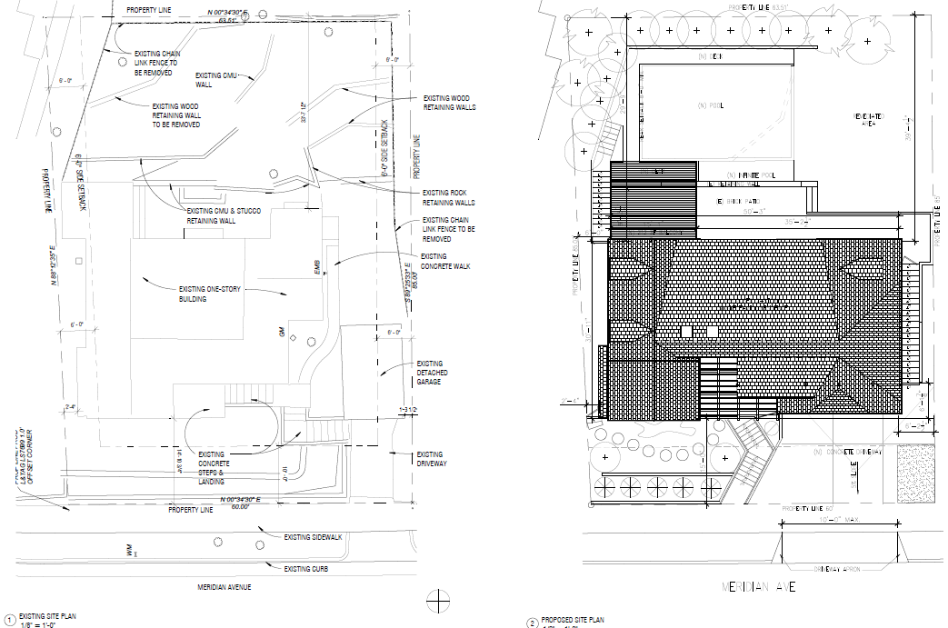
Existing Site Plan
Proposed Site Plan
N

Slide 6
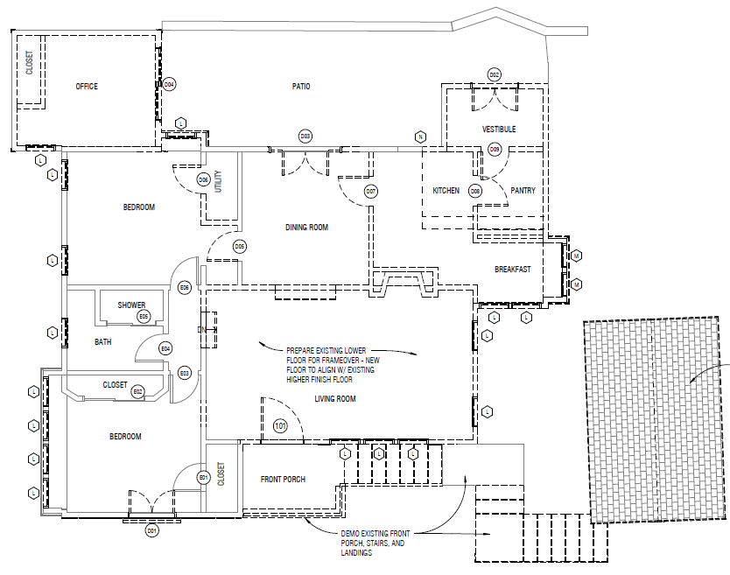
Demo Plan

Slide 8
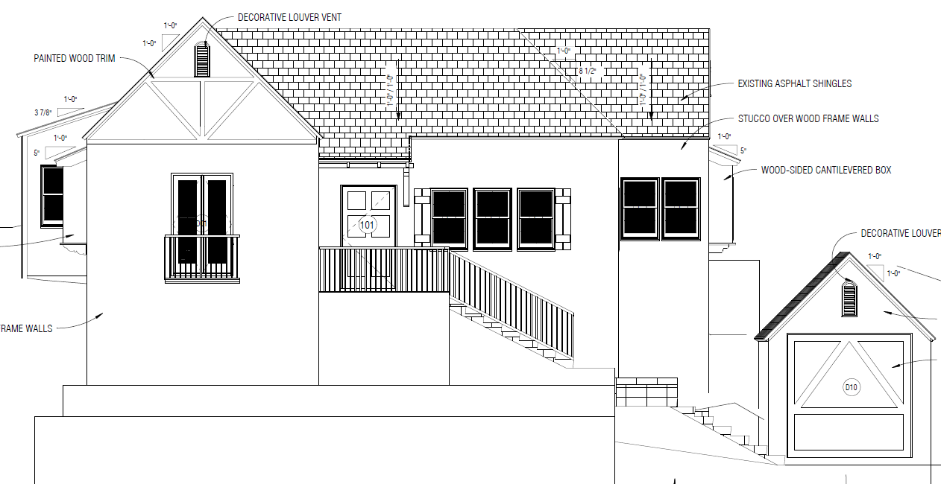
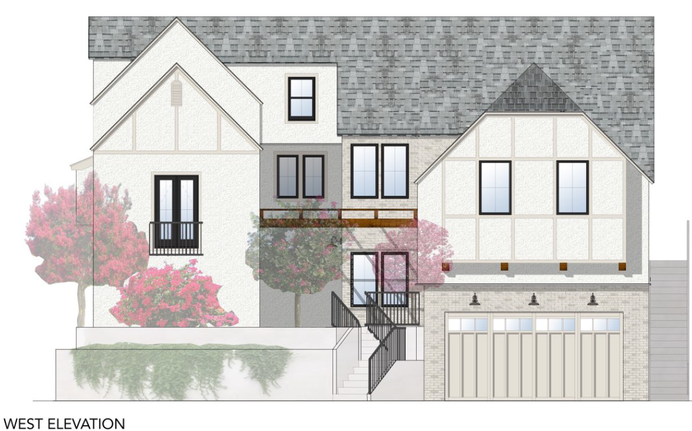
Existing & Proposed West (Front) Elevation
Existing
Proposed

Slide 9
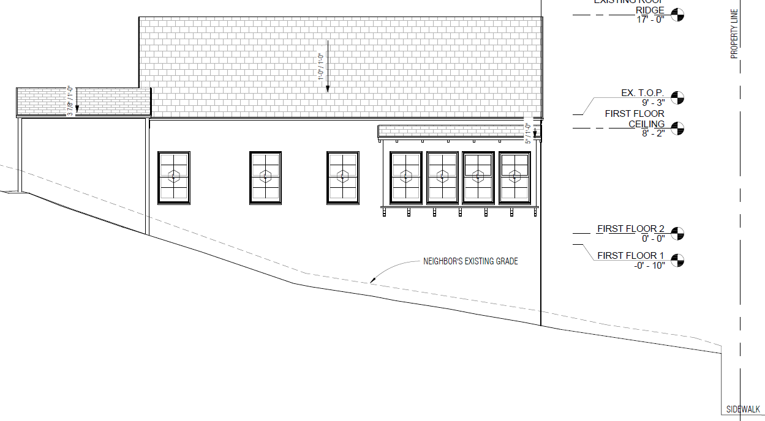
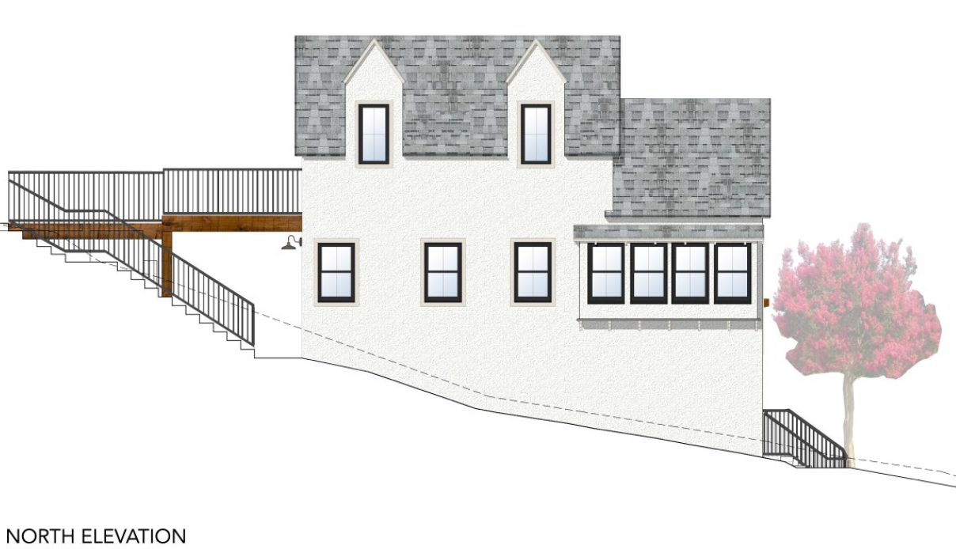
Existing & Proposed North Elevation
Existing
Proposed

Slide 10
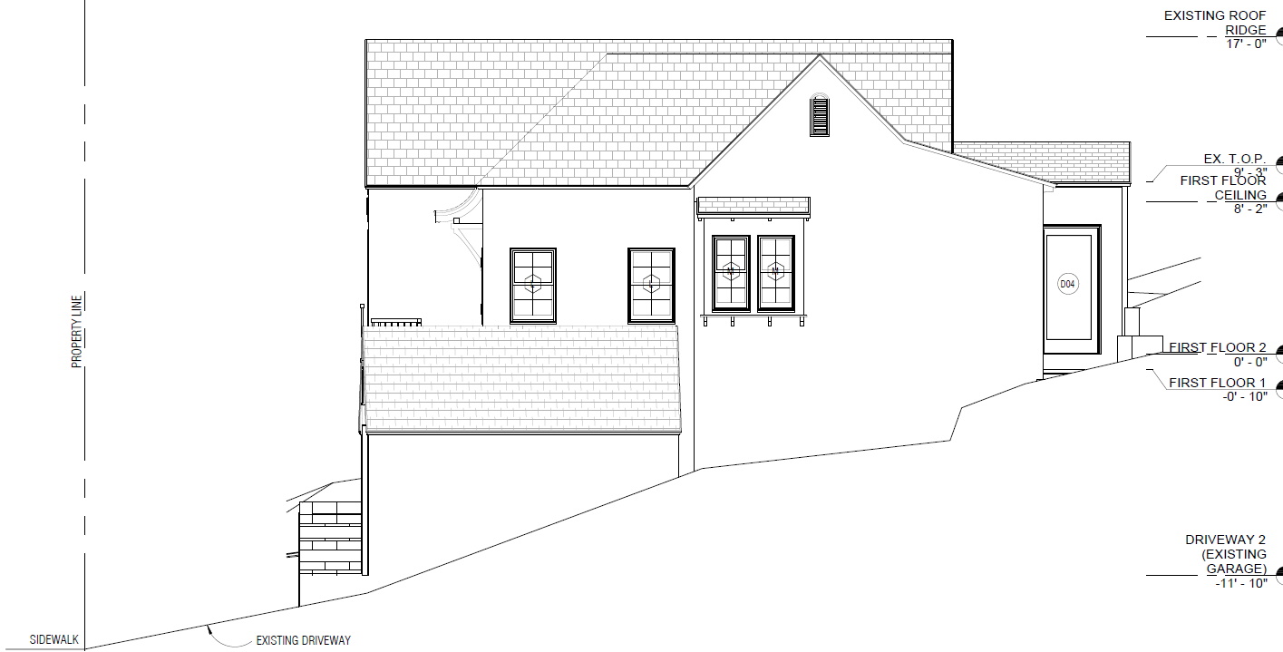
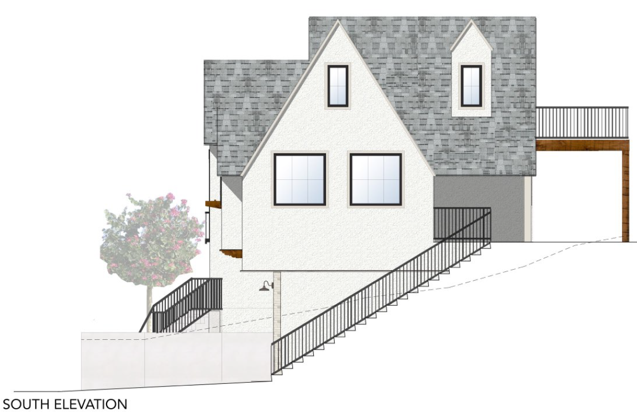
Existing & Proposed South Elevation
Existing
Proposed

Slide 11
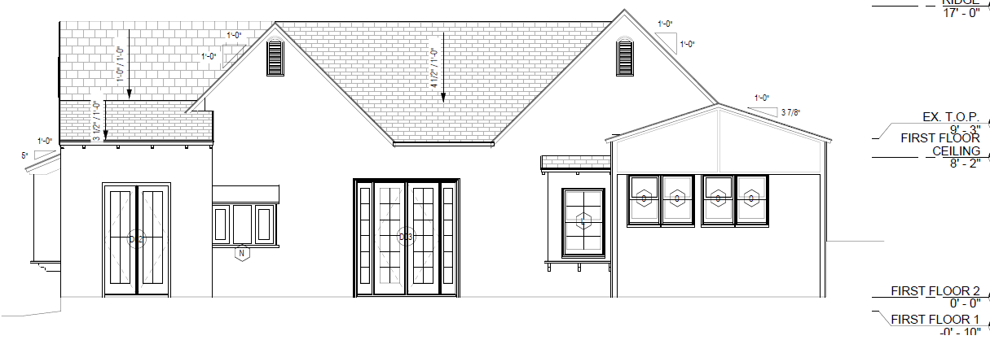
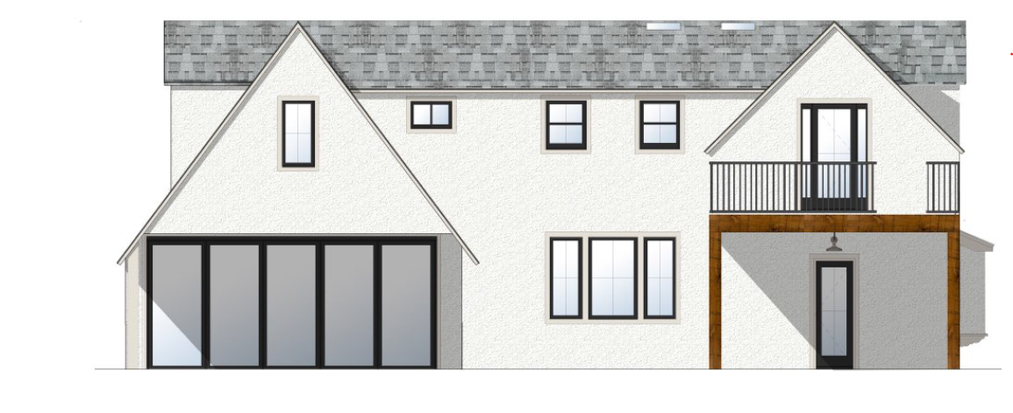
Existing & Proposed East (Rear) Elevations
Existing
Proposed

Slide 12
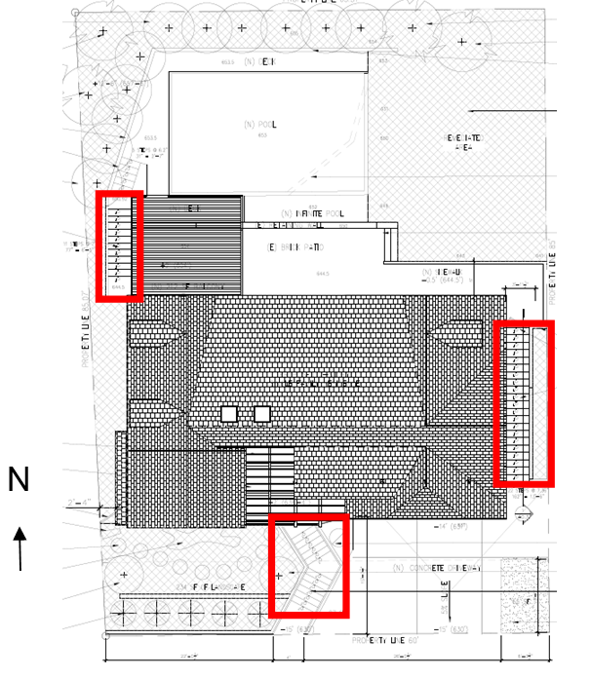
Variance - Exceed Three (3) Feet High and Over 10 Feet in Length Exterior Staircase Within the Front and Side Yard Setback

Slide 13
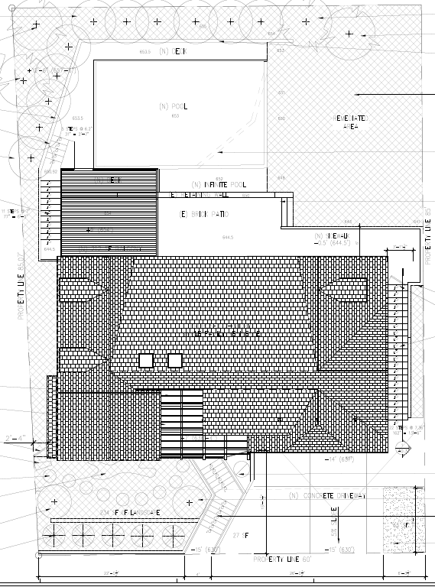
Variance - To Reduce the Percentage of Lot to Natural State

Slide 14
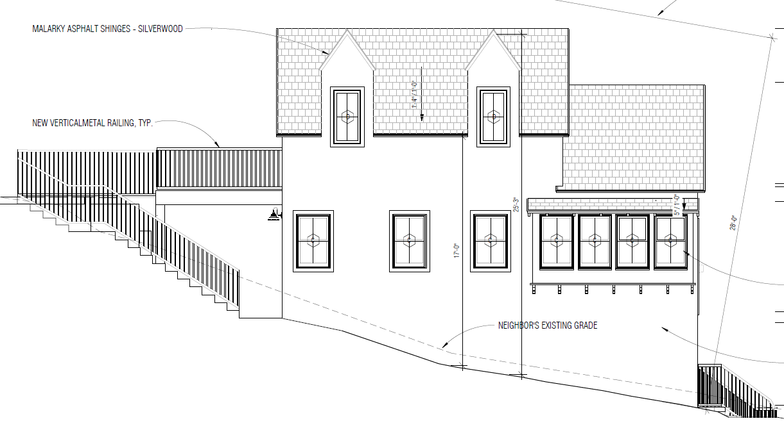
Variance - For Downhill Building Wall to Exceed 15 Feet in Height

Slide 15
Staff Recommendation:
Adopt a Resolution approving Project No. 2205-NID/DRX/HDP/VAR (Notice of Intent to Demolish, Hillside Development Permit, Design Review, and Variances) for the property located at 1312 Meridian Avenue, subject to conditions of approval.

Slide 16
Planning Commission Options:
Approve with condition(s) added.
Identify other issues or concerns with the proposed project and provide the applicant with direction to further modify the project and continue the public hearing to a date certain
Deny the project.

Slide 17
Questions?
Notes:
This concludes staff presentation.

