Slide 2
Project Description
Proposal: Conditional Use Permit (CUP) for the sales of beer and wine for on-site consumption (Type 41 License) at 901 Fair Oaks Suite B and patio area in front of restaurant.
CEQA: Categorical Exemption –
Section 15301 Class 1 Existing Facilities

Slide 3
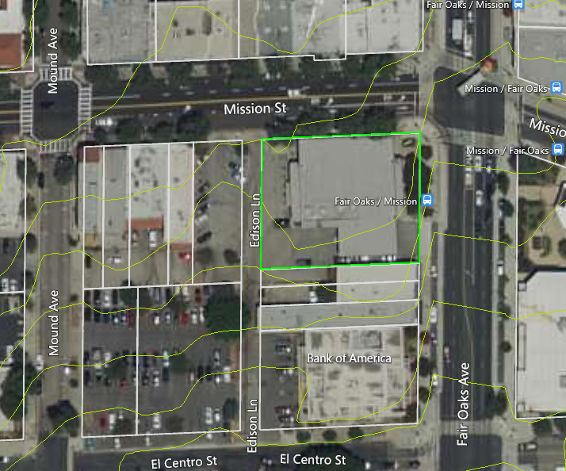
N

Slide 4
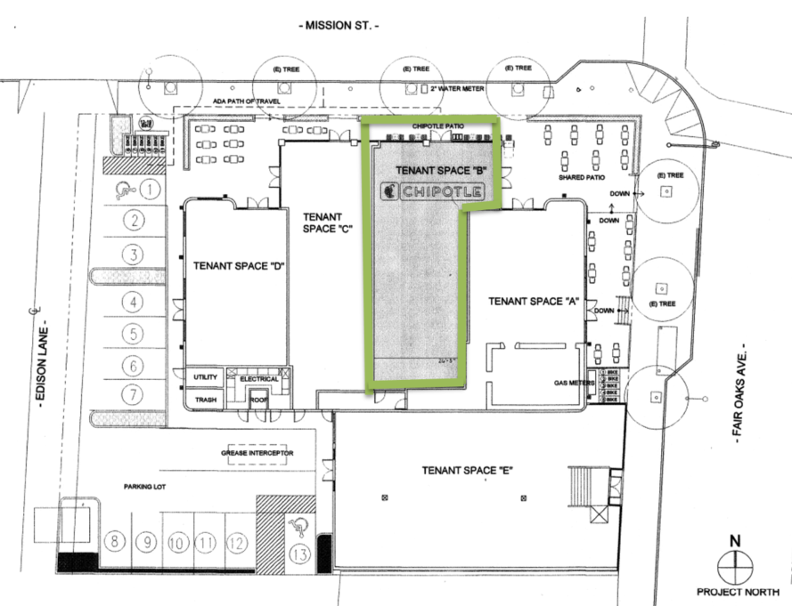

Slide 5
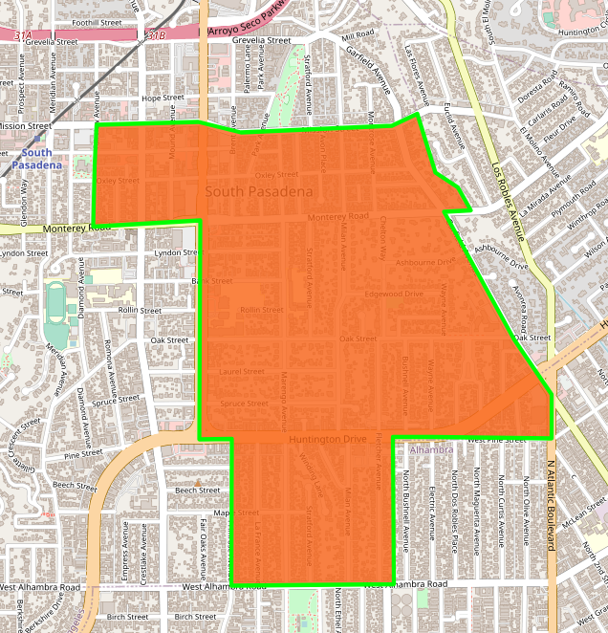

Slide 6
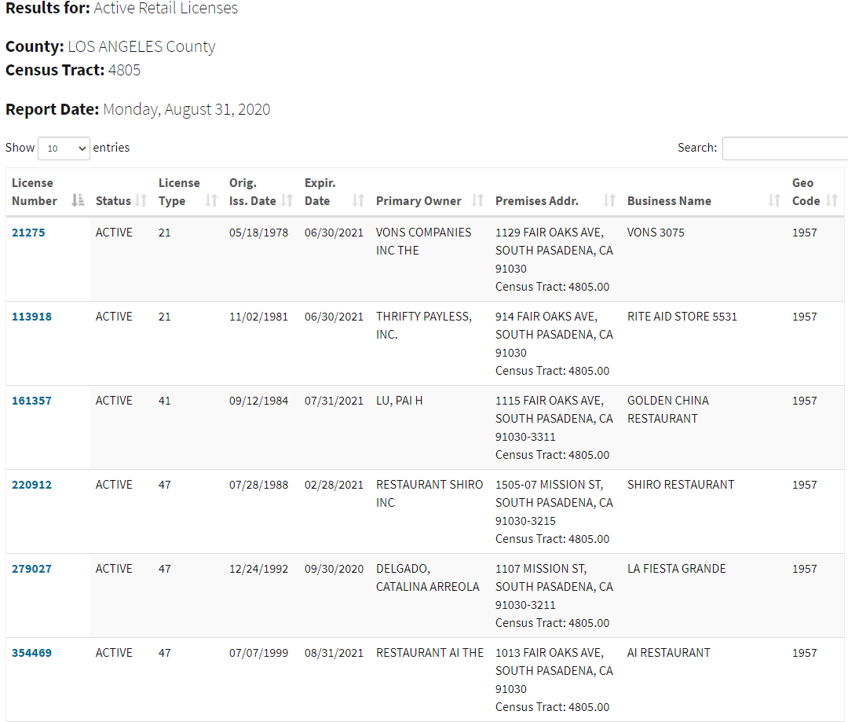
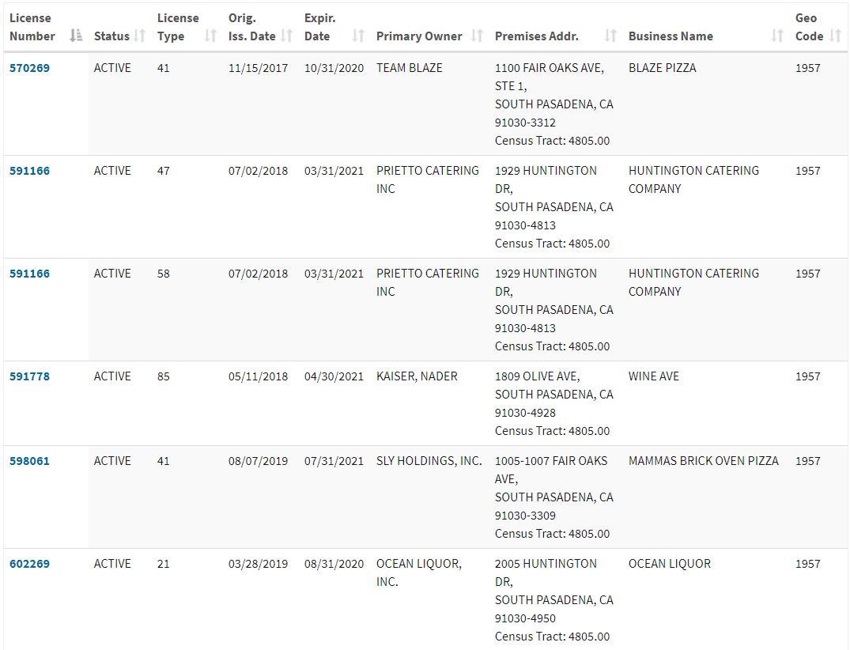
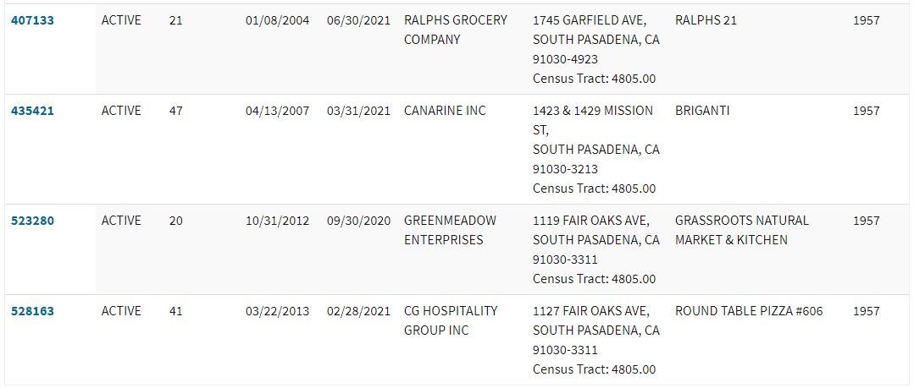

Slide 7
 | Type | Number of Licenses
On-Sale | 41 – On-Sale Beer & Wine Eating Place | 4
 | 47 – On-Sale General Eating Place | 5
Total: | 2 On-Sale License Types | 9
Off-Sale | 20 – Off-Sale Beer & Wine | 1
 | 21 – Off-Sale General | 4
 | 58 – Caterer’s Permit | 1
 | 85 – Limited Off-Sale Wine License | 1
Total: | 4 Off-Sale License Types | 7
Total: | 6 Different License Types | 16 Licenses

Slide 8
Conditions of Approval:
The sales of beer and wine shall be limited to the hours of operation.
All alcohol sales cases/displays shall be located in such a manner to prevent “grab and run” thefts of alcohol. The sales cases/displays shall be located in sight of the sales counter at all times, if possible.
The consumption of beer and wine shall be permitted only within the restaurant and in the patio area in front of the restaurant as outlined in green (for Suite B uses only) and the shared patio area on the corner of Fair Oaks and Mission Street
No advertising for alcoholic beverages may be displayed in store windows or outside of the store.
Signs shall be posted that alcohol consumption is not permitted beyond the fenced patio area directly in front of Suite B.

Slide 9
Staff Recommendation:
Adopt a Resolution approving Project No. 2290-CUP, Conditional Use Permit for sales of beer and wine (Type 41 License) at 901 Fair Oaks Suite B and the directly front adjacent patio area, subject to conditions of approval.

Slide 10
Planning Commission Options:
Approve with condition(s) added;
Continue the project to address comments discussed; or
Deny the project.

Slide 11
Questions?

