Slide 2
Background
May 11, 2021
PC continued the item for applicant to address architectural details (cladding, railing, garage, stairs, soffits, and overhang); and
Standardize plans -line weight and dimensions.
Discussed window shapes & proportion, floor plan, concern over the front wall meeting code and structure’s brightness.

Slide 3
Background
Railing details illustrate black top rails and posts.
Window shapes are largely the same as previous plans.
Additional wood paneling to break luminosity
Floor plan rearranged to maximize views.
Calculation with the revised plans, including size of structure 2,362 to 2,468 square feet.

Slide 4
PROJECT DESCRIPTION
Hillside Development Permit to allow construction of a 2,468 square-foot single-family home with an attached Accessory Dwelling Unit on a vacant hillside lot with an average slope of 20% or greater;
Design Review for the proposed project;
Tree Removal Permit to allow the removal of 10 trees;
Junior ADU located above garage;
Two Variances to deviate from the development standards 1) to allow the project to provide 34% of the lot size to remain in its natural state instead of 63%, 2) allow a staircase in the side setback that exceeds 36 inches height and width.

Slide 5
Environmental Review
On April 9, 2021 Environmental Science Associates, surveyed the site for environmentally sensitive animals, plants, and other wildlife. A report was completed, which determined that the site contains a variety of non-native plant species and some wildlife, including but not limited to the lesser goldfinch, northern mockingbird, western fence lizard, but no wildlife considered as “special status”. The report concluded the project, as proposed, would not have a significant effect on plant and wildlife species nor a cumulative effect.
CEQA: Categorical Exemption – Section 15303, Class 3 “Construction of Small Structures” and Section 15332, Class 32 “In-fill Development Project”.

Slide 6
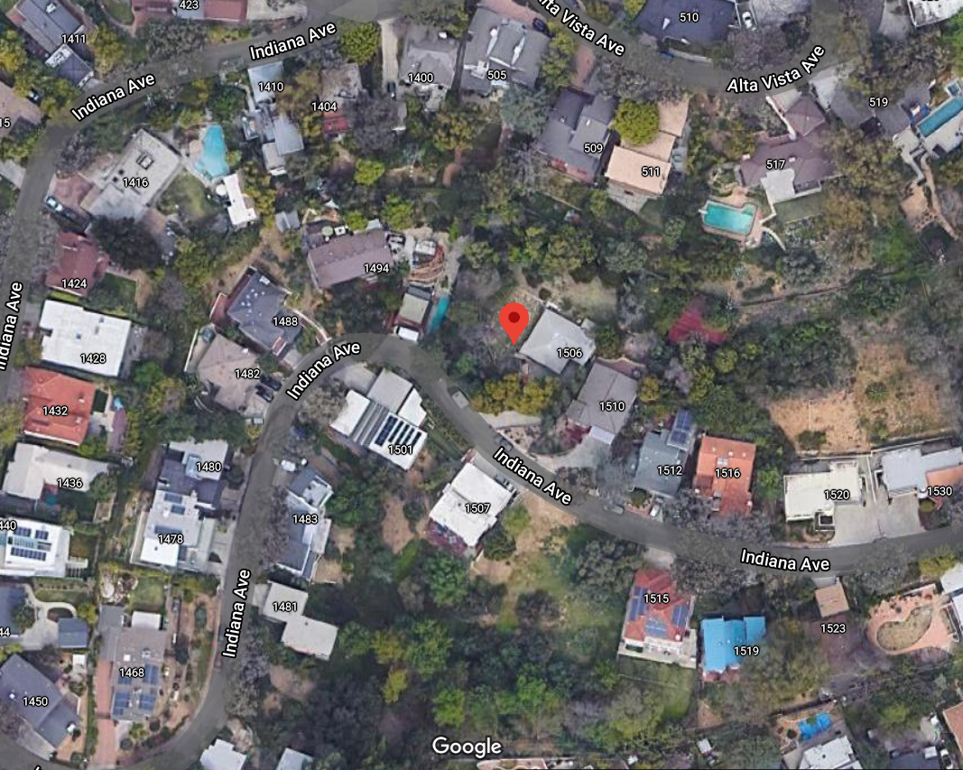
Aerial View
Monterey Road
Brunswick Ave.
N
Zoning: Residential Single-Family
General Plan: Low Density Residential
Site Not in Los Altos de Monterey Zone

Slide 7
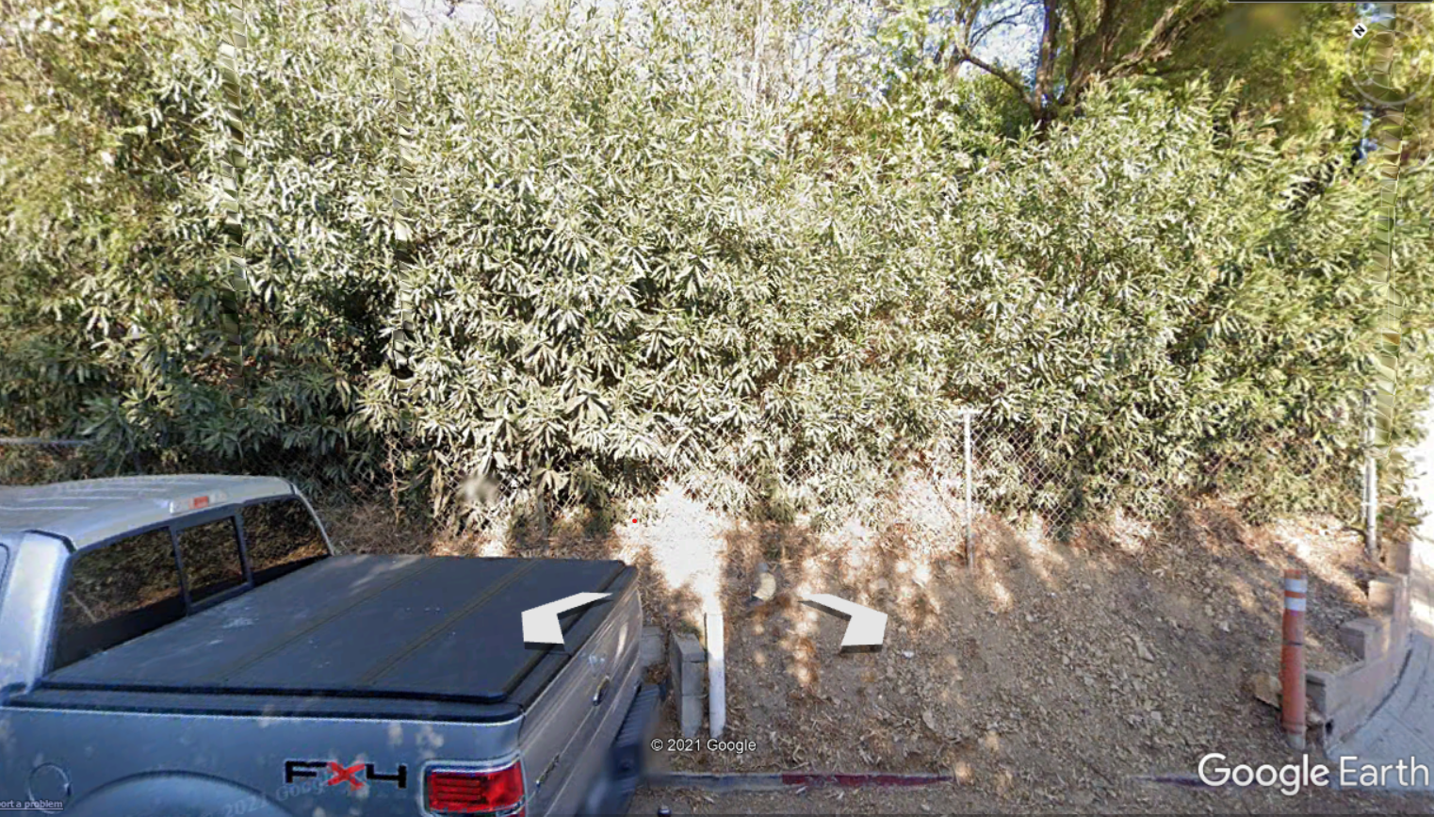
Street View

Slide 8
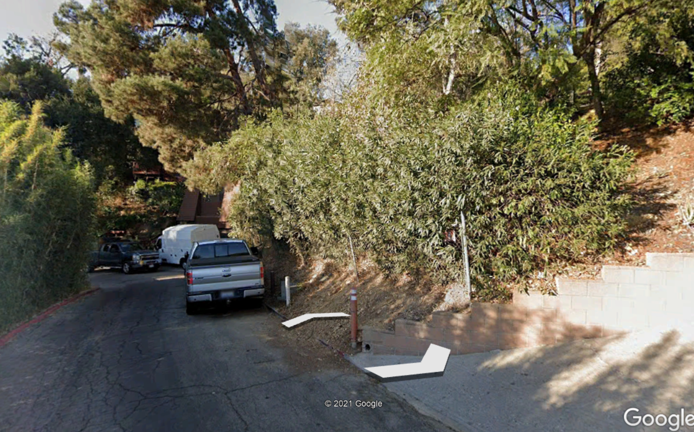
Street View

Slide 9
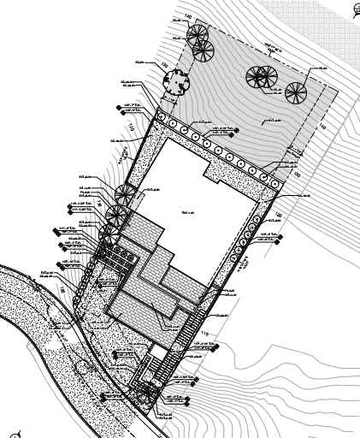
PROPOSED SITE PLAN
7,148 sq.ft. Lot Size
129 ft. L x 53 ft. W
Average Slope: 38%
2,468 sq.ft. Primary Residence,
2 levels, 3bd, 4bth
500 sq.ft. Junior ADU (studio)
629 sq.ft. 2-Car Garage

Slide 10
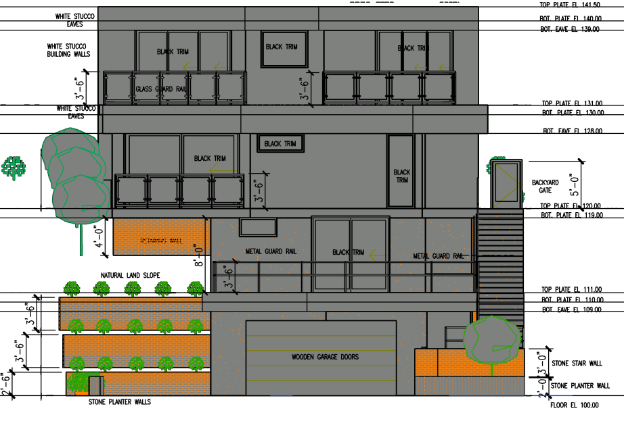
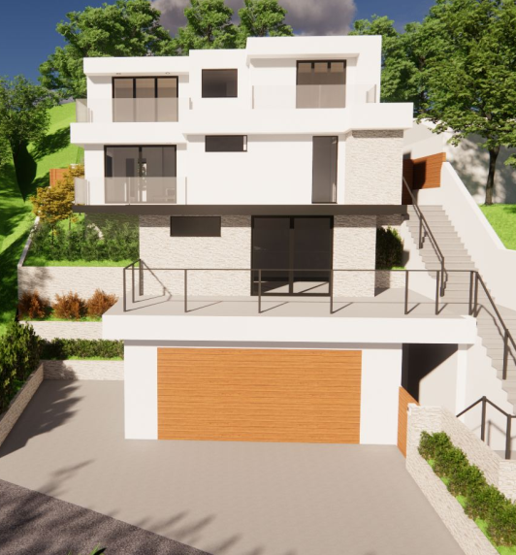
Previous South Elevation (Front)

Slide 11
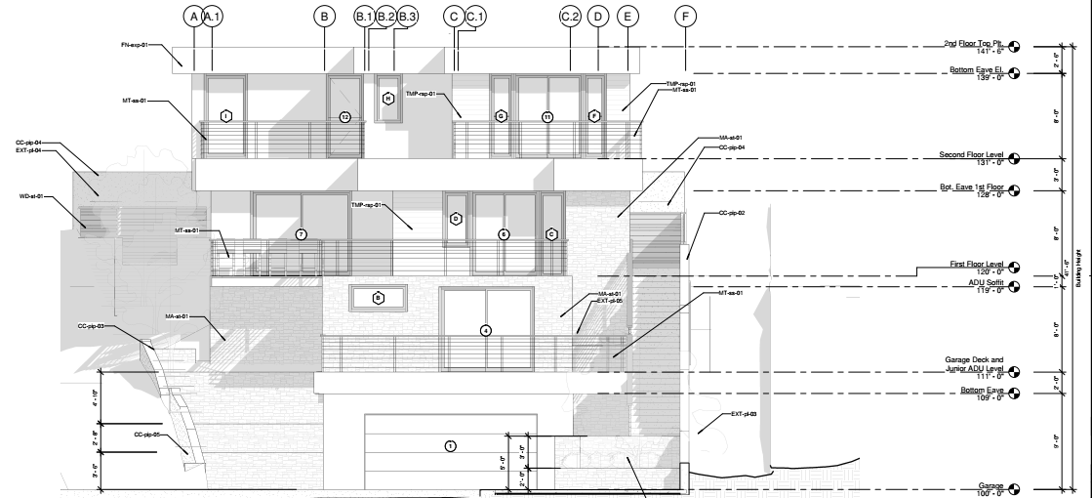
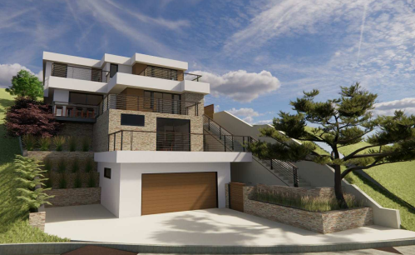
Proposed South Elevation (Front)

Slide 12
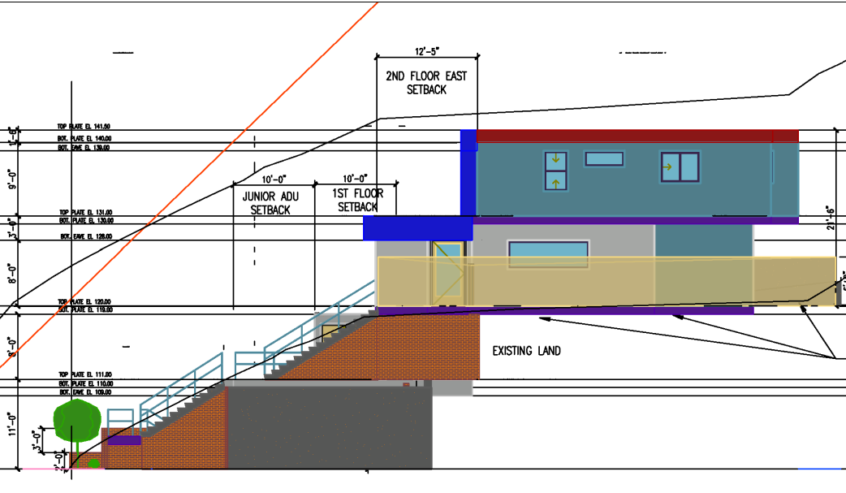
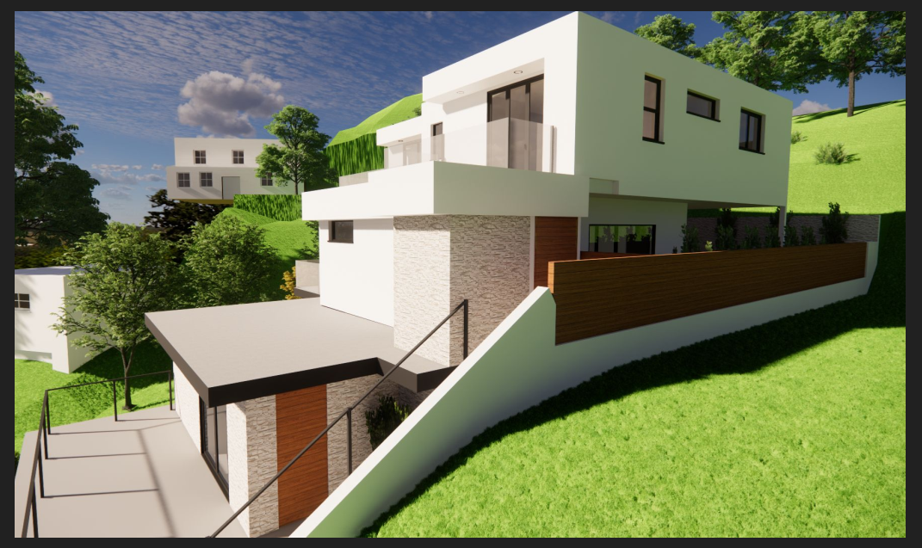
Previous East Elevation (Side)

Slide 13
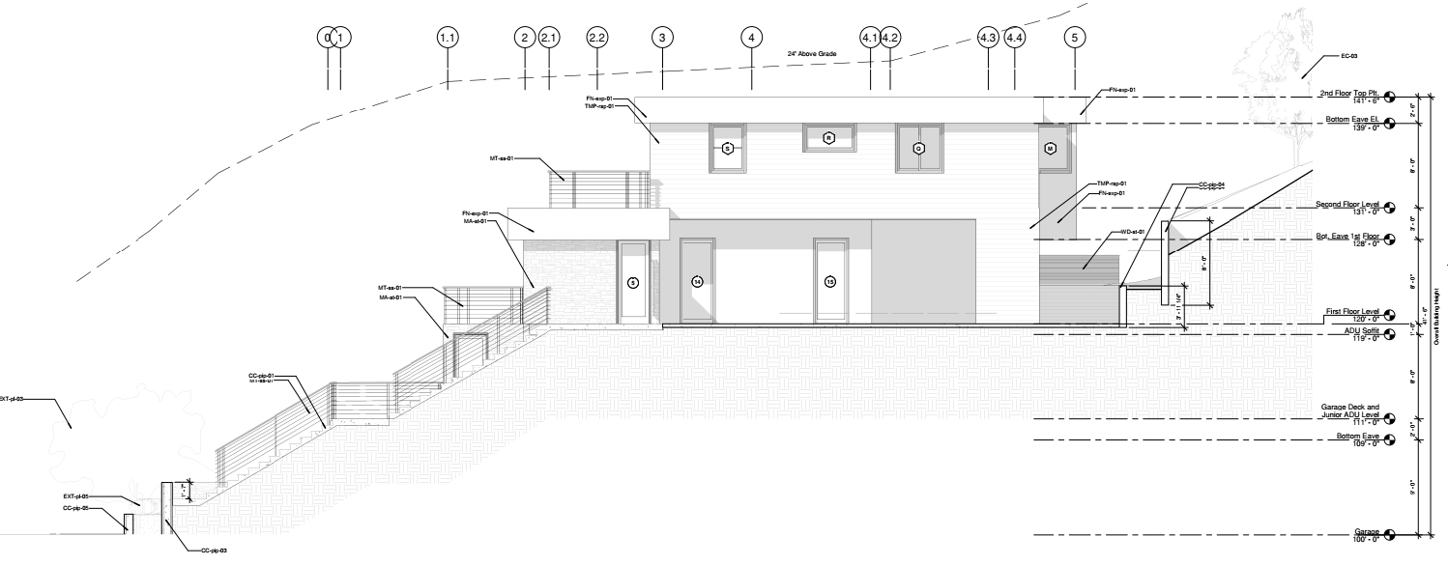
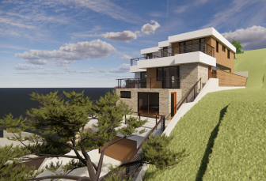
Proposed East Elevation (Side)

Slide 14
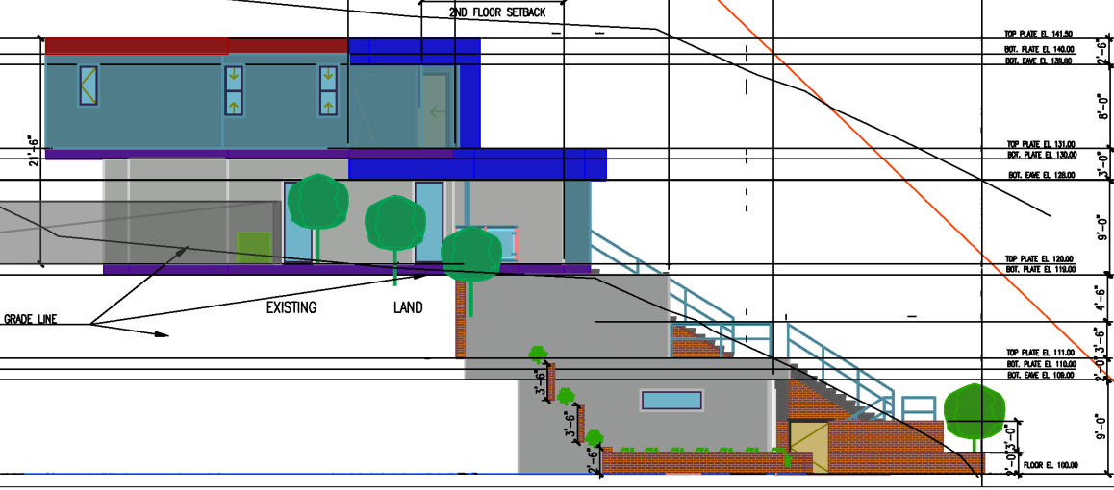
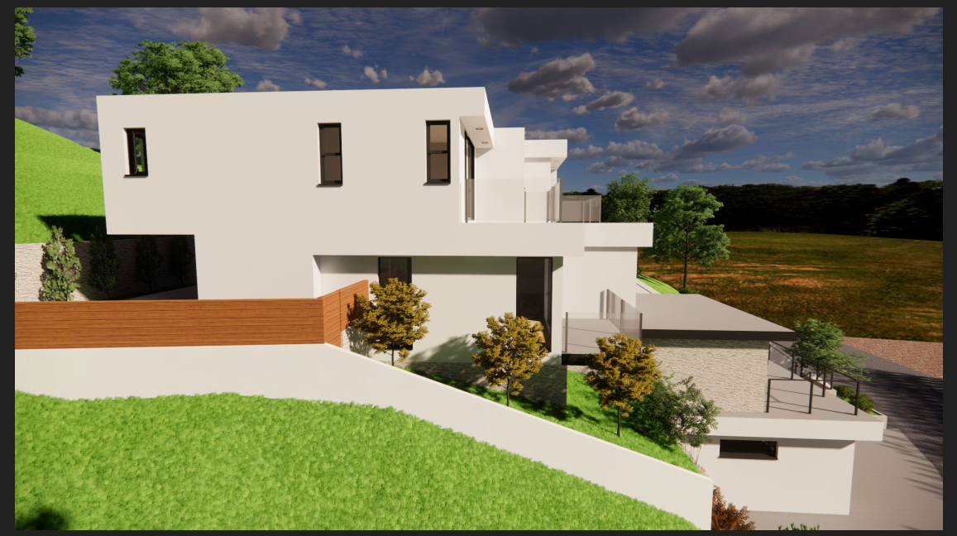
Previous West Elevation (Side)

Slide 15
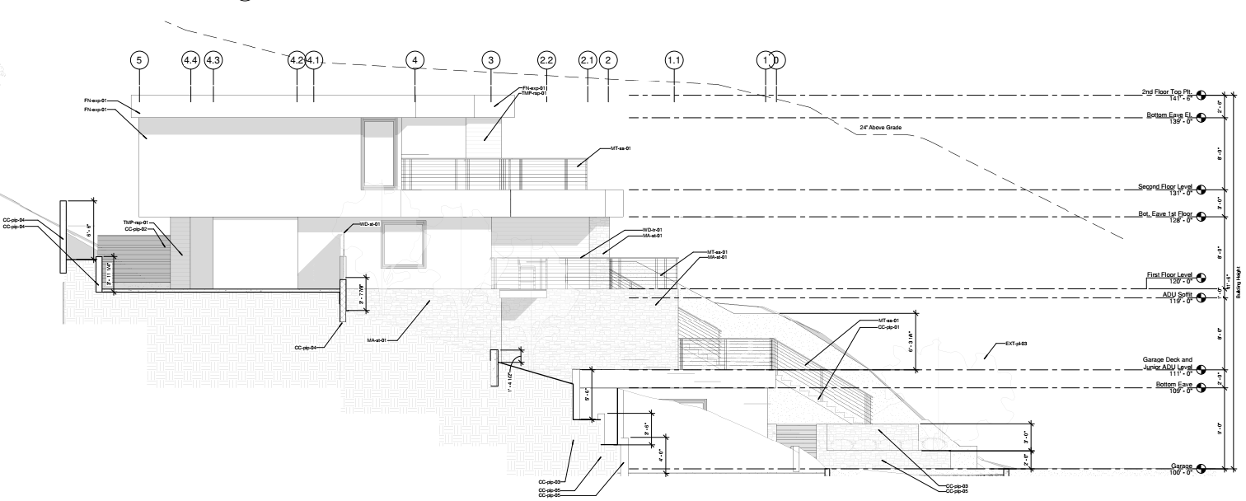
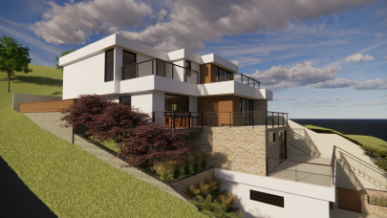
Proposed West Elevation (Side)

Slide 16
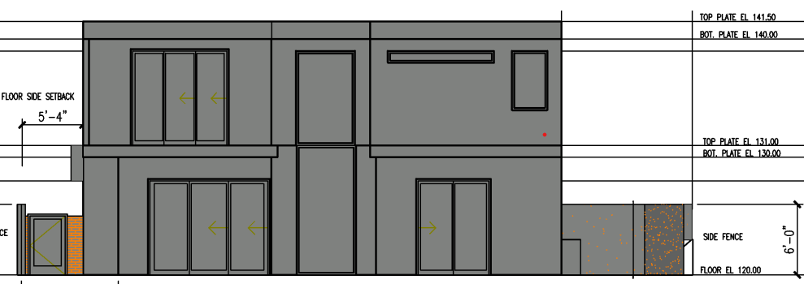
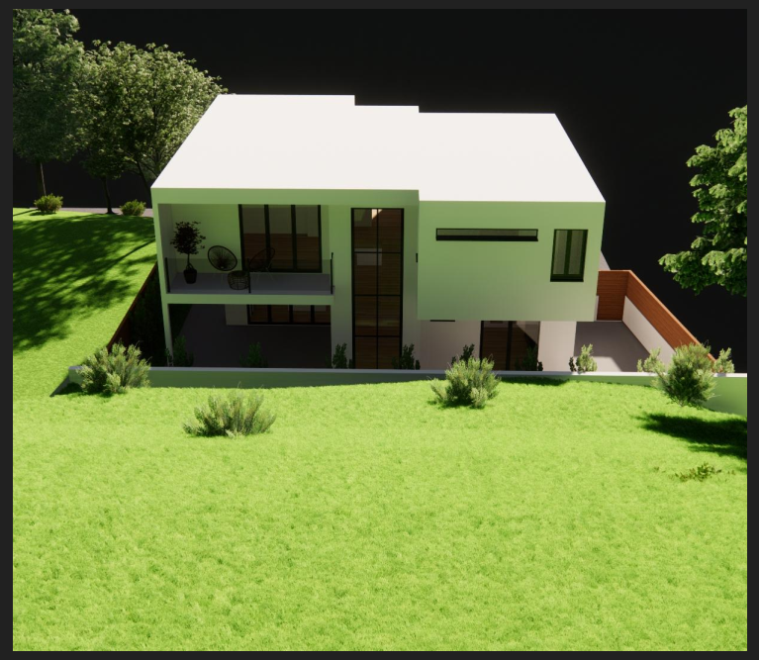
Previous North Elevation (Rear)

Slide 17
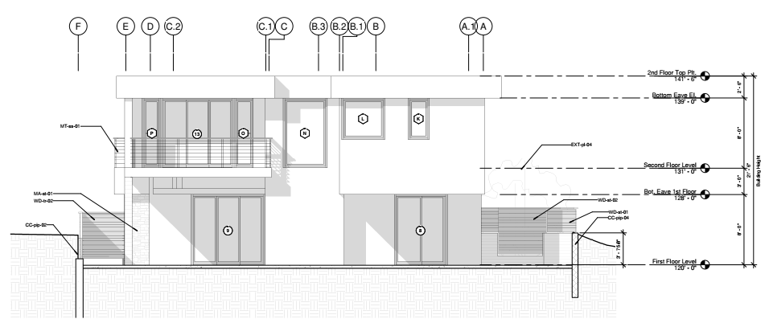
Proposed North Elevation (Rear)

Slide 18
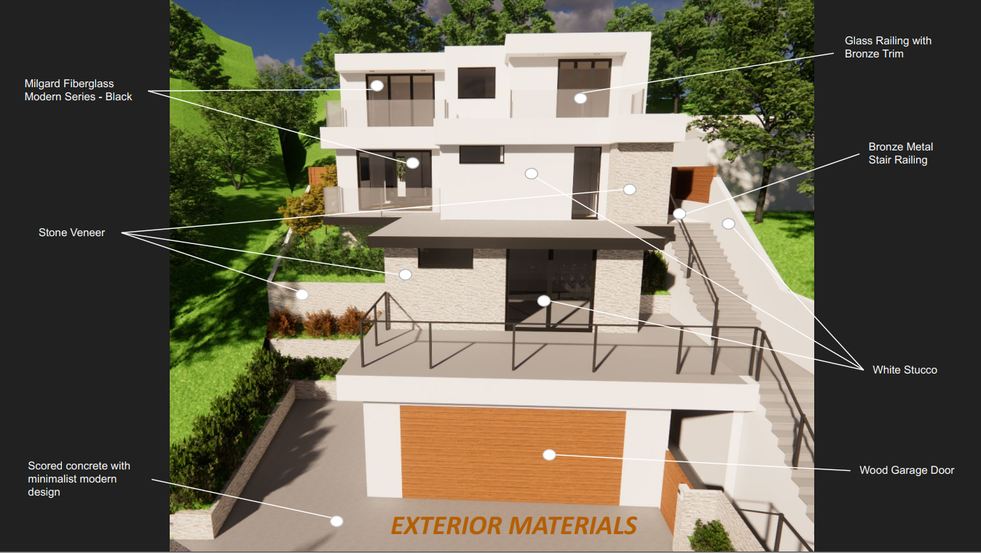
Previous Colors and Materials
White Stucco Walls

Slide 19
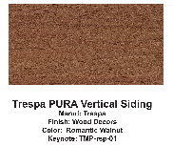
Proposed Colors and Materials

Slide 20
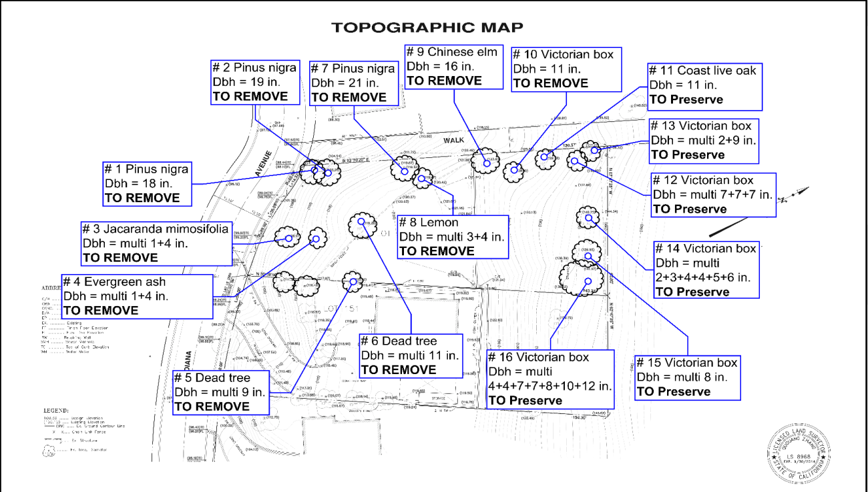
Tree Removal – 10 Trees
Tree to be Removed
Trees #5, #6 are dead trees

Slide 21
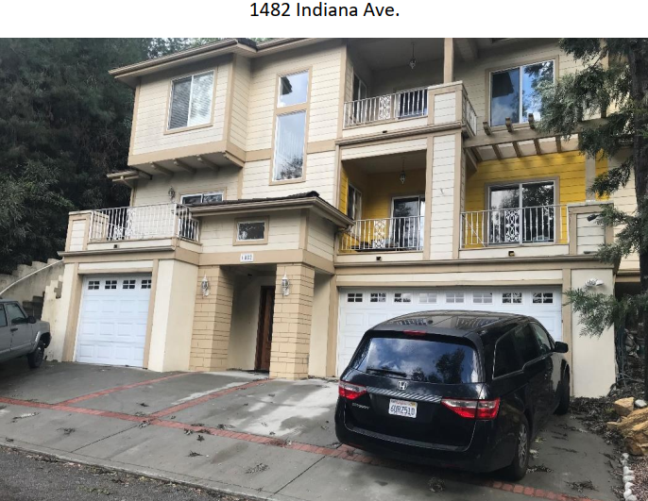
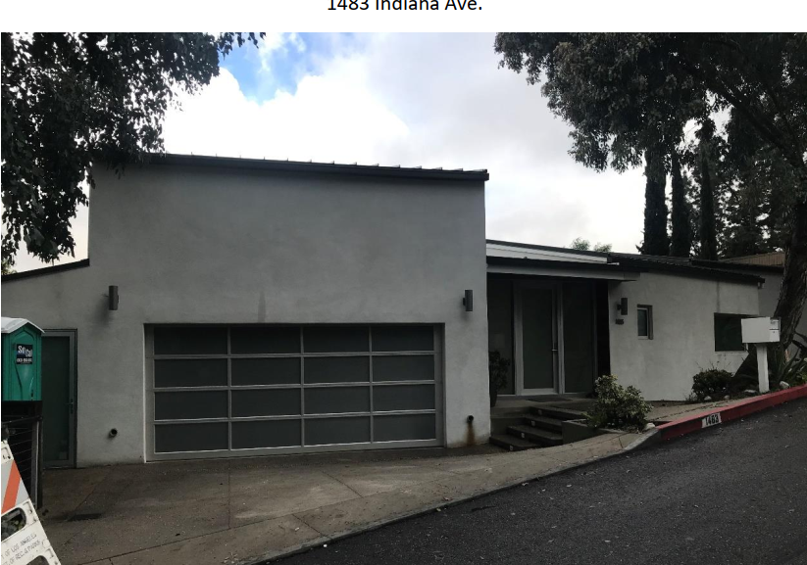
Neighborhood Compatibility
1482 Indiana Avenue
1483 Indiana Avenue

Slide 22
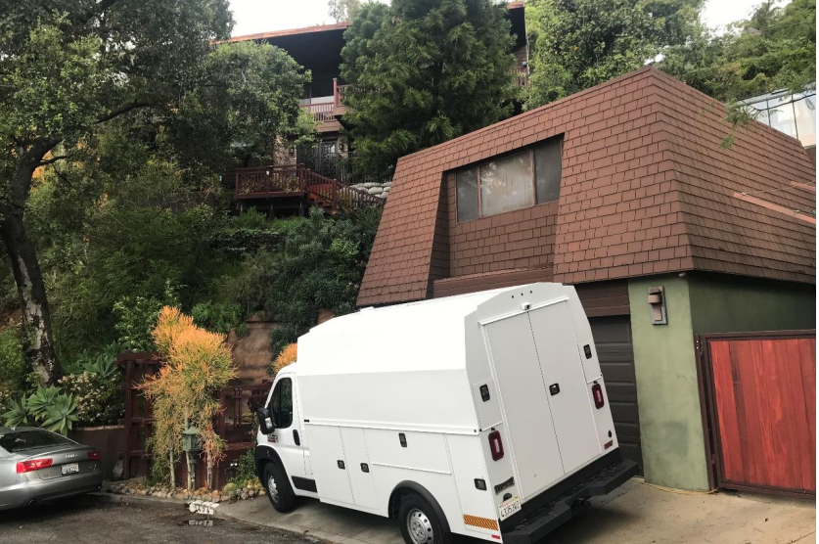
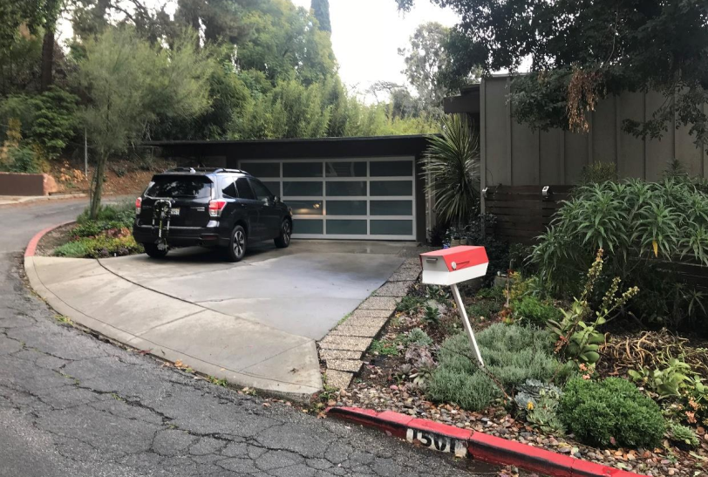
Neighborhood Compatibility
1494 Indiana Avenue
1501 Indiana Avenue

Slide 23
Variances
Two Variances to Deviate from the Development Standards:
Variance No. 1:
To allow the project to provide 34% of the lot size to remain in its natural state instead of 63% as required by Section 36.340.050 (F) of the Hillside Protection Ordinance; and
Support of No. 1:
The small size of this hillside lot (7,148 sq.ft.) and the average slope of 38% do not allow for development to comply with this requirement. The proposed lot coverage of 38.5% is below the allowed 40%. The slope and size of the lot impede the project to comply.

Slide 24
Variances
Two Variances to Deviate from the Development Standards:
Variance No. 2:
To allow a staircase to encroach into the side setback exceeding 36 inches in height, 36 inches in width, and 10 feet in length as provided in Section 36.300.030 (D) of the Zoning Code.
Support of No. 2:
To comply with the 45 -degree angle clearance in the height standards of Table 2-3 applicable to RS zoning district, the staircase was relocated from the west side of the house to the east side within the side yard setback. The project has been designed toward the front of the lot, which is the lowest point to reduce excessive grading. Due to the existing slope of the lot the staircase cannot comply with the 36 inches thresholds and the 10-foot length limitation.

Slide 25
1. Approve as proposed without changes; or
2. Approve with modifications to the conditions and/or design(s); or
3. Continue the project to a future public hearing and direct the applicant to make changes to the project; or
4. Deny the project.
Planning Commission Options:

Slide 26
STAFF RECOMMENDATION:
The Planning Commission make the findings to approve the project as proposed and adopt a Resolution to issue a Hillside Development Permit, Design Review approval, Tree Removal Permit, JADU, and approval of two Variances subject to the conditions of approval in Exhibit A of the Resolution for property located at 1502 Indiana Avenue.

Slide 27
Questions

