Slide 2
Project Description
Applications:
Hillside Development Permit
Design Review
Variances
Tree Removal Permit
CEQA: Categorical Exemption –
Section 15303 Class 3 New Construction or Conversion of Small Structures &
Section 15332 Class 32 In-Fill Development Projects

Slide 3
Aerial View
N

Slide 4
Street View

Slide 5
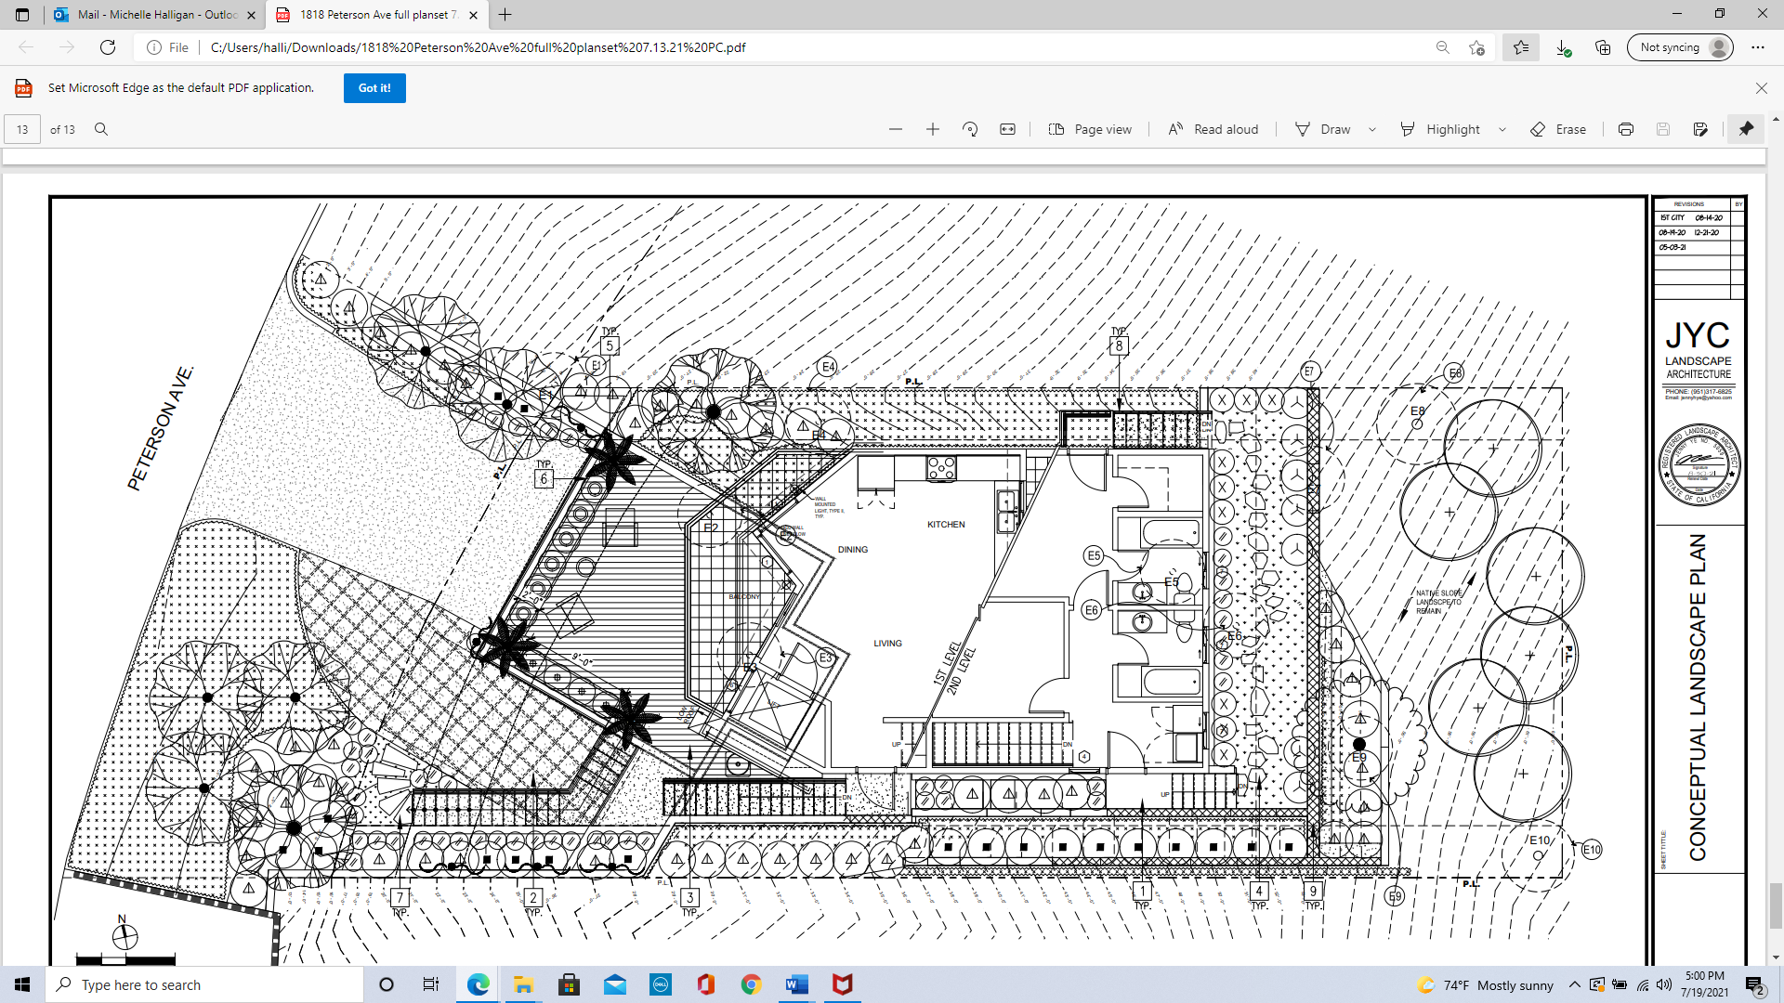
Proposed Site Plan
N

Slide 6
Cross-Section

Slide 7
Proposed West (Front) Elevation

Slide 8
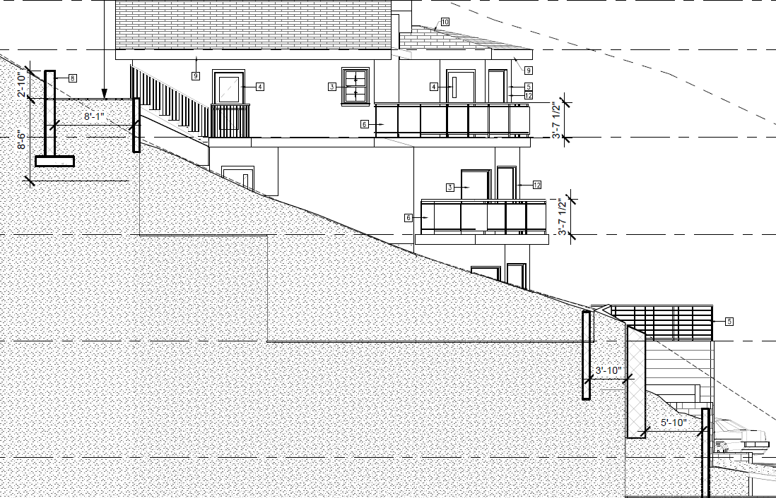
Proposed North Elevation

Slide 9
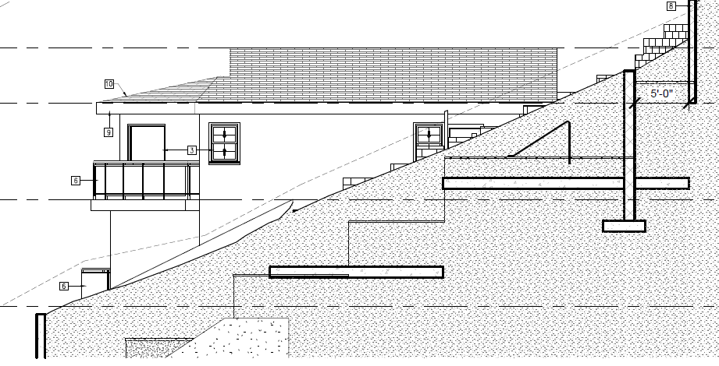
Proposed South Elevation

Slide 10
Proposed East (Rear) Elevation

Slide 11
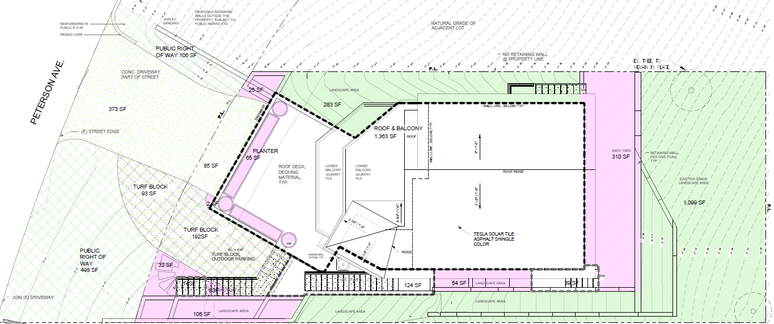
Variance - Reduce the Percentage of Lot to Natural State & Vegetation
Project | Lot Size (sq. ft.) | Home Size (sq. ft.) | Slope (%) | Natural State (%) |  |  | Approval Date
 |  |  |  | Required | Proposed | Deviation
226 Warwick | 4,465 | 1,510 | 35.7 | 60.7 | 46.5 | 14.2 | 10-Dec-19
228 Warwick | 4,352 | 1,334 | 37.8 | 62.8 | 45.3 | 17.5 | 10-Dec-19
804 Valley View | 7,500 | 3,125 | 38.0 | 63.0 | 57.0 | 6.0 | 13-Oct-20
807 Rollin | 9,970 | 3,411 | 22.1 | 47.1 | 23.0 | 24.1 | 12-Jan-21
1502 Indiana | 7,170 | 2,362 | 38.0 | 63.0 | 38.5 | 24.5 | Continued
Subject Project | 3,740 | 1,231 | 54.0 | 79.6 | 36.2 | 43.4 | Pending

Slide 12
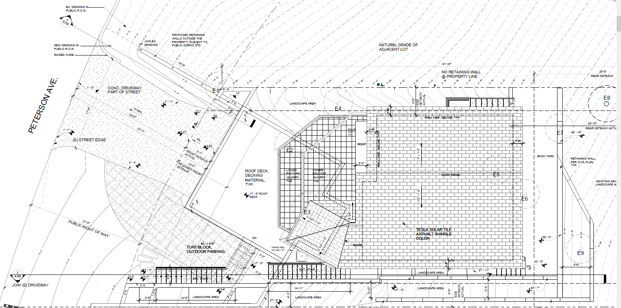
Variance – Reduce Front Yard Setback
Proposed
Required

Slide 13
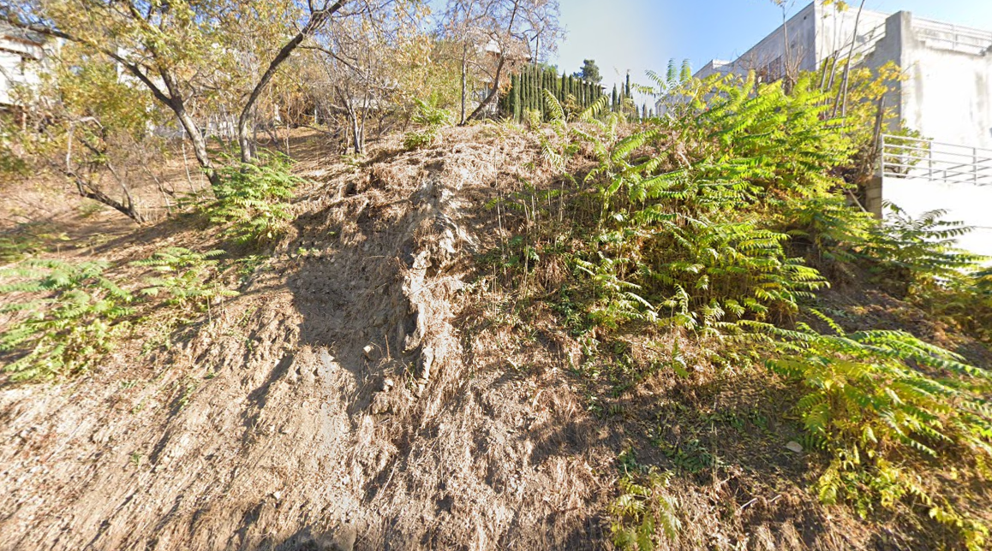
Variance – Increased Retaining Wall Height in Front and Rear Setback

Slide 14
Staff Recommendation:
Adopt a Resolution approving Project No. 2237-HDP/DRX/VAR/TRP (Hillside Development Permit, Design Review, Variances, and Tree Removal Permit) for the property located at 1818 Peterson Avenue, subject to conditions of approval.

Slide 15
Planning Commission Options:
Approve with condition(s) modified/added.
Identify other issues or concerns with the proposed project and provide the applicant with direction to further modify the project and continue the public hearing to a date certain
Deny the project.

Slide 16
Questions?
Notes:
This concludes staff presentation.

