Slide 2
Project Description
Applications:
Hillside Development Permit
Design Review
Variances
Tree Removal Permit
CEQA: Categorical Exemption –
Section 15303 Class 3 New Construction or Conversion of Small Structures &
Section 15332 Class 32 In-Fill Development Projects

Slide 3
November 9 Hearing
Concerns expressed by neighbors about privacy, impact to existing utilities
Commission continued hearing to December 14 and asked applicant to address the following items:
Orientation of the windows in relation to the neighboring homes should be evaluated to ensure appropriate privacy for the neighbors.
Position of the neighboring homes, and their relationship to the proposed home, should be shown on the plans.
Provide additional information about the nature of the entertainment room proposed in the new home.
Clarify whether an Accessory Dwelling Unit (ADU) or Junior Accessory Dwelling Unit (JADU) is being proposed.
Clarify whether an existing retaining wall is being removed and where it is located.
Percentage of the site remaining in natural slope and vegetation seems low; consider ways to increase the percentage.
Applicant should meet with the neighbors and listen to their concerns.

Slide 4
Aerial View
N

Slide 5
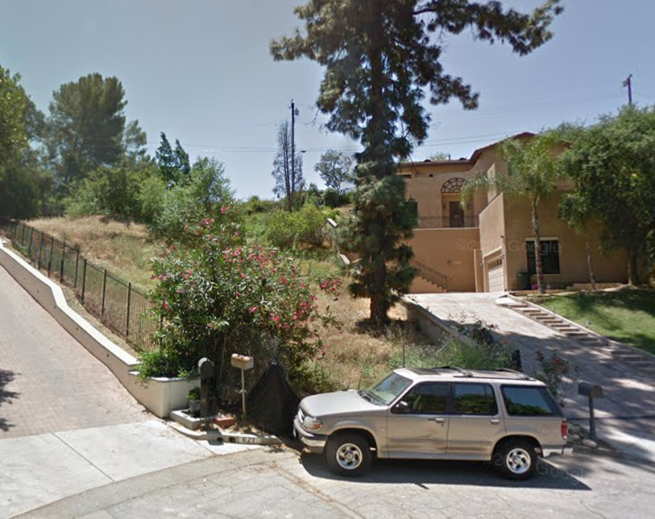
Street View

Slide 6
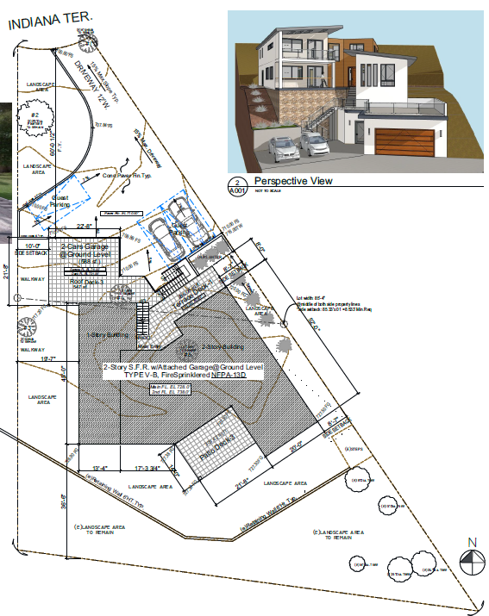
No ADU/JADU proposed. Entertainment room has only a wet bar and small refrigerator.
Proposed Site Plan
Deck above garage, 10’ setback, adjacent to driveway
Balcony (8’7” side setback)
N
19’7” setback, adjacent to house
Balcony (>30’ side setback)

Slide 7
Proposed Landscape Plan
Hollyleaf Cherry
Proposed Bay Laurel
Hollyleaf Cherry
N
19’7” setback, adjacent to house
10’ setback, adjacent to driveway

Slide 8
Front Perspective

Slide 9
Front (North) Elevation
Retaining wall that exceeds allowed height—subject of a variance

Slide 10
Proposed Side (East) Elevation
Proposed trees
Natural grade
Retaining wall that exceeds allowed height—subject of a variance

Slide 11
Proposed Side (West) Elevation
Proposed trees
Natural grade

Slide 12
Proposed Rear (South) Elevation

Slide 13
Civil Details
Proposed new retaining walls
Retaining wall proposed for removal
Neighboring homes

Slide 14
Variance - Reduce the Percentage of Lot to Natural State & Vegetation
Natural state: 47.9% of lot (6,706 sf)
56.9% of the lot to be landscaped or left in natural state
17.7% of the lot to be hardscaped (excluding building footprint)
25.4% of the lot occupied by building footprint
Project | Lot Size (sq. ft.) | Home Size (sq. ft.) | Slope (%) | Natural State (%) |  |  | Approval Date
 |  |  |  | Required | Proposed | Deviation
226 Warwick Ave. | 4,465 | 1,510 | 35.7 | 60.7 | 46.5 | 14.2 | 10-Dec-19
228 Warwick Ave. | 4,352 | 1,334 | 37.8 | 62.8 | 45.3 | 17.5 | 10-Dec-19
804 Valley View Rd. | 7,500 | 3,125 | 38.0 | 63.0 | 57.0 | 6.0 | 13-Oct-20
807 Rollin St. | 9,970 | 3,411 | 22.1 | 47.1 | 23.0 | 24.1 | 12-Jan-21
1502 Indiana Ave. | 7,170 | 2,362 | 38.0 | 63.0 | 38.5 | 24.5 | Continued
1818 Peterson Ave. | 3,740 | 1,231 | 54.0 | 79.6 | 36.2 | 43.4 | Pending
Subject Project | 14,057 | 4,322 | 29.63 | 54.63 | 47.9 | 6.73 | Pending

Slide 15
Staff Recommendation:
Adopt a Resolution approving Project No. 2218-HDP/DRX/VAR/TRP(Hillside Development Permit, Design Review, Variance, Tree Removal permit) for the property located at 619 Indiana Terrace, subject to conditions of approval.

Slide 16
Planning Commission Options:
Approve with condition(s) modified/added.
Identify other issues or concerns with the proposed project and provide the applicant with direction to further modify the project and continue the public hearing to a date certain
Deny the project.

Slide 17
Questions?

